Slide 1
The Real Mystery of Prince Henry Sinclair and Rosslyn Chapel
By Worshipful Matt Duley, Freedom Lodge No. 118
Notes:
I would first like to credit Brother Alexander Stuart (Sandy) MacNabb, of Henry Lodge No. 57 for authoring the original program.
I have endeavored here to expand on my Brother’s effort by adding illustrations, and much additional content based on my research.
Everyone likes a good story. Let me tell you one.

Slide 2
Notes:
If you read the Da Vinci Code or saw the film, the last thing that stood out in that exciting drama was Rosslyn Chapel and the claim that the Sinclair family was carrying on the bloodline of Mary Magdalin. Well, the Rosslyn Chapel was built by the Sinclairs.
Actually, it was founded by Sir William St Clair (the 11th Baron of Rosslyn) in 1446 and completed sometime after his death in 1484 according to the chapel website.

Slide 3
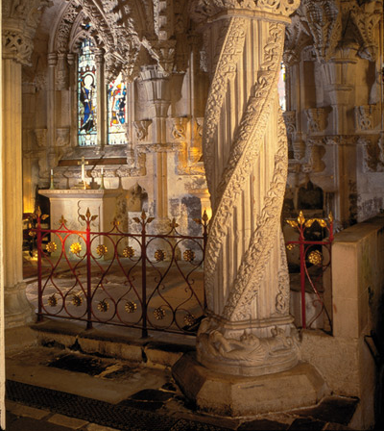
Apprentice Pillar
Notes:
Many books have been written about the Rosslyn Chapel and the carved stone imagery suggesting Masonic and Templar origin.
The most elaborately decorated pillar in the Chapel is called the Apprentice Pillar.
This pillar contains one of the most famous and fascinating riddles of the building. An Apprentice mason is said to have carved the pillar, inspired by a dream, in his master’s absence. On seeing the magnificent achievement on his return, the Master Mason flew into a jealous rage and struck the apprentice, killing him outright.
The pillar is rumored to be hollow and to contain secrets.

Slide 4
Notes:
I can add that based upon my reading, it was common to trace the outline of the knight’s sword upon his tombstone, as a form of identity.
This was especially true when people did not know how to write.

Slide 5
Notes:
Andrew Sinclair has maintained a claim that there is a grave within the crypt in the Rosslyn Chapel that is the grave of a Templar Knight.
All we have here is this carved stone.
I did notice that both stones have a decoration, and though different in design, have 8 points.
Perhaps the connection here is that The Maltese cross worn by the medieval order of the Knights Templar has eight points.
In addition, 8 in Hebrew mysticism is considered to be the number of Deity.

Slide 6
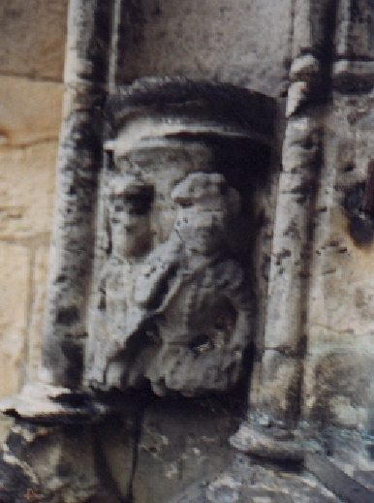
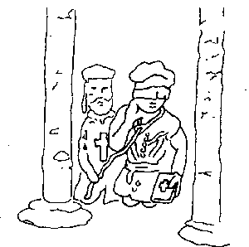
Notes:
Historian Robert Lomas speculates that another carving in the Chapel depicts a candidate being prepared to be made a Mason. This statement was controversial due to the age of the carving in relation to the perceived age of speculative Freemasonry.
“There are seven points of congruence (agreement) between the carving and the modern Masonic ceremony. These are
1. The man is blindfolded. This is unusual in medieval statues and the only other example it the figure of blind justice. There is no other blindfold figure carved in Rosslyn.
2. The man is kneeling. This is fairly common in medieval carvings and there are other kneeling figures in Rosslyn.
3. The man is holding a bible in his left hand. There are a number of other carvings showing figures holding books or scrolls within Rosslyn.
4. The man has a noose about his neck. There are few known figures of the period showing nooses about their necks. The best known is the statue called 'The dying Gaul'. There is one other figure in Rosslyn which has a noose in it and that is the figure of the hanged man which represents the angel Shemhazai whose sins caused God to send the Flood and who was so afraid to face God that he hung himself between heaven and earth with his face away from God. Shemhazai is carved with a noose about his feet but there is no other noose carved in Rosslyn.
5. The man has his feet in the posture that is still used today by Masonic candidates. This is a very unusual position and does not occur in any other carvings in Rosslyn.
[Personally, I do not understand where this point comes from as we do not see the feet as he is kneeling.]
6. The ceremony is being carried out between two pillars as it is in a Masonic Lodge. Pillars figure in a lot of the carvings at Rosslyn.
7. The noose is being held by a man clearly dressed as a Templar. There are many Templar symbols and images of Templars carved in Rosslyn.”
Some claim these points to be a coincidence, though the author conducted a null hypothesis test which resulted in a strong claim that Sir William was linked to Freemasonry in 1440 and that this link involved Templars.

Slide 7
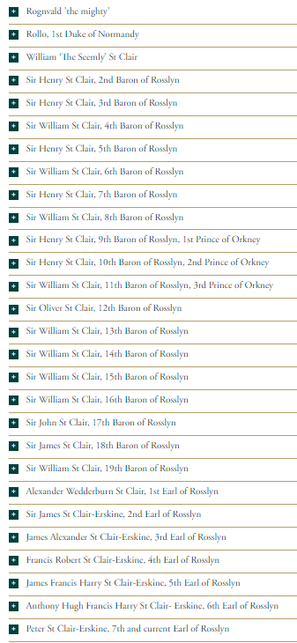
Notes:
Let’s step back a second and look at the lineage of the Sinclair family.
I am not sure they have enough people named Williams or Henry!
First, I think you should know that they started off from the Vikings.
In 911, A Viking called Hrolf (his Latin name is Rollo) was raiding up the river Seine and tried to seize the city of Chartres, France.
King Charles III (“the Simple”) decided it would be a good idea to offer these Vikings the area of Normandy as a buffer against other invasions on the condition that Rollo marry the King’s daughter Giselle, and his whole party convert to Christianity.

Slide 8
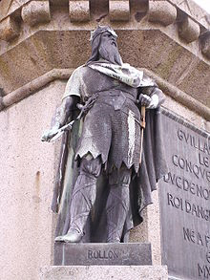
Notes:
Here we see Rollo, the First Duke of Normandy. This was a big dude – so big they called him The Walker because no horse could carry him.
Photo from: https://todayinhistory.blog/2017/09/01/september-1-est-911-a-different-normandy-story/

Slide 9
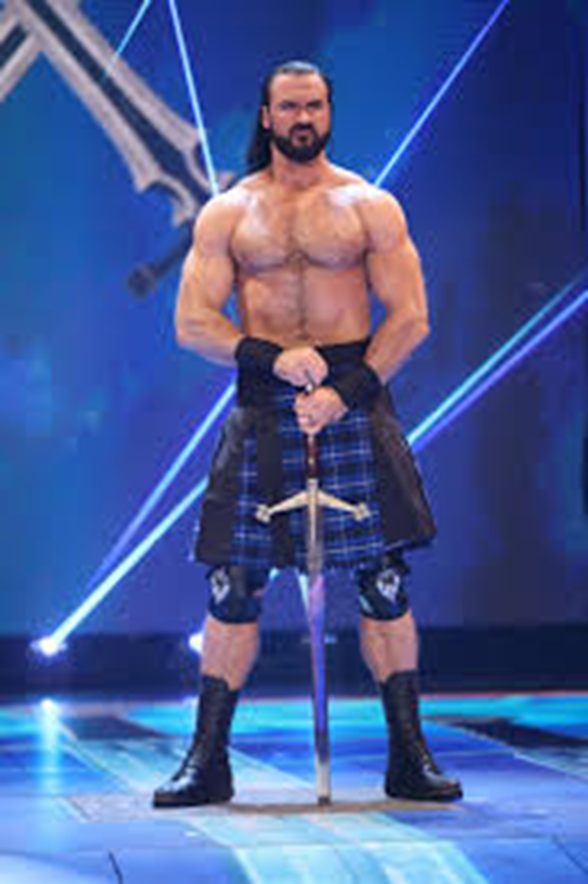
Notes:
Part of the ritual of signing the binding treaty involved kissing the King’s foot.
Rollo felt this action was beneath him, so he delegated the task to another one of his large officers, who I am guessing looked like WWE’s McIntyre seen here.
He solemnly leaned over and took the King’s foot in his hand and brought it to his lips....

Slide 10
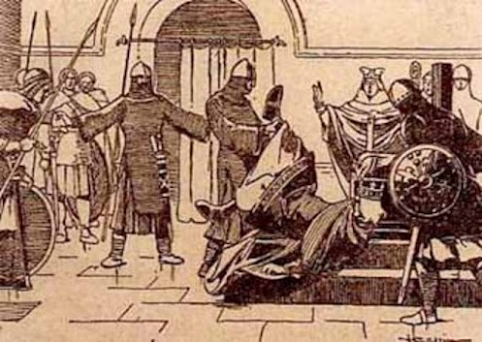
Notes:
…then stood to his full height and dumped the King on his ass!
Photo from: https://todayinhistory.blog/2017/09/01/september-1-est-911-a-different-normandy-story/

Slide 11
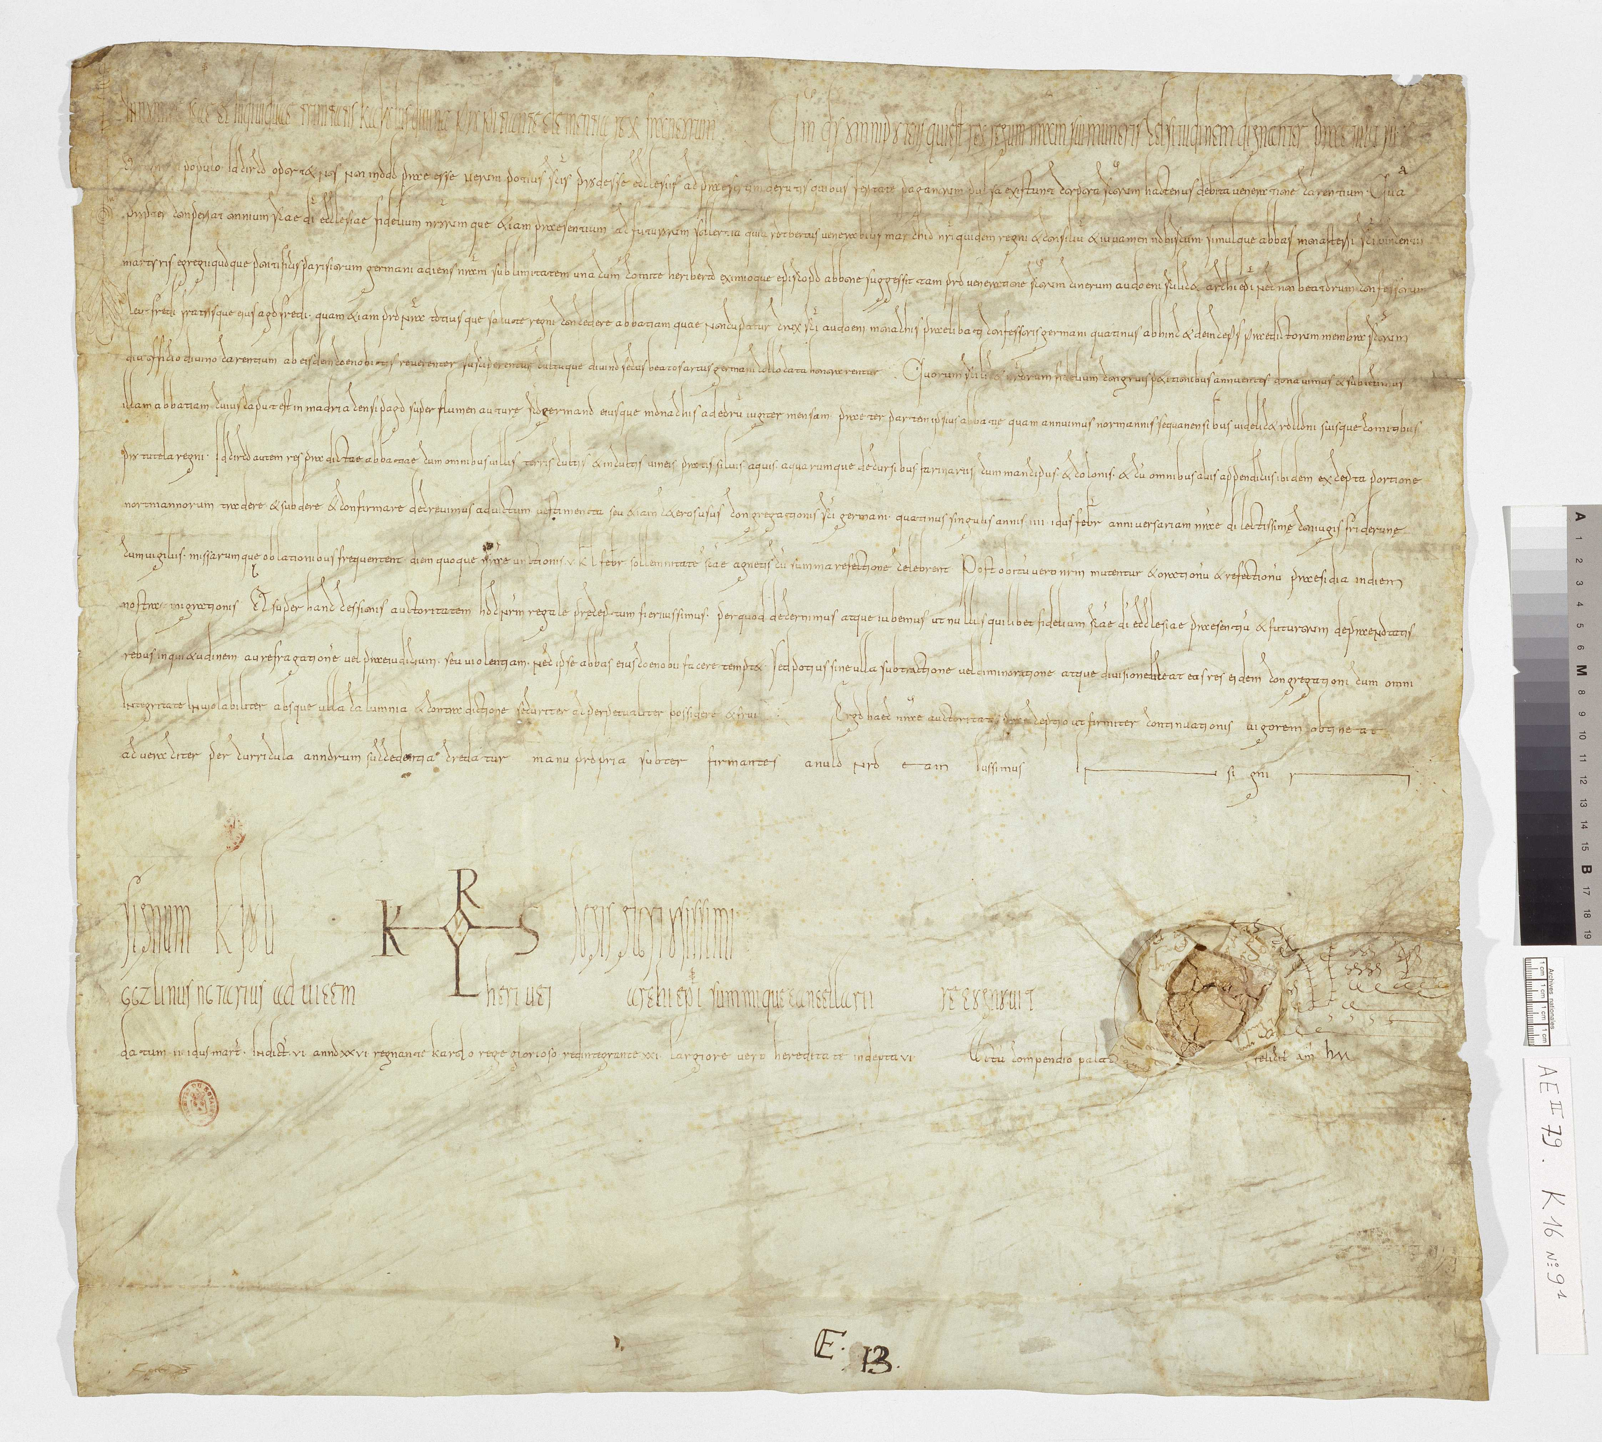
Notes:
I actually found a zoomable image of the original document signed by King Charles III!
I found Rollo’s name about the 7th line down on the right-hand side.
Image from: https://www.reddit.com/r/vikingstv/comments/5ntaum/spoilers_the_actual_document_wherein_charles_iii/

Slide 12
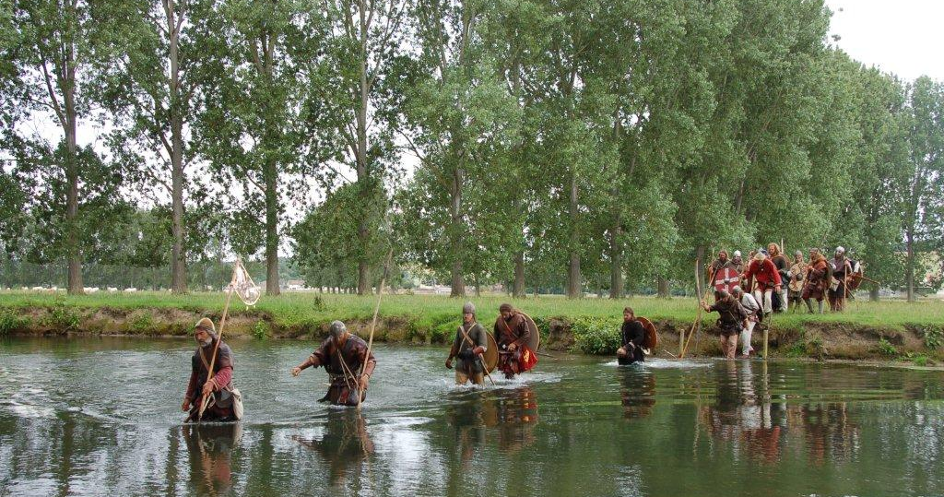
Notes:
Here we see a re-enactment that was done in 2011.
The baptism into Christianity was performed at a place called St. Clair-sur-Epte.
The location is where Saint Clair was beheaded in 884. The story is that when the blood hit the ground a spring miraculously appeared to form the Epte.
As a result, some folks think that this is where the Sinclair family name came from. You have to remember that due to the popularity of this Saint for over a 1000 years there’s a lot of places with a similar name, just like we have lots of places called Springfield etc.
Neither Rollo nor his successors ever owned that land, and it was not part of Normandy.
The author Tim Wallace-Murphy indicates in his book “Templars in America: From the Crusades to the New World” that the family name actually comes from the town of St. Clair near Saint-Lo, near the western limit of the Bessin.
Photo credit: https://www.medieval.eu/normandy-911/

Slide 13
Notes:
Before our main character came along, and before Rosslyn, there was his ancestor, the 7th Baron, also named Henry.
We see in his biography his involvement at Bannockburn.
The Battle of Bannockburn was fought on the 24th of June, 1314.
There is a legend that the Templar knights participated in this battle in assistance of the King, Robert the Bruce, and that afterwards he created the Order of Saint Andrew du Chardon, meaning “of the Thistle.” Those of you who advance into the Scottish Rite will hear more about this.
I speculate that it is his son, William mentioned here who may be the “Knight Templar” stone we saw earlier, however if his body was returned, what about his brother John’s?

Slide 14
Notes:
This painting shows Baldwin II ceeding the location of the Temple of Solomon to Hugues de Payns and Godfrey de Saint-Homer (also founding member of the Knights Templar in 1119). The fourth person is Warmund, Patriarch of Jerusalem.
The author, Lomas, also maintains that the Sinclairs and their French relatives, the St. Clairs, were instrumental in founding the Knights Templar.
It is claimed that Hugues de Payns, a Templar founder and their first Grand Master, was married to a sister (Catherine) of the Duke of Champaine (Henri de St. Clair) who was a powerful broker of the first Crusade and had enough political influence to nominate the Pope. [The claim that Hugues de Payens married Catherine St. Clair was made in Les Dossiers Secrets d'Henri Lobineau (1967), The “Dossiers Secrets d'Henri Lobineau” suddenly appeared in the National Library of France on April 27, 1967 and is widely considered to be a forgery. It was also used as a source for the book “Holy Blood, Holy Grail” and some of it appeared in “The Da Vinci Code.”
Our Henry Sinclair was the son of William Sinclair, the 8th Baron and Lord of Roslin, and his wife Isabella of Strathearn, a daughter of the Earl of Orkney.
Henry succeeded his father as the Baron of Roslin in 1358, Pentland and Couslan, which were minor properties in Lothian (not the Lothian near Richmond, Virginia), and he became the Earl of Orkney around 1369.

Slide 15
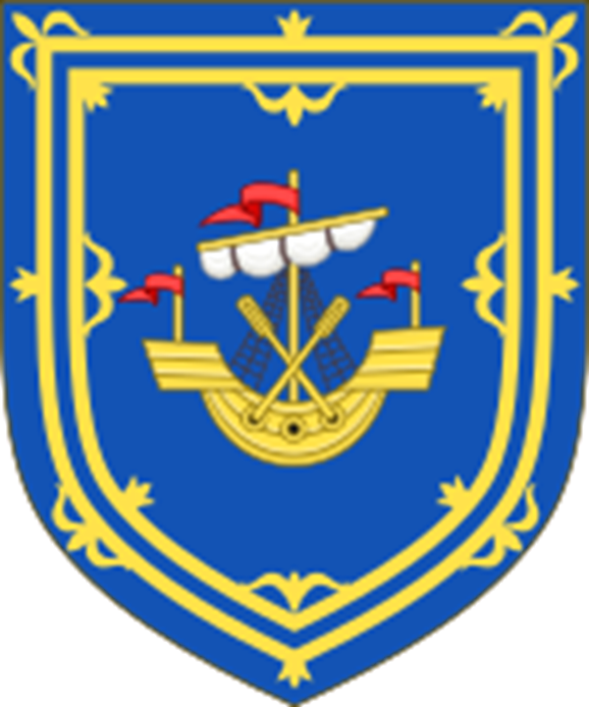
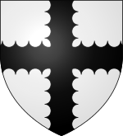
Notes:
Here we see the coat of arms for the Earl of Orkney and for the Baron of Rosslyn.
On August 2 1379, King Haakon VI of Norway resolved the succession dispute over the Earldom of Orkney, a Norwegian dignity located within the Kingdom of Scotland.
The King invested and confirmed the title of Earl of Orkney upon Henry Sinclair over the rival claim of Sinclair's cousin, Malise Sparre.
In return, Sinclair pledged to pay a sum of 1000 nobles before 11 November (St. Martin’s Day) the same year, and when called upon, was to serve the Norwegian king on Orkney or elsewhere with 100 equipped and armed men for up to three months. As a security for upholding this arrangement, Sinclair had to leave behind valued hostages when he departed for his earldom. It is unknown if Haakon ever attempted to call upon the forces pledged by Sinclair, or if the agreed sum was ever actually paid in full. Shortly before his death in 1380, Haakon permitted the hostages to return home.
The Sinclair family’s wealth and power increased substantially, and they also controlled one of two trade routes round Britain – the other being the Dover Strait between England and France. Earl Henry (Sir Henry of Roslin) married Jean Haliburton and their large family did well – only one of the eleven daughters did not marry someone with a title and his second son became Governor of Shetland securing the property there.

Slide 16
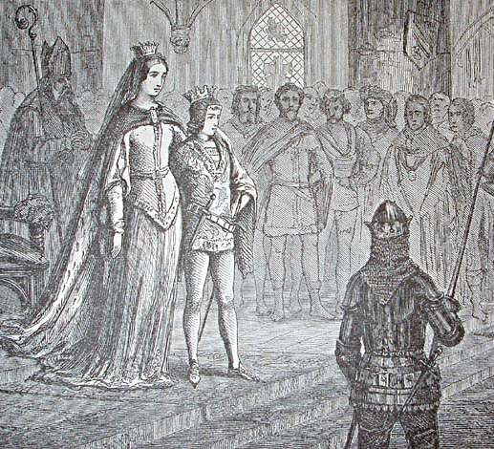
Eric of Pomerania with Margaret I of Denmark at his coronation.
Notes:
A decade later, Henry attended the coronation of, and pledged his fealty to, young King Eric of Pomerania in Norway in 1389. Out of this relationship came a warrant or commission from the King of Norway for Henry to bring law and order to the Orkney Islands, which he did.

Slide 17
Orkney Islands
Notes:
Part of Henry’s job in cleaning up the Orkney Islands was to eliminate or at least to curb the pirating of shipwrecked vessels.
In this map, we see the close proximity of Sinclair’s Bay to the islands northeast of Scotland.

Slide 18
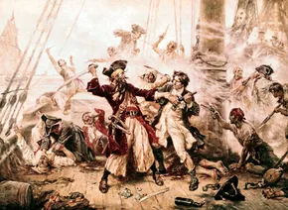
Notes:
In the 14th century, the practice was to discover a shipwrecked vessel and to capture or murder the sailors and steal the ship’s cargo.
As a side note, when King Eric was dethroned, he became one of these pirates.

Slide 19
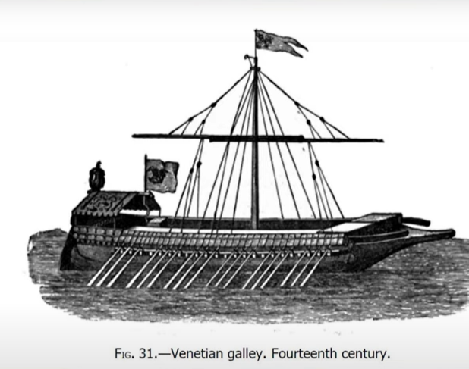
Notes:
The storyline is that Prince Henry did much to put an end to this practice, and one occasion was reputed to have saved some mariners from Venice, notably of the Zeno family, who had in their possession maps and charts to the New World. They ran aground on the Shetland Islands (northeast of the Orkneys) in a storm. Prince Henry is best known today because of a modern legend that he took part in explorations of Greenland and North America almost 100 years before Christopher Columbus. But did he? Let’s examine further.
In due diligence, this section of our story refers to what is commonly called the “Zeno Manuscript”, which is itself controversial. The original title was translated in Venice in 1558. It should be noted that the translation was done by a descendant 5 generations later who translated documents he did not fully understand. The manuscript features a nobleman named Zichmni who owned some islands and ruled the duchy of Sorant.
First, the manuscript is seen by some to be a big hoax. As evidence, Zeno’s map of Greenland included one extra location not seen on other maps, a monastery that he claims to have discovered. He gave it the name of a saint who never existed, St, Thomas Zenobius!

Slide 20
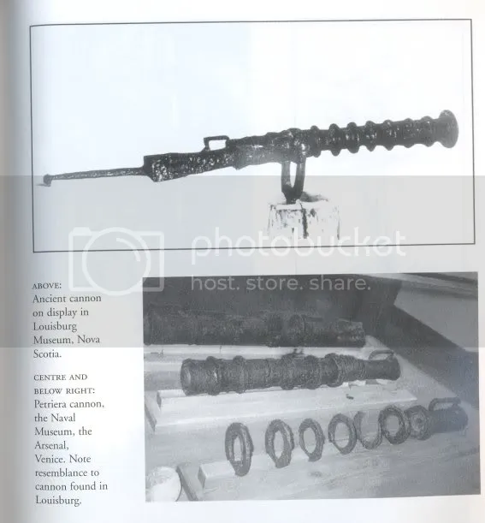
Notes:
At the Battle of Crecy in 1346 A.D., cannons were used for the first time in Europe. The English defeated the French in this battle. By the year 1381 A.D., Carlo Zeno, the hero of Venice, Italy, employed cannon on board his ships to win the Battle of Chioggia where he defeated the navy of Genoa. Niccolo and Antonio Zeno knew how to make these cannons. Prince Henry Sinclair needed not only the navigational talents of the Zeno brothers, he also needed their knowledge of the new weapons. (These are the brothers he reportedly saved that I discussed earlier).
Adding some creditability to the story, found about 1849 A.D. on the shoreline of Louisburg Harbor on Cape Breton Island (part of Nova Scotia, Canada), was a primitive cannon. Presumably, this gun was from Prince Henry’s fleet in 1398 A.D. It had eight rings around its barrel, and a detachable breech with a handle. Several very similar cannons can be seen at the Naval Museum in Venice. These are the same type as those used by Carlo Zeno at the Battle of Chioggia. They became obsolete by the end of the 14th Century. Later cannon were made in a single piece without that kind of barrel rings.
Photo from: https://forum.oakislandtreasure.co.uk/viewtopic.php?f=1&t=858

Slide 21
The Zeno Map, 1558
Notes:
Some historians believe that the Zeno Brothers Letters describe Prince Henry’s voyage in detail. The Zeno Brothers, Nicolo and Antonio, were noted Italian navigators from Venice living in the 2nd half of the 14th century. They were Italian aristocrats who held a transportation franchise between Venice and the Holy Land during the Crusade, similar to the Templars. Their letters and a map are the key points of their historic survival. This map specifically shows the pitch spring that Sinclair saw, while other maps of the time do not.
The Zeno letters, describe the exact course of the voyage in the North Atlantic – to Greenland and on to Nova Scotia – where the travelers encountered villages of Mi’kmaq Indians. The authenticity of the letters was reaffirmed when they were rediscovered and republished in the early 17th century. Historian Reinhold Forster writing in 1784 identifies Henry as being the Prince Zichmini described in the Zeno letters. This notion was carried forward by future authors.
John Dee, Queen Elizabeth’s favorite astrologer, seized on the Zeno narrative to convince the monarch to support voyages of exploration.

Slide 22
Notes:
Travel to the New World, at that time, included travel to Iceland and Greenland.
Reputedly, such voyages were undertaken long before the time of Prince Henry - for example, the voyages of the Irish Monk, St. Brendan, in the 6th century; and the voyages of the Norse, who sent 500 Norse settlers to Greenland in 985 A.D. Greenland fell under the rule of the King of Norway in 1261.

Slide 23
Notes:
Here we see a depiction of the route to the New World that Sinclair would have taken.
Upon arriving in Newfoundland, he met with local tribes.
Upon spotting some smoke further inland, the Indians took him by canoe where he discovered the source to be a rare tar pitch spring by the coast.

Slide 24
Notes:
Here we see the only monument to commemorate the landing of the Prince Henry Sinclair Expedition in 1398 to Nova Scotia, Canada. It was erected on November 17, 1996 by the Prince Henry Sinclair Society of North America, Inc. It is a fifteen-ton granite boulder with a black granite narrative plaque located at Halfway Cove on Rt. 16 in Guysborough County, Nova Scotia, above the original landing site.

Slide 25
Notes:
In 1889, Frederick J. Pohl published “Prince Henry Sinclair: His Expedition to the New World in 1398,” which is based almost wholly on the Zeno letters. The evidence that Dr. Pohl’s relies upon to support the claim that Henry did in fact make the voyage includes:
• The fact that some of the words in the Mi’kmaq (Abanaki) language are of a Norse origin;
• The existence of the Gluscap legends in what are now Nova Scotia and Newfoundland about original life coming from the east in a big canoe; and,
• The “Westford Knight rock carving,” which originally was believed to be Indian writing, but later was identified by the sword hilt and armor as a recumbent Knight Templar.
It has been suggested that the knight is Sir James Gunn, a member of Clan Gunn and a Knight Templar who reportedly traveled with Sinclair. Or is it simply glacial scratches?

Slide 26
Notes:
This casting was made to better visualize what some people believe is depicted on the stone. So how does this connect back to Scotland?

Slide 27
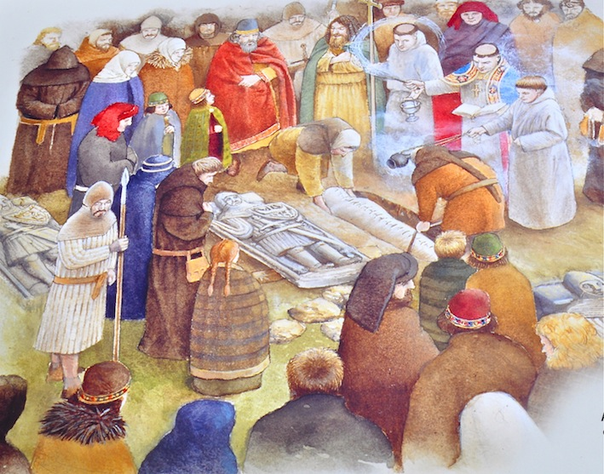
Notes:
Further research shows that in Iona, Scotland, “the graveyard adjacent to Iona Abbey, Reiling Oran is named after one of St Columba’s followers.
The burial ground has been in use since the Saint’s time and was the traditional burial place for the Kings of Dalriada from the 5th century and then later Scotland.
It is reputed that there are about 48 Kings buried here, including Macbeth, also Norwegian and Irish Kings, plus The Lords of the Isles, from the 13th to the 15th century.”

Slide 28
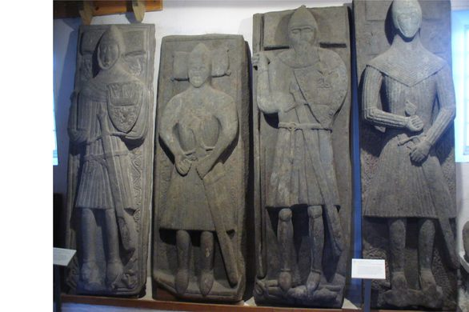
Notes:
Here is another image depicting grave slabs that have been preserved at the Iona Abbey.
I provided these images simply to corroborate that if indeed the Westford Knight marking shows what is perceived, it certainly could be of Scottish influence in its design.
Source of this image: https://www.atlasobscura.com/places/iona-abbey

Slide 29
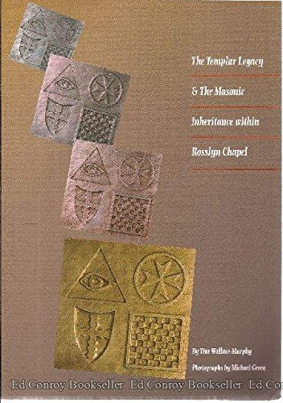
“A Man Worthy of Immortal Memory” “He was the first Sinclair “Jarl” of Orkney which in Scandinavian terms, included Shetland, the Faroes and, some say, Iceland – 200 islands in the North Atlantic which were the “stepping stones” to the New World which he visited with an expedition of Knights Templar and Christian monks in 1398 – almost 100 years before Columbus. Proof of this remarkable voyage is indelibly hewn in stone on both sides of the Atlantic.”
Notes:
More recently, the connection of Prince Henry Sinclair, the Roslyn Chapel, and Masonry were memorialized in the works of Tim Wallace Murphy, and especially in the book titled: The Templar Legacy & The Masonic Inheritance Within Rosslyn Chapel.” Mr. Wallace-Murphy dedicated that book to Henry and attempted to capture the role that Henry played in the dedication itself. Here is what he said of Prince Henry Sinclair.

Slide 30
Notes:
“Henry died defending his beloved Orkney islands circa A.D. 1400 and was buried in the church of St. Mathew at Rosslyn.
However, it is thought that his body would have been moved into the burial vaults below Rosslyn Chapel which his grandson, Earl William St. Clair, had built as a resting place for the dead of “The Lordly Line of High Sinclair” – a subject which has been immortalized in Sir Walter Scott’s poem “The Dirge of Rossabelle: “Seemed all on fire that chapel proud, Where Roslin’s chiefs uncoffined lie; Each baron for a sable shroud …. There are twenty of Roslyn’s barons bold Lie buried within that proud chapelle.”
His precise date of death is unknown and subject to speculation. Some say he was killed by pirates; some say he was lost at sea; others say he was killed by the British, somewhere around the year 1400.

Slide 31
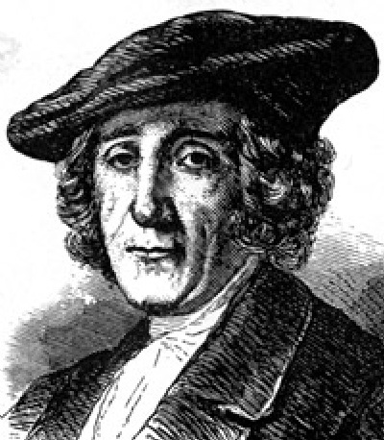
William St Clair
1st Grand Master of the Grand Lodge of Scotland
Notes:
We began this talk by noting that Roslyn Chapel was built by Henry’s grandson, Sir William Sinclair (the 11th Baron), the 1st Earl of Caithness.
It is interesting to note that a later descendent, also named William Sinclair of Roslin, became the first Grand Master of the Grand Lodge of Scotland and, that subsequently, several other members of the Sinclair family have held this position.
Having no male heir, he resigned his office as hereditary Grand Master Mason of Scotland to the Scottish Lodges at their foundation in 1736 (think operative masonry).
The Lodges then appointed him as the first non-hereditary Grand Master Mason of Scotland at their meeting on St Andrew’s day of the same year (think speculative masonry).

Slide 32
Conclusion
Notes:
Let me conclude first by noting that the answers to many of the questions regarding Prince Henry are elusive. However, searching for the answers is a fascinating journey. One reference leads to another, and there is much yet to be discovered.
Second, I would note that the author of the paper I originally started with, Brother Alexander Stuart MacNabb became interested in Prince Henry while researching the Gluscap Legends, the Battle of Culloden in 1746, and the 2nd Scottish Arms Act. This was not surprising considering that
his family has resided in Nova Scotia since the early 1700s, after the Battle of Culloden
that his paternal grandparent was Scottish with the name Alexander Stuart MacNabb – the same name he bears, and that his father’s mother was a Mi’kmaq Indian.
His interest also was sparked by Masonic ritual, for he is a Knight Templar of the Piedmont Commandery No. 26 of Manassas, Virginia and a Life Member of Scottish Rite Masons in the Valley of Alexandria, Orient of Virginia.
I am sure Brother MacNabb would welcome you joining in the search for the truth about Prince Henry, and sharing your results with him.
Finally, the larger point is that you may, by a study of Masonic history, morality and philosophy, find topics of interest that will direct your reading and encourage your research, and you too will be well rewarded for your efforts.

Slide 33
Sources
Sir Henry Sinclair of Roslin (rootsweb.com)
Explore The Carvings - The Official Rosslyn Chapel Website
Steven Wood Collins's Blog: The Writing of Steven Wood Collins - Author of "Puramore - The Lute of Pythagoras" - The Patricians: Prince Henry Sinclair (1345 - 1404) - 1st Sinclair Earl of Orkney, 9th Baron of Roslyn, 9th Chief of Clan Sinclair, Knight Templar, 14th Century Explorer of Greenland and North America - Author's 2nd Cousin 19x Removed - January 01, 2013 07:16 (goodreads.com)
Rosslyn chapel 1080P, 2K, 4K, 5K HD wallpapers free download | Wallpaper Flare
Origins of Freemasonry (robertlomas.com)
Eric of Pomerania: The king who became a pirate after he lost the throne (thevintagenews.com)
Sicily's Medieval Map of the World - Italian Stories (beyondforeignness.org)
Voyage of the Zeno Brothers - JASON COLAVITO
The Westford Knight – The Westford Historical Society & Museum
Hold my ARK
Mystery of the Westford Knight - WESTERLY RI (seewesterly.com)
KNIGHT TEMPLAR ROSSLYN CHAPEL | One of the knight templars s… | Flickr
Maritimes 2007: Linwood, NS (wiredtotheworld.net)
Baldwin II ceeding the Temple of Salomon to Hugues de Payens and Gaudefroy de Saint-Homer - Hugues de Payens – Wikipedia
“Turning the Templar Key” by Robert Lomas
https://blosslynspage.wordpress.com/2014/01/18/reilig-oran-burial-ground-iona-scotland/
https://jamesonfamily.org/Sinclair_Gunn.html

