Slide 1
The Masonic Incident at Antietam
By Wor. Matt Duley
Freedom Lodge No. 118

Slide 2
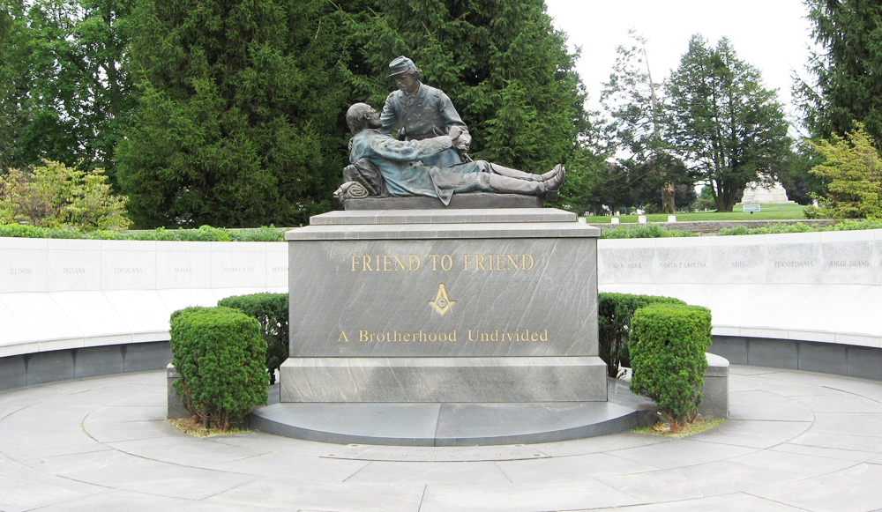
Notes:
Most Masons in the Washington DC metro area have probably heard of the famous “Friend to Friend” monument from the battle of Gettysburg seen here.
On the left-hand side of this memorial is a tablet that reads:
Union General Winfield Scott Hancock and Confederate General Lewis Addison Armistead were personal friends and members of the Masonic Fraternity.
Although they had served and fought side by side in the United States army prior to the Civil War, Armistead refused to raise his sword against his fellow Southerners and joined the Confederate Army in 1861.
Both Hancock and Armistead fought heroically in the previous twenty-seven months of the war. They were destined to meet at Gettysburg.
During Pickett’s Charge, Armistead led his men gallantly, penetrating Hancock’s line. Ironically, when Armistead was mortally wounded, Hancock was also wounded.
Depicted in this sculpture is Union Captain Henry Bingham, a Mason and staff assistant to General Hancock, himself wounded, rendering aid to the fallen Confederate General. Armistead is shown handing his watch and personal effects to be taken to his friend, Union General Hancock.
Hancock survived the war and died in 1886. Armistead died at Gettysburg July 5, 1863. Captain Bingham attained the rank of General and later served 32 years in the United States House of Representatives. He was known as the “Father of the House.”
Shown on the wall surrounding this monument are the names of the States whose soldiers fought at the Battle of Gettysburg.

Slide 3
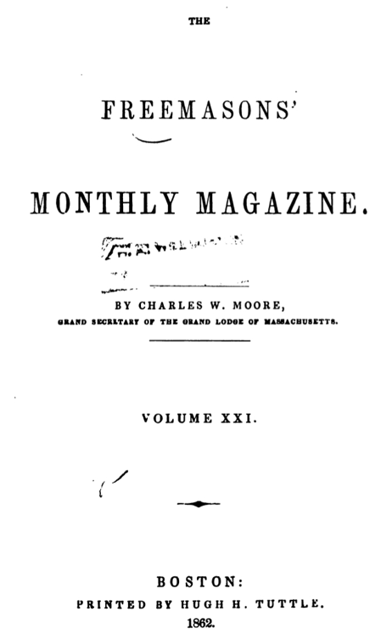
Notes:
So I wondered about any Masons that may have been at Antietam, which is closer to where I live.
Per the Antietam National Battlefield website, “23,000 soldiers were killed, wounded or missing after twelve hours of savage combat on September 17, 1862. The Battle of Antietam ended the Confederate Army of Northern Virginia's first invasion into the North and led Abraham Lincoln to issue the preliminary Emancipation Proclamation.”
But I did not find anything about Masons there. A quick Google search led me to the Freemason’s Monthly Magazine from 1862, the same year of the battle!

Slide 4
What happened?

Slide 5
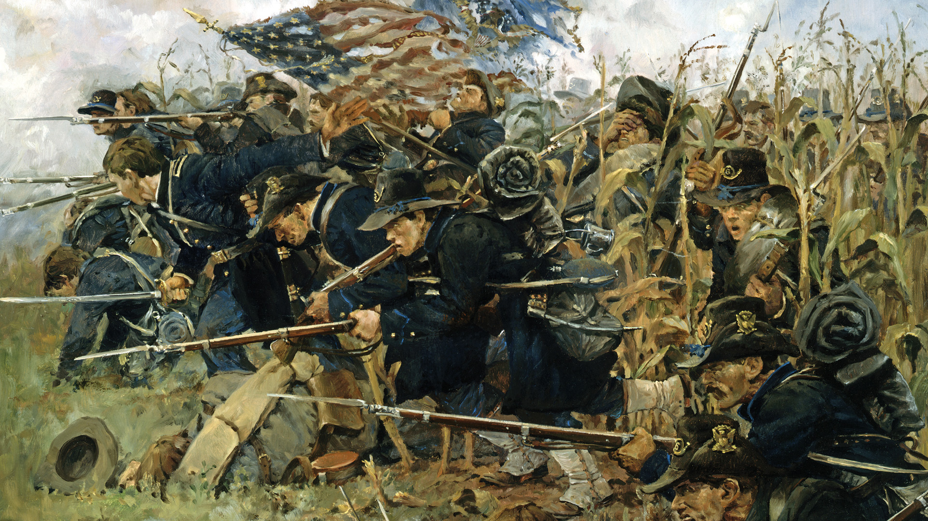
Notes:
Image from: https://warfarehistorynetwork.com/article/battle-of-antietam-clash-in-the-cornfield/

Slide 6
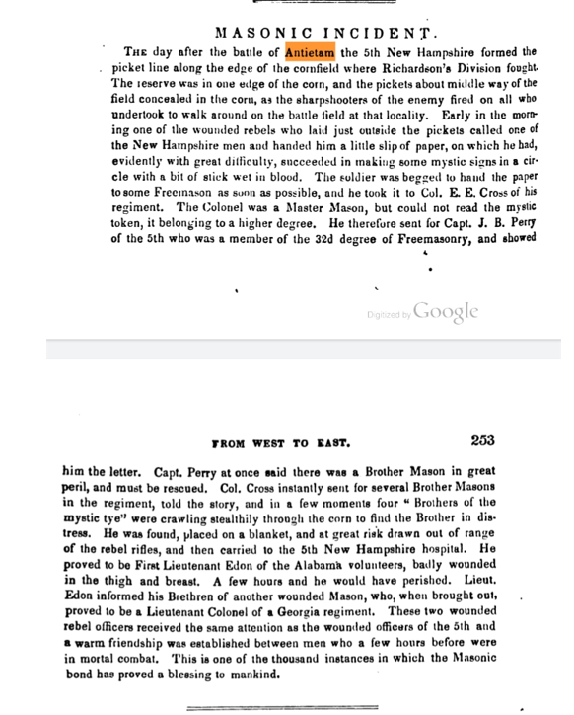
Notes:
Here is the segment about Antietam that I found!

Slide 7
Who was involved?

Slide 8
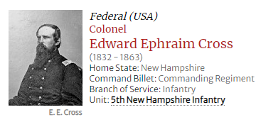
Notes:
Before Antietam
Young Cross was apprenticed as a printer at age 15. He served for some time as a newspaperman and editor. He lived in Cincinnati for a time, where his brother Nelson served as a judge, and later in Arizona. Eventually, he joined the Mexican Army. When he received news of Fort Sumter, he resigned his Mexican Army commission and returned home to New Hampshire. There, Governor Berry appointed him as Colonel of the 5th Regiment, New Hampshire Volunteers. His brother Richard served as a major in the 5th New Hampshire, and brother Nelson was later the CO of the 67th New York of the Sixth Corps. Both brothers would survive the Civil War.
On the Campaign
At Antietam Colonel Cross and the Fifth were involved in the heavy fighting of "the sunken road" or "bloody lane". In the words of Livermore,
"On looking about me I found that we were in an old sunken road and that the bed of it lay from one to three feet below the surface of the crest along which it ran. In this road there lay so many dead rebels that there formed a line which one might have walked on as far as I could see, many of whom had been killed by the most horrible wounds of shot and shell and they lay just as they had been killed apparently amid the blood which was soaking the earth. It was on this ghastly flooring that we kneeled for the last struggle." "As the Rebel advance became apparent we plied the line with musketry with all our power and with no doubt with terrible effect but they still advanced. A color bearer came forward within fifteen yards of our line and with the utmost desperation waved the flag in front of him. Our men fairly roared 'shoot the man with the flag!' and he went down in the twinkling and the flag was not raised in sight again." "As the fight grew furious the Colonel cried out 'Put on the war paint!' and looking around I saw the glorious man standing erect with a red handkerchief, a conspicuous mark, tied around his bare head..Taking the cue somehow we rubbed the torn ends of cartridges over our faces, streaking them with powder like a pack of Indians and the Colonel, to complete the similarity, cried out, 'Give 'em the war whoop' and all of us joined him in the Indian war whoop until it must have rung out amid the thunder of the ordinance". Among the wounded was Col. Cross.
The rest of the War
Col Cross was promoted to Brigade command after the disaster at Fredericksburg, in which the 5th NH suffered great loss. He led the brigade also at Chancellorsville. He was mortally wounded leading his brigade, including the 5th, in the Wheatfield on the second day at Gettysburg, and died the next day.
Birth
4/22/1832; Lancaster, NH
Death
7/3/1863; Gettysburg, PA

Slide 9
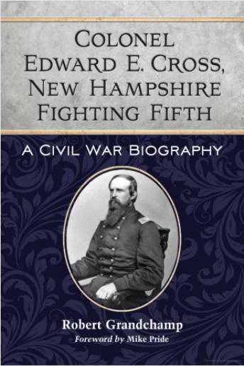
Notes:
Suggested reading (see slide graphic)
Annotations from a blog on the 5th New Hampshire indicate that while Captain James Perry had served as master of the Freemason lodge in Lebanon and headed the Hughes Lodge that was attached to the 5th New Hampshire, Cross had attained the same degree as he had; both Master Masons. The author of the book surmised that since Cross had earned all three of his degrees in one night at the Lancaster lodge, he had forgotten much of what he had learned. And so, when called upon to read the masonic symbols that the wounded Confederate officer had written at Antietam, Cross could not decipher them. That’s why he had to call for Perry. Yet another reason to dislike one day conferrals! ☺

Slide 10
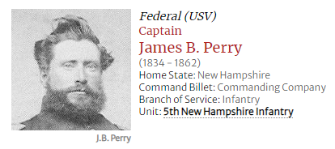
Notes:
Before Antietam
From Lebanon, NH, he enrolled as Captain, Company C, 5th New Hampshire Infantry on 12 October 1861 at age 37.
On the Campaign
He commanded Company C in Maryland.
The rest of the War
The day after the battle he was involved in the events of this program.
He was charged, along with Captain James E. Larkin, with inciting mutiny on the march in November 1862, and court-martialled, but acquitted. Reinstated as commander of his Company on 10 December 1862. He was killed in action at Fredericksburg, VA on 13 December 1862 while carrying the colors.
References & notes
Basic service information and the quote above from Child1. Perry was mentioned for leadership and "gallant conduct" in Maryland in Colonel Cross' after action Reports. His photo here from one of unknown provenance posted on Findagrave by David M Morin.
Birth
04/06/1834; Cabot, VT
Death
12/13/1862; Fredericksburg, VA; burial in School Street Cemetery, Lebanon, NH

Slide 11
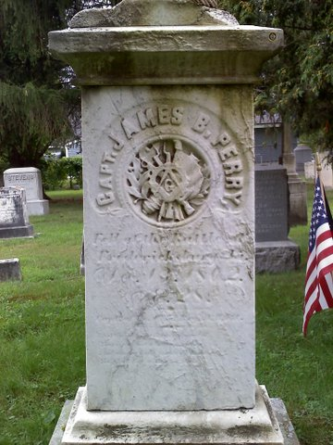
Notes:
Here we see the gravestone of Captain Perry, including the Square and Compasses.
I did find a note in the Proceedings of the Grand Lodge of Free and Accepted Masons of the State of New York from January 1864, a mention of the passing of James B. Perry from New Hampshire, Past District Deputy Grand Master (page 131).

Slide 12
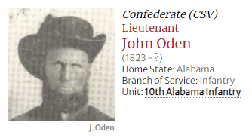
Notes:
[The first wounded Brother mentioned in the article]
Before Sharpsburg
A resident of Talladega County from age 9, he enrolled as First Lieutenant in Company K, 10th Alabama Infantry on 4 June 1861.
On the Campaign
He was wounded in the chest and thigh in action at Sharpsburg on 17 September 1862 and captured.
The rest of the War
He was probably treated at the 5th New Hampshire hospital at Sharpsburg (see Capt. James Perry, 5th NH). He was paroled at Fort McHenry, MD on 12 November 1862 and exchanged at City Point, VA on the 21st. He was promoted to Captain 1 March 1863, but resigned 20 June 1863. In early 1864 he was elected Captain of a company of Alabama Reserves (local defense) from Talladega County.
After the War
He was a farmer and miller, and in the mercantile business in Childersburg and Sylacauga. Later called "Piney" for his sawmill business.
More details of his life, and confirmation of the events told here can be found on findagrave.com.

Slide 13
Where did it happen?

Slide 14
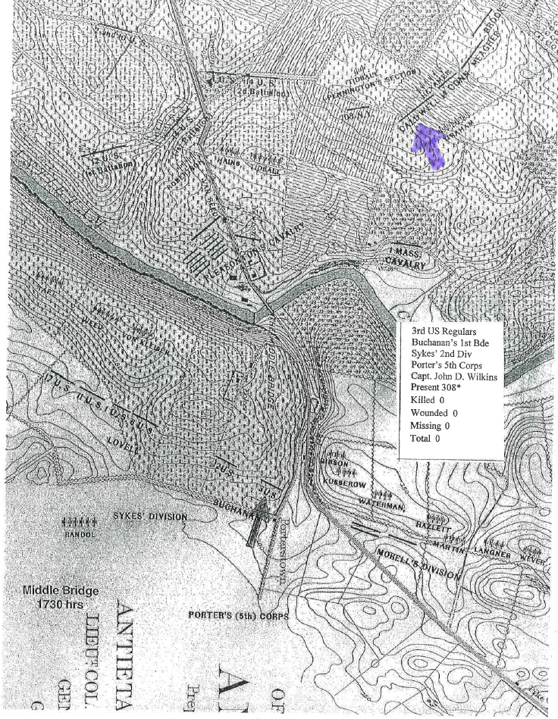
Notes:
I reached out to the Antietam National Battlefield for assistance in identifying the site mentioned. A volunteer did some research and sent the map with the following writeup:
Caldwell's position identified with the purple arrow.
The 5:30 Carman map shows where Caldwell’s Brigade containing the 5th New Hampshire was at the close of the battle.
Based on the map they were about 100 to 150 yards north and east of where the observation tower is and where the road turns to the south.
I would assume the cornfield is the one across (on the south side) of the road.
The corn field was according to the map was about 200 yards north to south and about 450 yards east to west, not quite a rectangle.
The description says the pickets were half way in the corn field assuming the writer meant in front of the regiment would mean about 100 yards into the cornfield in the direction of the Piper Farm.
Since Carman does not show the 5th NH but just the Brigade one doesn’t know how far to the west the 5th was from the corner of the road.
So in summary if a person was at the tower and faced southwest this was probably about 100 to 150 yards in front of you on the Piper Farm.
[Note to Volunteer Program Coordinator: This would be easier if the person had the Carman map for reference. You might send the 5:30 map for the Union Center that is in the unit files and mark the approximate location.}
Olivia Black
Volunteer Program Coordinator
Antietam National Battlefield
(301)432-5124; park cell: (301)401-7223
302 E. Main St.
Sharpsburg, MD 21782
On duty Tuesday through Saturday.

Slide 16
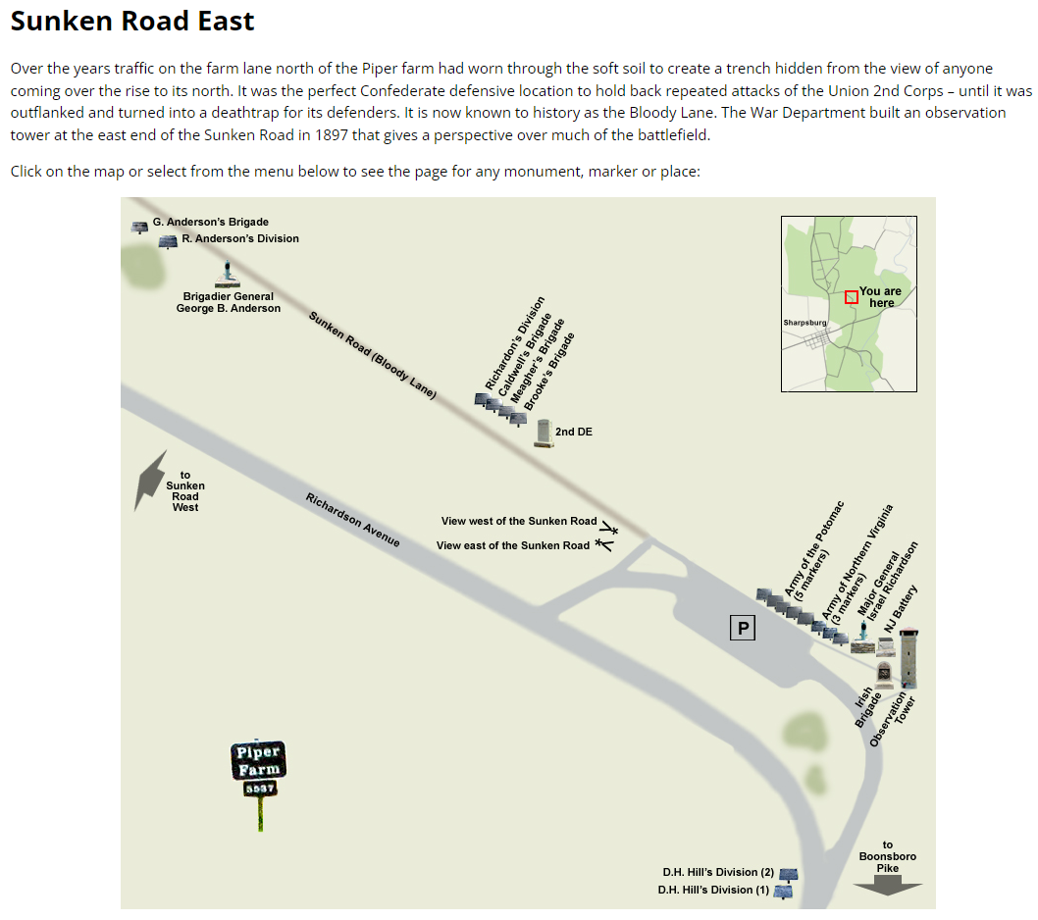
Notes:
Note that Caldwell’s Brigade is further up the road from the observation tower.

Slide 17
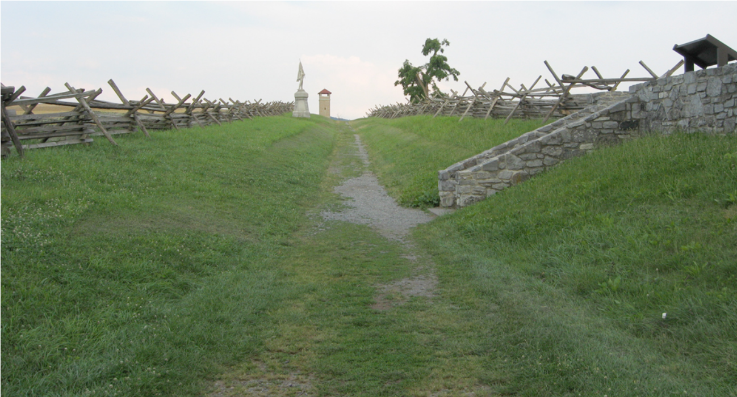
Notes:
The view faces southeast along the Sunken Road, or Bloody Lane. During the battle, this “Bloody Lane” was filled with hundreds of dead soldiers.

Slide 18
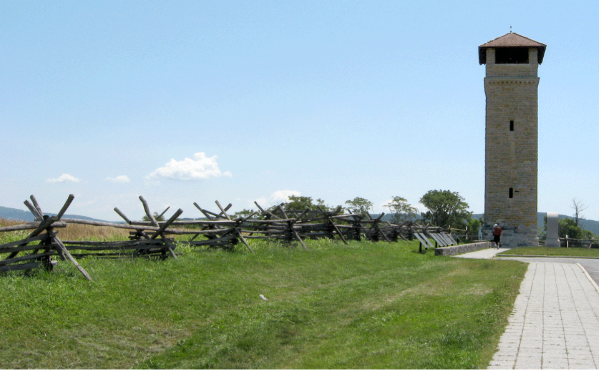
Notes:
If you visit the Antietam Battlefield, you will want to head to the Observation Tower. The 85 foot Observation Tower was constructed in 1897 at the east end of the Sunken Road (or Bloody Lane) by local workers from local stone. The tower was part of the War Department’s effort to document the battle, mark the lines and place information tablets around the field, creating an open air classroom of the battle. It allowed visitors to get a better overall view of the mostly low, rolling battlefield, much of which was private land at the time.

Slide 19
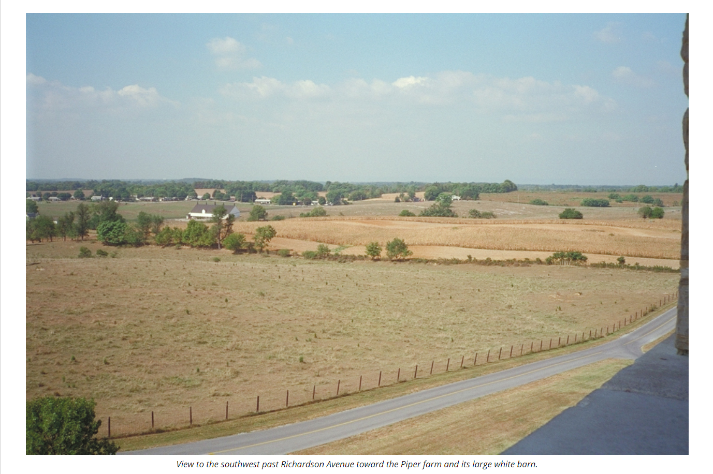
Notes:
Ascend the tower and look to the southwest. This is the view referred to by the park researcher. As you can see from the picture, there are still to this day cornfields maintained where the action occurred.

Slide 20
Do we know more about the unit involved?

Slide 21
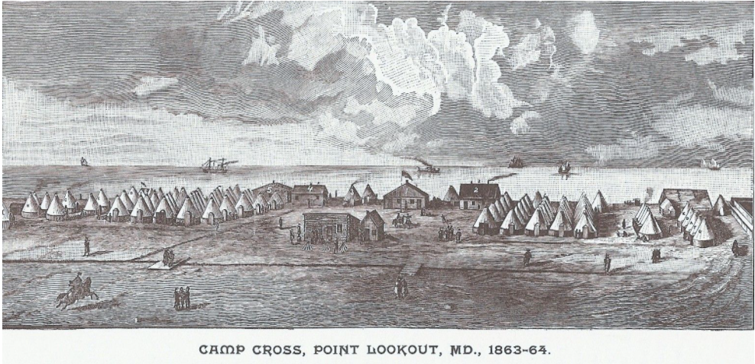
Notes:
Camp Cross at Point Lookout, MD (1863-1864): This image appears in William Child’s History of the Fifth Regiment New Hampshire Volunteers in the American Civil War, 1861-1865 (p. 238). Surgeon John W. Bucknam of the 5th New Hampshire sketched the image on which this wood-cut was based. The legend is as follows: (1) Colonel Charles Hapgood’s quarters (behind the flag pole) ; (2) quarters of Quartermaster Edmund Webber and Major Richard Cross (to the right of Hapgood’s quarters); (3) quarters of Lieutenant-Colonel James Larkin and Adjutant Elias Marston (the two tents to the left of Hapgood’s quarters); (4) quarters of Surgeon John W. Bucknam, Assistant Surgeons Child, and 2nd Assistant Surgeon Charles Trask (the structure to the left of Larkin and Marston’s tents); (5) a building that doubled as the church and Masonic hall (to the left of Bucknam, Child, and Trasks’s quarters); (6) regimental hospital.
Assistant Surgeon Child was himself a Mason, wrote a history of the regiment and included a chapter about the lodge,
For this chapter, see William Child, A History of the Fifth Regiment New Hampshire Volunteers in the American Civil War, 1861-1865 (Bristol, NH: R.W. Musgrove, Printer, 1893), pp. 332-334.
According to Child, upon the 5th New Hampshire’s organization, 31 masons in the unit petitioned the Grand Master of New Hampshire for a dispensation to meet as a lodge. The Grand Master assented to the petition, and the Hughes Army Lodge of the 5th New Hampshire held its first meeting at Bladensburg, MD, on November 22, 1861. Captain James Perry was the first Master.
Subsequent meetings took place at Camp California, not far from Alexandria, VA, until March 1862. Child’s account is somewhat unclear on the following point, but it appears the lodge held no further meetings until the fall of 1863, when one took place in Concord, NH. Regular meetings resumed in November 1863 after a “reorganization” while the regiment guarded Confederate POWs at Point Lookout, MD. They continued until late May 1864, at which point the 5th New Hampshire rejoined the Army of the Potomac during the Overland Campaign. According to Child, three men attained the degree of Master Mason in 1861. Another 29 became Master Masons during the regiment’s stay at Point Lookout.
Masons were extremely well represented in leadership positions. All three of the field officers (colonel, lieutenant colonel, and major) were masons, and masons held a number of positions on the regimental staff. Four of the regiment’s ten captains and half of its 1st Lieutenants were also masons. It is not surprising that civic-minded men prominent in their local communities—that is, just the type of people who recruited and led companies—would belong to a fraternal order. It should also come as no surprise that such men were older than the average soldier. Only seven of the 31 petitioners were 25 years old or younger. Over half were 30 or over. Since age correlated with wealth and they were generally prominent members of their localities, the masons who were field officers and company commanders owned substantial amounts of property.

Slide 22
Conclussion
Notes:
In conclusion, this program is a demonstration of the benefits of doing your own Masonic research.
I started with a simple question, and unraveled multiple layers of Masonic history which today, I am able to share with you.
My sincere hope is that each Mason viewing this is inspired to do their own research and share it with your Brethren so we can all benefit!

Slide 23
Sources:
https://gettysburg.stonesentinels.com/other-monuments/friend-to-friend-masonic-memorial/
https://www.nps.gov/anti/index.htm
https://www.google.com/books/edition/The_Freemasons_Monthly_Magazine/QSEsAAAAMAAJ?hl=en&gbpv=1&dq=antietam+%2B+Freemasonry&pg=RA2-PA325&printsec=frontcover
https://antietam.stonesentinels.com/war-department-markers-us/caldwells-brigade-richardsons-division-marker-45/
https://antietam.stonesentinels.com/tour-antietam-battlefield/sunken-road-east/
https://antietam.stonesentinels.com/views-antietam-battlefield/view-observation-tower/
https://antietam.aotw.org/officers.php?officer_id=12672
https://antietam.aotw.org/officers.php?officer_id=373
https://antietam.aotw.org/officers.php?officer_id=12676
https://www.findagrave.com/memorial/100102428/james-b-perry
https://www.findagrave.com/memorial/5573410/john-l-oden
https://5thnewhampshirevolunteerinfantry.home.blog/
https://5thnewhampshirevolunteerinfantry.home.blog/2021/10/22/the-5th-new-hampshire-and-freemasonry/
https://play.google.com/store/books/details?id=qtY5AQAAMAAJ&rdid=book-qtY5AQAAMAAJ&rdot=1

