Slide 1
The Republic of Texas: The Texicans and Freemasons involved
A Series Introduction
by Matt Duley, PM Freedom Lodge No. 118
Notes:
This program is intended to be the first of a series of programs being given in Freedom Lodge this year.
Other programs should follow, each focused on a specific Freemason and how they contributed to the formation of the Republic of Texas.

Slide 2
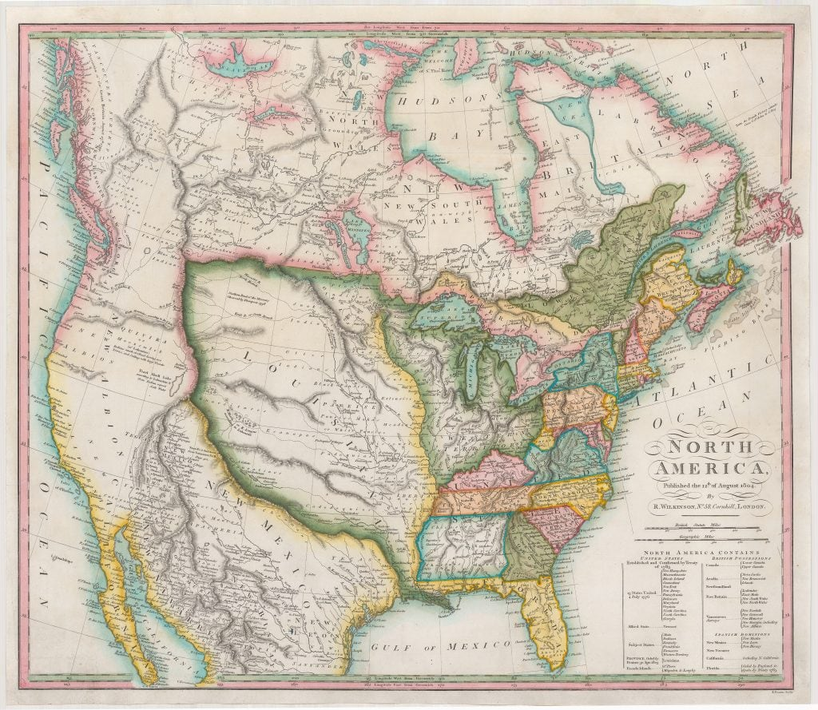
Notes:
Before we can talk about Texas, for context we first need to talk about Louisiana! The Louisiana Territory that is.
Freemasonry was established in Missouri in what was then the Louisiana Territory at St. Genevieve in 1807 when the Grand Lodge of Pennsylvania warranted The Louisiana Lodge № 109.
In 1808, the Grand Lodge of Pennsylvania warranted Meriwether Lewis (of the Lewis and Clark Expedition and first governor of the territory), Thomas F. Riddick (the first Grand Master of the Grand Lodge of Missouri) and Rufus Easton to establish Saint Louis Lodge № 111.
The Grand Lodge of Tennessee added to these two Lodges when in 1816 it chartered Missouri Lodge № 12 in St. Louis, and then in 1819, Joachim Lodge № 25 at Herculaneum and St. Charles Lodge № 28 at St. Charles.
Lastly, in 1820, the Grand Lodge of Indiana established Unity Lodge at Jackson.
From these Lodges the Grand Lodge of Missouri was established on April 21, 1821—five months before Missouri joined the Union.

Slide 3
AN ACCOUNT OF THE HISTORY OF TEXAS
AND FREEMASONRY IN TEXAS
Notes:
So why did I talk about the Louisiana Territory?
Because that is where Brother Stephen F. Austin came from, and because it provides context of the form of North America from which Texas was derived.

Slide 4
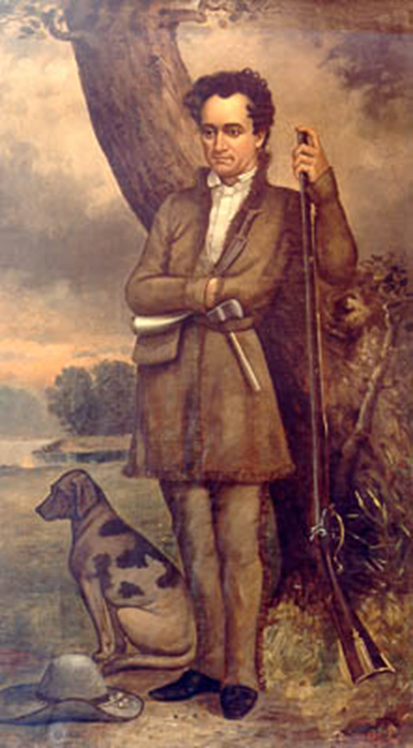
Notes:
Stephen F. Austin, (was born in Virginia), and a member of Louisiana Lodge No. 111 at Ste. Genevieve, Missouri, sought to establish Freemasonry in what today is Texas.
Freemasonry was well established among the educated classes of Mexican society. It had been introduced among the aristocracy loyal to the House of Bourbon, and the conservatives had total control over the Order.
By 1827, Americans living in Mexico City had introduced the United States York Rite of Freemasonry as a liberal alternative to the established European-style Scottish Rite.

Slide 5
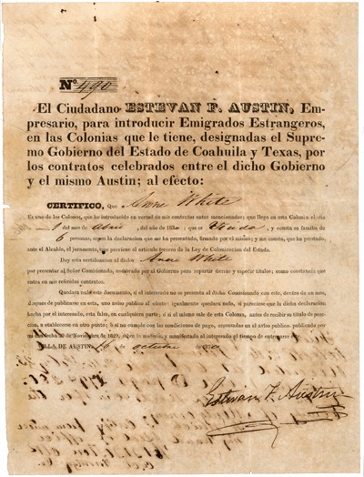
Notes:
Stephen’s dad Moses Austin had gone to San Antonio to apply for a grant of land and permission to settle 300 families in Texas. In Texas, these families are referred to as the “The Old 300”.
Upon his father’s death, Stephen went to San Antonio in August 1821, and was authorized by the Governor to carry on the colonization enterprise under his father's grant.
Here we see an early Texas colonization certificate.
Stephen was permitted by the governor to explore the coastal plain between the San Antonio and Brazos rivers for the purpose of selecting a site for the proposed colony and was informed by the Governor that Stephen would be responsible for the behavior of folks in the colony.
Austin returned to New Orleans, published these terms, and invited colonists, saying that settlements would be located on the Brazos and Colorado rivers. The long depression, followed by the panic of 1819 and changes in the land system of the United States, made settlers eager to take advantage of the offer, and the first colonists began to arrive in Texas by land and sea in December 1821. To his great disappointment, Austin was informed by Governor Martínez that the provisional government set up after Mexican independence refused to approve the Spanish grant to Moses Austin, preferring to regulate colonization by a general immigration law.

Slide 6
MATAGORDA

Slide 7
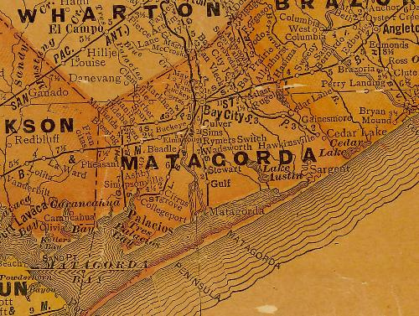
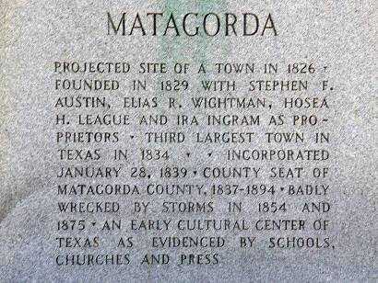
Notes:
We see here on the map at the left both the county and the town of Matagorda. To the northeast we see the town of Brazoria which we will here about in a minute.
It was in the late 1820’s when Stephen F. Austin got permission from Mexico to build the town of Matagorda.
Fifty-two families from New York and New England became the first settlers.
It was incorporated in 1830 and two years later it had over 1400 people. During the Mexican invasion, Matagorda was abandoned.
When the people returned after the battle of San Jacinto, they formed a county by the same name and made the town the county seat in 1836.
For much more on this historical figure and his accomplishment, see Texas State Historical Association reference.

Slide 8
Notes:
For some historical context, around this time, the rapid Americanization of the area and growing anti-Mexican sentiment for suppression of civil and religious liberties gave rise to the passage of a law on April 6, 1830, which forbade further immigration of Anglo-Americans into Texas. They were probably worried that Texas would look like this.
Things in Texas were tense, with increased trade restrictions and close supervision of increased military garrisons.
In March 1834, in an attempt to calm things down, the Coahuila Legislature passed an act which provided that no one was to be molested for expressing religious or political opinions if he kept the peace.
In the winter of 1834, Anson Jones, who was to become the first Grand Master of Texas Masonic lodges and later the third president of the Republic of Texas, met with four other Masons and took measures to establish a Lodge of their order in Texas.

Slide 9
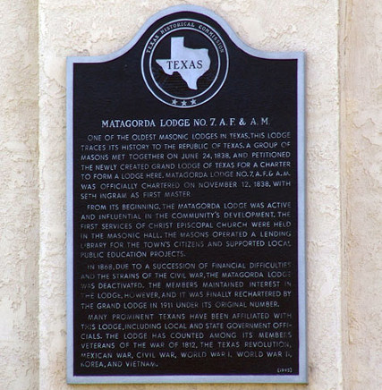
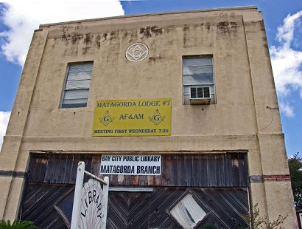
Notes:
Following the act to expand religious and political beliefs, one of the oldest Masonic lodges in Texas, Matagorda Lodge No. 7, A.F. & A.M was formed.
A group of masons met together on June 24, 1838 and petitioned the newly created Grand Lodge of Texas for a charter to Seth Ingram as first master. From its beginning, the Matagorda Lodge was active and influential in the community's development. The first services of Christ Episcopal Church were held in the Masonic Hall. The masons operated a lending library for the town's citizens and supported local public education projects.

Slide 10
FOUNDING OF MASONRY IN TEXAS
Notes:
We are getting ahead of ourselves. We need to step back a few years now to hear more about how the Grand Lodge of Texas came to be.

Slide 11
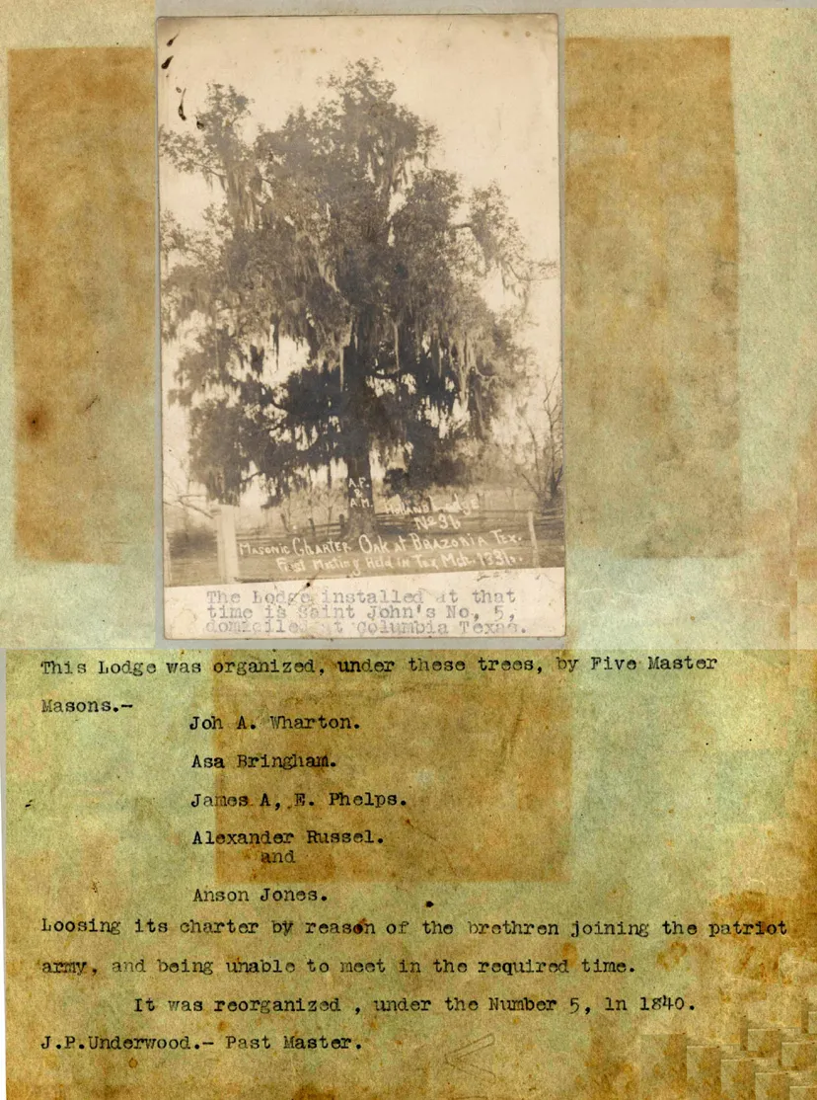
Notes:
On March 1, 1835, five Master Masons met “in a little grove of peach or laurel” at the town of Brazoria, “near a place known as General John Austin’s,” and resolved to petition Grand Master John H. Holland of the Grand Lodge of Louisiana asking for a dispensation to form a lodge in Texas. Foremost among these five Masons was Anson Jones who would later serve as Grand Master, and as President of the Republic of Texas. A record of the meeting was written by Anson Jones as follows:
“The place of the meeting was back of the town of Brazoria, near the place known as General John Austin’s, in a little grove of wild peach or laurel, and which had been selected as a family burying-ground by that distinguished soldier and citizen. The spot was secluded and out of the way of ‘cowans and eavesdroppers’ and they felt they were alone. Here and under such circumstances, at 10 o’clock in the morning of a day in March, 1835, was held the first formal meeting in Texas as connected with the establishment and continuance of masonry in this county.”
Anson Jones, John Wharton, Asa Brigham, James Phelps, and Alexander Russell, wishing to formally meet as an organized masonic lodge, met under the Masonic Oak near the burial ground of General John Austin and petitioned the Grand Lodge of Louisiana for dispensation to organize a lodge in the Texas territory.
This live oak tree, though affected by the ravages of nature, is revered by Texas Masons for the part it played in Texas’ Masonic history.

Slide 12
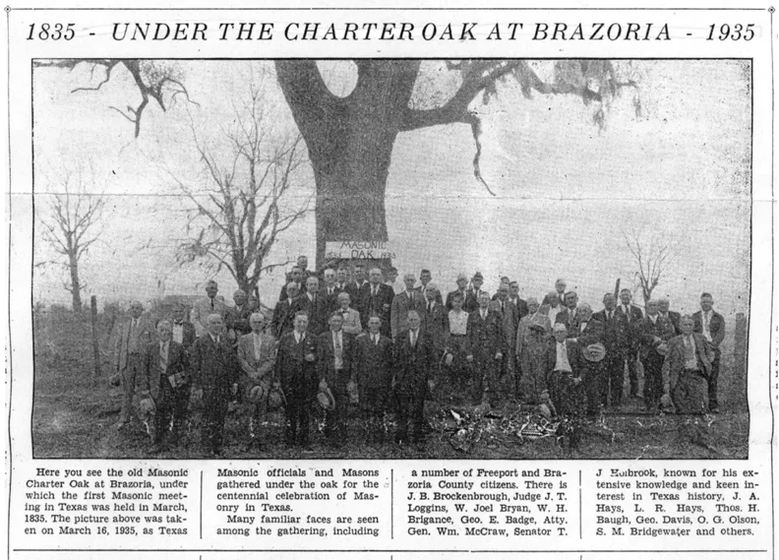
Notes:
Here we see an image celebrating the 100 year anniversary of that meeting.
The Masonic Oak is located on the south side of Pleasant Street, in Brazoria, across from the main Masonic Oak Park & pavilion.

Slide 13
CREATION OF HOLLAND LODGE

Slide 14
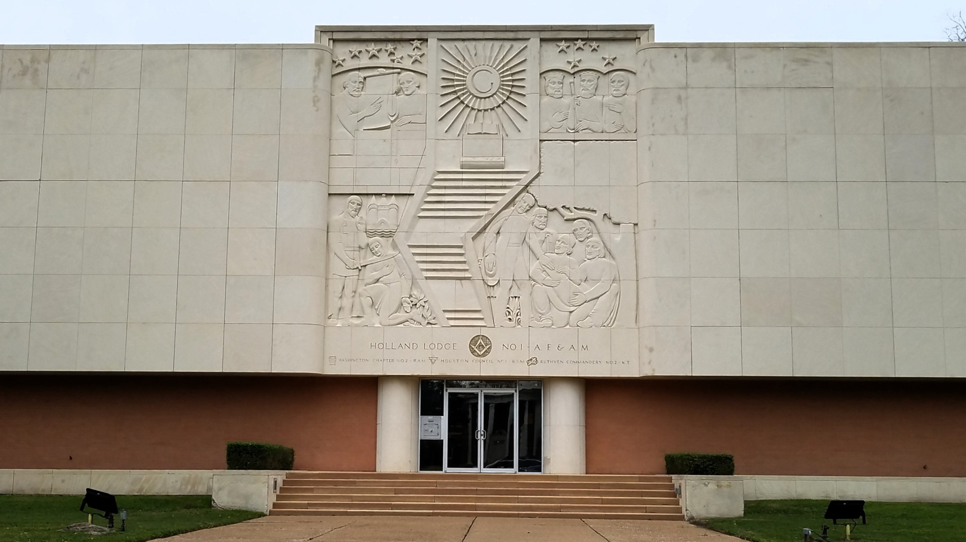
Notes:
Either: [At our next meeting we will here about the creation of Holland Lodge. SUGGESTED: play the video at https://www.youtube.com/watch?v=sZa2u7cSOw0 ]
[Alternatively: read the text below]
That charter, creating Holland Lodge No. 1 (it was originally Holland Lodge No. 36, and later reorganization made it No. 1), was issued and signed on 27 December 1835 by John Holland, Grand Master of Louisiana.
It was given to a Mr. John M. Allen, originally of Louisiana Lodge No. 32 to carry to Texas. Allen had been recruiting volunteers for the Texas Army in New Orleans, and would not reach Texas until just before the Battle of San Jacinto on 21 April 1836.
At the end of 1837, Holland Lodge moved to Houston and opened regularly at the Senate Chamber of the original Capitol Building, place of Rice Hotel and now the Rice Lofts, until October 1838. Holland Lodge No. 1 has relocated several times and now meets at 4911 Montrose Boulevard in the Museum District area of Houston, Texas.
Holland Lodge No. 36 of Louisiana was instituted and opened on the second floor of the old courthouse in Brazoria, Texas and when the lodge was set to labor, Jones was elected its first Master. Meetings continued here until March 1836, when Brazoria was abandoned due to General Urrea and his Mexican troops taking possession of the town of Brazoria. The Mexican troops destroyed the records, regalia, and property of Holland Lodge, and appropriated it dispensation to work. The members of the Lodge were scattered by the havoc of war. James Fannin, who had become a member of this lodge, was among those who had been massacred at Goliad. Jones, Wharton, and Phelps joined the Texan troops on the Colorado River about the middle of March.
During this time, the official charter issued to Holland Lodge #36 was delivered to Texas and presented to Anson Jones just before the Battle of San Jacinto while the Texan troops were retreating before the forces of General Santa Anna.. The charter for Holland Lodge No. 36 arrived in April 1836, and Jones carried it in his saddlebags during the Battle of San Jacinto. This document arrived safely in Brazoria after the battle, but the brethren had dwindled in number post-revolution.
After the capture of Santa Anna, the dispensation was returned to Jones, and thereafter both the dispensation and charter were taken back to Brazoria. Because of the depleted membership of the Lodge, however, no effort was made to resume labor at Brazoria, and no further meetings were held until the lodge was reopened in the Senate Chambers of the Republic of Texas at Houston in October, 1837.
Two other subordinate lodges were established in Texas under the jurisdiction of the Grand Lodge of Louisiana Masons. They were Milam Lodge No. 40 at Nacogdoches and McFarland Lodge No. 41 at San Augustine. Hayden Edwards was the first master of Milam Lodge; William McFarland was the first master of McFarland Lodge. Each of these lodges was issued its charter on September 22, 1837.

Slide 15
Conclusion
Notes:
The dedication and perseverance of men such as Stephen Austin served a crucial role in the spread of Freemasonry and the establishment of the Republic of Texas.
We encourage you to learn more about these men, and this year present your own program on one of them.

Slide 16
Other programs you can contribute this year
Masons related to today’s program
Stephen Austin, Anson Jones, John Wharton, Asa Brigham, James Phelps, and Alexander Russell, Ira Ingram, John Holland…
Freemasons & the Texas Revolution
James Bonham, James Bowie, David Crockett, Almaron Dickenson, William Barrett Travis, or General Santa Anna...
The Formation of the Grand Lodge of the Republic of Texas
Anson Jones, Sam Houston…
Masons in the Government of the Republic

Slide 17
Resources
https://gwmemorial.org/blogs/gl-of-the-month/the-grand-lodge-of-Missouri
https://bostonraremaps.com/inventory/wilkinson-first-map-louisiana-purchase/
https://www.tshaonline.org/handbook/entries/austin-stephen-fuller
http://www.sonsofdewittcolony.org/adp/history/bios/austin/austin.html
http://www.texasescapes.com/TexasGulfCoastTowns/MatagordaTexas.htm
https://www.hollandlodge.org/
https://www.facebook.com/hollandlodgeno1
https://www.youtube.com/watch?v=sZa2u7cSOw0

