Slide 1
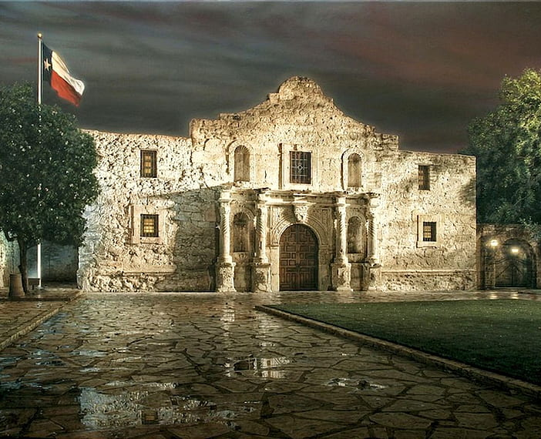
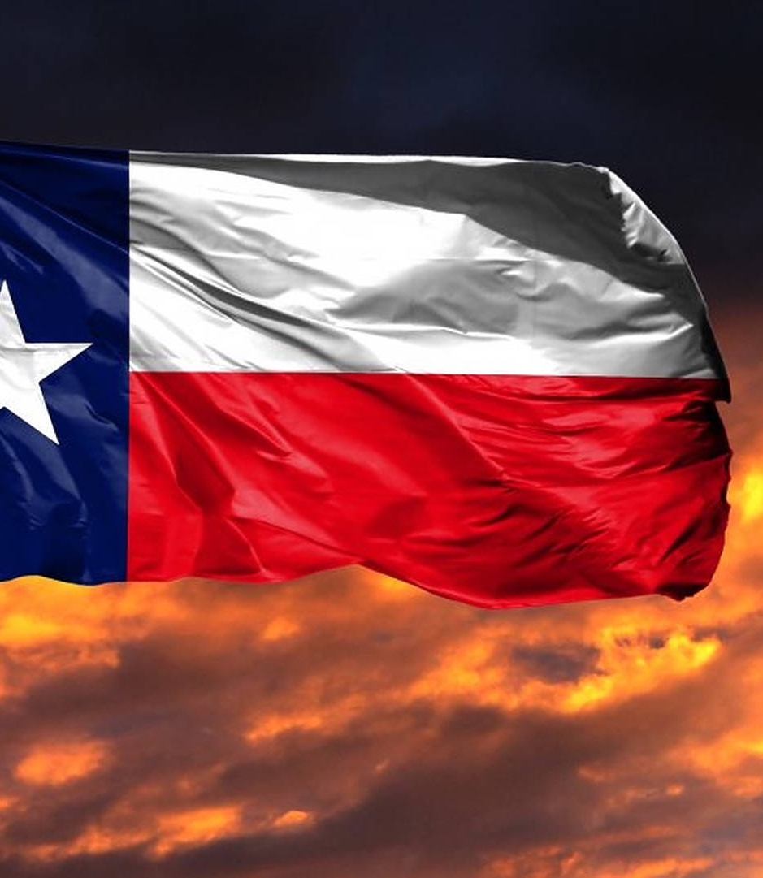
The Founding of the Republic of Texas
October 2, 1835 – April 21, 1836

Slide 2
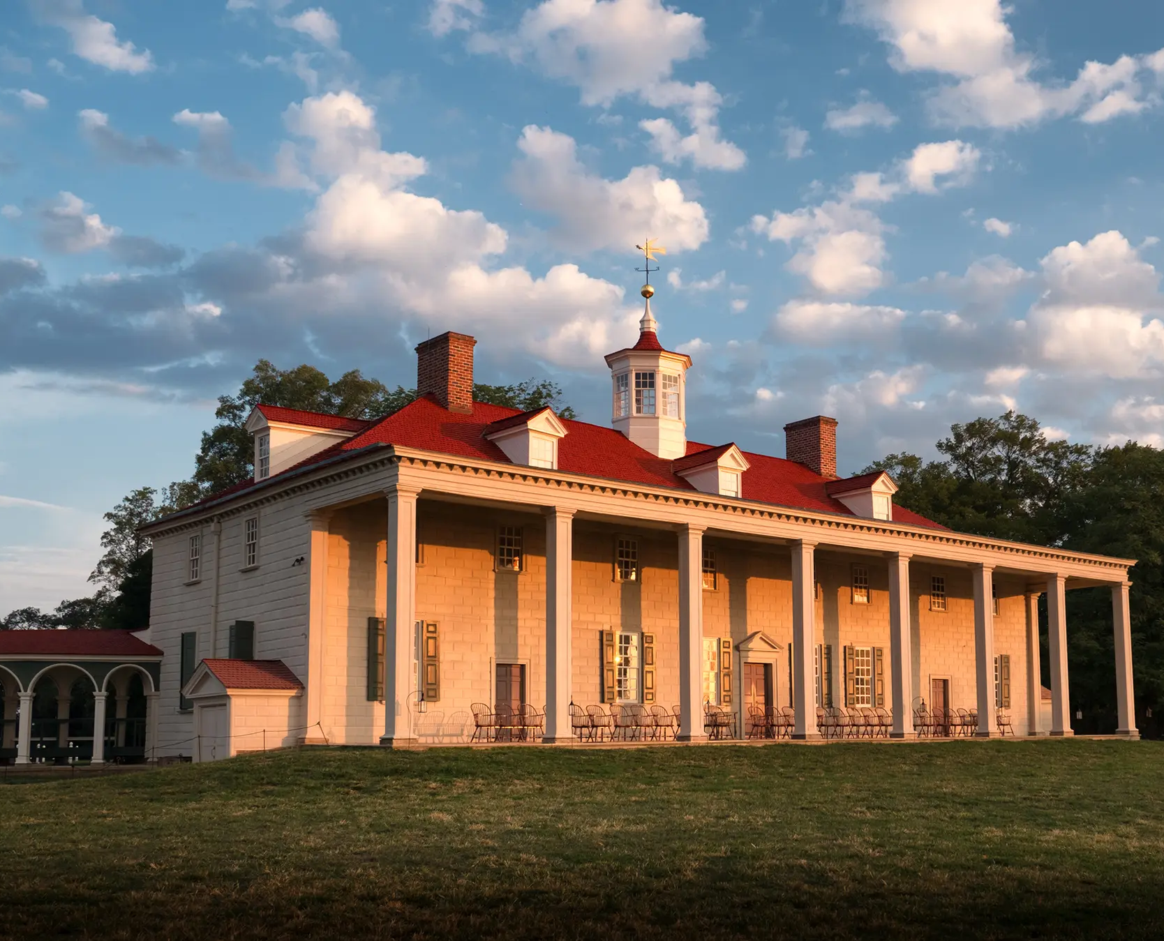
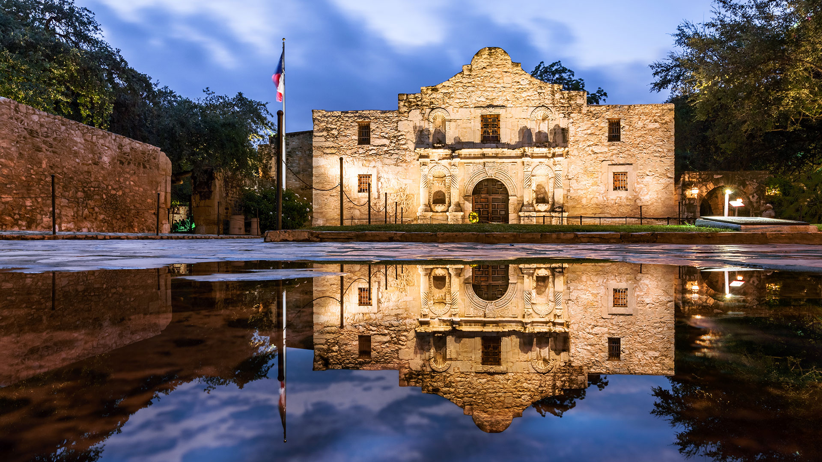
Freemasons & The Founding Fathers
We are all familiar with the story of Masonry and the formation of the United States
What is less well known is the impact of Masonry on the formation of the Republic of Texas
You cannot talk about the Alamo without talking about Masonry, there is a reason Masons in Texas make the pilgrimage to San Antonio and in particular, the Alamo to pay homage
It’s not unlike Masons making the same pilgrimage to Mount Vernon
Notes:
The hard part of this presentation is putting it summary form that can be delivered in a summary that has enough information to make it interesting without being so long
I’m really grateful to this Lodge for asking me to present, as researching this was a joy and not a labor

Slide 3



Pre-History – Side 1
Pro Regent
Spain
York Rite Masons led by Augustin de Iturbide
Notes:
When the ultra-liberals gained control of Spains political machinery, Spaniards loyal to the king concluded that only through revolution and independence for Mexico could they continue to protect their privileged position. They found an ardent follower in Augustin de Iturbide, an ambitious native Mexican who had obtained a commission in the Spanish Army that placed him in the Aristocratic party
The conservatives generally favored a monarchy which continued special privileges for the Church, the clergy, and large land-holders.

Slide 4
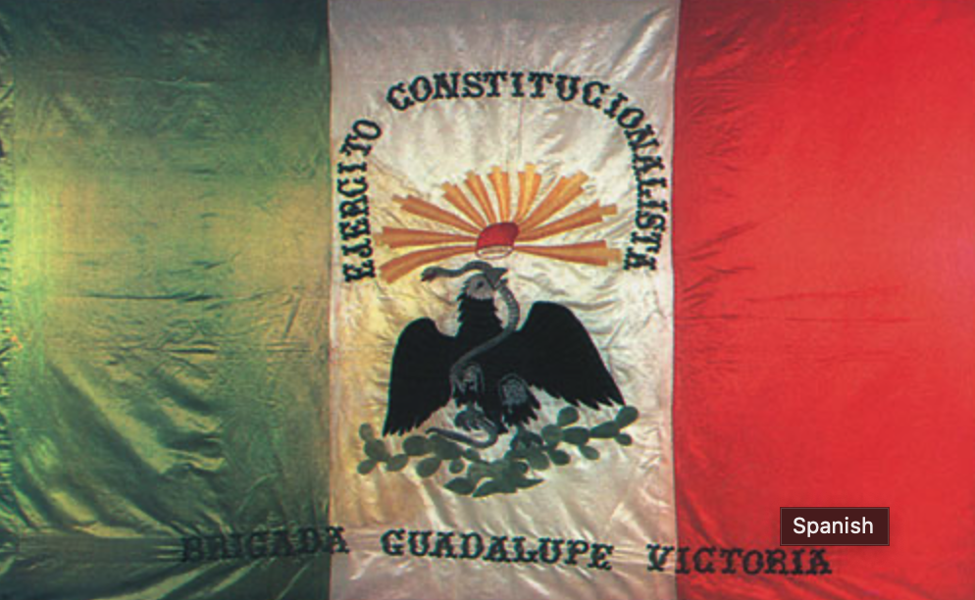
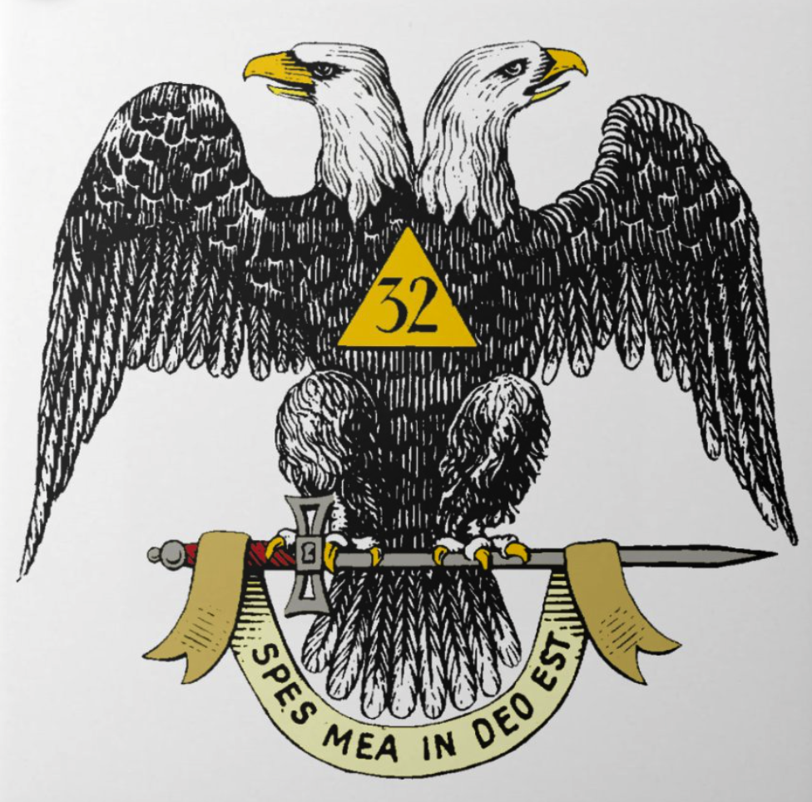

Pre-History Side 2
Constitutional Republic
Scottish Rite Masons led by
Antonio Lopes de Santa Anna
Notes:
Having lined up with the Republicans against Iturbide, Santa Anna soon found himself with the support of Nicholas Bravo, Vincente Guerrero, and Guadalupe Victoria. All were Masons. Guadalupe Victoria, who had formerly opposed Santa Anna, now had his support for the presidency under a federal republic. Within a short time, the liberals were in control of the Mexican government. Iturbide was forced to abdicate and went into exile in March,.

Slide 5

Historical Background
Masonry in Mexico 1785
  Masonry takes hold, Blue Lodge, Scottish Rite and York Rite
  No less than 14 Presidents of Mexico have been Masons
First Mexican Republic1824 – 1836
Augustin de Iturbide - hero of the masses
  Raised in Mexico City
  In power for one year
Overthrown in 1824
Notes:
It may be said at the outset that in its beginning the Mexican Revolution was really a class war, having at its basis social jealousies and exclusion from preferments.
Revolution having been begun by an ecclesiastic.
There was hardly a battle in which priests were not found as leading officers. Many of these priest were Master Masons.
In 1814, Ferdinand VII was elevated to the throne of Spain.
The Inquisition was restored and Freemasonry was again outlawed.
But the ideals of Freemasonry were too firmly established in Mexico to be denied.
The establishment of the First Mexican Republic was a result of several factors, including:
1. The fall of the Mexican Empire: The Mexican Empire was established in 1821 after Mexico gained independence from Spain. However, the empire was short-lived and was overthrown in 1823, leading to the establishment of the First Mexican Republic[1][3].
2. The Constitution of 1824: The First Mexican Republic was established by the Constitution of 1824, which was the first constitution of independent Mexico. The constitution established a federated republic and officially designated Mexico as the United Mexican States[1].
3. Political controversies: Political controversies, ever since the drafting of the constitution, tended to center around whether Mexico should be a federal or a centralist state, with wider liberal and conservative divisions[1].
4. Financial and political instability: The First Mexican Republic was plagued through its entire twelve-year existence by severe financial and political instability[1][2].
Overall, the establishment of the First Mexican Republic was a result of Mexico's desire for independence and its attempt to establish a stable and democratic government.
Citations:
[1] https://en.wikipedia.org/wiki/First_Mexican_Republic
[2] https://countries.fandom.com/wiki/First_Federal_Republic_of_Mexico
[3] https://en.wikipedia.org/wiki/First_Mexican_Empire
[4] https://www.britannica.com/place/Mexico/Independence
[5] https://artsandculture.google.com/story/the-birth-of-the-states-of-the-mexican-republic-part-i-archivo-general-de-la-nacion/gwUxkdP0Lhc1OA?hl=en-US
[6] https://study.com/academy/lesson/first-mexican-empire-history-timeline-facts.html
Augustin de Iturbide Emperor Augustin I of Mexico in 1823

Slide 6

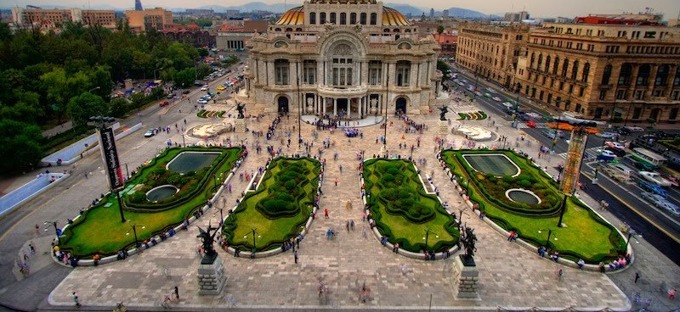
The province of Coahuila “Coa wee la” y Tejas
For a while, Mexico was happy with Texas
The immigration allowed for greater taxation
  Mexico had a terrible debt the foundation of business in Texas allowed for growth in the province of Texas
Notes:
.They let many Americans immigrate to the State without anything more than a pledge

Slide 7
Mexicans unhappy
Mexico was determined to extract itself from the influence of the Catholic Church
There are still divisions, Liberal and Conservative even within Masonry
  Maybe a lesson here as the Catholic Church was marginalized,
  Political competition develops between the York Rite and the Scottish Rite
This conflict spilled over to Texas
Notes:
Economic issues: The Mexican government had enacted policies that were intended to promote economic development in Texas, but these policies had mixed results. Some Texans felt that they were not receiving the support they needed from the Mexican government to develop their economy.
Political unrest: Mexico was experiencing political turmoil during this time, with frequent changes of government and instability in the federal system. This made it difficult for the Mexican government to effectively govern Texas, which was a remote frontier region with a small population.
Illegal immigration: Many Americans had settled in Texas illegally, which the Mexican government saw as a threat to its sovereignty. The Mexican government had encouraged American immigration to Texas in the 1820s and 1830s to help populate the region, but the number of Americans entering Texas far exceeded what the Mexican government had expected or wanted.
From the Mexican perspective, there was more than enough cause for alarm. By 1835-1836 Texan numbers had swelled to around 30,000, while the Hispanic population remained stable, roughly 4,000 people.

Slide 8
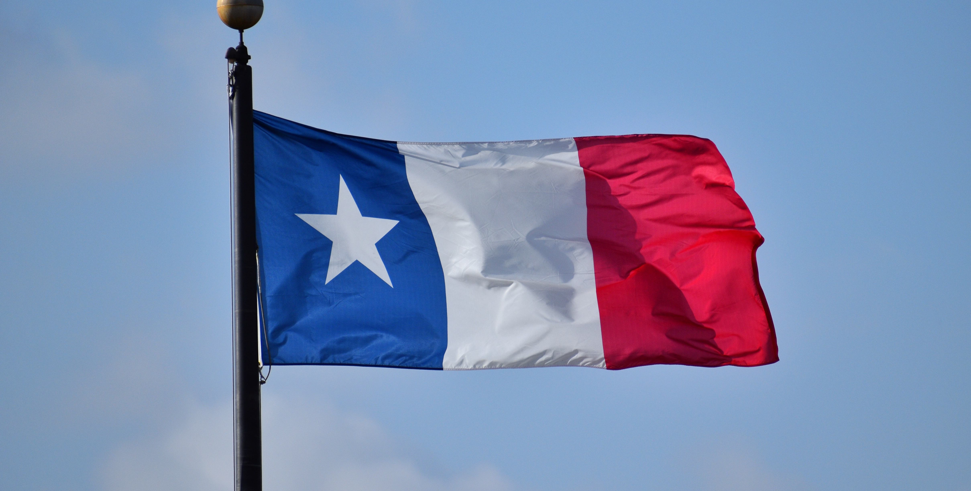
Texans unhappy with Mexico
Economic Issues
Political Oppression
Cultural differences
Notes:
Economic issues: Many Texans were unhappy with the Mexican government's economic policies, which they felt favored Mexico over Texas. This included high taxes and restrictions on trade.
Political oppression: Many Texans felt that the Mexican government was becoming increasingly dictatorial and that their rights were being violated. This was exemplified by the passage of the Law of April 6, 1830, which was designed to curtail American immigration into Texas and gave more power to the Mexican government, specifically taking it away from the local governments.
Cultural differences: Texans were mostly American settlers who had a different cultural background than the Mexican government and many of the Mexican residents of Texas. This led to tensions and misunderstandings between the two groups.
Dodson Flag

Slide 9
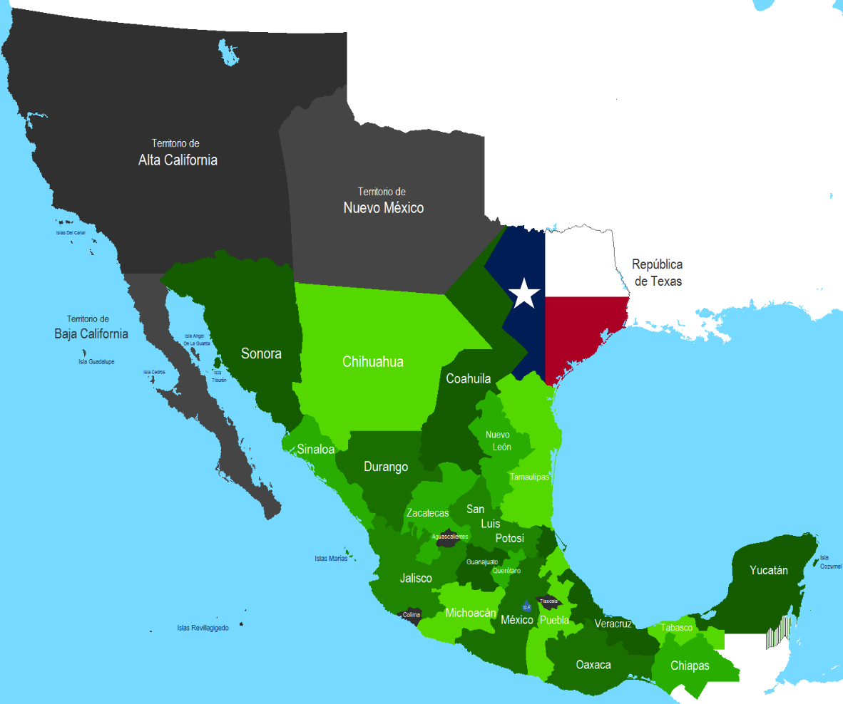
Unrest in Mexico
Notes:
Causing this part of Mexico to have its own version of unrest

Slide 10

1835 War is declared

Slide 11
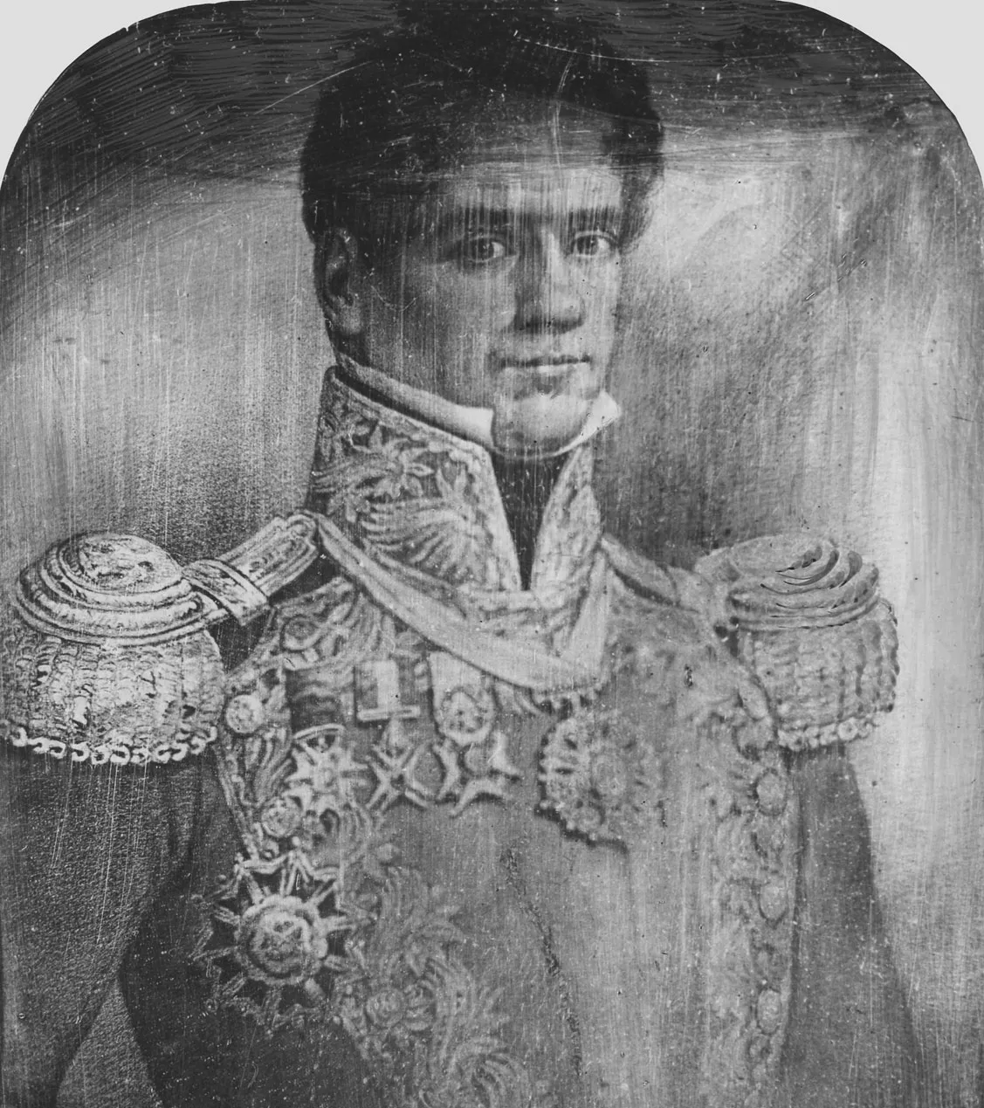
Mexican Freemasons
General Antonio López de Santa Anna
General Martín Perfecto de Cos - Santa Anna’s brother-in-law, originally sent to Texas to put down the rebellion
General Vicente Filisola
General Jose Maria Tornel - Mexican Ambassador to the United States
General Juan José Andrade - led the Battle of Concepción
General José de Urrea - defeated at the Battle of San Jacinto
Col. Juan Morales - Battle of the Alamo, Coleto and San Jacinto
Col. Francisco Duque - Battle of the Alamo
Notes:
This list is not even pretending to be complete, but here we go..
Santa Anna fought on both sides of nearly every issue of the day. In 1821, he supported Agustín de Iturbide and the war for Mexican independence, but in 1823, he helped overthrow Iturbide. In 1828, he backed Vicente Guerrero for president, only to help depose him later. Santa Anna gained much prestige in 1829 when he fought against Spain’s attempt to reconquer Mexico, and he became known as the Hero of Tampico. This surge of glory helped him gain the presidency in 1833 as a federalist, but he soon switched to centralism and became a dictator. He was exiled to Cuba in 1839, but he returned to Mexico in 1841 and was elected president again in 1842. He lost Texas to the United States in 1836 and was defeated by the United States in the Mexican-American War (1846–48)

Slide 12
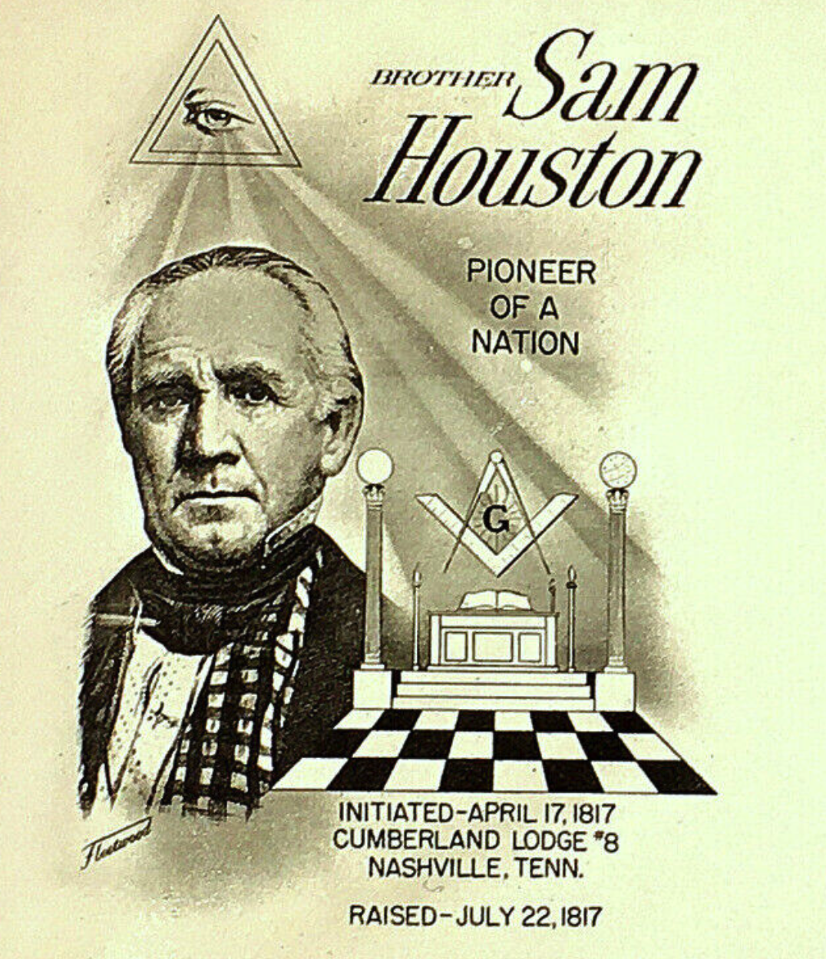
Texas Freemasons
Col. William Barret Travis - Holland Lodge #1 Alabama, wrote “Victory or Death” letter to America
Col. James Bowie - Opelousas Lodge #111, Louisiana
Lt. Col. James Bonham - Clinton Lodge #23, South Carolina
Senator Juan N. Seguín - San Antonio Lodge #11, Tejano, Bexar County, Left the Alamo before the last battle to seek reinforcement
Congressman and Col. David Crockett - Raised in DC unknown, source GL of Maryland

Slide 13
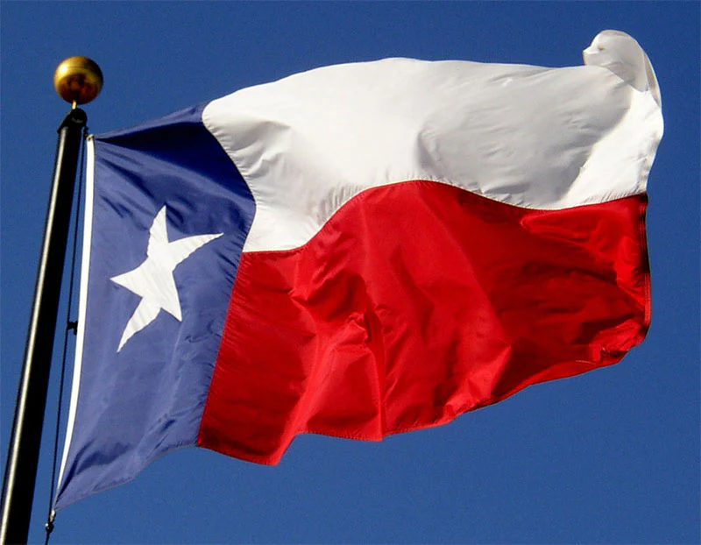
Texas War for Independence
October 2, 1835: The Battle of Gonzales marks the start of the Texas Revolution,
October 28, 1835: Texans capture Goliad and gain control of the town.
November 4, 1835: The Consultation, a meeting of Texan leaders,
November 26, 1835: The Texan army captures San Antonio from Mexican forces in the Battle of Bexar.
March 6, 1836: The Battle of the Alamo
March 27, 1836: The Goliad Massacre occurs
April 21, 1836: The Battle of San Jacinto
  “Remember the Alamo”
Notes:
October 2, 1835: The Battle of Gonzales marks the start of the Texas Revolution, as Texans successfully resist Mexican soldiers trying to take a cannon.
October 28, 1835: Texans capture Goliad and gain control of the town.
November 4, 1835: The Consultation, a meeting of Texan leaders, is held in San Felipe de Austin to discuss the future of Texas.
November 26, 1835: The Texan army captures San Antonio from Mexican forces in the Battle of Bexar.
March 6, 1836: The Battle of the Alamo takes place, as Mexican forces led by General Santa Anna attack and defeat a group of Texan soldiers defending the Alamo Mission in San Antonio. All of the defenders, including Davy Crockett and Jim Bowie, are killed.
March 27, 1836: The Goliad Massacre occurs, as Mexican soldiers execute over 300 Texan prisoners of war at Goliad.
April 21, 1836: The Battle of San Jacinto takes place, as the Texan army led by General Sam Houston defeats the Mexican army led by General Santa Anna. Santa Anna is captured and forced to sign the Treaty of Velasco, recognizing the independence of Texas.

Slide 14
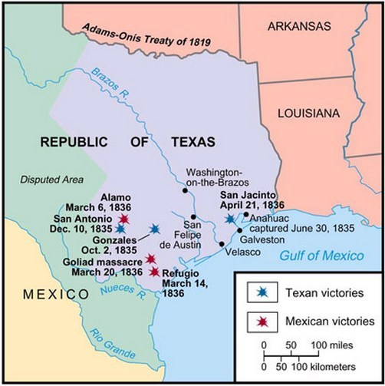

Slide 15
The Alamo – 13 days that formed a Republic
Notes:
Backstory - The Alamo has been documented quite well and for those that do not know, Col. William B. Travis knew that this was fight to the death. The whole reason the Alamo took place was to delay the Mexican advance so the Sam Houston could deploy an army.
While 13 days might not seem a long time, it was 13 days, that led to victory

Slide 16
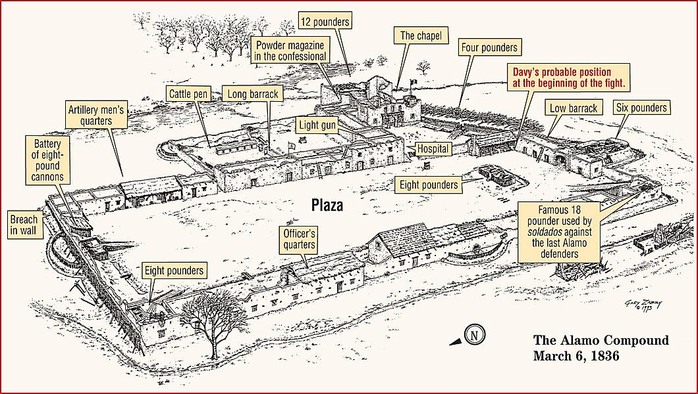

Slide 17
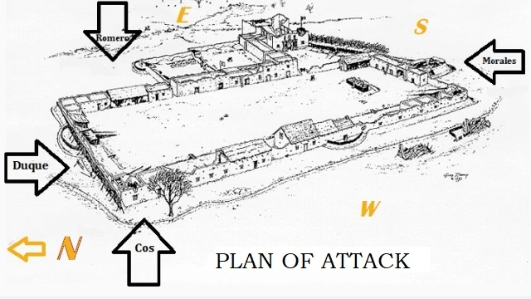
Notes:
Battle of the Alamo Timeline Fact 1: The Texas Revolution began in October 1835 with the Battle of Gonzales. Battle of the Alamo Timeline Fact 2: The siege started in February 23, 1836 and ended on March 6, 1836. 180 Americans were laid to siege by the Mexican Army consisting of 4000 soldiers led by General Santa Anna during the Battle of the Alamo
Battle of the Alamo Timeline Fact 3: The Alamo was originally built in 1718 as Roman Catholic Franciscan mission and then used as a garrison for the Mexican army
Battle of the Alamo Timeline Fact 4: November 1835: Sam Houston was selected as Commander-in-Chief of the Texas Army
Battle of the Alamo Timeline Fact 6: January 17, 1836: Jim Bowie arrives at the garrison to evaluate the situation - Sam Houston had suggested he remove the artillery and blow up the Alamo. The decision is made to defend the garrison
Battle of the Alamo Timeline Fact 7: February 3, 1836: Colonel William B. Travis arrives at the garrison
Battle of the Alamo Timeline Fact 8: February 8, 1836: Davy Crocket arrives at the garrison with a group of Tennessee volunteers
Battle of the Alamo Timeline Fact 9: February 11, 1836: Neill becomes ill and leaves the garrison
Battle of the Alamo Timeline Fact 10: February 11, 1836: Neill transfers command to William B. Travis, the highest-ranking regular army officer in the garrison
Battle of the Alamo Timeline Fact 11: February 12, 1836 : William Travis and Jim Bowie argue over who has command of the garrison
Battle of the Alamo Timeline Fact 12: February 14, 1836: Neill returns to settle the dispute. Bowie and Travis agree to a joint command
Battle of the Alamo Timeline Fact 13: February 17, 1836: William B. Travis sends his first letters asking for assistance, the Texans were not expecting Santa Anna's forces until spring
Battle of the Alamo Timeline Fact 14: February 22, 1836: Santa Anna reaches San Antonio with generals Sesma, Amador and Castrillón and the Vanguard Brigade
Battle of the Alamo Timeline Fact 15: February 22, 1836: Santa Anna demands surrender and states that no one will be spared if this is not done. The Texans refuse to surrender
Battle of the Alamo Timeline Fact 16: February 23, 1836: Daniel Cloud sounds the alarm as the attack begins. The fort comes under artillery fire from Mexican troops
Battle of the Alamo Timeline Fact 17: February 24, 1836: William B. Travis writes his Victory or Death Letter to the closest town at Gonzales. He vows "I shall never surrender or retreat.” Other letters requesting help for the Battle of the Alamo are sent to Gonzales, Goliad, San Felipe, Nacogdoches and Washington-on-the-Brazos
Battle of the Alamo Timeline Fact 18: February 24, 1836: Jim Bowie becomes ill and William B. Travis assumes full command
Battle of the Alamo Timeline Fact 19: February 26, 1836: Relief forces begin to gather at Gonzales
Battle of the Alamo Timeline Fact 20: 26 Feb 1836: James Fannin attempts his relief march to the fort but is forced to turn back
Battle of the Alamo Timeline Fact 21: March 1, 1836: 32 men of the Gonzales Ranging Company arrive at the fort in response to the Victory or Death letter
Battle of the Alamo Timeline Fact 22: March 2, 1836: The Texas Declaration of Independence is signed and the Republic of Texas is declared although the men fighting the Battle of the Alamo are unaware of these momentous events
Battle of the Alamo Timeline Fact 23: March 3, 1836: James B. Bonham arrives at the garrison and tells Travis that James Fannin and his troops were not coming
Battle of the Alamo Timeline Fact 24: March 3, 1836: William Travis tells all the troops that they are free to leave - the brave men choose to stay and fight at the Battle of the Alamo Battle of the Alamo Timeline Fact 25: March 3, 1836: Mexican battalions Aldama, Toluca and Zapadores arrive in San Antonio
Battle of the Alamo Timeline Fact 26: March 5, 1836: The Mexican artillery stop shelling the fort, they defenses have been weakened to such an extent that plans are made to assault the garrisonBattle of the Alamo Timeline Fact 27: March 6, 1836: The final attack begins at dawn with hand-to-hand combat
Battle of the Alamo Timeline Fact 28: March 6, 1836: Only a few Texans survive the bloody siege of the Battle of the Alamo. Civilian non-combatants such as women, children and cooks were spared.
Battle of the Alamo Timeline Fact 29: March 6, 1836: Over 600 Mexicans were killed during the Battle of the Alamo and countless injured
Battle of the Alamo Timeline Fact 30: March 6, 1836: A handful of Texans were also spared who were sent Sam Houston’s camp at San Jacinto as a warning that a similar fate awaited the rest of the Texans if they continued their rebellion against Mexico.
Battle of the Alamo Timeline Fact 31: April 22, 1836: Following a series of battles Santa Anna is defeated and captured
Battle of the Alamo Timeline Fact 32: May 14, 1836: The peace treaty of Velasco is signed by the Republic of Texas and General Santa Anna of Mexico.
Battle of the Alamo Timeline Fact 33: June 15, 1836: The demoralized Mexican army, cross the Rio Grande back into Mexico

Slide 18
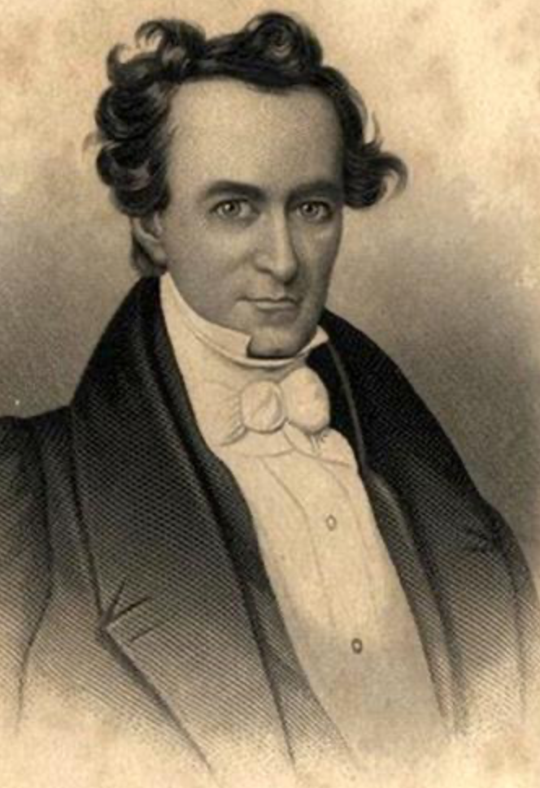
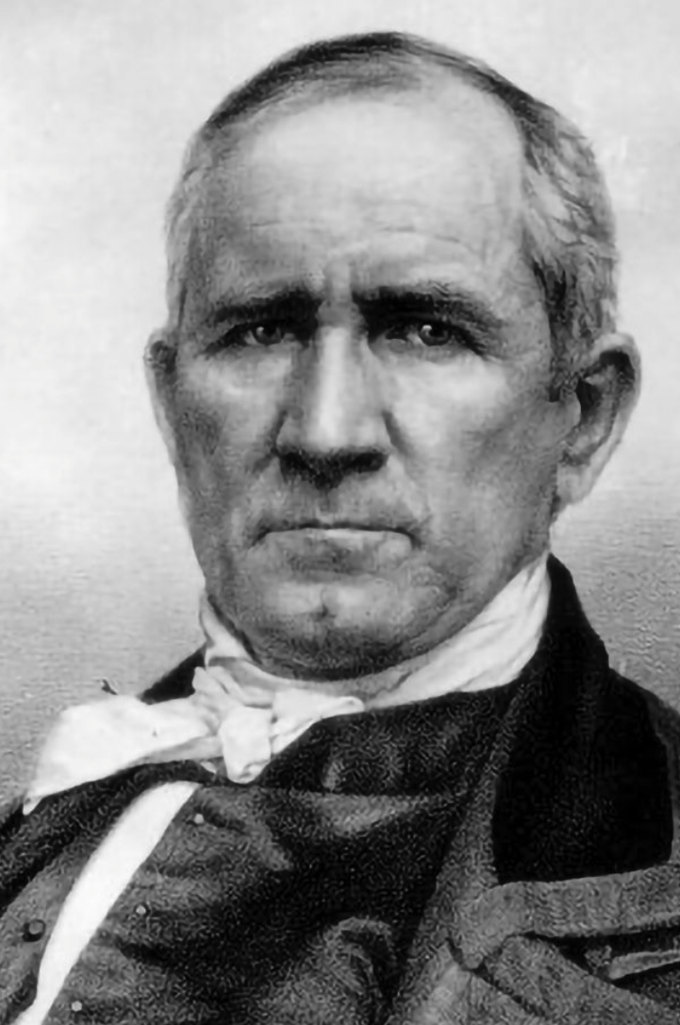
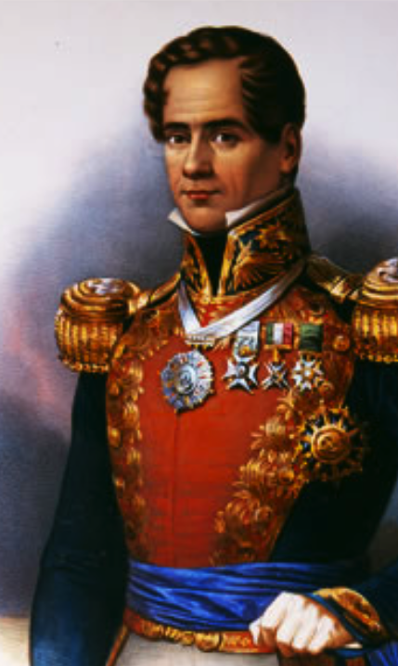
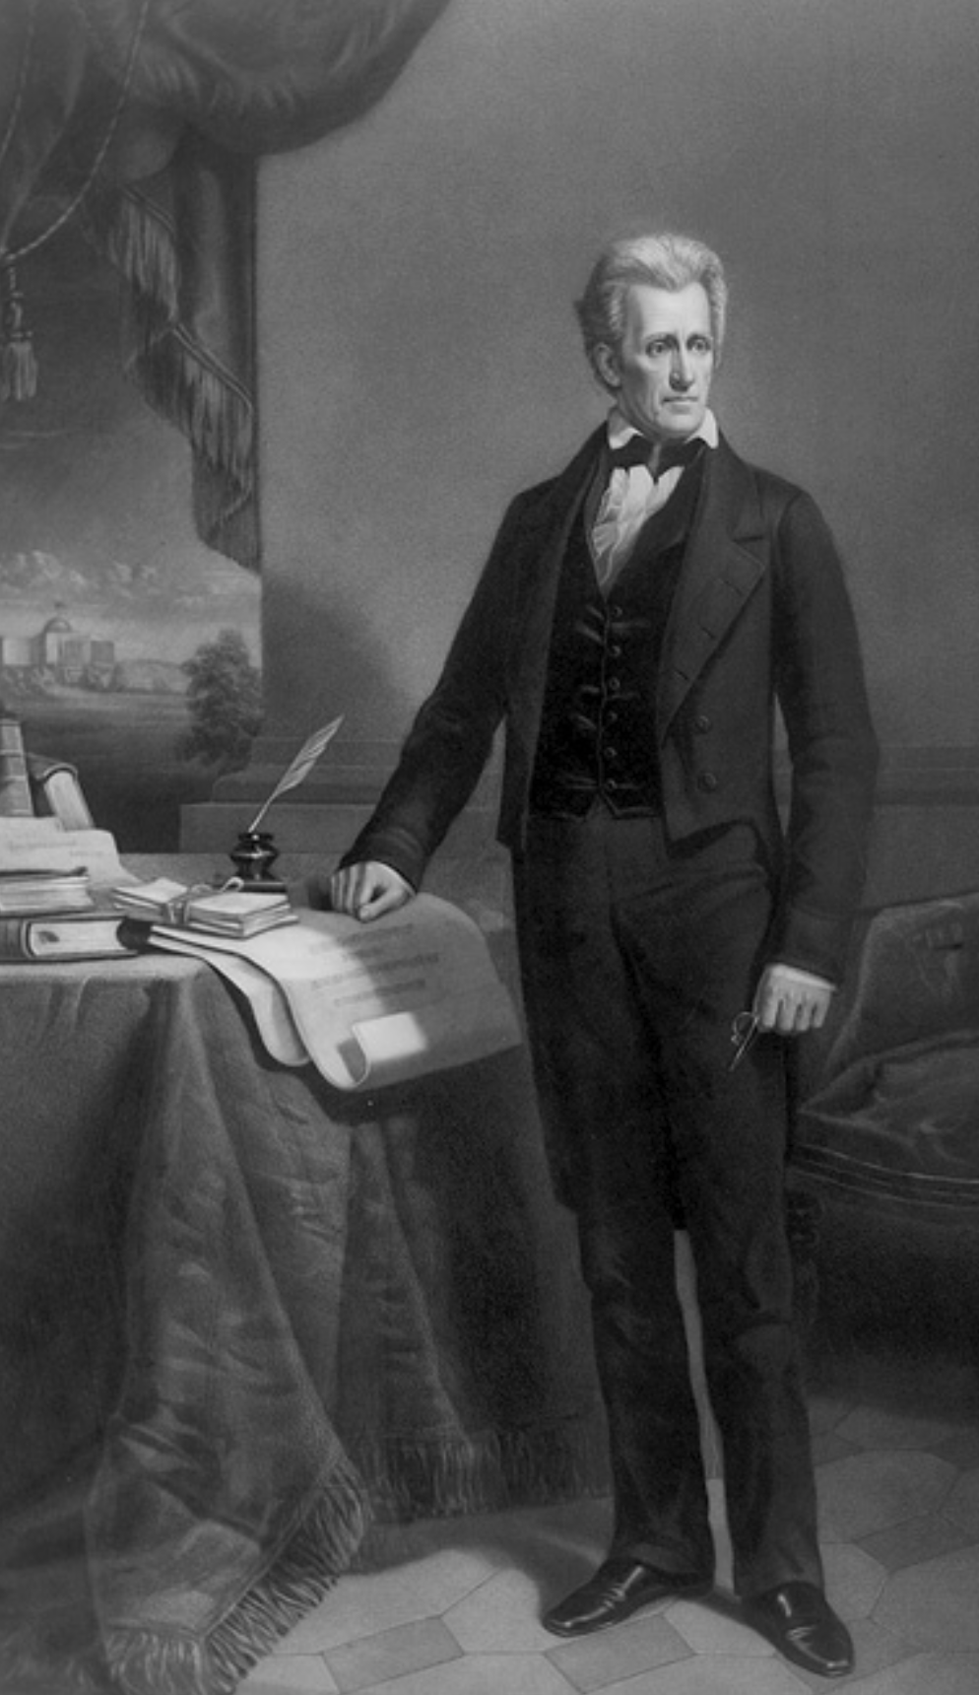
Masonry Spares the life of Santa Anna
Notes:
SFA, SH, Santa Anna, and President Jackson
General Santa Anna displays the Masonic sign of distress to his captures who immediately notify Gen. Sam Houston
The Washington Masonic Fraternity intervenes as President Andrew Jackson’s government asks the leaders of the new Republic to grant General Santa Anna leniency, it is understood in Texas as a Mason to Mason request and this request is granted for a variety of reasons, mostly political

Slide 19
All Presidents of the Republic of Texas were Masons
David G. Burnet - Holland Lodge #1, first President, Order of Odd Fellows and the Sons of Temperance
Sam Houston - Holland Lodge #36, second President
Mirabeau B. Lamar - Initiated in Georgia, Harmony Lodge #6, third President
Sam Houston - Fourth President
Anson Jones - Initiated in Indiana, Holland Lodge #26, Fifth and final President
Stephen F. Austin - Louisiana Lodge #109, Mo, Secretary of State, drafted the declaration of Independence and the first constitution of Texas, joined Brazos Union Lodge No. 16 in Texas

Slide 20
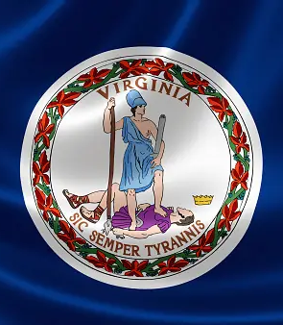
Texas ties to Virginia
Stephen F. Austin: Known as the "Father of Texas,” Born November 3, 1793
Wythe County, Virginia
Sam Houston: Military hero and President of the Republic of Texas, Born in Rockbridge County, Virginia
Branch T. Archer: Texan Commissioner to the United States, Speaker of the House of the Republic of Texas House of Representatives, and Secretary of War of the Republic of Texas Archer was born in Fauquier County, Virginia on December 13, 1790

Slide 21
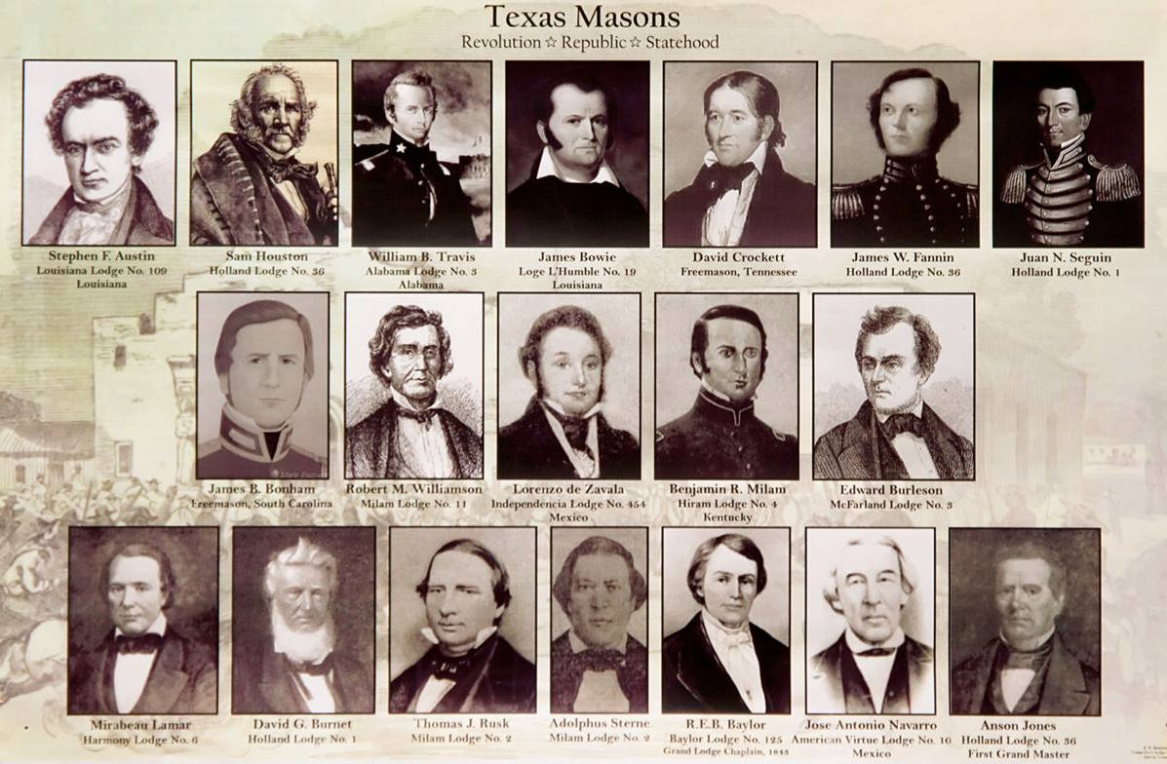

Slide 22
Other Masons involved in the Battle for Texas Independence
Col. James Fanin: Columbian Lodge #7, died at Goliad
Ashbel Smith: Smith was a physician and diplomat who served as the Secretary of State of the Republic of Texas. He was initiated into Freemasonry in Virginia in 1838 and later became a member of the Holland Lodge No. 36 in Texas.
Edward Burleson: Burleson was a military leader during the Texas Revolution and served as the commander of the Texan forces at the Battle of San Jacinto. He was a member of the Masonic lodge in Alabama before moving to Texas.
Albert Martin: Martin was a member of the Tennessee Lodge No. 12 before moving to Texas. He was one of the 32 men who answered William Barret Travis's call for reinforcements at the Alamo and was killed in the battle.
Thomas J. Rusk: Rusk was a military leader during the Texas Revolution and served as a Senator from Texas after statehood was achieved. He was initiated into Freemasonry in Mississippi in 1837 and later became a member of the Milam Lodge No. 2 in Texas.
Albert Sidney Johnston: Johnston was a military leader during the Texas Revolution and later served as a General in the Confederate Army during the American Civil War. He was initiated into Freemasonry in Kentucky in 1826 and was a member of several lodges throughout his life.
George C. Kimbell: was a member of the Louisiana Lodge No. 111 in Opelousas, Louisiana, before moving to Texas. He was one of the defenders of the Alamo and was killed in the battle.
John McGregor: McGregor was a member of the Texas Harmony Lodge No. 4 in Brazoria, Texas. He was one of the defenders of the Alamo and was killed in the battle.
Thomas J. Green: Green was a military leader during the Texas Revolution and served as a Brigadier General in the Texas army. He was initiated into Freemasonry in Tennessee in 1828 and later became a member of the Milam Lodge No. 2 in Texas.
Isaac Millsaps: Millsaps was a member of the Texas Holland Lodge No. 36 in Gonzales, Texas. He was one of the defenders of the Alamo and was killed in the battle.
Notes:
Edward Burleson
Thomas J. Rusk
Albert Sidney Johnston
Thomas J. Green

Slide 23
Other Masons involved in the Battle for Texas Independence
William R. Carey: Carey was a member of the Texas Holland Lodge No. 36 in Gonzales, Texas. He was one of the defenders of the Alamo and was killed in the battle.
Green B. Jameson: Jameson was a member of the Harmony Lodge No. 6 in San Augustine, Texas. He served as a scout for the Texian army during the Revolution and fought at the Battle of the Alamo.
John W. Smith: Smith was a member of the Holland Lodge No. 36 in Gonzales, Texas. He was one of the defenders of the Alamo and was killed in the battle.
Samuel Whitely: Whitely was a member of the Texas Holland Lodge No. 36 in Gonzales, Texas. He was one of the defenders of the Alamo and was killed in the battle.
Claiborne C. Young: Young was a member of the Texas San Felipe de Austin Lodge No. 27. He fought at the Battle of the Alamo and was one of the few defenders who survived the battle. He was later released by General Antonio López de Santa Anna as a messenger to carry the news of the defeat to Sam Houston and the Texan army.
Amos Pollard: Pollard was a member of the Texas Holland Lodge No. 36 in Gonzales, Texas. He fought at the Battle of the Alamo and was killed in the battle.
Sidney Sherman: Sherman was a military leader during the Texas Revolution and played a key role in the Battle of San Jacinto. He was a member of the Masonic lodge in New York before moving to Texas.
James W. Robinson: Robinson was a military leader during the Texas Revolution and served as the Secretary of State of the Republic of Texas. He was a member of the Masonic lodge in Tennessee before moving to Texas.
William H. Wharton: Wharton was a lawyer and politician who served as a delegate to the Convention of 1836, which declared Texas' independence from Mexico. He was initiated into Freemasonry in Tennessee in 1827 and later became a member of the Milam Lodge No. 2 in Texas.
Richard Coke: Coke was a lawyer, politician, and the 15th Governor of Texas. He was initiated into Freemasonry in Virginia in 1851 and later became a member of the Waco Lodge No. 92 in Texas.
John Henry Brown: Brown was a lawyer, politician, and historian who wrote several important works on Texas history. He was initiated into Freemasonry in Tennessee in 1847 and later became a member of the Milam Lodge No. 2 in Texas.
Notes:
Claiborne C. Young
Sidney Sherman
James W. Robinson
Richard Coke

