Slide 1
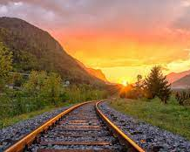
Freemasons and Railroading
By Bro. Stephen Daniel
Illustrated by Wor. Matt Duley
Freedom Lodge No. 118
Notes:
The main text of this program is from Bro. Stephen Daniel, entitled "Freemasons and Railroading" which was presented in Virginia Research Lodge No. 1777 on August 16, 2014. I have simply extended his work by adding illustration with additional context and comments.
In this paper, the author discusses the Industrial Revolution and the part Masonry had to play, both in the United States and around the world, particularly as relates to the locomotive. He mentions several Masons whose inventions drove the development of the railroad system, as well as Lodges with strong ties to the railroad.
We all know of Famous Freemasons who were industrialists, scientists, orators, etc. but have we ever stopped to think of those Brothers who have contributed to the industrialization of the world? When we think of some, the first ones who come to mind are:

Slide 2
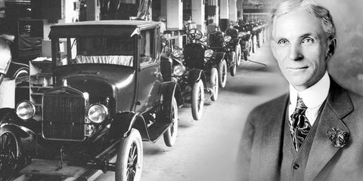
Notes:
Henry Ford – Creator of the modern assembly line.
Image source: https://bricksmasons.com/blogs/masonic-education/some-famous-freemasons

Slide 3
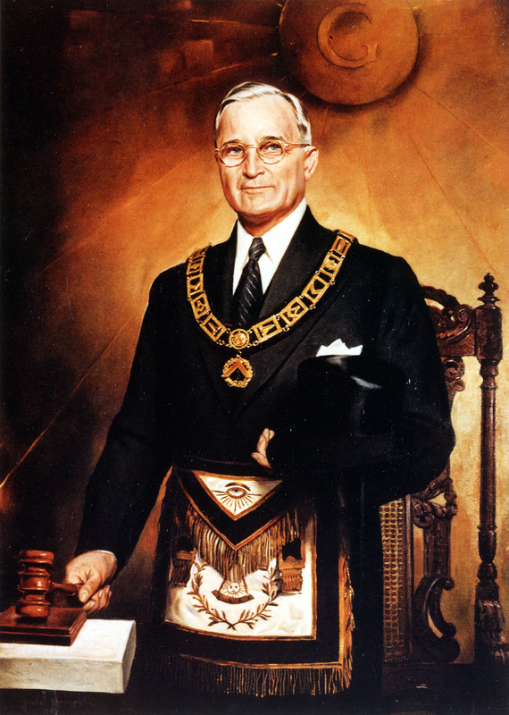
Notes:
Harry S. Truman – President of the United States and who ordered the dropping of the first atomic bomb.
Image Source: https://www.trumanlibrary.gov/photograph-records/67-938

Slide 4
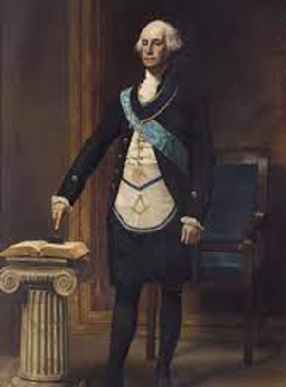
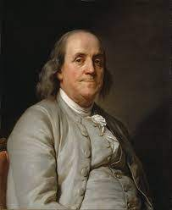
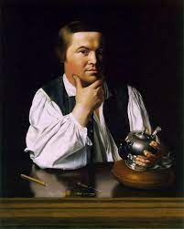
Notes:
George Washington, Ben Franklin, Paul Revere, etc. all who helped found and created our great Nation.
This list can go on and on.

Slide 5
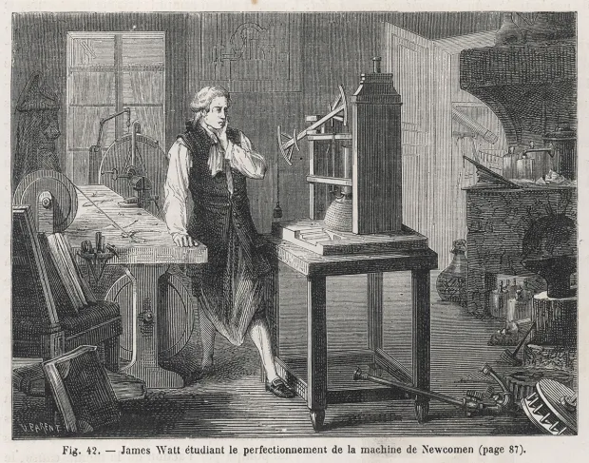
Notes:
Now let us turn our attention to the beginning of the Industrial Revolution. Two Brethren had significant impacts on the development of the steam engine and later on the use of the steam engine, in the form of a locomotive, as a means of transportation.
In Scotland, James Watt, initiated into Masonry in 1763, took out a patent in 1784 for a locomotive, although it was never constructed.
Image Source: https://makezine.com/projects/remaking-history-james-watt-and-the-flyball-governor/

Slide 6
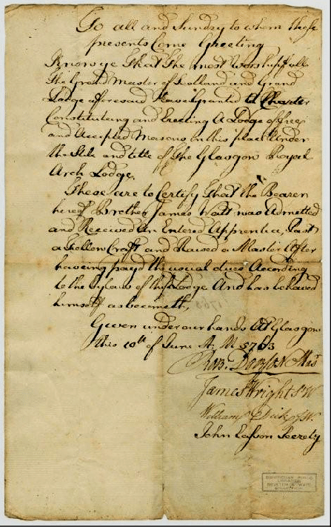
Notes:
Brother James Watt's (1736-1818) masonic certificate
Image source: https://www.researchgate.net/figure/Brother-James-Watts-1736-1818-masonic-certificate-Transcription_fig3_271071868

Slide 7
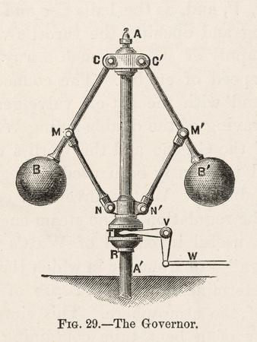
Notes:
Watt was specifically known for his invention of the flyball governor, which regulates the supply of steam.
Maybe it’s just me, but something about this design seems quite familiar.
Image source:
https://www.art.com/products/p53615982714-sa-i1751422/robert-h-thurston-governor-or-fly-ball-governor-invented-by-james-watt-to-regulate-the-supply-of-steam.htm

Slide 8
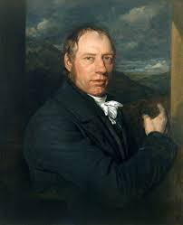
Notes:
From Cornwall, we have Bro. Richard Trevithick to introduce.

Slide 9
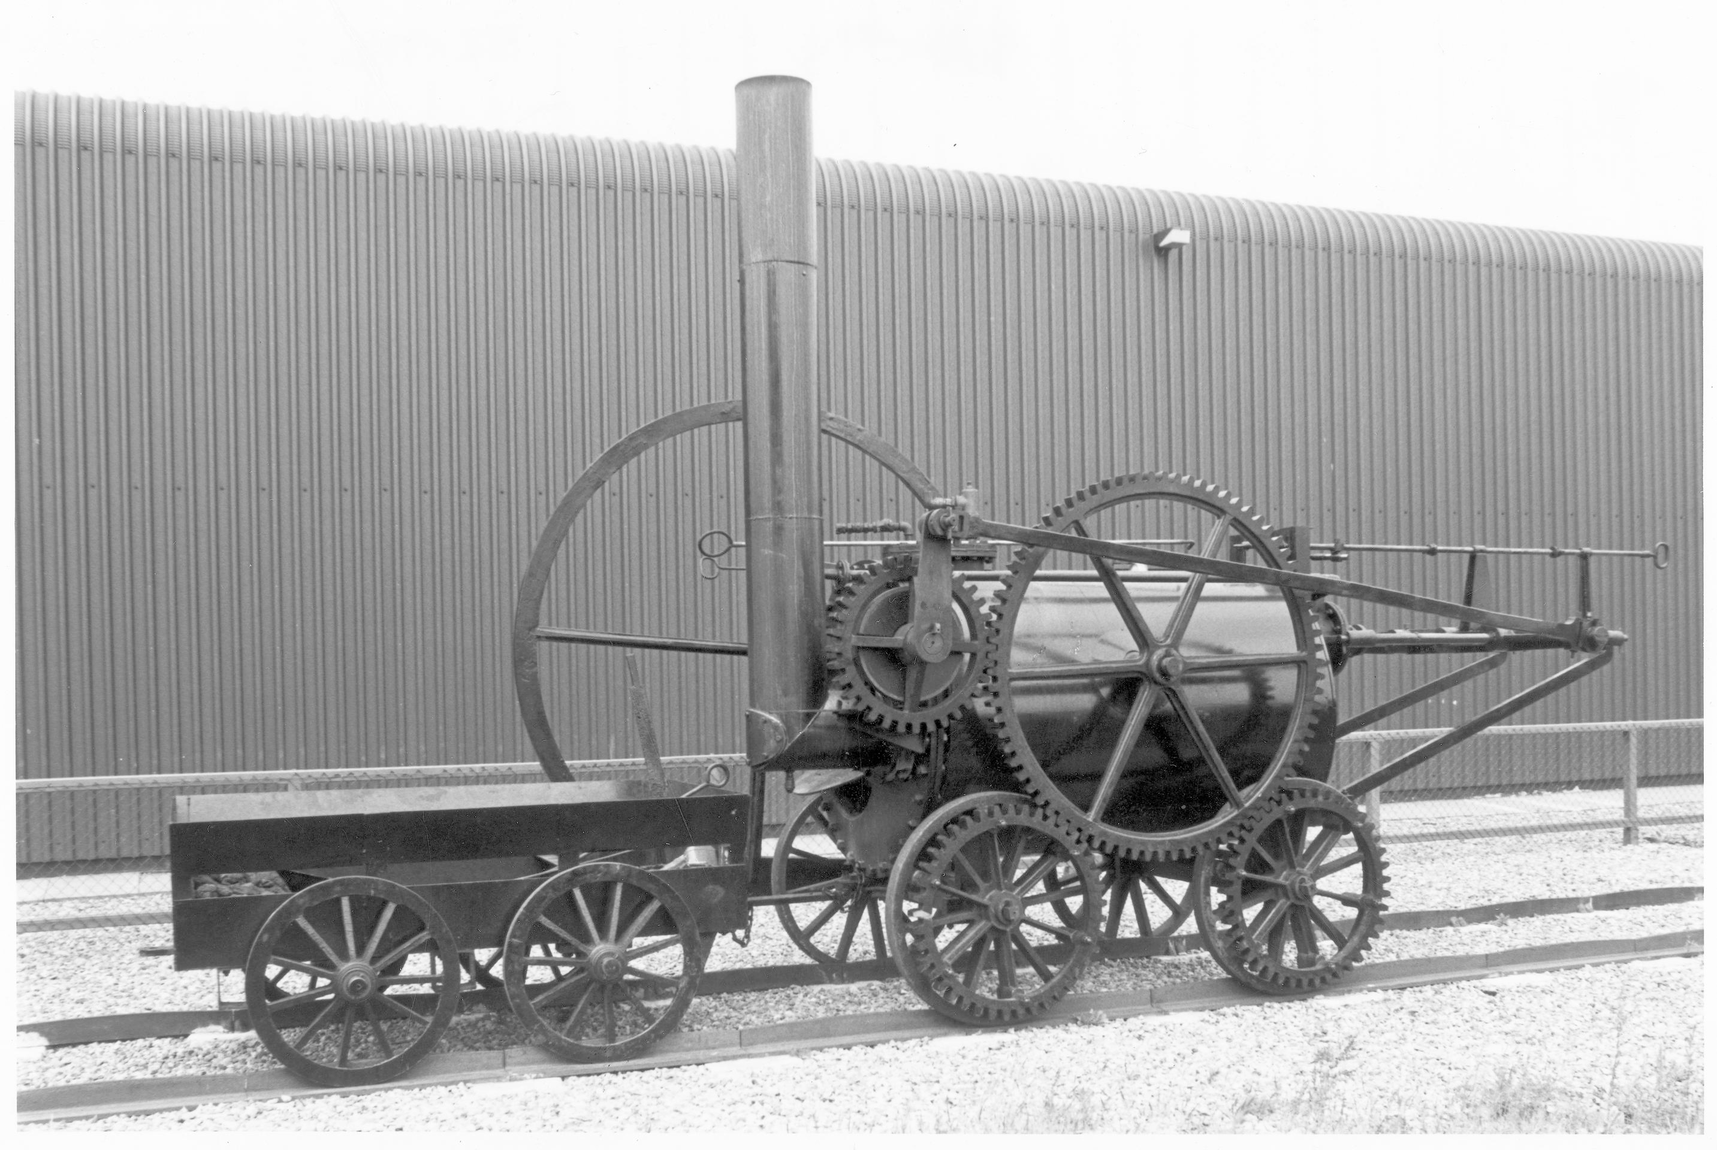
Notes:
In Cornwall, Bro. Richard Trevithick built the first tramway locomotive in 1803 and in 1804 built the Penydarren locomotive – the first steam locomotive to successfully run on rails.
Note: We cannot overestimate the importance of Trevithick’s locomotive. In 1800, the fastest a man could travel over land was at a gallop on horseback; a century later, much of the world had an extensive railway system on which trains regularly travelled at speeds of up to sixty miles per hour. This remarkable transformation, a momentous occasion in world history, was initiated in south Wales in that February of 1804.
There is no record on the Web of when or where Trevithick was made a Mason, but mention is made of a Masonic souvenir of his stay in Swansea, Wales: A glass vase inscribed with the name "Brother Richard Trevithick" in Indefatigable Lodge #237.
[Note: Penydarren was the location of an ironworks at Merthyr Tydfil in South Wales]
Image source: https://museum.wales/collections/online/object/9db6503b-914e-32b0-95d8-b20a85cb1a19/Trevithicks-Penydarren-locomotive/
The source website also includes a video of the replica in operation.

Slide 10
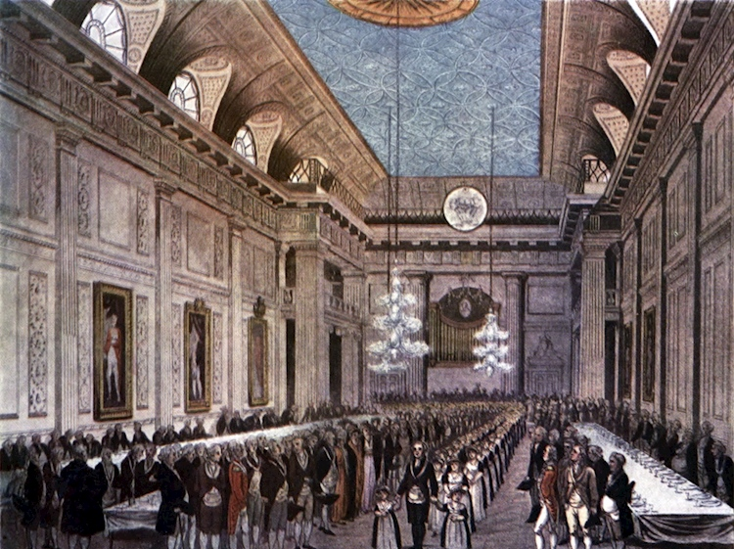
Notes:
Now a few interesting facts related to Freemasonry and Railroads around the world.
By the mid-1800's the impact of a growing railway system was being felt by Grand Lodges:
"The growth of the railway systems led to greater mobility and easier communication between the Grand Lodge and the Provinces". History of the United Grand Lodge of England
"The advent of Railways in the 1840's led to a more active interest in Grand Lodge by the brethren of the Provinces and correspondingly larger attendances at the Quarterly communications and the need for devolution of real power to the Provinces was soon apparent“
This image is of Freemason’s Hall in London around 1809
Image source: https://www.thehistorypress.co.uk/articles/freemasonry-the-first-masonic-grand-lodge/

Slide 11
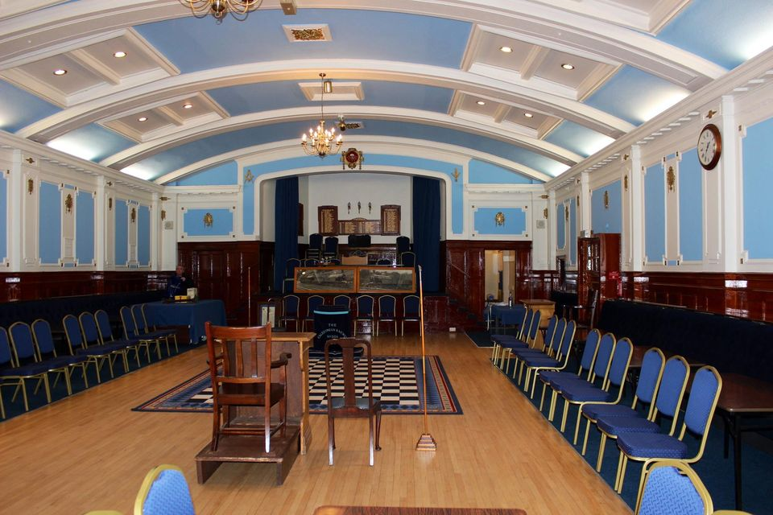
Notes:
In Scotland:
The formation of new lodges or the growth of existing lodges around a "railway" theme spread around the world. In 1849, in Glasgow, Caledonian Railway Lodge No. 354 was granted a charter to hold and constitute meetings anywhere on Caledonian Railway property. Membership was restricted to those employed on the railway when initiated, although gradually this requirement was eased.
Note: Observe that the lodge room even seems to resemble a train car!
Image source: https://www.facebook.com/groups/752103198194713/

Slide 12
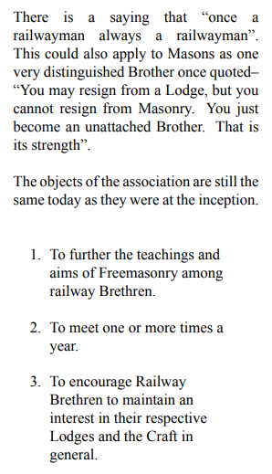
Notes:
In New Zealand:
In 1949, "The Railway Craftsmen's Association of New Zealand" was formed and is still in existence. Its objects are to further the teachings and aims of Freemasonry among Railway brethren and to encourage Railway brethren to maintain interest in their respective Lodges and in the Craft. The Association puts on degrees for Lodges throughout New Zealand, and presents a Master's apron to every member being installed into the chair of King Solomon for the first time.
Note: https://freemasonsnz.org/wp-content/uploads/2015/07/Issue1_2007.pdf
See Page 16 for “Railway Craftsmen’s Association of NZ – a brief history”

Slide 13
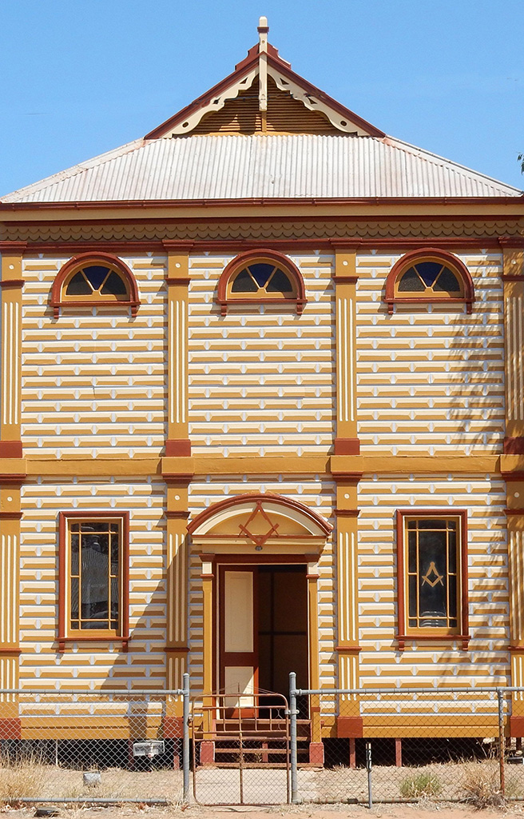
Notes:
In Australia:
Now let's look at the history of Comet Masonic Temple in Barcaldine, Queensland, Australia. Comet Lodge erected and re-erected its hall six times in nine years, beginning in 1876, moving it to accompany the extension of the Central Railway 300 miles across the country.
Source of additional text and images: https://www.qld.gov.au/recreation/arts/heritage/experience/heritage-case-studies/barcaldine-masonic-temple

Slide 14
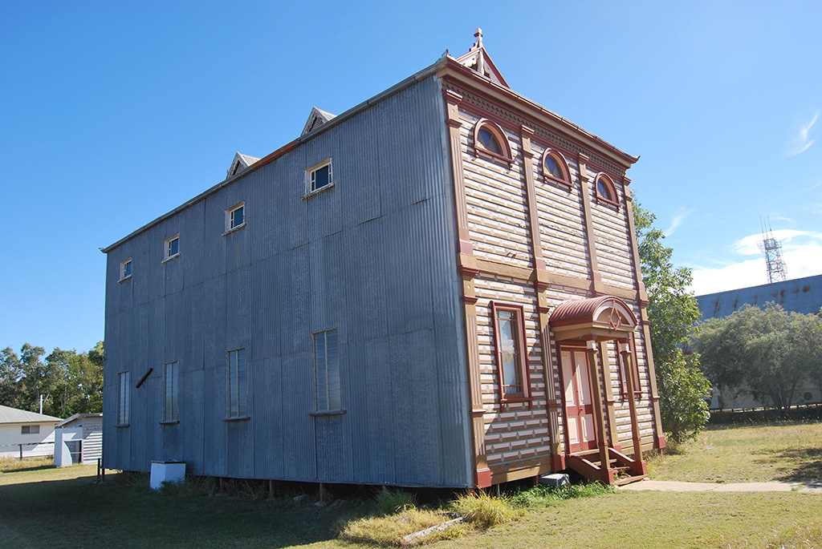
Notes:
“The railway’s chief engineer Robert Ballard, and a handful of other Masons working on the railway, established the Comet Lodge No 1680 at Dingo Creek in 1876. As the railway progressed, workers carried the building westward with them, dismantling it and moving it in railway trucks to be bolted together again in the next settlement.
The first temple could therefore be Queensland’s most travelled public building, being moved six times, from Dingo Creek to Cometville, Emerald, Bogantungan, Pine Hill, and Jericho before coming to rest at Barcaldine in 1886 – 320 kilometres from the site of its original construction. The temple was then refurbished and used until the current temple, a larger and more elaborate building, was constructed (for £720) in 1900 and dedicated in 1901.
While the exterior of the Barcaldine Masonic Temple is clad plainly in corrugated iron on the back and sides, the front of the building features a rare and elaborate façade, clad with horizontal timber boards painted to mimic a classically styled masonry building.”

Slide 15
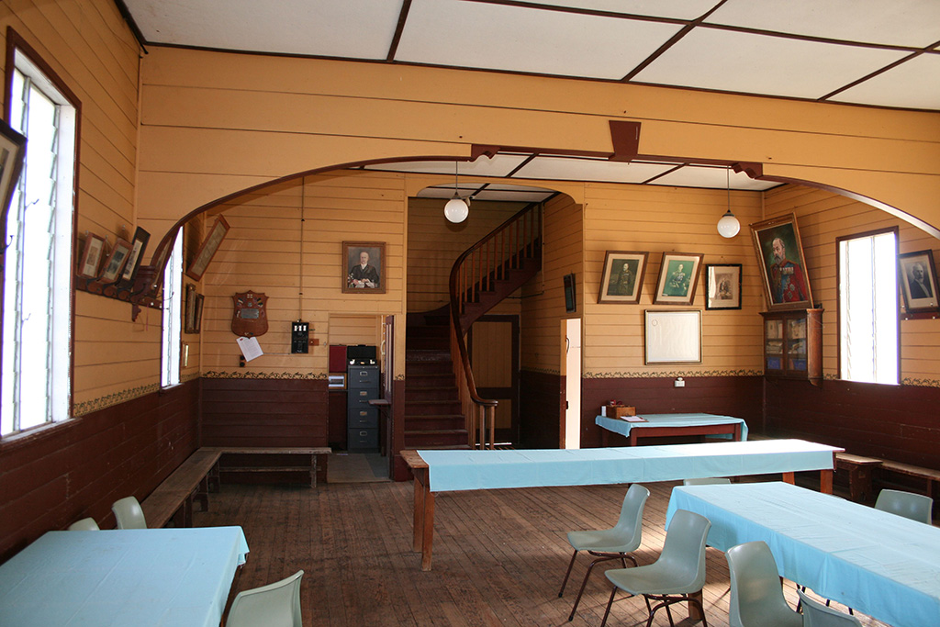
Notes:
Here is an interior picture of the Lodge.

Slide 16
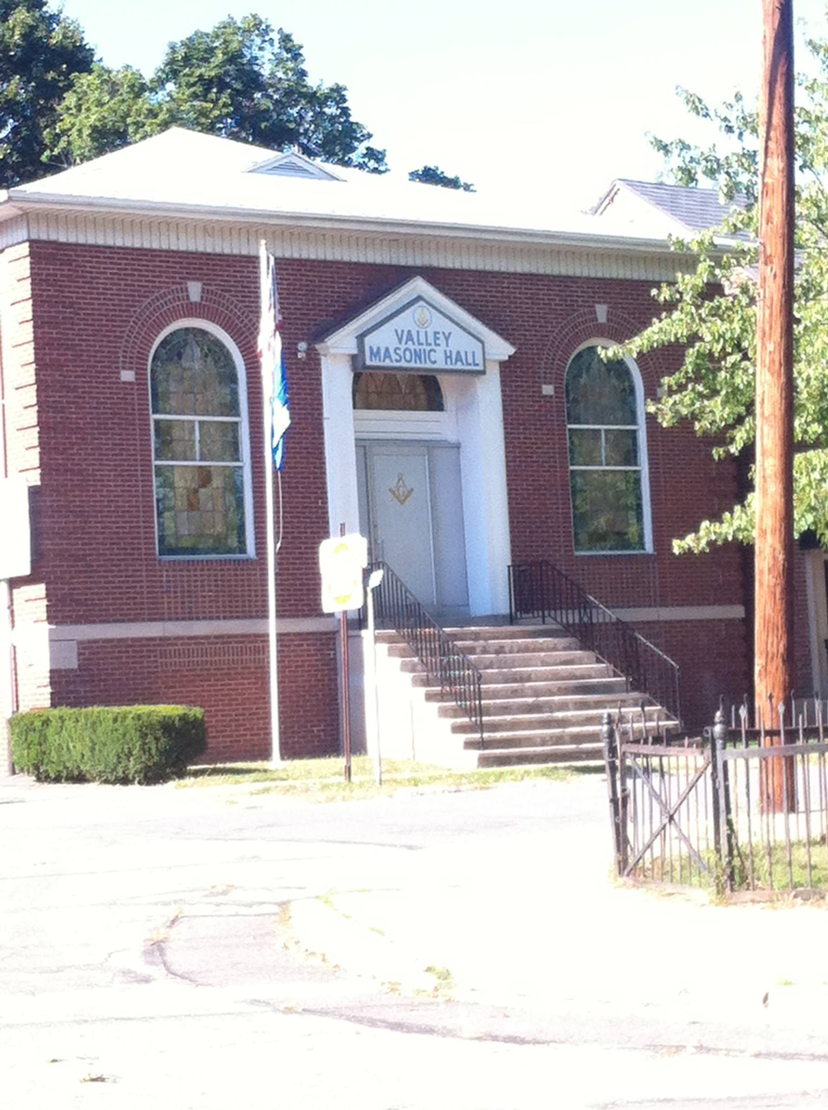
Notes:
In North America:
Unfortunately, in North America only fragments of published railway connections can be found.
Valley Lodge in West Pittston, Pennsylvania, was so named in 1871 because most of its original members were employed by the Lehigh Valley Railroad.
Image Source: https://www.facebook.com/people/Valley-Masonic-Lodge-499/100064320087276/?sk=photos

Slide 17
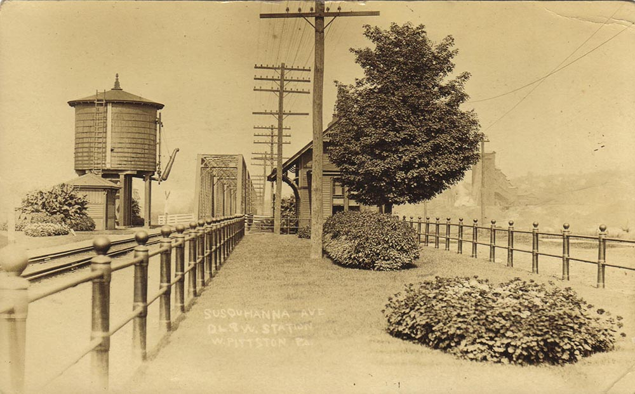
Notes:
Here for context, I have a couple old photos I found of the DL W Station on Susquhanna Avenue.
Image source: https://westpittstonhistory.org/wp-content/uploads/2018/03/9-DL_W-Susq.-Ave.jpg

Slide 18
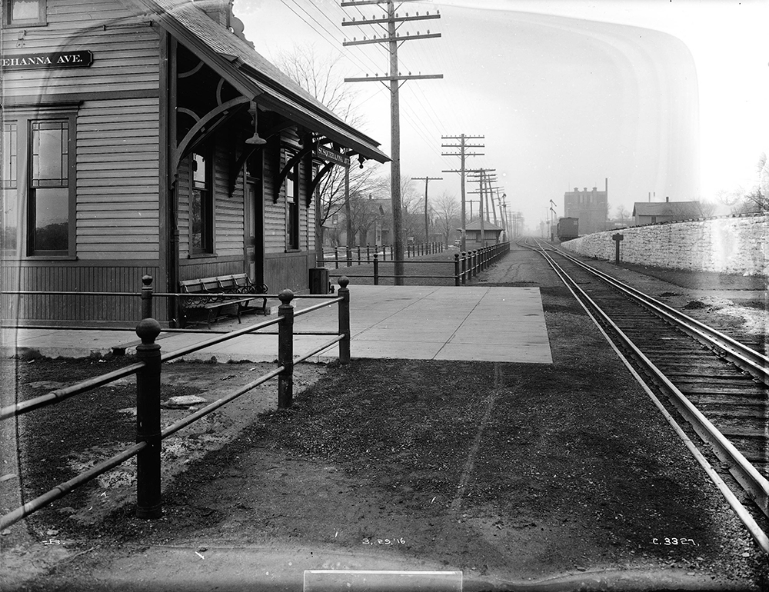
Notes:
Image source: https://westpittstonhistory.org/wp-content/uploads/2018/03/DL_W-Station-Susquehanna-Avenue.jpg

Slide 19
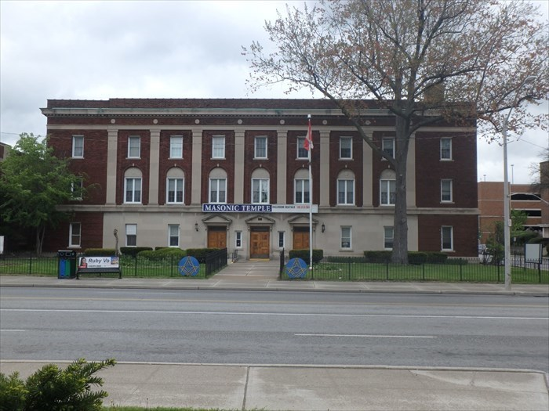
Notes:
In Canada:
Windsor, Ontario's first Lodge in 1854 was known as "Great Western Lodge". As was the case elsewhere, the arrival of the railway in Windsor caused the decline of smaller surrounding communities and in this case resulted in the closure of Rose Lodge in nearby Sandwich.
Pictured is the lodge today
Source: https://www.waymarking.com/waymarks/WMVZJ9_Great_Western_Lodge_47_AFAM_Windsor_ON

Slide 20
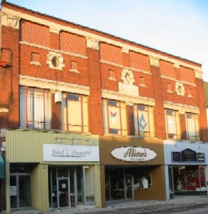
Notes:
Talbot Lodge No. 546 in St Thomas, Ontario was instituted in 1919 and became known as a railway Lodge because of the dominance of CPR and NYC railway workers as officers.
Image source: https://www.angelfire.com/ok3/Freemasonry/lodge/546.html

Slide 21
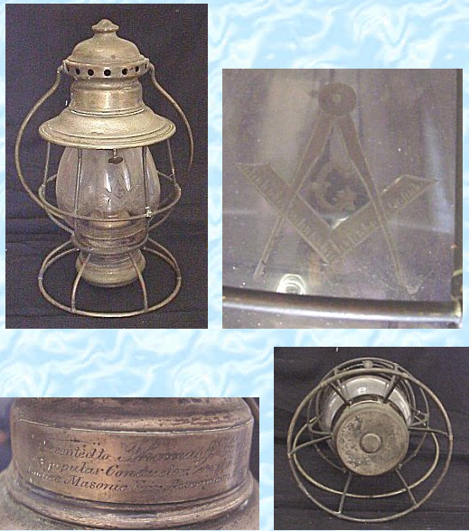
Notes:
Now to mention some out-of-the ordinary material showing the connection between railways and Freemasonry.
Here is a unique artifact from the Phoenix Masonry's Museum.
“This is a signal lantern that was presented as an award to the most popular conductor on the Baltimore and Ohio Railroad. It is marked: "Presented to Thomas J. Henrisc, as the most popular conductor on the B & O. R.R. by the Ladies Masonic Fair Association through Waverly Lodge." It was not unusual at the turn of the 19th century that you had to be a Mason in order to get a job with any railroad.
It appears to be silver or nickel plated. The Masonic square and compasses with the Letter "G" is etched on the glass. The lantern is tarnished and the plating is worn through in spots. It measures 11 ½ inches tall and approximately 6 inches wide at the base. This lantern recently sold on eBay for $650.+”
Source: http://www.phoenixmasonry.org/masonicmuseum/b_.htm

Slide 22
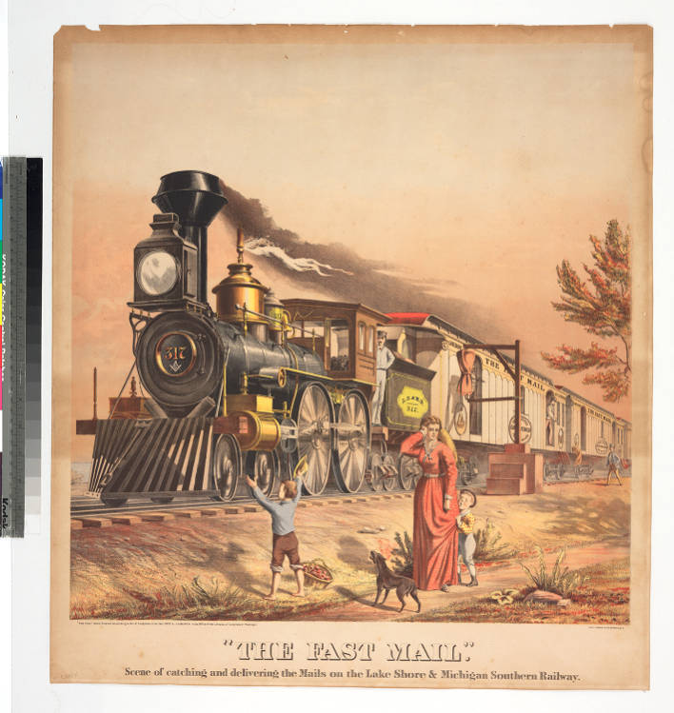
Notes:
Here we see a poster reproduction "Mail Carrier of the Lake Shore and Michigan Southern Railway". The locomotive shown on the posters has the Square and Compasses on the nose, but there is no information about the source.
Image source: https://hdl.huntington.org/digital/collection/p16003coll4/id/1491/

Slide 23
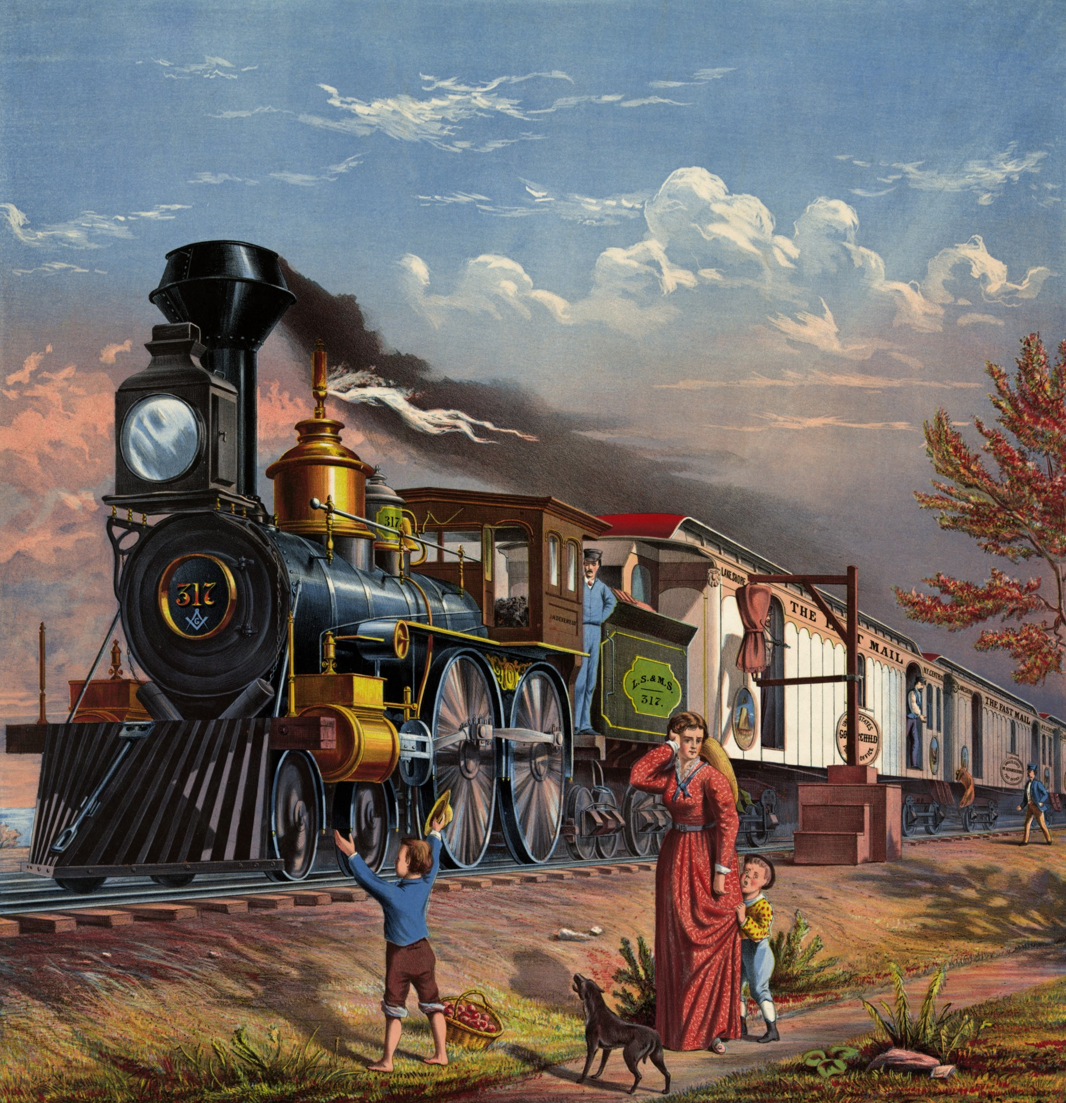
Notes:
Free online jigsaw puzzle to solve! https://www.jigidi.com/solve/thelclpm/just-a-fun-puzzle-l-s-m-s-317-mail-train-painting/
This image source: https://www.publicdomainpictures.net/en/view-image.php?image=76636&picture=the-fast-mail-train

Slide 24
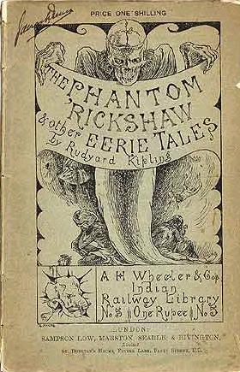
Notes:
And of course, there is a railway connection in Rudyard Kipling's "The Man Who Would be King".
At first this statement confused me until I found the original cover online.
First published in India in 1888, by Allahabad: Messrs. A.H. Wheeler & Co. Notice the connection to Indian Railway Library No. 5
The short stories collection contains the first appearance of 'The Man Who Would Be King' by Rudyard Kipling
If you are unfamiliar with the work, check out the plot summary on Wikipedia which mentions how Freemasons are connected to the story.
Source: https://en.wikipedia.org/wiki/The_Man_Who_Would_Be_King
“Rudyard Kipling was well-known for his poems and novels, including The Jungle Book. He was awarded the Nobel Prize in Literature in 1907.
He was born in India in 1865 and later lived in the UK. Kipling was initiated at the age of 20 in the Lodge of Hope and Perseverance No. 782 in Lahore in 1886.
He was immediately appointed the Lodge's Secretary because, as a young journalist, he possessed a typewriter. He later joined the Lodge of Independence with Philanthropy No. 391 in Allahabad.
Involved in the War Graves Commission after the First World War, he was a founder member of both Builders of the Silent City Lodge No. 12 (Grand Loge Nationale Francais) in St. Omer, France, in 1922, and Builders of the Silent Cities Lodge No. 4948 in London in 1925.”
Source: https://www.ugle.org.uk/discover-freemasonry/famous-freemasons/rudyard-kipling

Slide 25
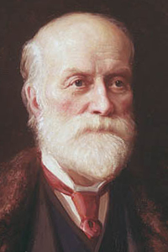
Notes:
Now here are some other Famous Freemasons who have connection to Railroading:
Sir Sandford Fleming, Canadian engineer and inventor mainly credited with creation of Standard Time Zone. (he developed this system due to the fact he missed a train, the schedule said 6 but made no reference to A.M. or P.M.) He also engineered much of the Canadian Pacific Railroad.
Image Source: https://freemasonry.bcy.ca/biography/fleming_s/fleming_s.html

Slide 26
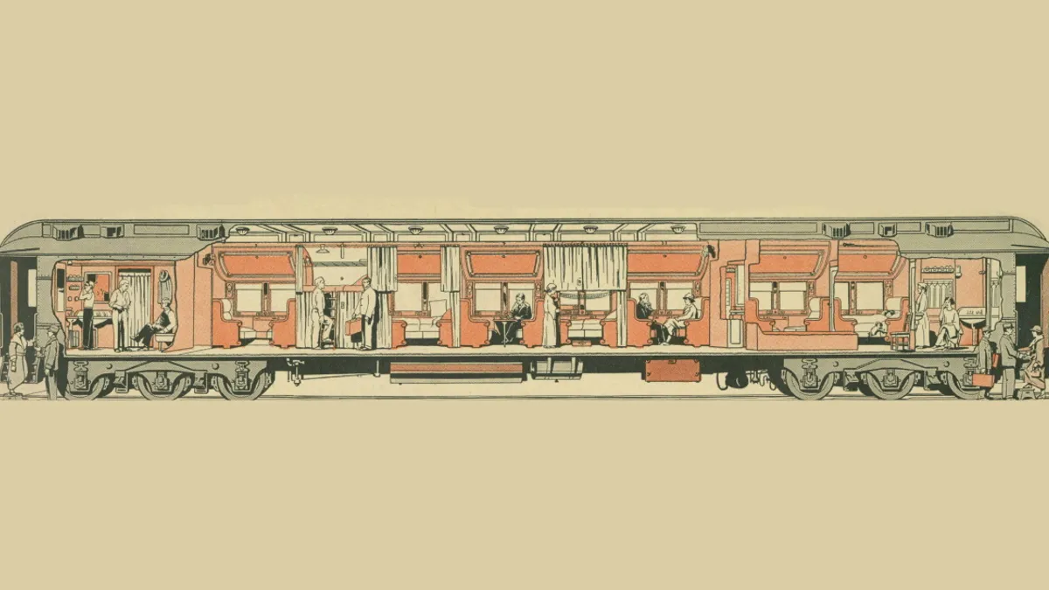
Notes:
George Pullman developed the Pullman sleeper car used on trains and also helped create jobs for a lot of former slaves by hiring them to serve on his cars as the well-known "Pullman Porter".
Image source: https://interestingengineering.com/innovation/engineer-george-pullman-inventor-of-sleeping-and-eating-on-trains

Slide 27
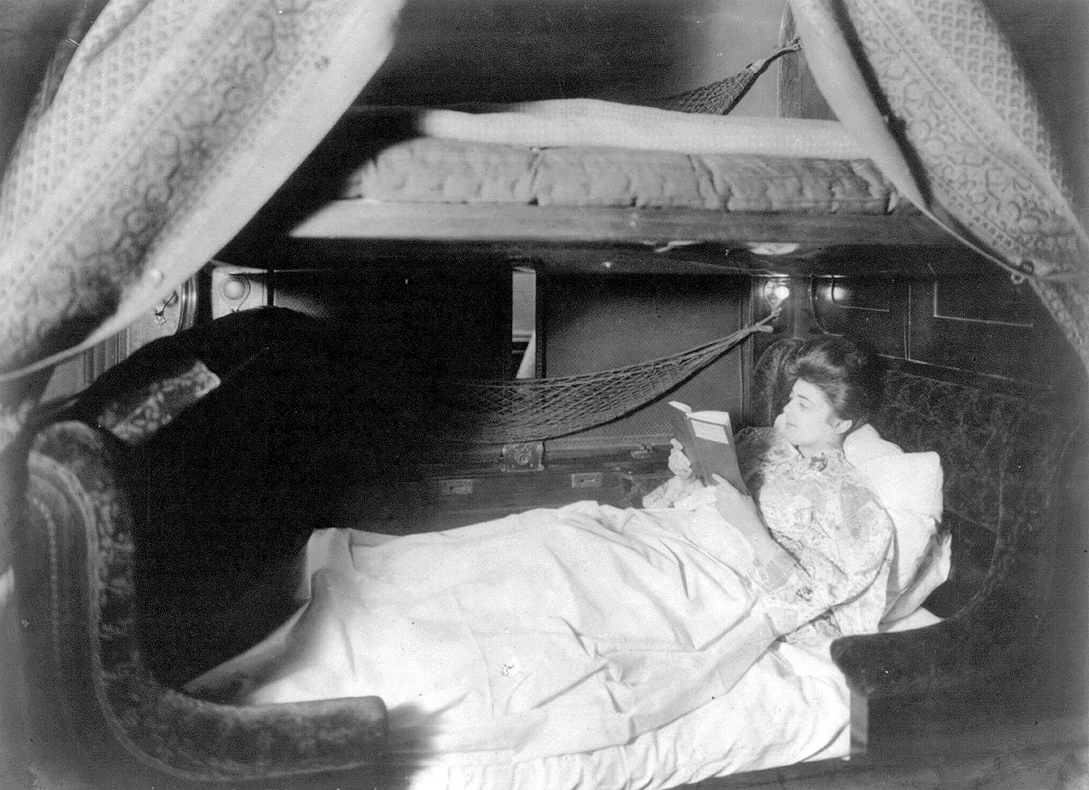
Notes:
Yes folks, you too can now travel in this type of luxury…or at least you could in 1909.
Image source: https://www.britannica.com/biography/George-M-Pullman

Slide 28
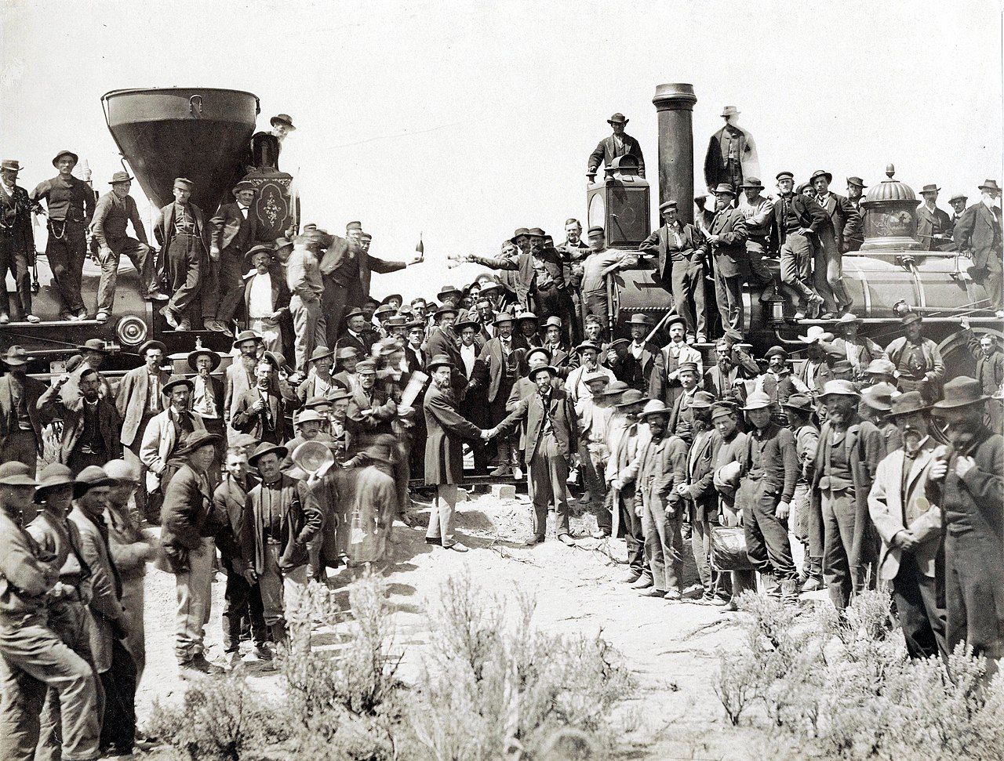
Notes:
And now let's travel to Promontory Point, Utah – it is May 10th, 1869 and a railroad from the East meets a Railroad from the West. A man named Leland Stanford drives a Golden spike linking East and West railroads and yes, my Brothers, a Mason linked the railroads on that date.

Slide 29
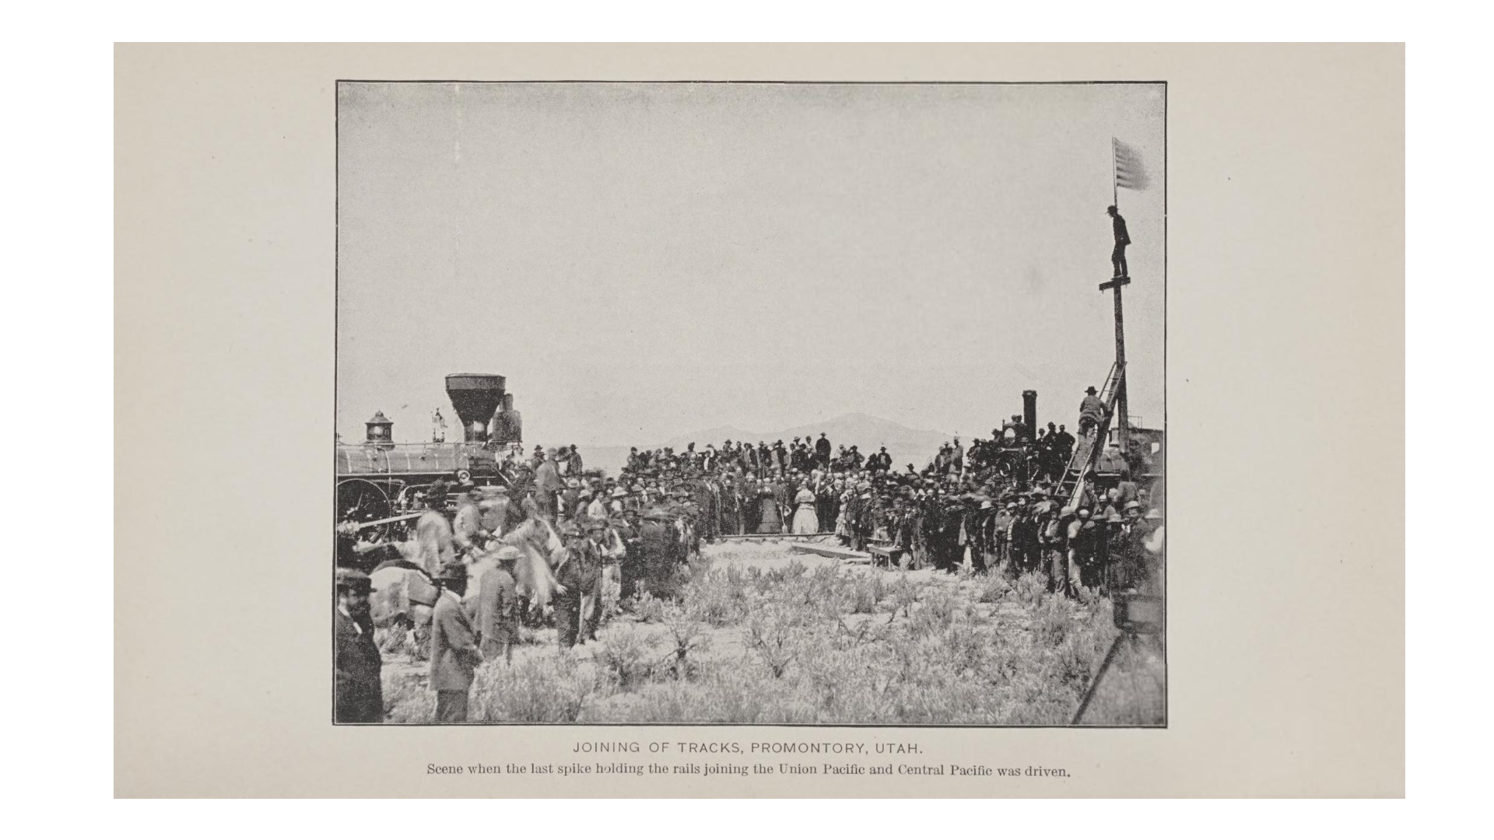
Notes:
I’ve always liked this moment in time, so I threw in an extra image for you.
Image publication: How we built the Union Pacific railway, and other railway papers and addresses
Image location: https://www.loc.gov/item/10035482/
Image source: https://www.loc.gov/resource/gdcmassbookdig.howwebuiltunionp00dodg_1/?sp=82&r=-0.103,-0.077,1.205,1.896,90

Slide 30
Conclusion
Notes:
So in conclusion, we can see that all around the world, Masons were greatly involved in the invention, development and spread of the railroads and further promoting and connecting members of the Craft to each other.

