Slide 1
The Lost Jewel
By Bro. Martin Jackson
Notes:
The source for this program is: https://www.thesquaremagazine.com/mag/article/202009the-lost-jewel
ARTICLE BY: Martin Jackson [some images added for context by Wor. Matt Duley]
Martin is a Freemason of 20 years, initiated into Scott M.L. 300 Coalisland, Northern Ireland.
He is also a member of Mark, Royal Arch and Knight of the East and West.
He is the designer, along with his brother Trevor, of the covers of several books by Masonic author Robert Lomas.

Slide 2
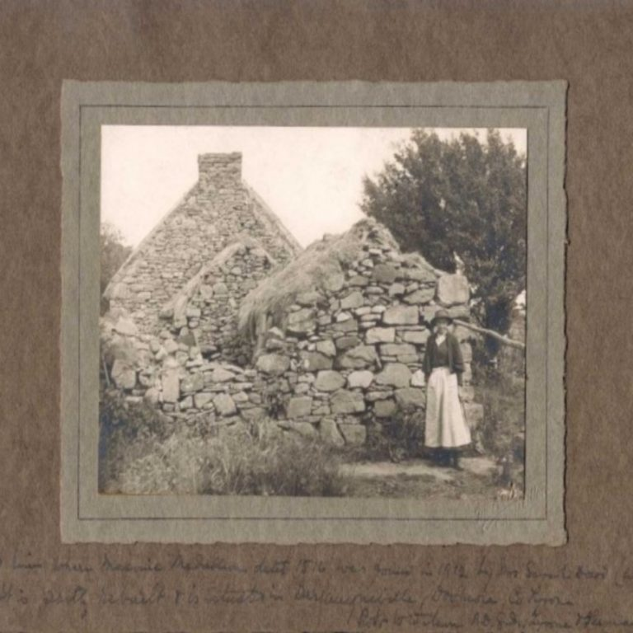
Notes:
SARAH DOWD AT HER HOUSE IN DROMORE, IRELAND.
IMAGE CREDIT: AUTHOR’S OWN COLLECTION
Like many Masonic researchers I can often be found rummaging through second-hand book shops looking for any works of Masonic interest.
One such fine bookshop is Barter Books in Alnwick, where I managed to acquire a dozen or so old books in one afternoon of haggling.
When I arrived home and flicked through the books, I was surprised to find three old photographs. The first of which can be seen here.
The writing at the bottom explains that the ladies name is Sarah Dowd, who found a Masonic jewel at this house in 1912.
The house, it explains is at Dromore and the jewel is inscribed with the date 1516. What exciting serendipity.

Slide 3
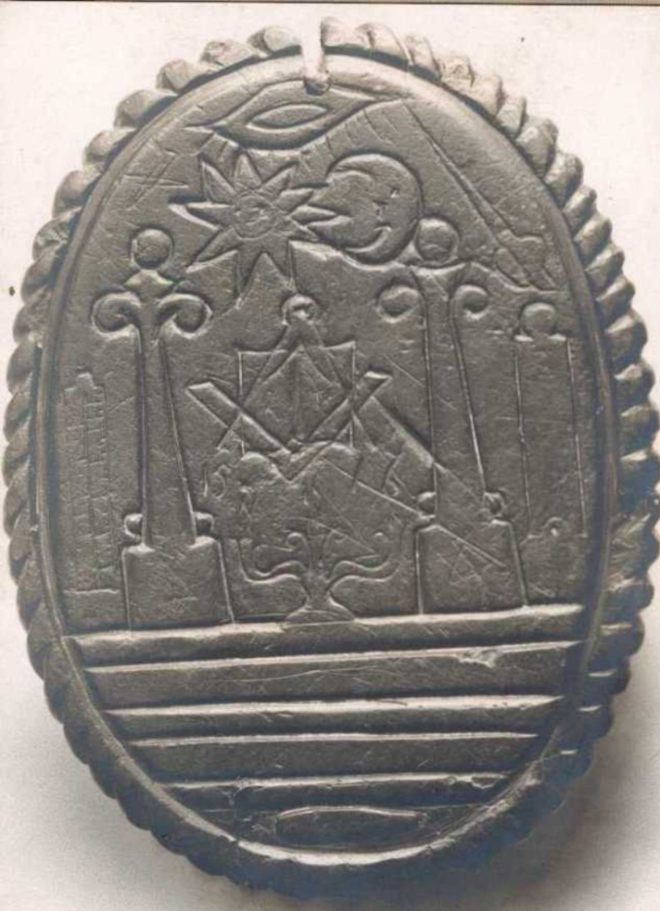
Notes:
JEWEL FRONT – WITH CRAFT SYMBOLISM
IMAGE CREDIT: AUTHOR’S OWN COLLECTION
The second photograph is one face of the Masonic jewel which Sarah found. As you can see it is covered with Craft symbolism.
You can see two pillars, celestial/terrestrial… three great lights…sun/moon…three lesser lights…seven steps, and interestingly a coffin.
Some insist that the Third Degree is a modern contrivance, but this would indicate otherwise.
There is, however, a correction to the original date on the jewel of 1516.
As you can see the error is due to the fact that the third flame of the lesser light has been mistaken for the circular base of the number ‘6’.
The actual date is 1517. Not that 12 months is of great importance with an item nearly 500 years’ old.
Those of you in the know understand the importance of this. A Masonic jewel existing 200 years before Grand Lodge! Not possible.
How can Freemasonry exist without Grand Lodges collecting money for charity and doing clerical work?
Well as you will see in the next image it operated very nicely thanks very much.

Slide 4
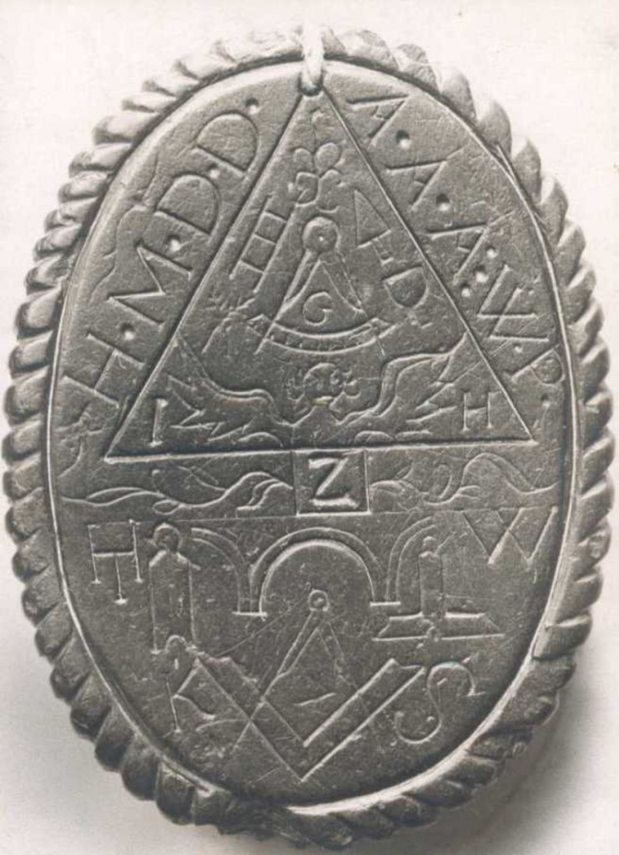
Notes:
JEWEL REVERSE WITH ROYAL ARCH SYMBOLISM
IMAGE CREDIT: AUTHOR’S OWN COLLECTION
This is the reverse image of the jewel. As you can see it is covered with Royal Arch symbolism.
This again will require a rewrite of the history books. Royal Arch has its earliest reference as Yaughal, County Cork 1743.
This evidence is hundreds of years earlier. Showing that it was well established with all of its esoteric symbolism.

Slide 5
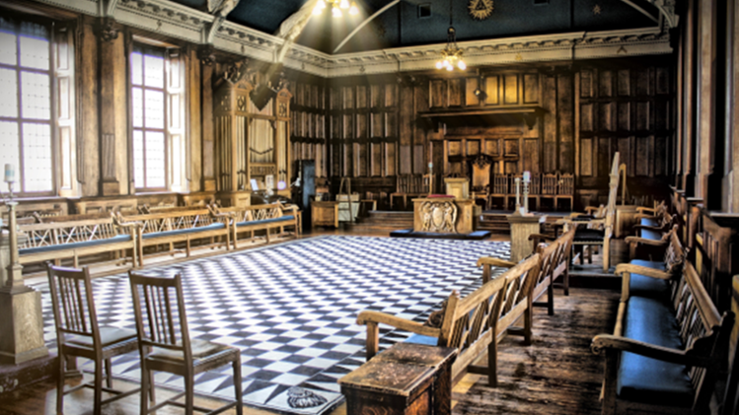
Notes:
[Image of Aberdeen Lodge in Scotland has been added for context. Source https://aberdeenno1ter.com/]
As an interesting aside associated with the period of time between the Kirkwall Scroll (1480) and the jewel (1517), I would like to include a comment by Dr Robert Lomas.
Bro. Robert explained that he had recently came across minutes of a lodge in Aberdeen dated 1490, which stated that the W.M. Alexander Stewart had been appointed as Alderman for the City of Aberdeen.
The minutes note that he was appointed to the esteemed post of alderman because he was the W.M. and that he was the W.M. because he was an esteemed city alderman.
Each position complemented the other. This fact should cast doubt on the romantic speculation that our Craft originated with bands of itinerant brick layers.

Slide 6
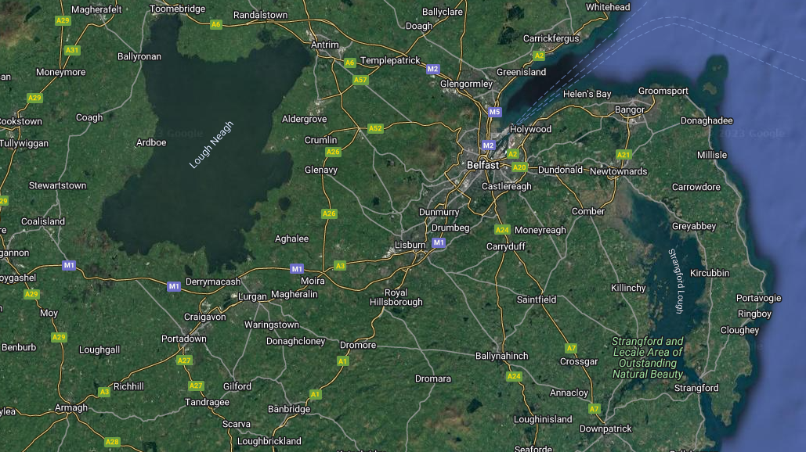
Notes:
[Image from Google has been added to this presentation for context. Dromore is located on the A1 southwest of Belfast]
I took the notion to find out more and went to Dromore in County Tyrone.
I enquired in the post office if any Dowds still lived in the town and was given directions to a terraced house.
At the house I met an elderly lady who confirmed that the Sarah Dowd in the photo was in fact her mother-in-law, but she had no idea of the location of the house where the 1517 jewel was found.
I thanked her for her time and took a drive around Dromore to get a feel for where the world’s oldest Masonic jewel was discovered.

Slide 7
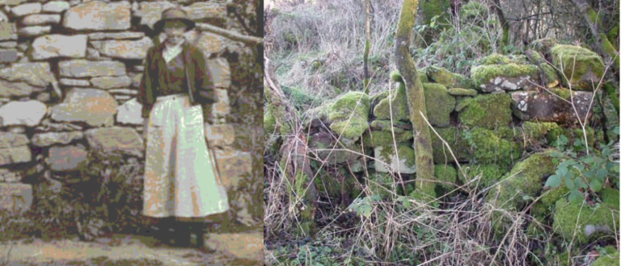
Notes:
LEFT: SARAH DOWD AND DETAIL OF THE STONE WALL IN DROMORE, WHERE SHE FOUND THE JEWEL
RIGHT: STONE WALL IN DROMORE, AS DISCOVERED BY THE AUTHOR
IMAGE CREDIT: AUTHOR’S OWN COLLECTION
I parked at the top of a brow so as to look back on the town and noticed this pile of stones on the other side of the hedgerow.
After clambering through brambles, I spotted a small section of dry-stone wall. [image on the right]
As you can see the irregular shape of one particular stone matches that in the 1912 photo of Sarah Dowd.
Looking closer you will notice that that the other stones match those in the photo.
So, the beautiful hand of serendipity had led me to the exact spot at which nearly 100 years earlier Sarah Dowd had discovered the world’s oldest Masonic jewel.

Slide 8
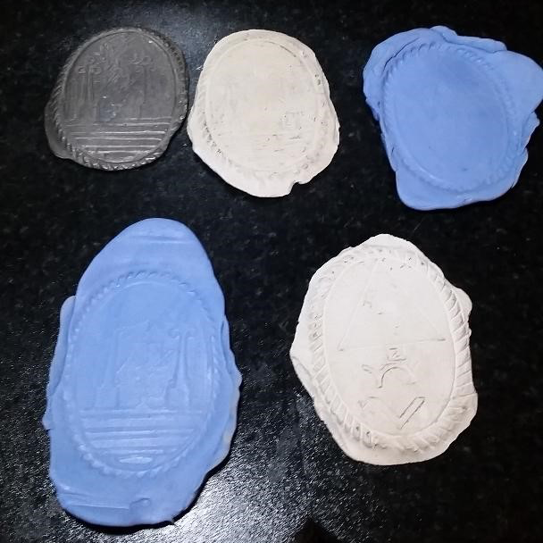
Notes:
SILICONE MOULDS TAKEN FROM THE ORIGINAL 1517 CLAY JEWEL
IMAGE CREDIT: AUTHOR’S OWN COLLECTION
But the story does not end there…
Sometime after discovering Sarah Dowd’s house, I visited a Masonic lodge in Ireland.
I was examining a cabinet filled with Masonic jewels when I spotted something at the back.
I called over another Brother who was familiar with the story of the jewel.
I pointed at a dark object at the back of the cabinet and asked ‘is that what I think it is?’ He then confirmed it was the original 1517 clay jewel.
Through various means, I obtained the keys to cabinet and returned with a silicone moulding kit, with which I made copies of the jewel. I then, of course, returned it to its rightful place.

Slide 9
Conclusion
Notes:
In conclusion, I chose to present this program to you for several reasons.
It highlights Masonry elsewhere in the world and it illustrates the rewards of being curious about the Craft and pursuing your own lines of inquiry into our deep history.

