Slide 1
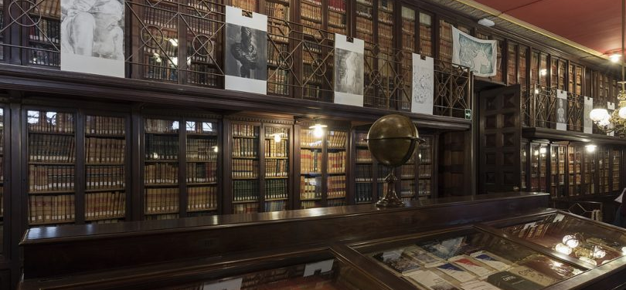
Rossend Arús Masonic Library
Barcelona, Spain
A once-secret library of Freemason history in Catalonia
Notes:
DURING THE 19TH CENTURY, THE FRATERNAL order of Freemasons had lodges in practically every European-influenced country. Spain was no different, though the traces of the Freemasons are mostly hidden now—apart from this once-secret library.
Barcelona, much like London, Paris, Buenos Aires, or Washington D.C., has an extraordinary artistic and architectural heritage based in Freemasonry. Masonic symbols like pyramids and the all-seeing eye can be found in cemeteries, libraries, sculptures, even government buildings. Passeig Sant Joan (“Saint John Avenue”) is devoted to Saint John, the chosen patron of Christian Freemasons. Ildefons Cerda, the urban planner who designed Barcelona’s layout, was a member, and imagined a utopian city based on Masonic principles. At the turn of the century, there were nearly 170 Freemason lodges in Spain alone.
Rossend Arús was an influential journalist and playwright of the 1800s who used his Freemason associations for republican political favor. Along with his fellow Masons, Arús had control of the city from behind the scenes. He began to host meetings in his home in 1888, and it soon became an official Masonic Temple. After his death in 1891, the house was turned into a library dedicated to Freemasonry.
During Franco’s regime, almost every Freemason building was torn down and the Masons were prohibited from meeting. Like many fascist leaders, Franco feared uprising from independent organizations, as well as having misplaced antisemitic beliefs about the Freemasons’ purposes. Some in power sympathized with the Freemasons though, and the Rossend Arús library was shut down and hidden from view during the Franco years. After the dictator’s death and the end of his regime, Freemasonry slowly but surely crept its way back into Spain.
After timidly growing less and less private and secretive, the Freemasons of Barcelona have opened Biblioteca Publica Rossend Arús to the public in Passeig Sant Joan. The luxurious reading rooms, golden frames, and precious marble of the 19th century still impress visitors. The collection includes important Masonic texts, as well as anarchist collections and rare magazines and literature. The third original version of the Statue of Liberty also resides in the main entrance. Today, the Rossend Arús is the best library for studying the working class history and Freemasonry in Catalonia.

Slide 2
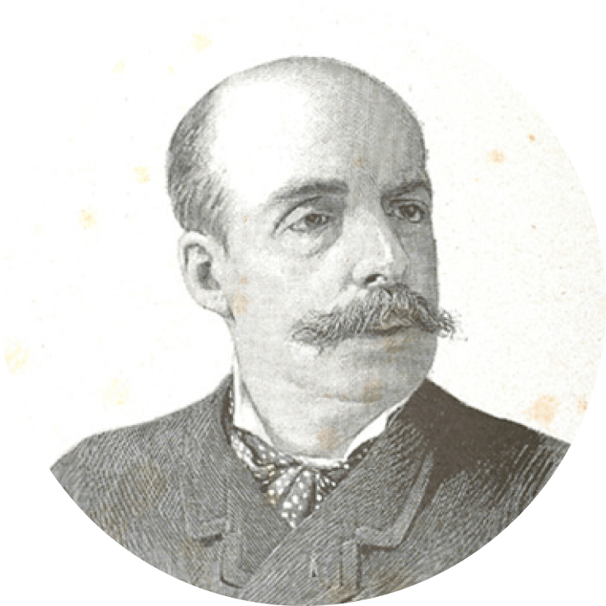
Notes:
ROSSEND ARÚS
Barcelona, 1844 – 1891
Rossend Arús was born in Barcelona in 1844. His father, Pere Arús Cuixart, was a prominent trader of colonial goods, particularly textile industry dyes, who came from a wealthy family from l’Hospitalet de Llobregat, whereas his mother, Teresa Arderiu Pons, came from Das, a little village in the Catalan Pyrenees. Arús was good-natured and cheerful, yet had a sharp and sarcastic demeanour, which spurred his avid defence of democracy, federal republicanism, left-wing catalanism, freethinking and Freemasonry. He also was a philanthropist and generous benefactor who sought progress for those around him.
Source: https://bpa.es/en/the-arus-public-library/

Slide 3
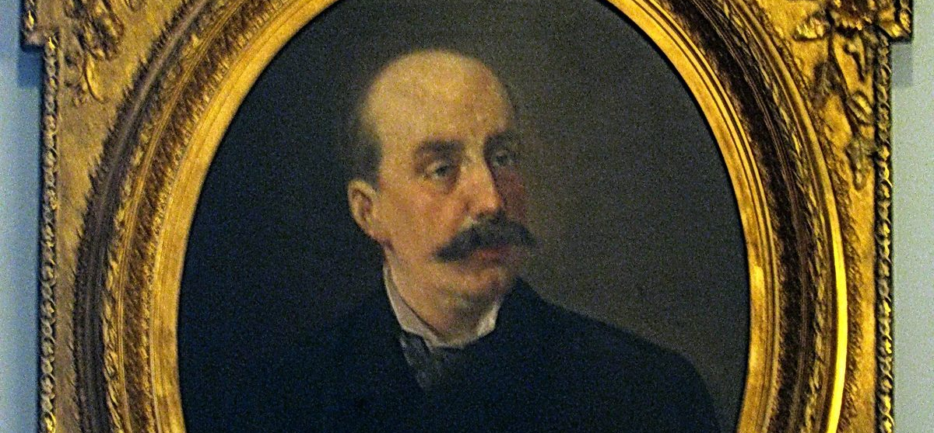
Notes:
Rossend Arús founded the library to teach workers how to read and write as, at the time, they did not commonly know how to.
The library website home page features the slogan: "The greater the enlightenment of a nation, the further it is from absolutism"

Slide 4
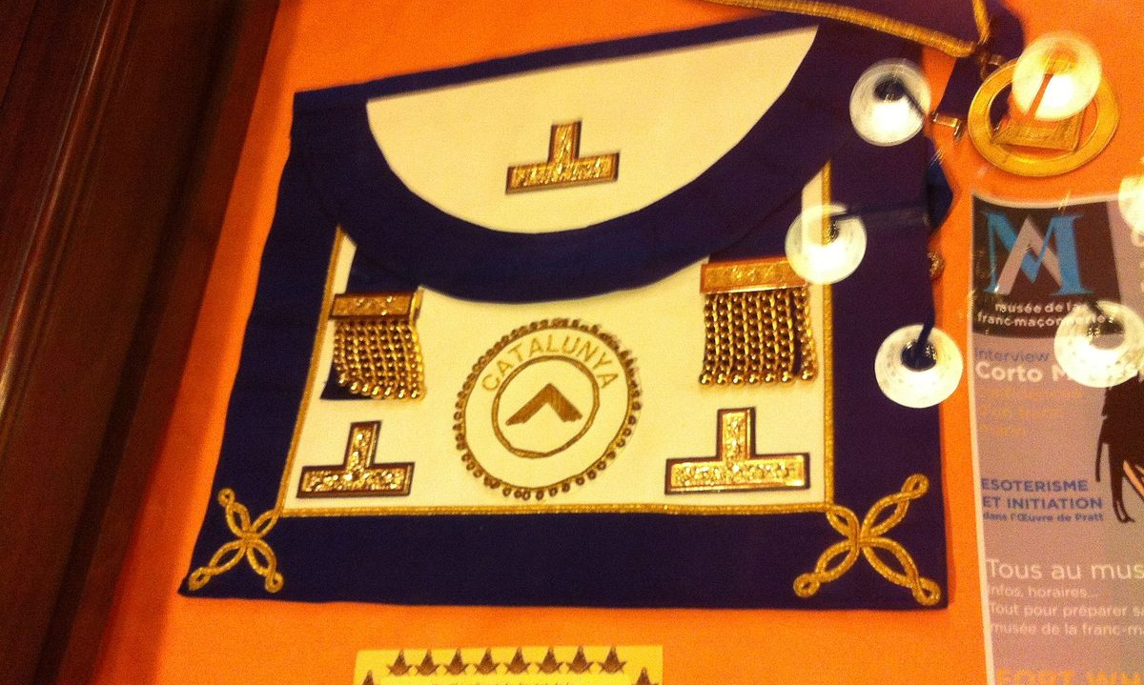
Notes:
Here we see one of the many Masonic artifacts in the library.

Slide 5
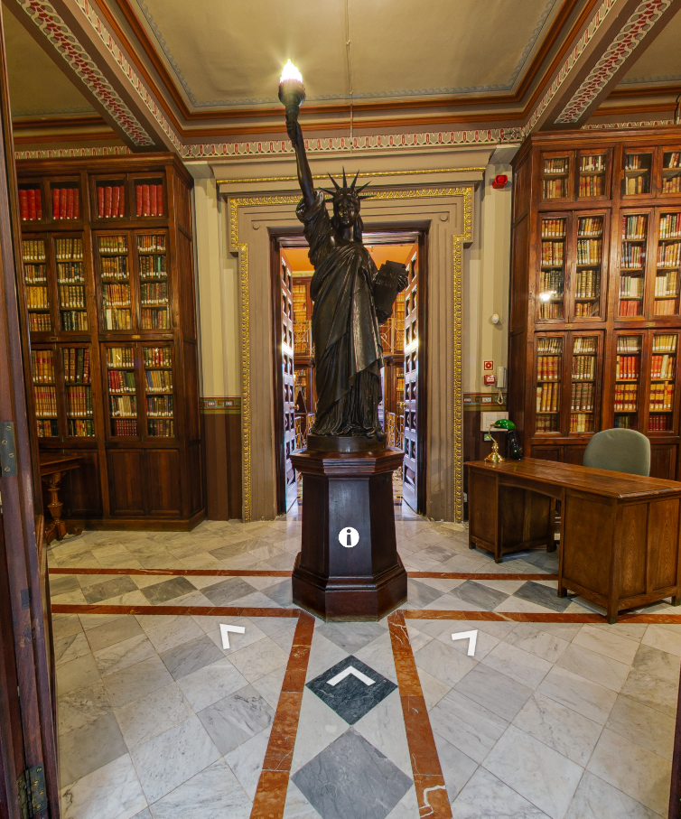
Notes:
Another asset of the library is one of the world's three original copies of the Statue of Liberty.
"Rossend Arús was not only the library founder but also a writer, journalist, poet, and playwright. But also a very passionate person in favor of a federal republic; for him, the US was the biggest federal republic at the time," …
"And as the US had a Statue of Liberty, so just before founding the library, Arús ordered to build one more similar to the one in Paris than the one in the US," he added.

Slide 6
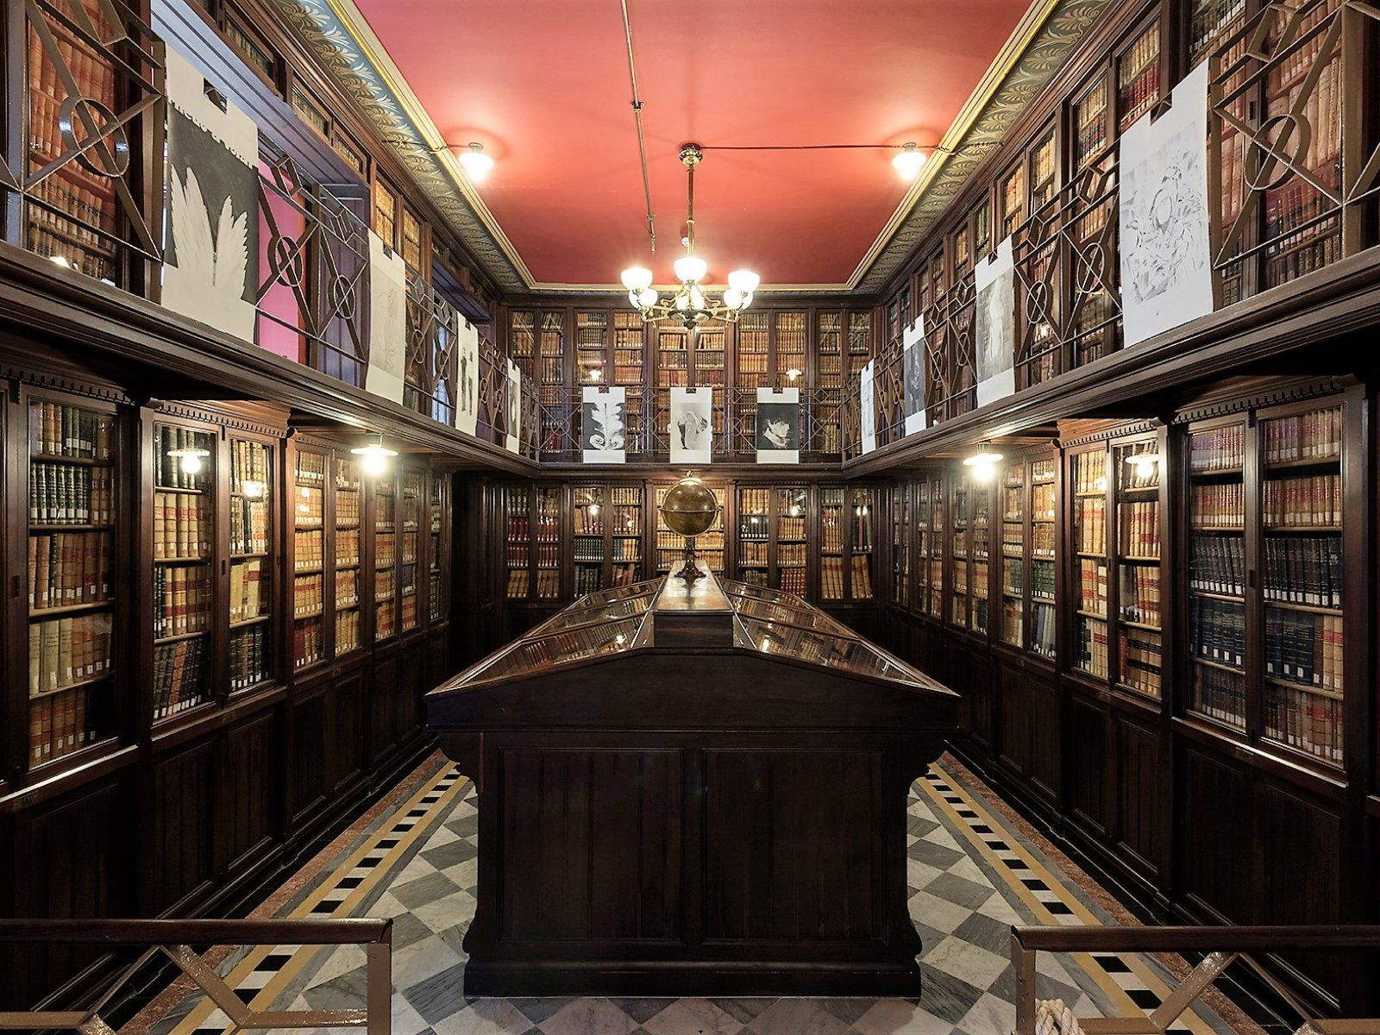
Notes:
Exhibition room
The room where the Arús Library’s collection is displayed. The current definition of the Arús Library is that it is a specialised research Library. The Arús Library had 3 objectives: to educate, inform and distract. For eighty years, it was a general library of public access, which doesn’t mean that it was the city’s first public library. However, it was the first modern library, of general access to modernity, which was expressed in relevant points: it had an exhibition room from the very first day where the most emblematic pieces or important documents in printing history were displayed.
Here is a collection of 70,000 books on the purpose of Masonic movements and ancient manuscripts, as well as other fiction.
The library has 82,000 volumes, but it spent years closed because of the Francoist regime in Spain. It closed in 1939 "to protect what it had inside," Brunet said, as "there was a seizure order to get the books from the library and take them to Salamanca or even burn them outside, meaning that the library would have disappeared."
Almost three decades after, the library reopened in 1967, but with some complications.
The site held "complicated material for the time," as Brunet said, and if "someone came to the library, they had to register, risking the possibility of getting a book considered wrong for the time and being stopped on their way out [by someone] wondering what they did in the library."
"Not a lot of people came," he added.

Slide 7
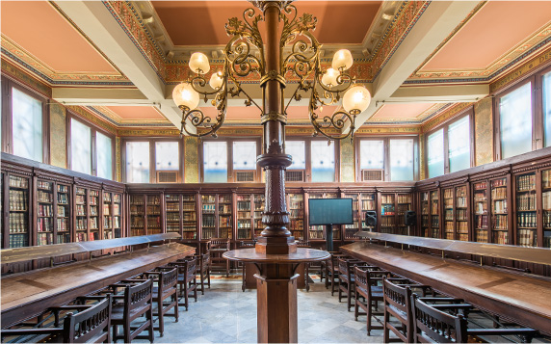
Notes:
The Reading Room of the library.
It is the original one from the Library. There are 9 panels on the ceiling that previously featured pictorial representations of museums, libraries and educational centres such as the British Library or the Vatican Library. The Arús Library was closed for 28 years and the paintings were lost. It was refurbished in the 1980’s but they were unrecoverable. Nowadays we could call this room the Knowledge Room. The objective of the owners of the Arús Library was to educate the popular classes. They promoted multidisciplinary education, knowledge; comprehension of reality is the only path towards freedom.
A prize will be offered to the first Brother of Freedom Lodge who sends me a screenshot of the author “Dickens” name found in this room.

Slide 8
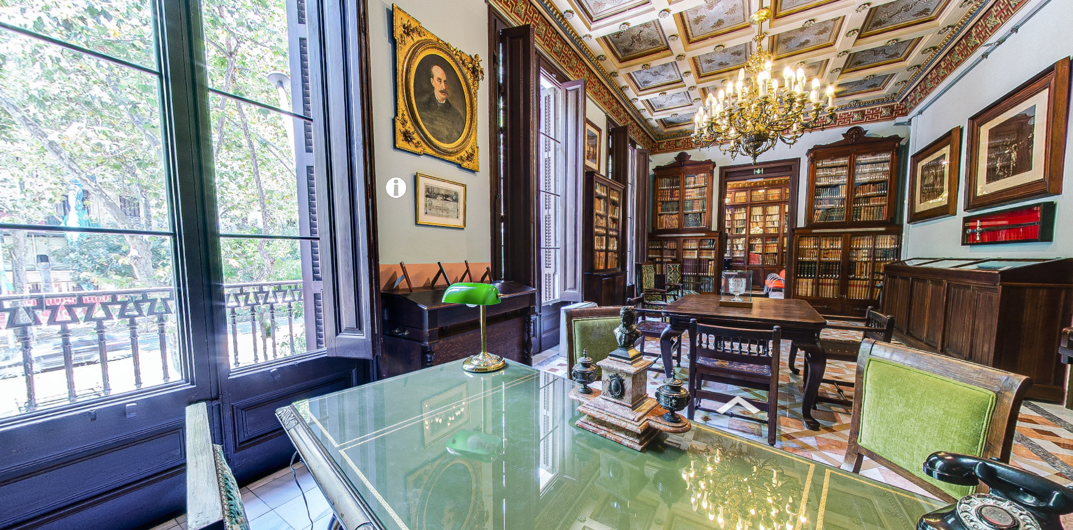
Notes:
Music room
It was originally a music room where users could come and play the musical scores. There is a piano and a harmonium, which is a wind and keyboard instrument. The room has been refurbished. It was a multipurpose room which also served as a conference room and is overlooked by the Venus de Milo.

Slide 9
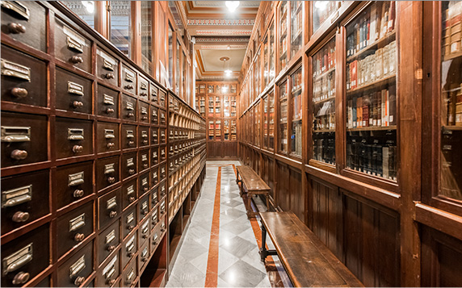
Notes:
Hallway
There is currently an exhibition of relevant books from the Arús Library’s collection. Reference must be made to the bathroom, which is large for the period, and is also public.

Slide 10
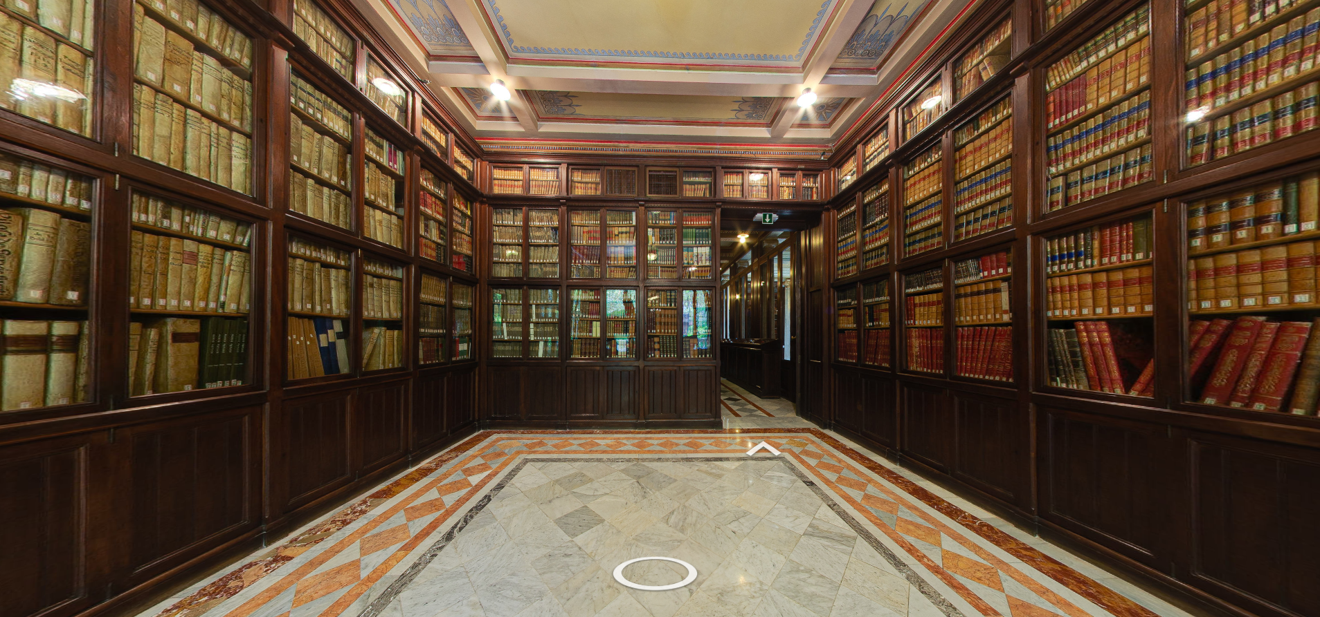
Notes:
Auditorium
This space is used for giving lectures.

Slide 11
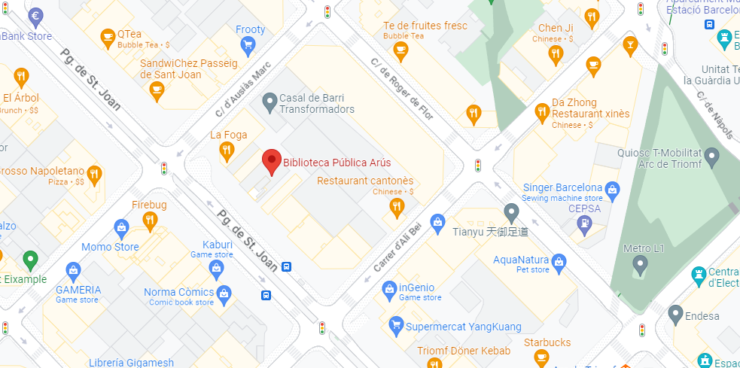
How to visit
Notes:
How to visit?
1. You can find the library in the Gothic Quarter at Passeig de Sant Joan, 26. 2. Do not hesitate coming in. It is free admission. To become a reader, buy a subscription (€20 for three years). You will also need two photos 3x4.
Location: Passeig de Sant Joan, 26 Phone: +34 932 565 950 Official website: http://www.bpa.es
When to do?
Monday, Wednesday and Friday 10 am to 3 pm
Tuesday and Thursday 3:30 p.m. to 8:30 p.m
Christmas, Easter and summer Check with the Library

Slide 12
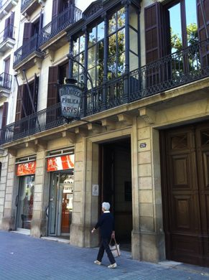
Notes:
This is what it looks like on the outside

Slide 13
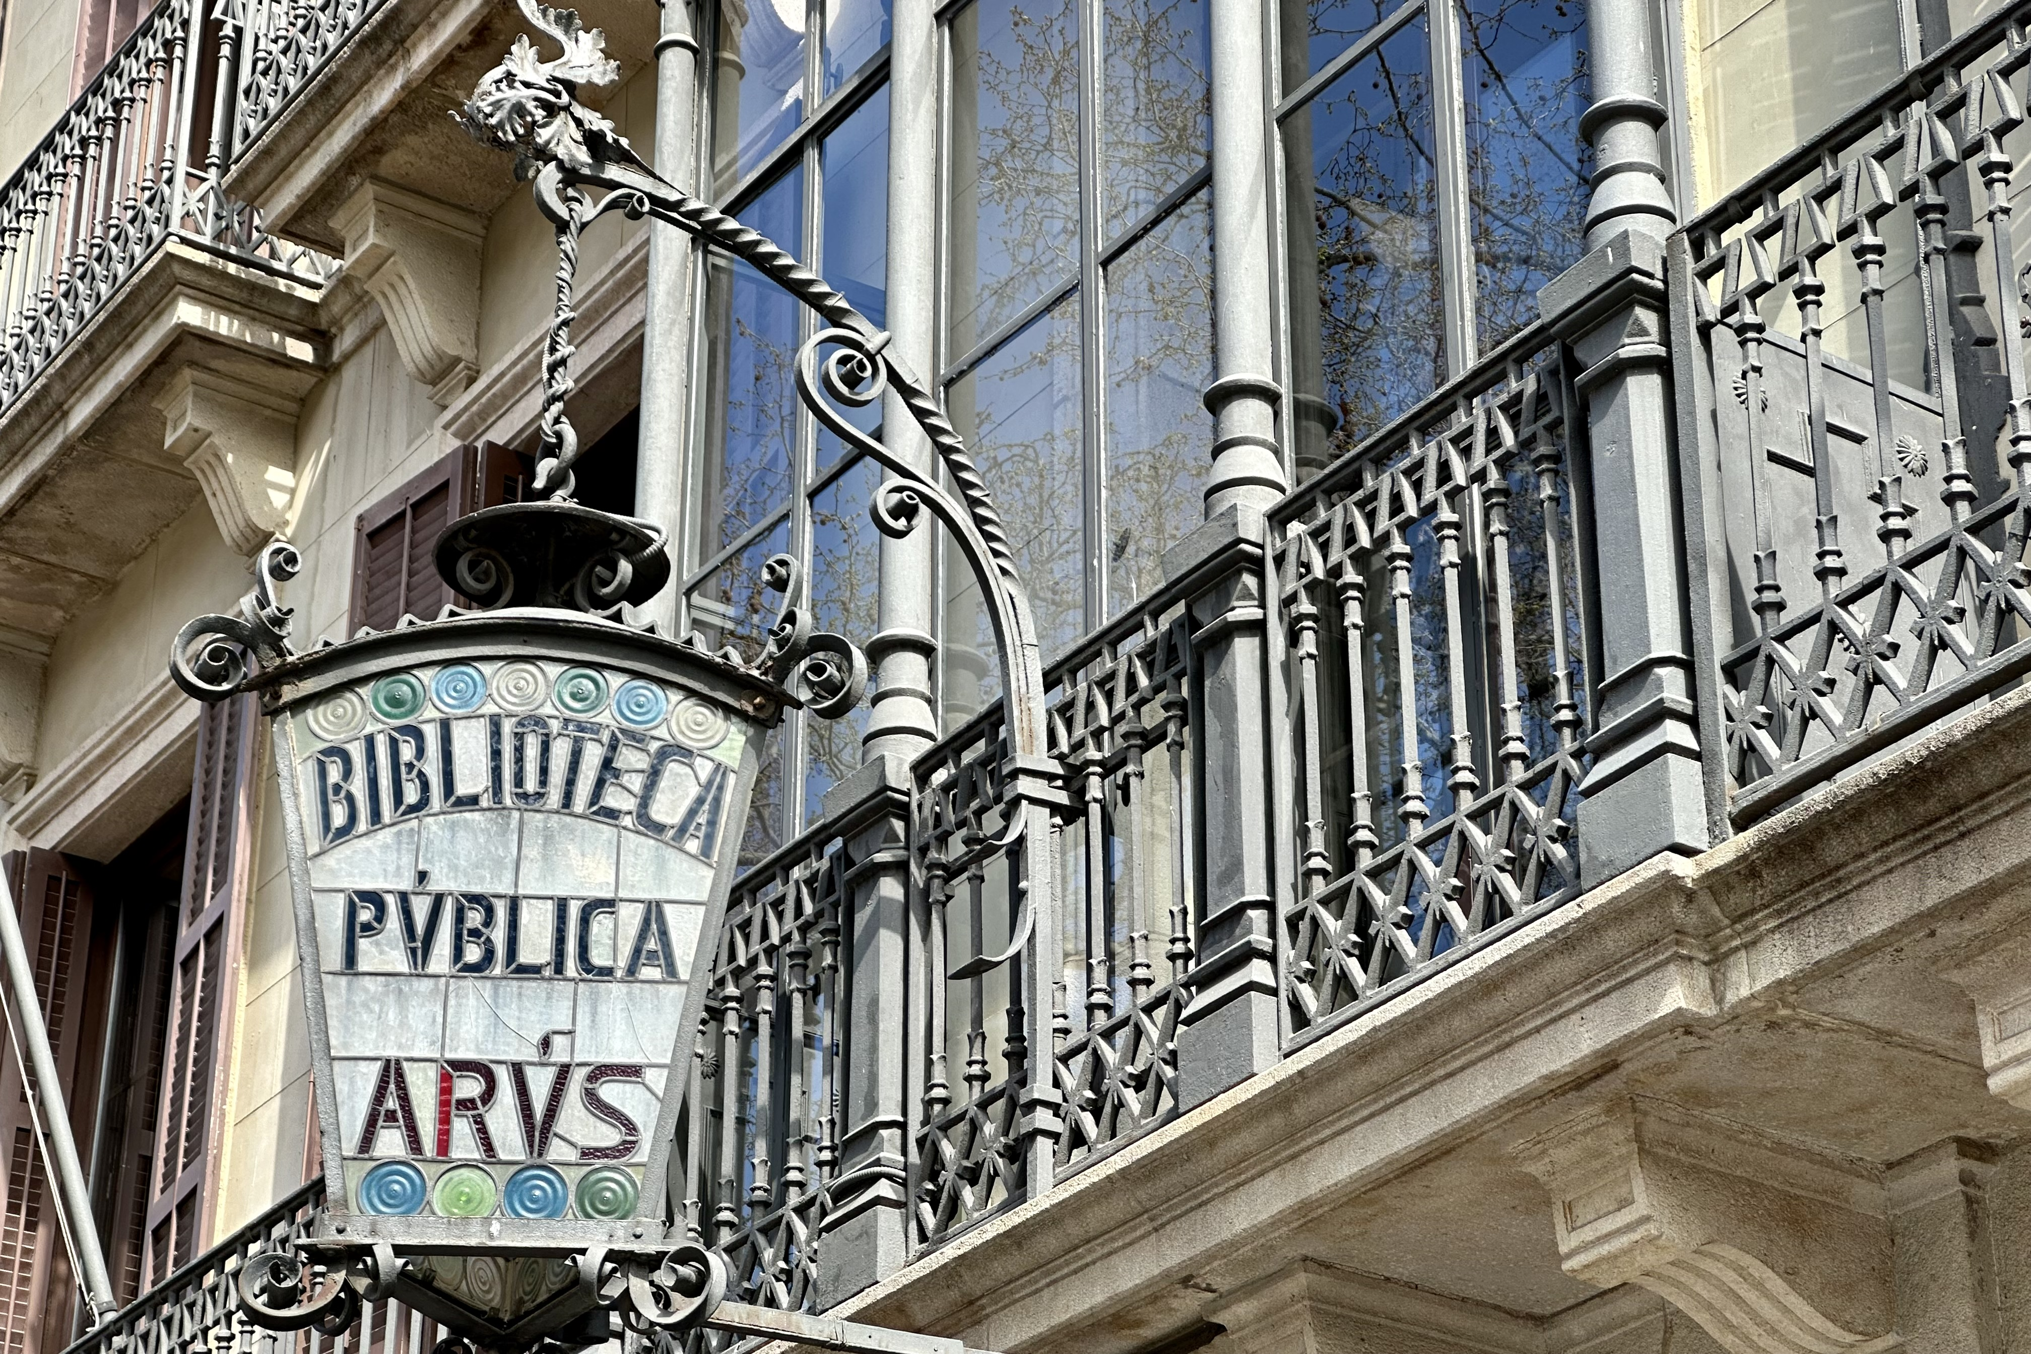
Notes:
You might not even notice the entrance so be sure to look for this stained glass lantern.
Image source: https://www.catalannews.com/culture/item/freemasonry-anarchism-and-sherlock-holmes-books-fill-biblioteca-publica-arus-shelves

Slide 14
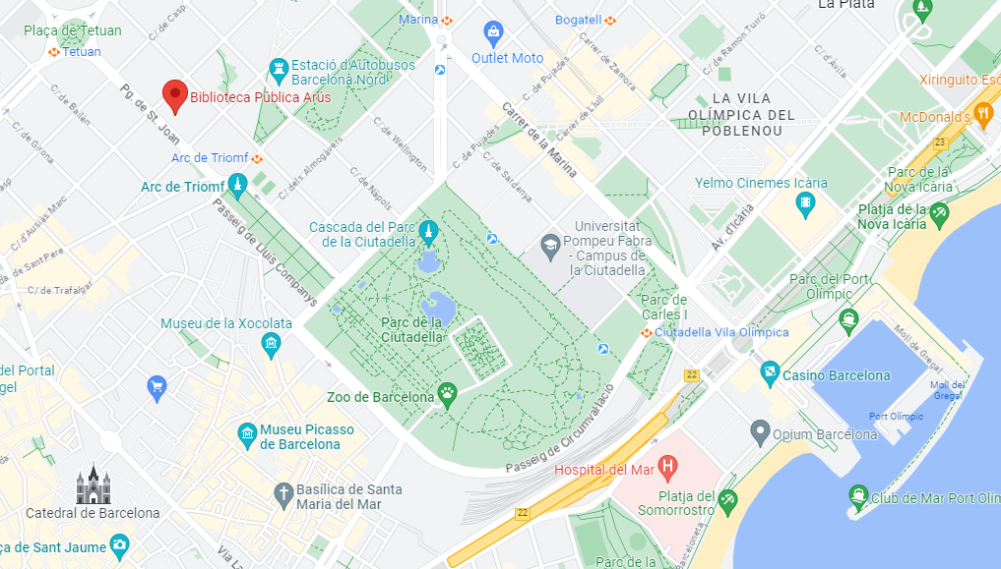
Location in context
Notes:
Here we can see it’s relation to the port, the zoo, the Ard de Triomf and two Metro stations.

Slide 15
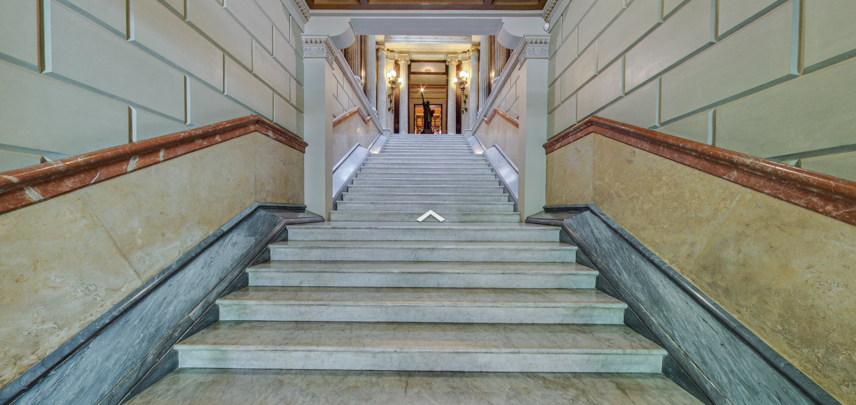
Visit virtually!
Notes:
The virtual tour can be found at https://bpa.es/visitavirtual/
The grand staircase references the Sanctuary of Athena in Greece, a sanctuary dedicated to freedom that ends with the reproduction of New York’s Statue of Liberty. A reduced reproduction with some differences: it doesn’t feature the broken chains around her feet and the inscription on the tablet that she holds in her hand which, in New York, features the date of independence, in Barcelona it says Alma libertas which means nourishing freedom, that protects, in other words it disassociates freedom from any historical event. The Arús Library is a space of freedom.
Scavenger Hunt! Offering 3 prizes, limit one per Brother.
I will offer a prize to the first Brother of Freedom Lodge No. 118 who sends me a screenshot of the Masonic apron seen hanging above a doorway somewhere in this tour! [No hints]
2. I will offer a prize to the first Brother of Freedom Lodge No. 118 who sends me a screenshot of the author “Dickens” name found in the Reading Room. [Hint: Look in Sala de Lectura]
3. I will offer a prize to the first Brother of Freedom Lodge No. 118 who sends me a screenshot of the Venus statue that overlooks the Music Room. [Hint: Look in Passadas 1]

Slide 16
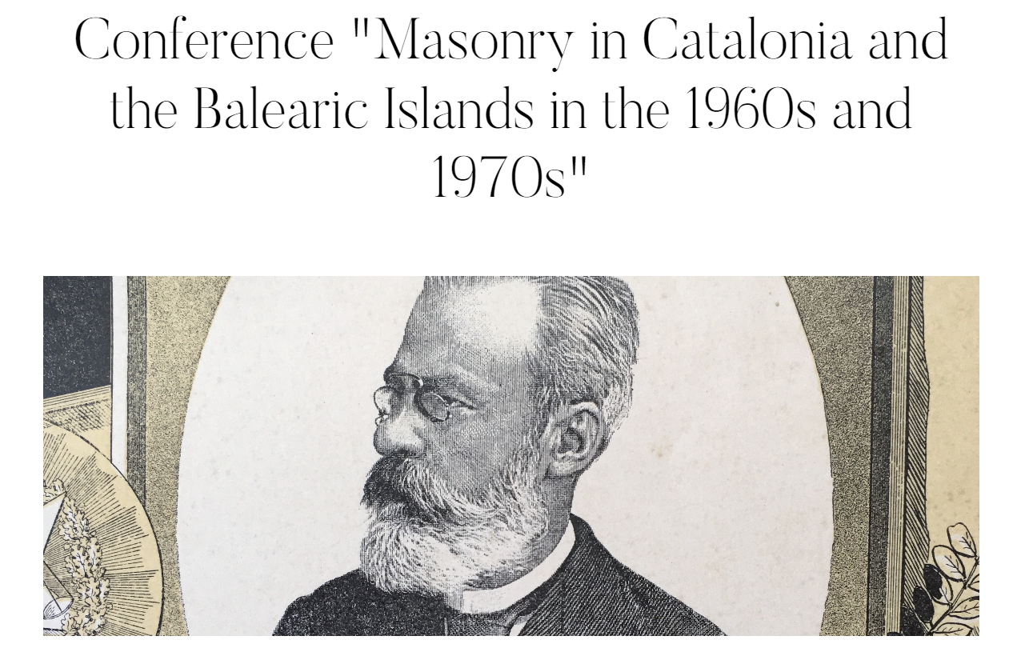
Notes:
From what I saw on the library website, they routinely offer programs of Masonic interest, such as this one from June of 2023.

Slide 17
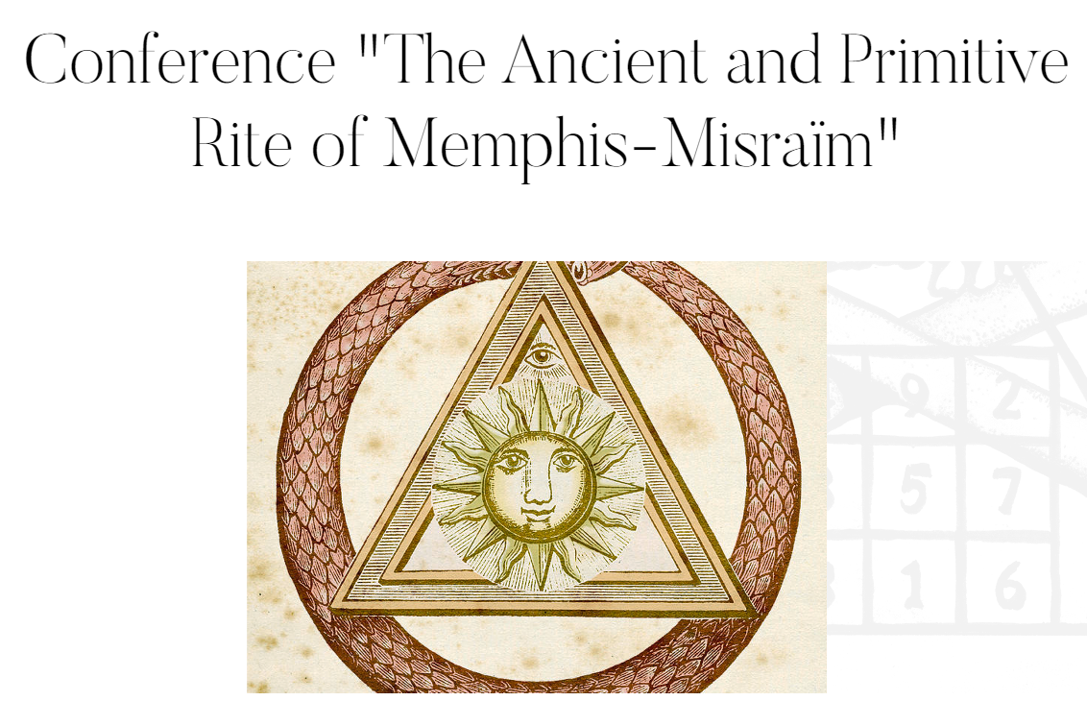
Notes:
Another program offered in June of 2023.

Slide 18
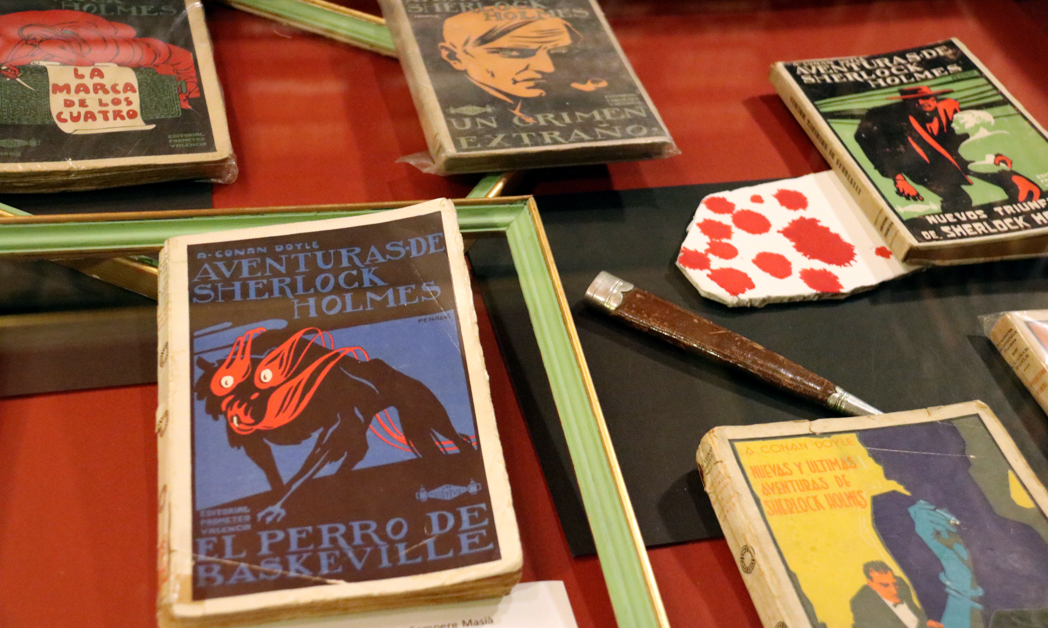
Notes:
Sherlock Holmes collection
This site also hides a Sherlock Holmes collection with up to 15,000 items open to the public. Joan Proubasta donated the collection after a global event held in Barcelona in 2010 in honor of Arthur Conan Doyle's most famous character. At the time, members of the Holmes fandom dressed up as characters from the novels, such as the detective himself or even his archenemy, Professor James Moriarty.
After the event, Probausta was "fascinated with the library" and handed over his collection.

Slide 19
Conclusion

Slide 20
Sources
https://www.atlasobscura.com/places/rossend-arus-masonic-library
https://www.shbarcelona.com/blog/en/arus-public-library/
https://oddviser.com/spain/barcelona/library-visit
https://www.catalannews.com/culture/item/freemasonry-anarchism-and-sherlock-holmes-books-fill-biblioteca-publica-arus-shelves
https://bpa.es/en/the-arus-public-library/
https://casessingulars.com/en/las-casas/biblioteca-arus/

