Slide 1
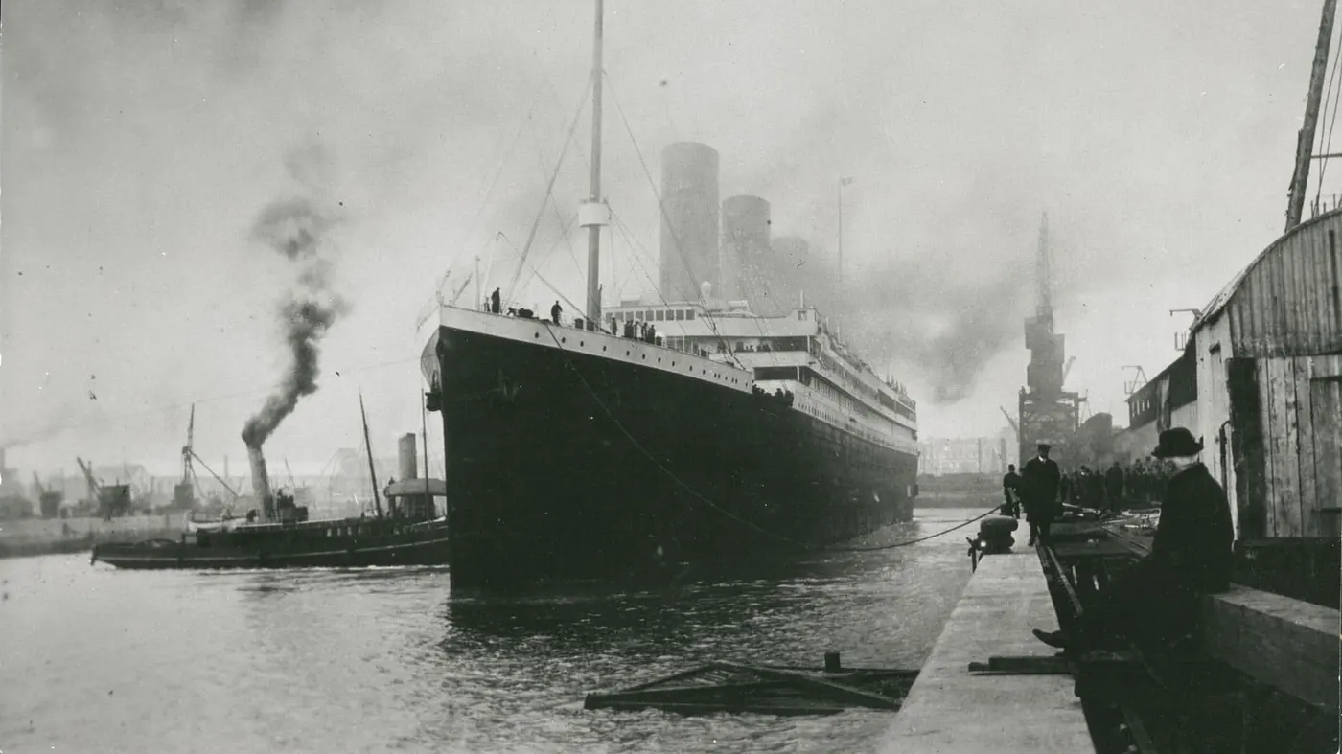
Notes:
“Masonic Connections to the Titanic” – produced by Wor. Matt Duley, Freedom Lodge No. 118
Introduction:
We began this year with a discussion on Masonry and railroads, so I figured it would be appropriate to end the year discussing Masonry and it’s connection to another mode of transportation.
I had seen an ad for a Titanic exhibit coming to Washington DC that had previously sold out in New York and London and I wanted to go see it.
That got me wondering about Masons that may have some connection to the ship.
I have essentially compiled several topics I came across into one, more comprehensive program which you will hear about this evening.

Slide 2
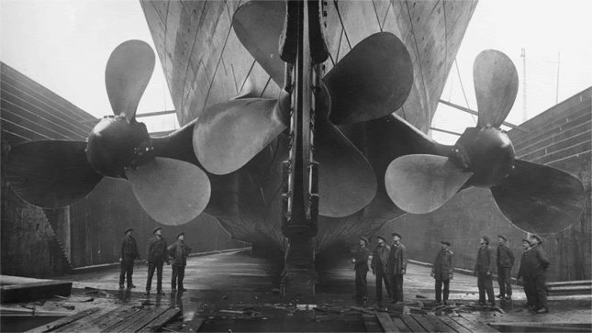
Notes:
[Note: This section contains excerpts from “The Midnight Freemasons: Freemasons on the Titanic” by WB E. Gordon Mooneyhan]
[image source: https://sites.google.com/view/oscarscottwoody]
I have always loved his image of the Titanic for the sense of scale that it provides.
We all know that the sinking of the Titanic was an epic disaster in which many people lost their lives, but “It was not the deadliest sinking ever; that dubious honor belongs to the Wilhelm Gustloff, when over 9,000 people died when she sank near the end of WW2.”
In researching Freemasons aboard the Titanic, WB Mooneyham indicates that “From what I have been able to find out, of the 2,240 passengers and crew on board, 29 were members of the Craft. Nine were in First Class, six in Second Class, three in Third Class, and the balance of thirteen were part of the ship’s crew, and there was one Brother who was an employee of the United States Post Office.”
“Let’s start with the Brothers who survived the sinking:
Doctor William Frauenthal was a First-Class passenger on the Titanic after returning from France where he had gotten married. His specialty was the treatment of chronic joint diseases, and he had established a clinic in New York City for the treatment of patients. He, his wife, and his brother were all in lifeboat number 7 when it left the sinking Titanic at about 12:40 a.m., approximately one hour after the ship struck the iceberg.
Elmer Taylor was a pioneer in the paper container industry. He designed and manufactured automatic machinery for moisture-proof food containers, and had begun the manufacture of paper cups in England under the name Mono Industries. He and his wife were in lifeboat 5 or 7. He died on May 20, 1949, in East Orange, New Jersey, and was buried with his first wife in Smyrna, Delaware.
Second Class Chief Steward John Hardy had been employed with the White Star Line for 12 years and had served on the Majestic, Adriatic, Olympic, Teutonic, and finally the Titanic. He retired to his room on Sunday, April 14, at approximately 11:25 p.m. His room was on E Deck, roughly amidships and he felt a slight shock a few minutes later. He was later roused by the Chief First-Class Steward who told him the ship was taking on water forward. He got dressed and made his way to the Boat Deck, assisting passengers in getting their life belts fastened. He reached his assigned station and assisted Second Officer Charles Lightoller in getting passengers on the lifeboats. Eventually, he would board Collapsible D and be saved by the Carpathia. He and his family later emigrated to the United States. He died in Maplewood, New Jersey on October 7, 1953.
Aragõa Harrison was a First-Class Saloon Steward on the Titanic. He had served in the Boer War as a Lieutenant in the Royal Field Artillery. He was assigned to lifeboat 15 at the time of the sinking. Once it was lowered away, he assisted passengers into lifeboats 11 and 13. He then assisted passengers in getting into lifeboat 9 until he was ordered to get into the lifeboat by First Officer William Murdoch.
Herbert Pitman was the Third Navigation Officer on the Titanic. At the time of the Titanic's collision with the iceberg, Pitman was off-duty, half-asleep in his bunk in the Officers' Quarters. He heard and felt the collision, later testifying that it felt like the ship "coming to an anchor." He was dressing for his watch when Fourth Officer Boxhall rushed in and informed him they had struck an iceberg and were taking on water. Pitman was then ordered to report to the starboard side of the ship to assist in uncovering lifeboats. After receiving the command to lower the boats, Murdoch ordered Pitman to take charge of Lifeboat No. 5. Before Pitman entered the lifeboat, Murdoch shook his hand saying "Goodbye; good luck." Pitman at this point did not believe that the Titanic was seriously endangered, and thought the evacuation of passengers was precautionary. He stepped into the lifeboat and it was lowered to the water. Murdoch had ordered Pitman to take the lightly loaded lifeboat to the gangway doors to take on more passengers there, but (as Pitman later testified) the doors failed to open as the lifeboat waited for this about 100 yards off from the ship. Up to this point, Pitman had expected the ship to remain afloat. After an hour in the lifeboat, however, he realized that the Titanic was doomed, and withdrew the lifeboat 300 yards further off from the descending ship. He watched the Titanic sink from about 400 yards distance, and was one of the few to state afterward in the official inquiries that he thought she sank in one piece. As the stern slipped underwater, he looked at his watch and announced to the lifeboat's occupants, "It's 2.20." Hearing the cries of those in the water after the ship had gone, Pitman decided to row back to them to rescue whomever he could. However, after announcing this course of action to the passengers in the lifeboat he was confronted with many protests from them against the idea, with the expression of fear that the lifeboat would be mobbed and capsized by the panicking multitude in the water. Faced with this Pitman acquiesced and kept the lifeboat at its station several hundred yards off while the passengers and crew in the water perished swiftly in the cold. The water temperature was estimated to be 28 degrees F and hypothermia would occur in under 15 minutes. In later life, Pitman admitted to bearing the burden of a bad conscience for his failure to take the lifeboat to the rescue of those dying in the water that night. He died of a hemorrhage on December 7, 1961, at the age of 84.
James Widgery was a Second-Class Bath Steward on the Titanic. He was assisting with getting passengers onto Lifeboat No. 9. He would leave on that boat after helping it to get filled almost to its limit.
Of the 29 Brothers on the maiden voyage of the Titanic, those six were the only ones to survive.
Starting with the First-Class passengers who did not survive:
Let’s look at businessman John Baumann and theatrical producer Henry Harris. In addition to being Masonic Brothers, they were also acquaintances. Baumann had helped out Harris during a time of need in 1909 and, in 1912, Baumann found himself in need while in London and Harris returned the favor. Both men were on the Titanic. While not much is known about their time on the Titanic, Baumann was last seen in the company of Harris after he had placed his wife on the last lifeboat to leave the ship. Baumann’s Will left his Masonic charm, watch and chain, and several other personal possessions to Mr. Harris. Both men would die on that fateful night in 1912.
John Brady was Vice President of the Pomeroy (Washington) Savings Bank. He had been on an extended European vacation and was concerned about being able to return home because of the coal strikes that were ongoing in the United Kingdom. He had also booked passage on a German-flagged vessel in case there wasn’t coal available for the Titanic. He was a member of the Pomeroy Masonic Lodge as well as the Commandery in Walla Walla and the Elkatiff Temple in Spokane.
Major Archibald Willingham Butt was a military aide to Presidents William Howard Taft and Theodore Roosevelt. His health was faltering because of his attempts to remain neutral in the quarrel between Taft and Roosevelt. He took six weeks' leave from the White House and went to Europe. He was returning on the Titanic with his close friend Francis Millet. There was a story that Major Butt had a daughter who was illegitimate and survived the sinking of the Titanic. When the facts of her story are looked at, it becomes clear that the story has no foundation in truth. The Millet-Butt Memorial Foundation was set up in their honor after the sinking.
Howard Case was born in Rochester, NY in 1863. He had moved to England around 1890 when he first appears on a census. He was in the oil business. It is believed that he was on a business trip to Standard Oil of New York when the Titanic sank. There are many accounts of Case helping women and children into the lifeboats before stepping away from the lifeboats to meet his own fate.
Alexander Oskar Holverson was born in Rushford Minnesota in 1869. He became a successful traveling salesman and was a member of Transportation Lodge #842. He and his wife had been on vacation in South America since late 1911. They arrived in Southampton, England on April 6 aboard the Aragon and departed on April 10. Mrs. Holverson would survive in Lifeboat No. 8. His body was one of the few recovered.
Harry Molson’s name may sound familiar. He was the 4th generation of a family that had made its fortune in brewing beer, banking, and building steamships. Although he wasn’t from the influential side of the family, he did inherit a considerable fortune when his uncle, John Henry Robinson Molson, unexpectedly died and left him with a fortune. He was the Worshipful Master of Quebec’s oldest Masonic Lodge, St. Paul’s Lodge #374. He survived several boating accidents; the sinking of the Scotsman in the Gulf of St. Lawrence, and he swam to shore when the Canada collided with a collier in the St. Lawrence River. He was a bit of a playboy and engaged in a long menage a trois with his cousin Alexander Harris and his (Harris’) wife, Florence. Alexander did not mind sharing his wife with Harry; even though they kept their affair discreet, it was well a known fact in Montreal. He was last seen on the Titanic removing his shoes and planning to swim to a ship whose lights could be seen off the port bow. His body was never recovered. There is a memorial to him in Montreal’s Mount Royal Cemetery, Psalm 77, Verse 19, “Thy Way is in the Sea, and Thy path is in the great waters, and thy footsteps are not known.”
William Walker was a merchant. He was an active Mason in Hope Lodge F. and A.M. #124 having served as Worshipful Master. After it became apparent that he had not survived the disaster, Hope Lodge had a special meeting. Walker had taken a special interest in a friend’s son, and Theodore Bomeisler was to have been raised to the sublime degree of a Master Mason with Walker presiding.
Moving on to the Second-Class passengers:
Reverend Robert Bateman was a Methodist Minister. He had returned to England to visit relatives and was encouraged to bring his widowed sister-in-law with him on his return to America. On the night of the sinking, he had organized a prayer meeting near the Second-Class Dining Room. It was a small group, not more than six or eight people. They sang hymns and prayed. The group had dispersed by 10:30 p.m. He had to escort his sister-in-law to the lifeboats, as she was reluctant to leave the ship. As the lifeboat she was in was being lowered, he reportedly threw her his necktie and shouted, “If I don’t meet you again in this world, I will in the next.” His remains were recovered by the cable ship Mackay-Bennett and forwarded to his widow in Jacksonville, FL, where he was interred in the Evergreen Cemetery.
William Gilbert was born in Breage, Cornwall, England in 1864. His father had emigrated to Butte, MT. where he worked as a miner, making intermittent visits back to Cornwall. William would eventually follow in his father’s footsteps becoming a miner. On January 24, 1896, he joined True and Faithful Lodge in Helston, England. His father retired from mining around 1900 and returned to Cornwall where he died in 1902. William never married and returned to Cornwall for a three-month vacation in January 1912. He delayed his departure until April so he could be on the maiden voyage of the Titanic. His Second-Class ticket cost £10, 10s. His body, if recovered, was never identified.
The ‘Guarantee Group’, put together by Harland and Wolff, sailed on the great ship’s maiden voyage to deal with any minor finishing faults. From apprentice plumbers to the ship’s chief designer, Thomas Andrews, each of the chosen men was selected for this prestigious role as a reward for his hard work during the ship’s construction. Second-Class passenger Robert Knight was a member of the Harland and Wolff Guarantee Group and a Brother. He was an engine fitter. Along with the rest of the H&W Guarantee Group, he would perish in the sinking. The city of Belfast erected a plaque in his honor near his home on Yarrow Street. They also erected plaques near the homes of the other eight members of the Guarantee Group.
Robert W. N. Leyson was from Kensington, London, England, and was born in 1887. He was inducted into Cambrian Lodge on January 16, 1912. His profession was listed as an engineer although virtually all records indicate he was a solicitor. He boarded the Titanic and was intending to join his older brother in New York. His body was recovered by the cable ship Mackay-Bennett. He was buried at sea on April 24, 1912.
Philip Stokes was a Mason in both senses of the word. There is no record of when he joined our gentle craft, nor of which Lodge he may have belonged to. His body was recovered with a Masonic button. He was also a bricklayer or an operative mason. His body was recovered by the Mackay-Bennett and was buried at sea on April 24th.
William Turpin was a member of the Lodge of St. George #2025 in Plymouth, England. He and his wife married on March 23, 1908, and, shortly after, he secured employment in Salt Lake City, UT. They had no children. In August 1911, they returned to England to visit their respective families. They were originally scheduled to return to the United States aboard the steamer New York, but the coal strike had them transferred to the Titanic. On the night of the sinking, second officer Charles Lightoller encountered a couple from the West Country. When the woman was advised that she should try to board a lifeboat, she replied, “Not on your life.” Although there is no proof, it is believed that the couple were the Turpins. Both of them died in the sinking and their bodies, if found, were never identified.
Only two brothers from Third-Class died in the sinking:
Alexander Mellis Thompson was a stone polisher born in Aberdeen, Scotland on October 19, 1875. He would move to Cape Town, South Africa to pursue his chosen craft. He later returned to the United Kingdom. Thompson had secured work in Barre, Vermont, and was traveling alone to establish a home with his wife and children joining him at a later date. He was originally supposed to have traveled on the S.S. Cymric but the nationwide coal strike had caused that ship to cancel its voyage. He boarded the Titanic in Southampton. He had been raised to the sublime degree of a Master Mason shortly before sailing. His body, if recovered, was never identified. His obituary says that “He was known as a deft and artistic workman in lettering and designing.”
Arthur O’Keefe was born in Rahway, New Jersey in 1867. On the census, his profession was listed as a grocer. Arthur never married and spent his life living with his mother above the grocery store. His sister was widowed in 1908 and moved in with her brother and mother. Together the three of them ran the grocery store. The mother died in 1911. He was believed to have been a Freemason, and there is mixed evidence. He was heavily involved in local politics with the Republican Party. Besides the grocery store, he owned other property in Rahway. In February 1912, he left on a voyage to visit England, Scotland, and Ireland. He would send hope postcards and gifts from the various places he visited, including shamrocks which he timed to arrive on St. Patrick’s Day. On the night of the sinking, it is believed that O’Keefe was one of the men who managed to drag himself into Collapsible A. Olaus Abelseth from Norway, recognized him as the man that he had shared a carriage with on the boat train to Southampton. The hypothermia had made O’Keefe delirious and he died in the boat. His body, along with two others, was left in the boat when Fifth Officer Lowe arrived to transfer the survivors to one of the lifeboats. About a month after the sinking, Collapsible A was found by the Oceanic and the bodies were buried at sea.
There were six crewmen who were known to be Brothers and lost their lives on that terrible night:
Henry Ashe was born in 1871 and, by 1891, had already begun a seafaring career. He first shows up as a waiter on the Cunard Line’s RMS Campania in 1897. By 1902, he had transferred to the White Star Line and was a steward on board the Majestic. He was made a Mason at Egremont Lodge on February 5, 1906. He signed on to the Titanic on April 4, 1912, as a Glory-Hole Steward. He was. basically, a steward for the crew.
Alfred Deeble was a First-Class Saloon Steward on the Titanic. Prior to that, he had served in the same position on the Titanic’s sister ship, RMS Olympic. He was born in 1877 and first went to sea aboard the Royal Navy ship HMS Brilliant. His last naval tour was on the HMS Prince of Wales. He was a member of Neptune Lodge 1264. His body was recovered by the Mackay-Bennett and he was buried at Fairview Lawn Cemetery, Halifax, Nova Scotia on May 3, 1912.
Edward Dodd was a Junior Third Engineer. He was born in Cheshire England in 1873. The 1891 census described him as a steam engine maker’s fitter apprentice. He apprenticed at the Crewe works of the London and North Western Railroad Company. When he completed his apprenticeship, he joined the White Star Line as Sixth Engineer, serving aboard the Celtic in 1904. He served on various White Star Line ships, including the Olympic. He was not married and was a member of Four Cardinal Virtues Lodge Number 979 in Crewe. A brass memorial tablet was erected in Christ Church, Crewe by his Lodge Brothers. It states, “In memory of Edward Charles Dodd, Junior 3rd Engineer who perished by the foundering of the Steamship Titanic in the Atlantic Ocean, April 1912. This tablet was erected by the Brethren of the Freemasons’ Lodge, Four Cardinal Virtues no 979 Crewe.”
George Dodd (no relation to Edward Dodd) was born in 1867. He was a member of Light of the South Lodge having become a mason on December 2, 1890. At that time, his occupation was described as Livery Story Keeper. He served as J. Bruce Ismay’s valet for ten years. He initially joined the Titanic for its delivery voyage from Belfast to Southampton. Dodd was instrumental during the sinking in directing passengers to the lifeboats. He perished in the sinking and his body, if recovered, was never identified.
Herbert Harvey was a Junior Assistant Second Engineer. He was born in Belfast, Ireland in 1878. He apprenticed at the Belfast and Northern Counties Locomotive Works in Belfast. After serving in the Boer War, he joined the shore staff of Harland and Wolff (the builders of the Titanic). He was on duty in the engine room when the Titanic collided with the iceberg. His body was never identified.
John Strugnell was born in Liverpool, England in 1878. He began his seafaring career in 1901 and was initiated into Freemasonry in October 1907. He was on board the delivery trip of the Titanic from Belfast to Southampton where he signed on for the maiden voyage as a First-Class Saloon Steward. He died in the sinking and his body, if recovered, was never identified.
Though technically not a crew member, Oscar Woody was a postal clerk on the Titanic.” [additional source article text removed here.] We will hear more about him in upcoming slides.
Five survivors of the sinking became members of our Craft afterward:
Arthur Burrage was born in Sussex, England on August 4, 1891. He was a Plate Steward and probably escaped the sinking in lifeboat 13. He served in the merchant fleet during WW1 and was initiated into St. David’s Lodge on September 3, 1918.
Frank Aks, a Third-Class passenger, was born on June 7, 1911. He and his mother ended up on different lifeboats during the sinking and were reunited on the Carpathia. He owned a salvage company in Norfolk, VA. He was a member of Khedive Shrine Temple and Masonic Lodge 1. He died on July 15, 1991, at the age of 80.
William Coutts was born in Kent, England in 1902. His father had previously emigrated to America and saved enough money for his wife and two sons to travel in Second-Class. Wanting to save money to help furnish their new home, his mother purchased Third-Class tickets instead. They escaped in lifeboat 2. He was a member of the Pittsburgh Masonic Lodge. He died from a stroke on Christmas Day, 1957.
August Wennerström was born in Sweden on April 24, 1884. He was a journalist, typesetter, and social activist. He left Sweden to emigrate to the United States in 1912. He was a Third-Class passenger on the Titanic. He was swept overboard as the Titanic was making its final plunge and managed to get into collapsible A. He suffered permanent foot troubles from his prolonged exposure to the cold. He resided in Culver, Indiana where he was a gardener. He died on November 22, 1950, and is buried in Culver’s Masonic Cemetery.
Titanic’s Fifth Officer, Harold Lowe, became a mason in the 1920s. He never held an office in his Lodge but was as active as being a mariner would allow him to be. He remained at sea but never achieved a command although he was made a Commander in the Royal Navy Reserve during WW1. He was also the only Titanic crew member to take his lifeboat back to look for survivors. He died on May 12, 1944.”

Slide 3
What was the main function of the Titanic?
A. Serve as a test platform for the Marconi wireless technology
B. Carry passengers from Southampton to New York
C. Delivery of the mail
D. Serve as part of a secret US Navy mission

Slide 4
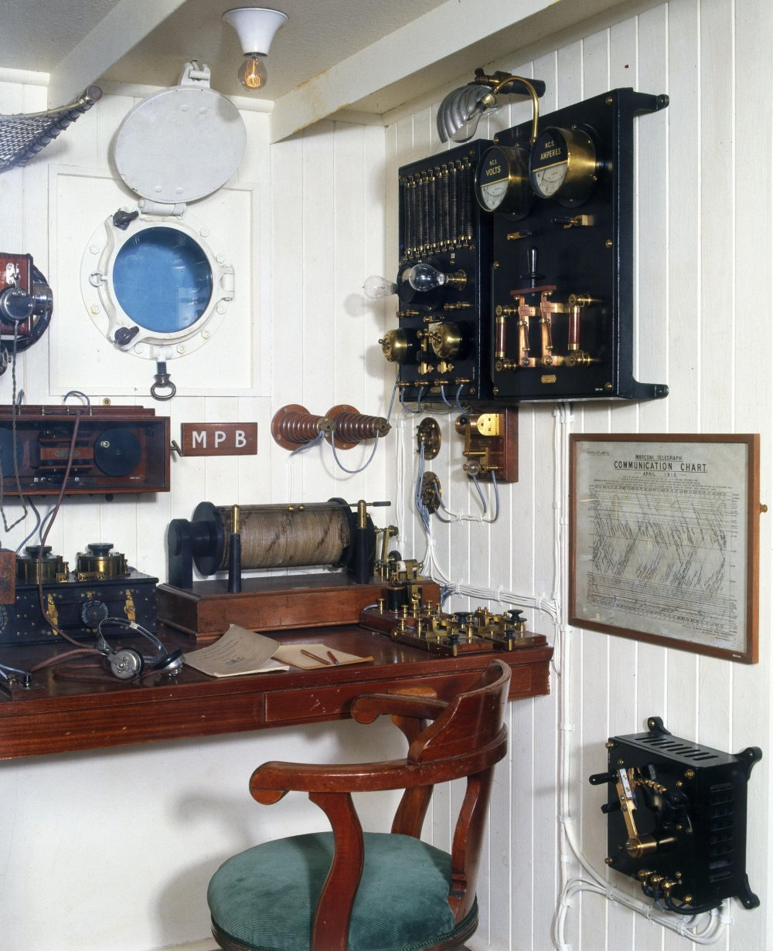
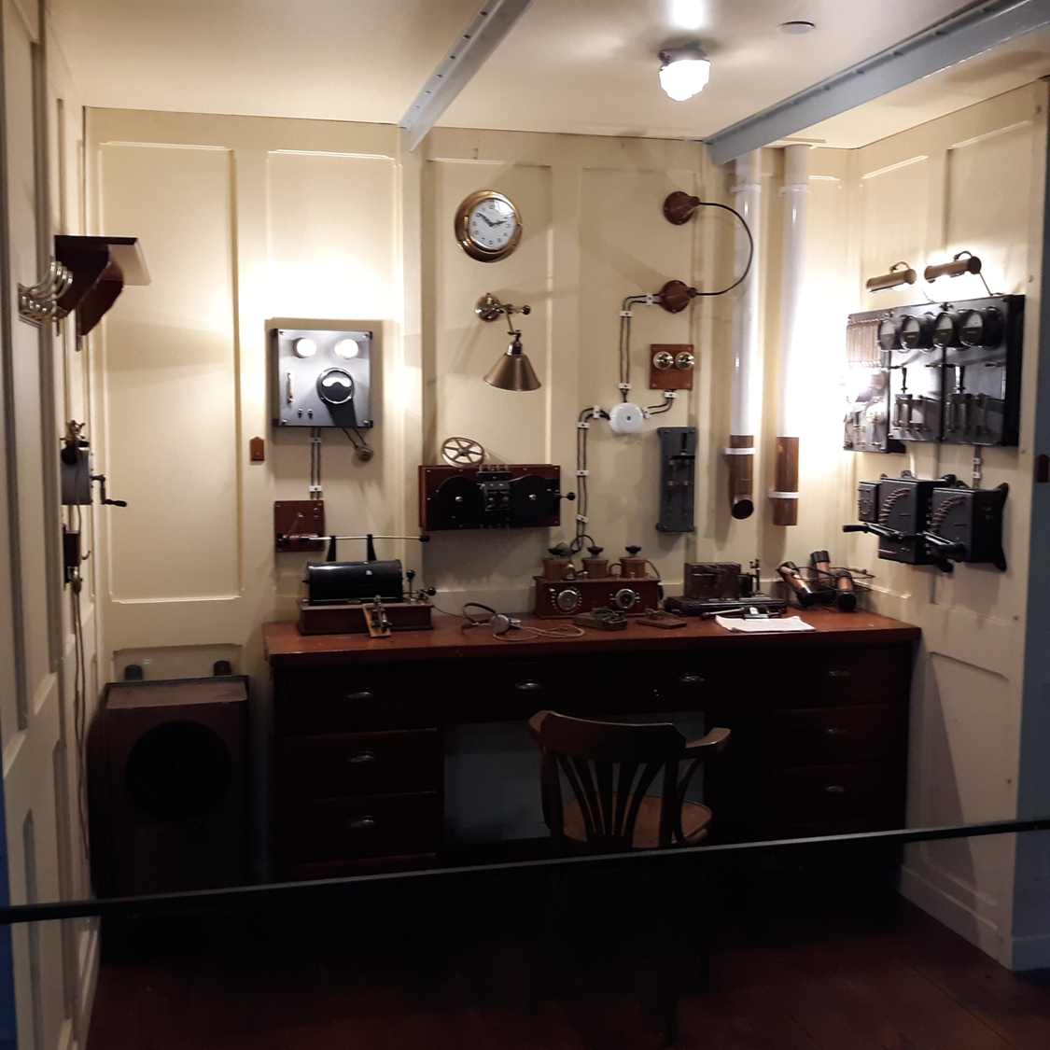
Notes:
[left image source: https://www.sciencemuseum.org.uk/objects-and-stories/titanic-marconi-and-wireless-telegraph]
[right image: photo by Matt Duley]
A. “By the time of Titanic’s maiden voyage in 1912, most passenger ships operating in the north Atlantic had a Marconi installation staffed by Marconi Company operators.”
Certainly, without the availability of the wireless, there would have been no survivors.
“The International Radiotelegraphic Convention, signed in 1906, had agreed on SOS—three dots, three dashes, three dots in Morse code—as the international distress signal. The Convention had come into force in 1908, but 'CQD', the Marconi Company's distress signal, was still widely used at the time of Titanic's voyage, including by Jack Phillips.
For two hours on Titanic, Phillips and assistant operator Harold Bride continued to send out a stream of distress signals and messages that were picked up by other vessels. Not knowing that Carpathia was already on the way, at some point Bride turned to Phillips and said, ”Send SOS. It’s the new call, and it may be your last chance to send it.”
B. While it is also true that the ship carried passengers from port to port
C. The prefix “R.M.S.” indicated that Titanic was a Royal Mail Ship, so the correct answer is C, to deliver the mail
D. It was the discovery of the Titanic that served as part of a secret US Navy mission. Doctor Robert Ballard “was a commander in the US Navy and a scientist at the Woods Hole Oceanographic Institution. The Navy offered him the funding and opportunity to search for the Titanic, but only if he first explored the USS Thresher and the USS Scorpion, two American nuclear subs that sank in the 1960s. “We knew where the subs were,” Ballard said. “What they wanted me to do was go back and not have the Russians follow me, because we were interested in the nuclear weapons that were on the Scorpion and also what the nuclear reactors (were) doing to the environment.” “The Navy also wanted to find out if there was any evidence to support the theory that the Scorpion had been shot down by the Soviets.”
References:
https://www.cnn.com/2018/12/13/us/titanic-discovery-classified-nuclear-sub/index.html
https://www.nationalgeographic.co.uk/history-and-civilisation/2018/11/titanic-was-found-during-secret-cold-war-navy-mission

Slide 5
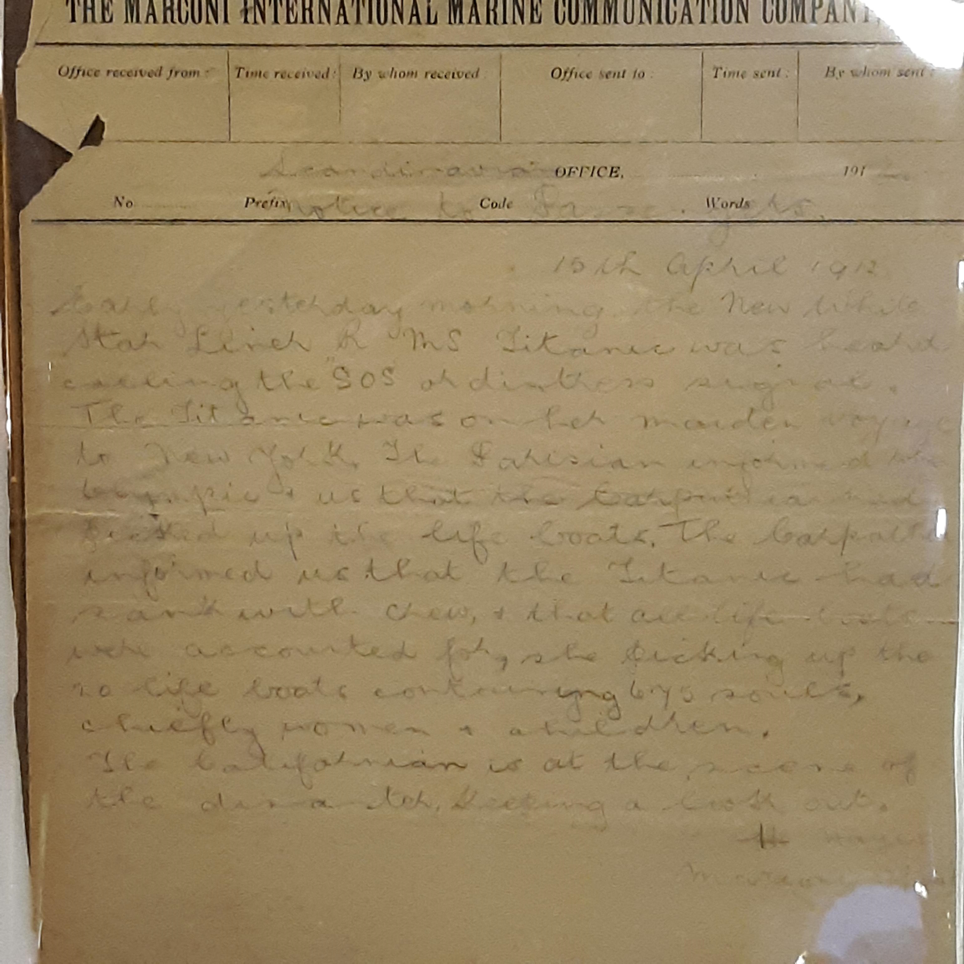
Notes:
At an exhibit on Titanic this year, I got to see an original telegram received by the Scandinavian office. Here you can see for yourself, that Titanic used the new “SOS” code.

Slide 6
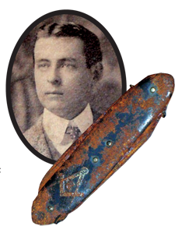
Notes:
RMS Titanic: The Maryland Masonic Connection - Scottish Rite of Freemasonry, S.J., U.S.A.
By Bro. Edward Heimiller
Photo: Bro. Oscar Scott Woody (1868–1912), Acacia Lodge, No. 16 of Clifton, Virginia was a Sea Post Office Clerk aboard the R.M.S. Titanic and perished on his 44th birthday when the Titanic sank. Bro. Woody’s Masonic pocketknife was found when his body was recovered. (Photos: Courtesy the Stephen J. Ponzillo, Jr. Memorial Library & Museum)
Among the more unusual items in the Stephen J. Ponzillo, Jr. Memorial Library & Museum at the Grand Lodge of Maryland are a number of items related to R.M.S. Titanic. While the connection between the Titanic and Masonry may not be apparent, like everything in the museum there is a story. The reason this collection of material is in the museum begins with a brother by the name of Oscar Scott Woody (1868–1912). Born on April 15, 1868, in Roxboro, North Carolina, he later moved to Virginia and became a member of Acacia Lodge No. 16 in Clifton, Virginia. He served for fifteen years as a Railroad Postal Service Clerk prior to being assigned as a Sea Post Office Clerk. He volunteered for the position on the Titanic after the clerk initially assigned to the post had been called home as his wife was ill. Brother Woody was one of five postal clerks serving aboard R.M.S. Titanic; two others were American, while the other two were British. Sadly all five perished when the Titanic sank on April 15, 1912. It was also Bro. Woody’s 44th birthday.
Bro. Woody’s body was later recovered. An entry in the diary of F. H. Lardner, Captain of the Mackay Bennett describes the scene the day they recovered his body: “Monday, April 22d. This day we picked up 27 bodies.… Everyone had on a lifebelt and (the) bodies floated very high in the water.…” The crew of the Mackay Bennett, one of the four ships chartered by the White Star Line to recover as many bodies as possible, would recover 306 bodies, of which 116 were buried at sea, including that of Bro. Woody. As part of the recovery each body received a separate number. Postal Clerk Woody was assigned number 167, which was stenciled upon a canvas bag into which his personal effects were placed after an inventory was recorded in a ledger.
Leelia B. Woody (ca. 1880–1963?), Oscar S. Woody’s widow, received bag 167 and retained it and its contents as her only memento of her husband. Despite having been married for less than three years, she never remarried and kept her husband’s photograph by her side until her death. At the time of her death these items were passed on to V. R. Gill (1901–1987), a member of Perseverance Lodge No. 208 in Indianhead, Maryland, to be presented to the museum in memory of Bro. Woody.
Among the items in the museum’s collection are his pocketknife, corroded by sea water and decorated with Masonic symbols, his membership card to his home lodge in Virginia (currently on loan to the Grand Lodge of Virginia), and a number of other documents found in his waistcoat pockets.
Coincidently, a Titanic survivor was a resident at the Maryland Masonic Homes at Bonnie Blink. Mrs. Ada Balls (1875–1967), born Ada E. Hall in 1875, married Martin Luther Balls (dates unknown) in 1896 and had two sons, Martin Luther Balls and Edgar William Balls. She was a second-class passenger on the ill-fated ship. A widow with two grown sons; she had decided to emigrate with her brother-in-law, Rev. Robert James Bateman, to Jacksonville, Florida, as missionaries. She had no idea that she would be one of just 710 survivors. During the fateful night, Rev. Bateman gave up his seat in Lifeboat 10 to Mrs. Balls after seeing she was still aboard. Rev. Bateman perished with the ship and his body was subsequently recovered by the Mackay-Bennett, the same ship that recovered Bro. Woody’s body.
After the disaster Mrs. Balls married William R. Perine (1865–1955), a member of King David’s Lodge No. 68 of Baltimore, and went on to live a full life. From 1953 until her death, she resided at Bonnie Blink with her sister, Emily Bateman (the widow of Rev. Bateman). A religious woman, she regularly attended church services at the Chapel at Bonnie Blink. During her stay at Bonnie Blink it was noticed that every time the hymn, “Nearer, my God, to Thee,” was played she would cry. It was later learned that Mrs. Perine, as she was then known, remembered this hymn as the last song the orchestra played onboard the Titanic as she sank. As a result, the hymn was barred from regular church services, a ban that has not been lifted to this day. She died October 1, 1967, at the age of 92 and is interred next to her second husband at Oaklawn Cemetery, Baltimore County, Maryland.
Woody’s heroic efforts to save the mail were noted in the 1912 U.S. Postmaster General’s Annual Report:
“About a quarter of an hour after the collision the opening or lower room in the sea post office was found to be practically filled with water and the sacks in it adrift. The clerks were seen in the sorting room above, closing sacks and preparing to take on deck all the mails available. The last reports concerning their actions show that they were engaged in this work and in carrying the sacks upon the deck to the last moment.”
“The Titanic was designated as a Royal Mail Ship (RMS), carrying mail under contract with the Royal Mail and the U.S. Post Office. The Sea Post Office used 26,800 cubic feet in her holds allocated for letters, parcels, bullion, coins, and other valuables. The Sea Post Office was on G Deck and was staffed by three Americans and two Britons, who worked thirteen hours a day, seven days a week sorting up to 60,000 items daily.” (en.wikipedia.org)

Slide 7
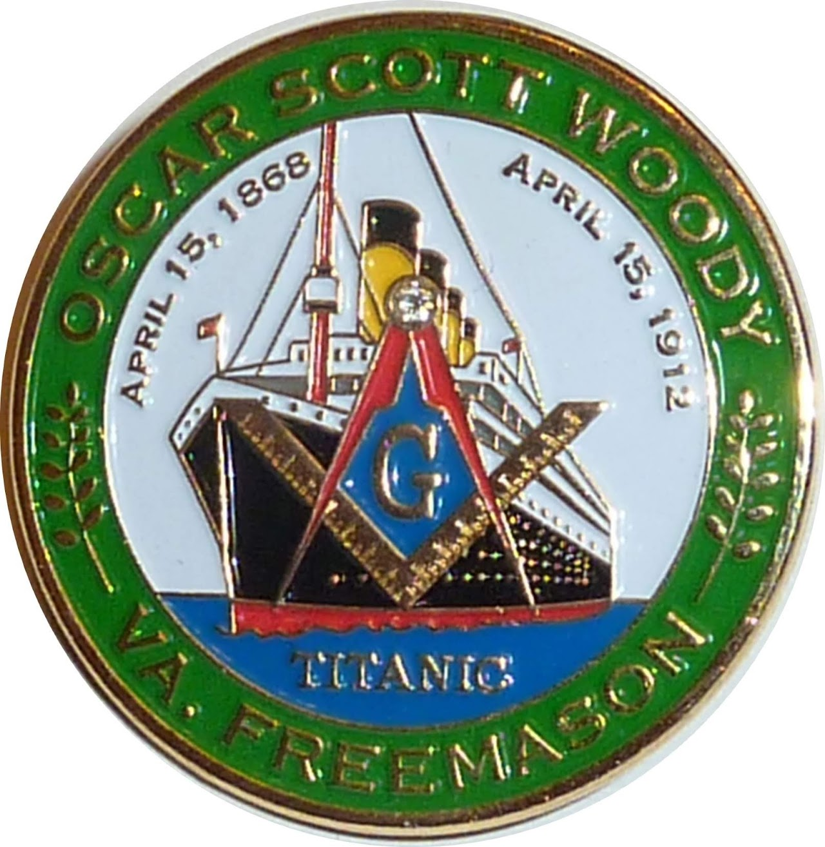
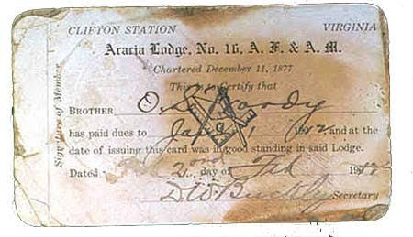
Notes:
[This sections excerpts come from https://sites.google.com/view/oscarscottwoody]
The backside of this now collectible coin says "Stead Fast In Peril" "In Memory of Masons who lost their lives" "April 15, 1912"
Oscar Scott Woody was a Freemason and was raised to the sublime degree of Master Mason in Acacia Lodge No. 16 in Clifton, VA. on August 30, 1903.
The site contains a copy of his travel orders to “return to New York as a clerk in the sea post office on the RMS Titanic, sailing from Southampton, on April 10, 1912”
In November of 2003, Governor Mike Easley declared November 24th "Oscar Scott Woody Day" In NC. and in 2004 Roxboro Mayor Steve Joyner proclaimed July 12 "Oscar Scott Woody Day" In addition, the NC. Museum of Natural Sciences released a commemorative envelope with a cancellation stamp honoring Woody.
On June 25, 2004 President George W. Bush signed a Bill designating the facility of the United States Postal Service located at 223 South Main Street in Roxboro, NC. as the "Oscar Scott Woody Post Office Building“
June 24, 2009 A U.S. Flag that was flown over the United States Capitol on April 15, 2009 to "Honoring Acacia Lodge No. 16, A.F. & A.M. and "Remembering - Oscar Scott Woody" at the request of the Honorable Robert J. Wittman, Member of Congress.
August 6, 2009 Woody's Masonic Lodge, Acacia Lodge No. 16 adopts a resolution to honor Brother Woody each April by inviting a representative of the Post Office serving the Town of Clifton, Virginia to attend dinner prior to the stated meeting and offering a prayer for the peaceful repose of Brother Woody at such meal.
April 7, 2009 Mayor Thomas Peterson and the Town Council, by unanimous vote adopt a proclamation drafted by William J. Baumbach, II declaring April 15th as "Oscar Scott Woody Day" in the Town of Clifton Virginia.
March 2012 the House Joint Resolution No. 518 "Commemorating the life of Oscar Scott Woody" was voted on by the House and Senate in Richmond, Va. On Wednesday July 3, 2013 Delegate Richard L. Anderson of the 51st House District of the Virginia General Assembly presented the Joint Resolution to Acacia Lodge.
April 15, 2012 for the 100-year anniversary the Grand Lodge of Maryland opened up their museum with a special Titanic and Oscar Scott Woody display. [https://drive.google.com/file/d/1CtWpuYanmxTObh1XvPAEsF3DUHv0ncfY/view]

Slide 8
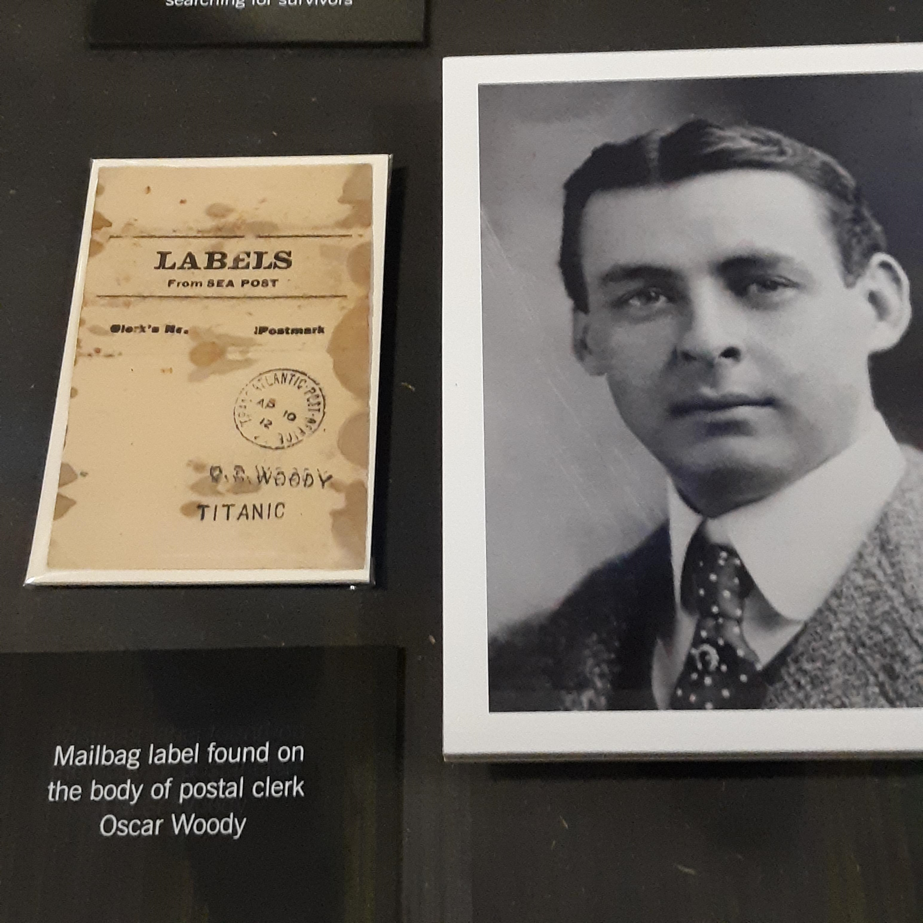
Notes:
[Photo of Titanic exhibit by Matt Duley]
At the Titanic exhibit, I was pleased to find some mention of our departed Brother! There was no mention of him being a Mason.
I was fortunate enough to have known this beforehand, so I was purposefully scouring the exhibit for mention of him to present to you.

Slide 9
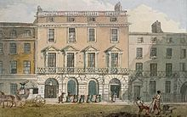
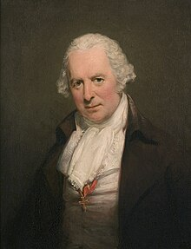
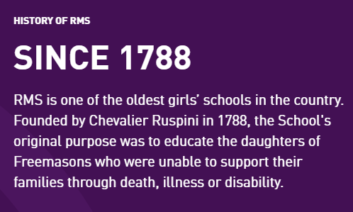
Notes:
[Portrait of Bartholomew Ruspini by George Romney, National Gallery of Denmark.]
Here we see a portrait of Bro. Bartholomew Ruspini, a dentist in Hertfordshire, England.
“It should be remembered that dentistry was not perceived as a skilled profession, nor had it the status it has now. Dentistry was generally practiced as a sideline by blacksmiths, hairdressers and (frequently) charlatans. Ruspini styled himself as a "surgeon dentist" to separate himself from the like of these.”
“In 1768 Ruspini became the author of a Treatise on Teeth. He wrote about many things that we now take for granted including the effect of too much sugar on the teeth”
“By 1777 Ruspini was established enough within society and within the Masonic movement to be a founder member of a Lodge, the Lodge of the Nine Muses.”
“On 14 May 1788, a committee of Bartholomew Ruspini and nine other Freemasons met at the Freemasons' Tavern in Great Queen Street to plan the details of a charitable institution for the daughters of Masons who were struggling financially.”
So what does this have to do with the Titanic?

Slide 10
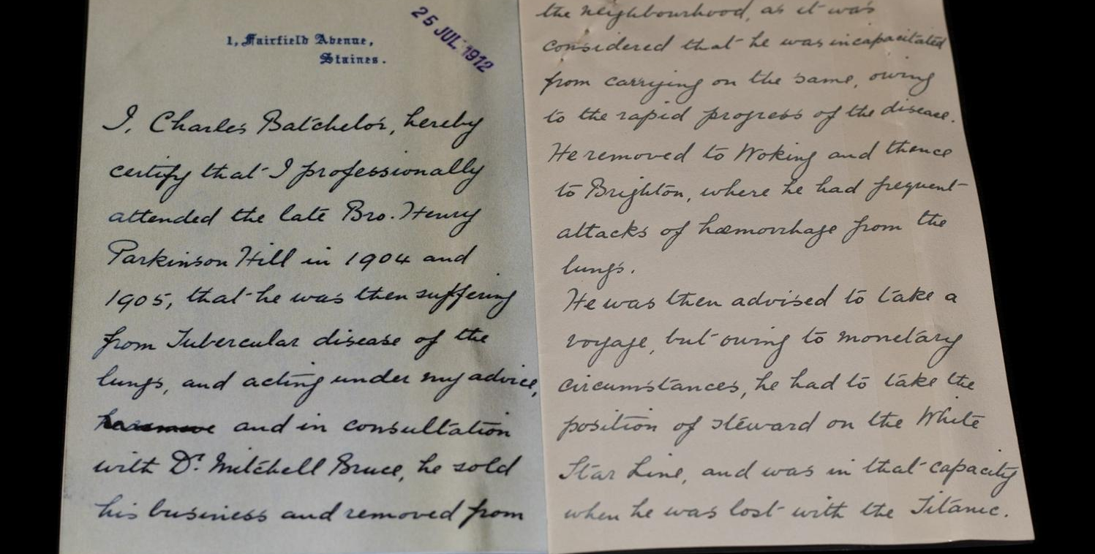
Notes:
Handwritten letter from Parkinson Hill petition to School for Girls, 1912 ©Museum of Freemasonry, London
Tale of the Titanic twins | Museum of Freemasonry (museumfreemasonry.org.uk)
Who hasn’t heard of the Titanic? The tragic story of the ship that struck an iceberg and sank on her maiden voyage is so well known that it was made into a Hollywood blockbuster. So, imagine my surprise when I discovered a link to this piece of history buried in the Museum’s archives. I was looking for items for our Treasures exhibition in 2019/20 and it was chance to show off areas of the collections which people don’t often get to see. I stumbled across the words ‘Titanic case’ written in red ink across some of our records.
I was looking at items relating to the Royal Masonic Institution for Girls. This was a school set up by freemasons, led by Bartholomew Ruspini in 1788 to support the daughters of members who had hit hard times. Often, fathers had died, leaving mothers without a means of supporting their children. To apply for a place at the school, an application was completed, known as a petition. Our Archives include petitions going back to 1789 and they are, quite possibly, my favorite part of the collection.
The records of the School for Girls are mostly made up of minute books, admissions registers and petition paperwork. The forms give rather dry details of finances, along with the copies of birth, marriage and death certificates, and medical officers’ reports. They only tell half the story. Amongst the impersonal facts and figures are letters written by friends of the families, doctor’s notes, and even samples of children’s handwriting. As well as giving details of a father’s freemasonry, these records are a window into the human stories behind the paperwork.
The case of seven-year-old twins Eleanor and Florence Hill is particularly poignant. Their father, Henry was a freemason, initiated in Staines Lodge in Middlesex in March 1904 and had originally worked as a jeweler. The girls’ petitions for admission include a letter from the family doctor, Charles Batchelor, concerning Henry’s health. He had been suffering from ‘tubercular disease of the lungs’ and had given up his business and moved to Brighton in the hopes of improving things.
Mr Batchelor’s letter goes on to say that Henry had also been ‘advised to take a voyage for his health’. Unable to afford a ticket for a voyage, and in a rather tragic twist of fate, Henry instead took a job for the White Star Line. By that point he had moved to Southampton, working as a Steward on the Olympic before boarding the Titanic on 4 April 1912. The letter rather blandly ends with the statement that Henry was ‘in that capacity (as a Steward) when he was lost with the Titanic’. Without her husband’s income, his widow Florence was unable to support her daughters and called on the freemasons for help.
Stories like this are the reason I became an archivist. There is something about handwritten pages that transports you into the lives of the people who wrote them. When looking at the school records in particular, I find myself wondering what happened to the families who needed help – what were their lives like? From these records we get a glimpse of Henry’s life before the Titanic and the unfortunate circumstances which led to him being on the ship on that fateful day. These pieces of paper in the Museum’s Archives make him, and his family, all the more real and, to me, that’s what makes them a true treasure.

Slide 11
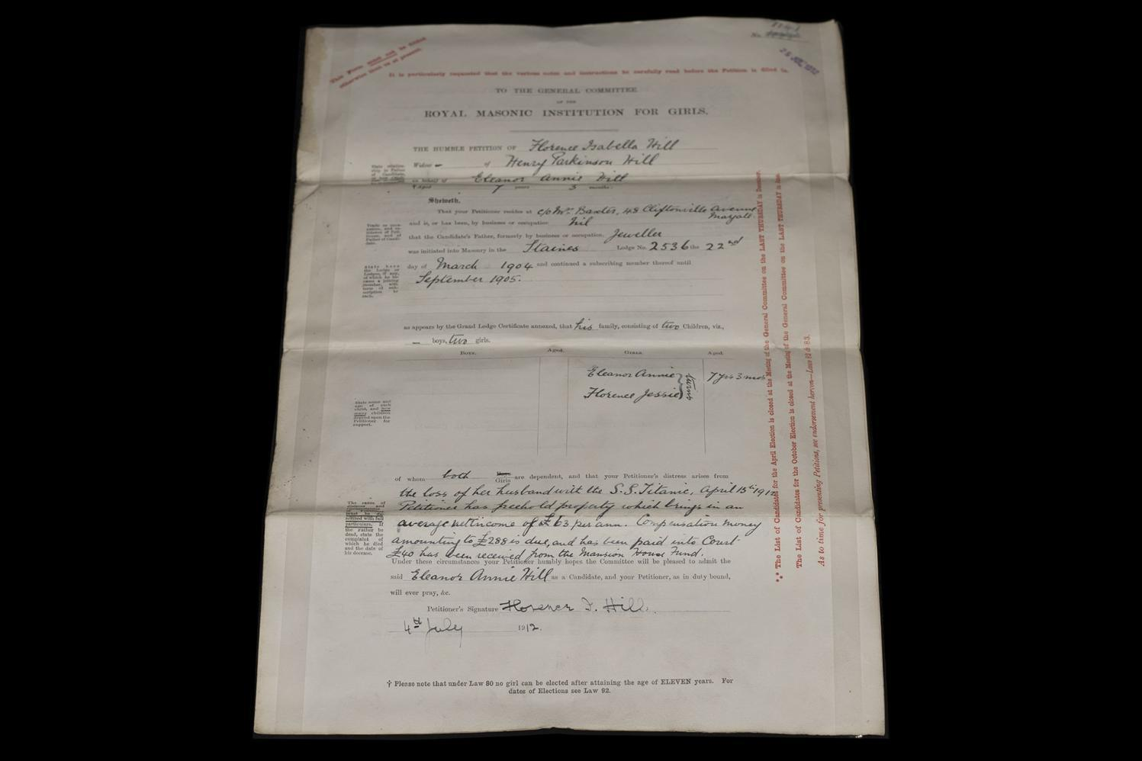
Notes:
Formal petition for Parkinson Hill girls to School for Girls, 1912 ©Museum of Freemasonry, London

Slide 12
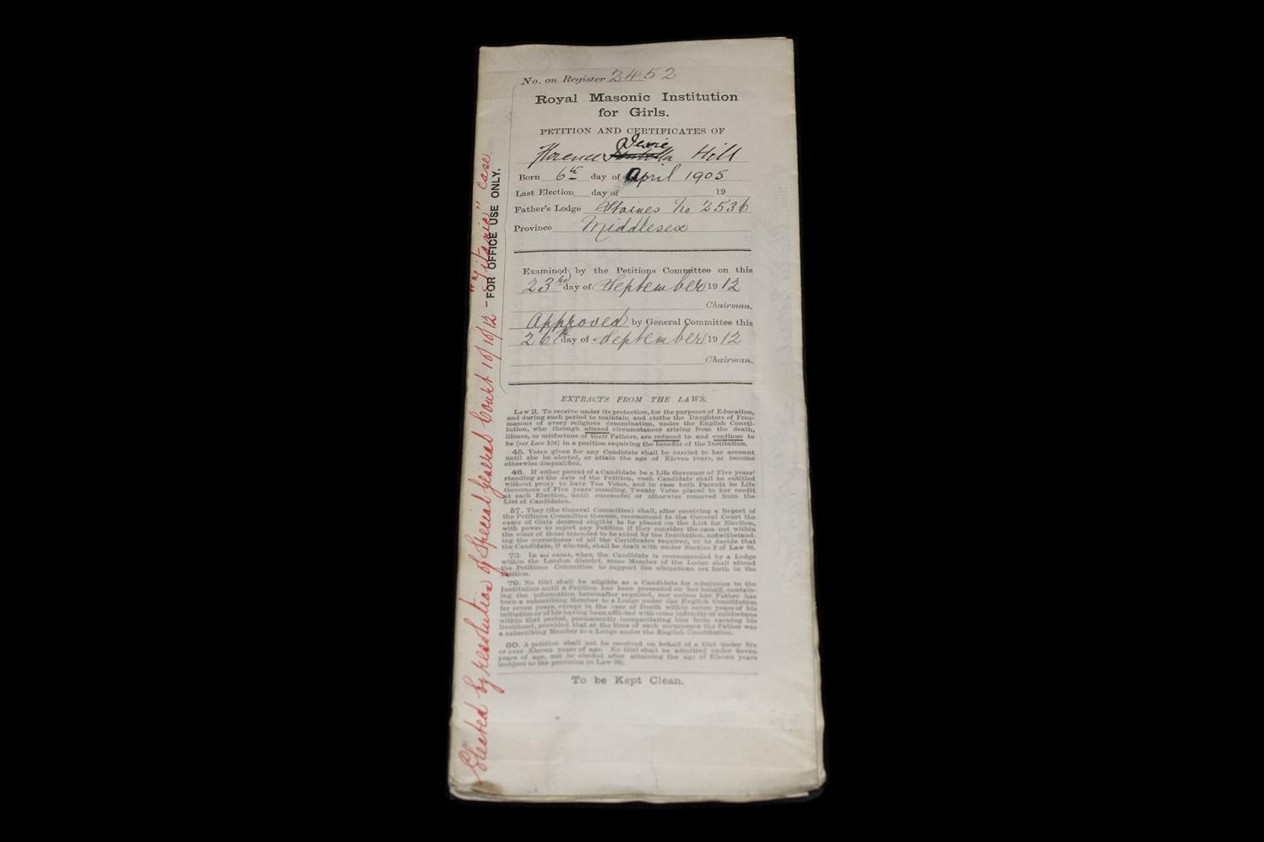
Notes:
Formal acceptance of Parkinson Hill girls to School for Girls, 1912 ©Museum of Freemasonry, London

Slide 13
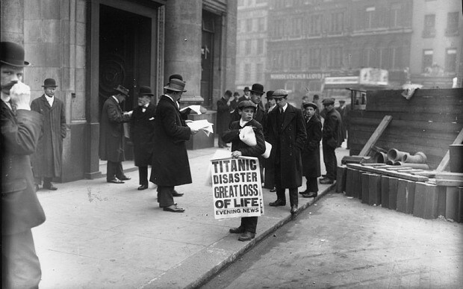
Notes:
To more completely cover our topic, we must be willing to consider other viewpoints.
From back in 2015 there were numerous articles along the following lines:
“A secret list containing the names of two million Freemasons may have revealed an inquiry into the sinking of the Titanic was influenced by the organization.
The archives, published by genealogy site Ancestry, reveal many people involved in a British investigation into the tragedy, including the judge who oversaw the inquiry, its leading investigators and the chairman of the ship’s parent company, participated in Masonic activity, The Daily Telegraph reports.”
Was Titanic inquiry scuppered by the Freemasons? (telegraph.co.uk)
Freemasons may have influenced Titanic inquiry, newly disclosed list of members' names reveals | The Independent | The Independent
Freemasons 'fixed inquiry into sinking of the Titanic to clear bosses' | Daily Mail Online

Slide 14
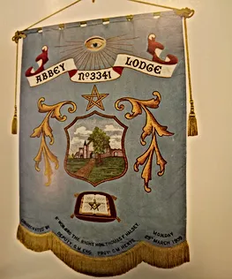
Notes:
"A Masonic Apron at the Titanic Museum, Branson, Mo" – YouTube
From the Sep/Oct 2022 Scottish Rite Journal
Abbey Lodge No. 3341 Hertfordshire, Herbert J Pittman 3rd officer, in command of Lifeboat No. 5.
Was a Fellowcraft at the time of the sinking, and was raised to the Sublime Degree of Master Mason two months afterwards.
Abbey 3341 | museum2017 (hertsmasonicbanners.uk)
Lodge went dark in 2012.
Lane's Masonic Records 1717-1894 (dhi.ac.uk)

Slide 15
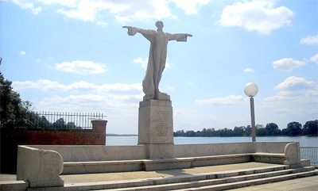
Notes:
Not many people are aware that Washington D.C has memorial to the Titanic. Having lived there, I once got a chance to see it.
“With the support of Helen Taft, the Titanic Memorial was dedicated in Washington, D.C. on May 26, 1931.
The memorial honors the men on the Titanic who gave their lives so that women and children might be saved.
Originally located on the current site of the Kennedy Center, the Titanic Memorial is now located on 4th and P Streets, SW.
Titanic memorials are located around the world in cities including New York, Southampton, Cobh, and Belfast.”

Slide 16
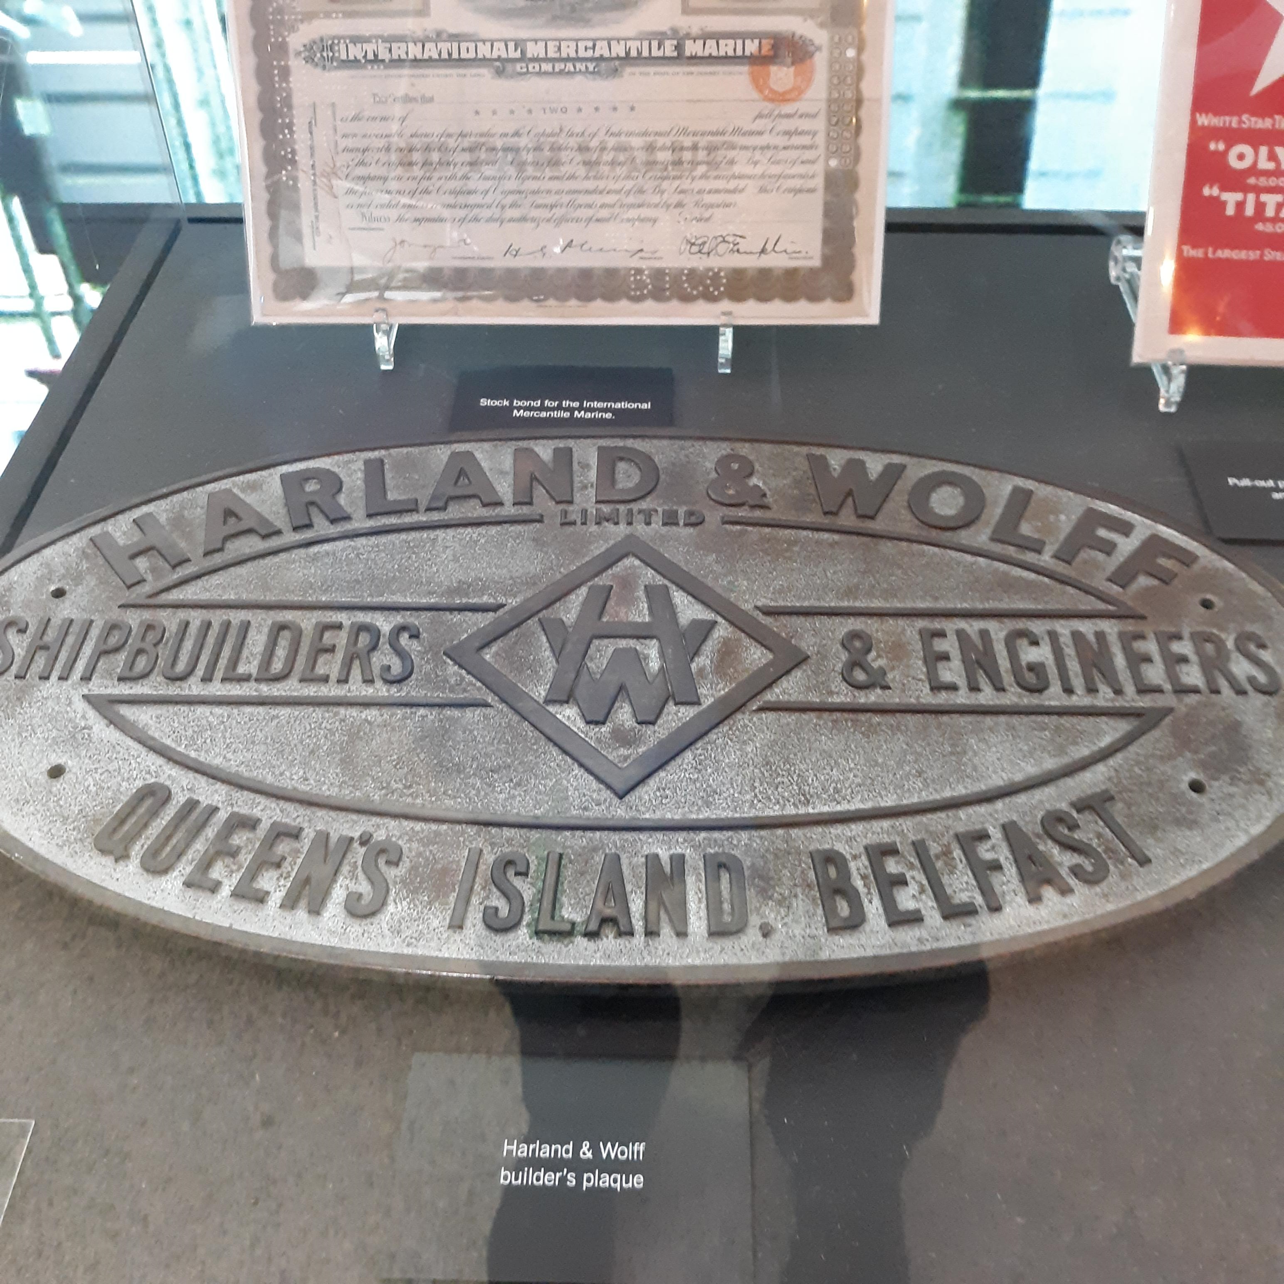
Notes:
Titanic. The Exhibition in D.C. Area (titanicexhibition.com)
Included here for some additional context are a few more photos I took at the Titanic exhibit.
This is the plaque of the company that constructed the great ship.

Slide 17
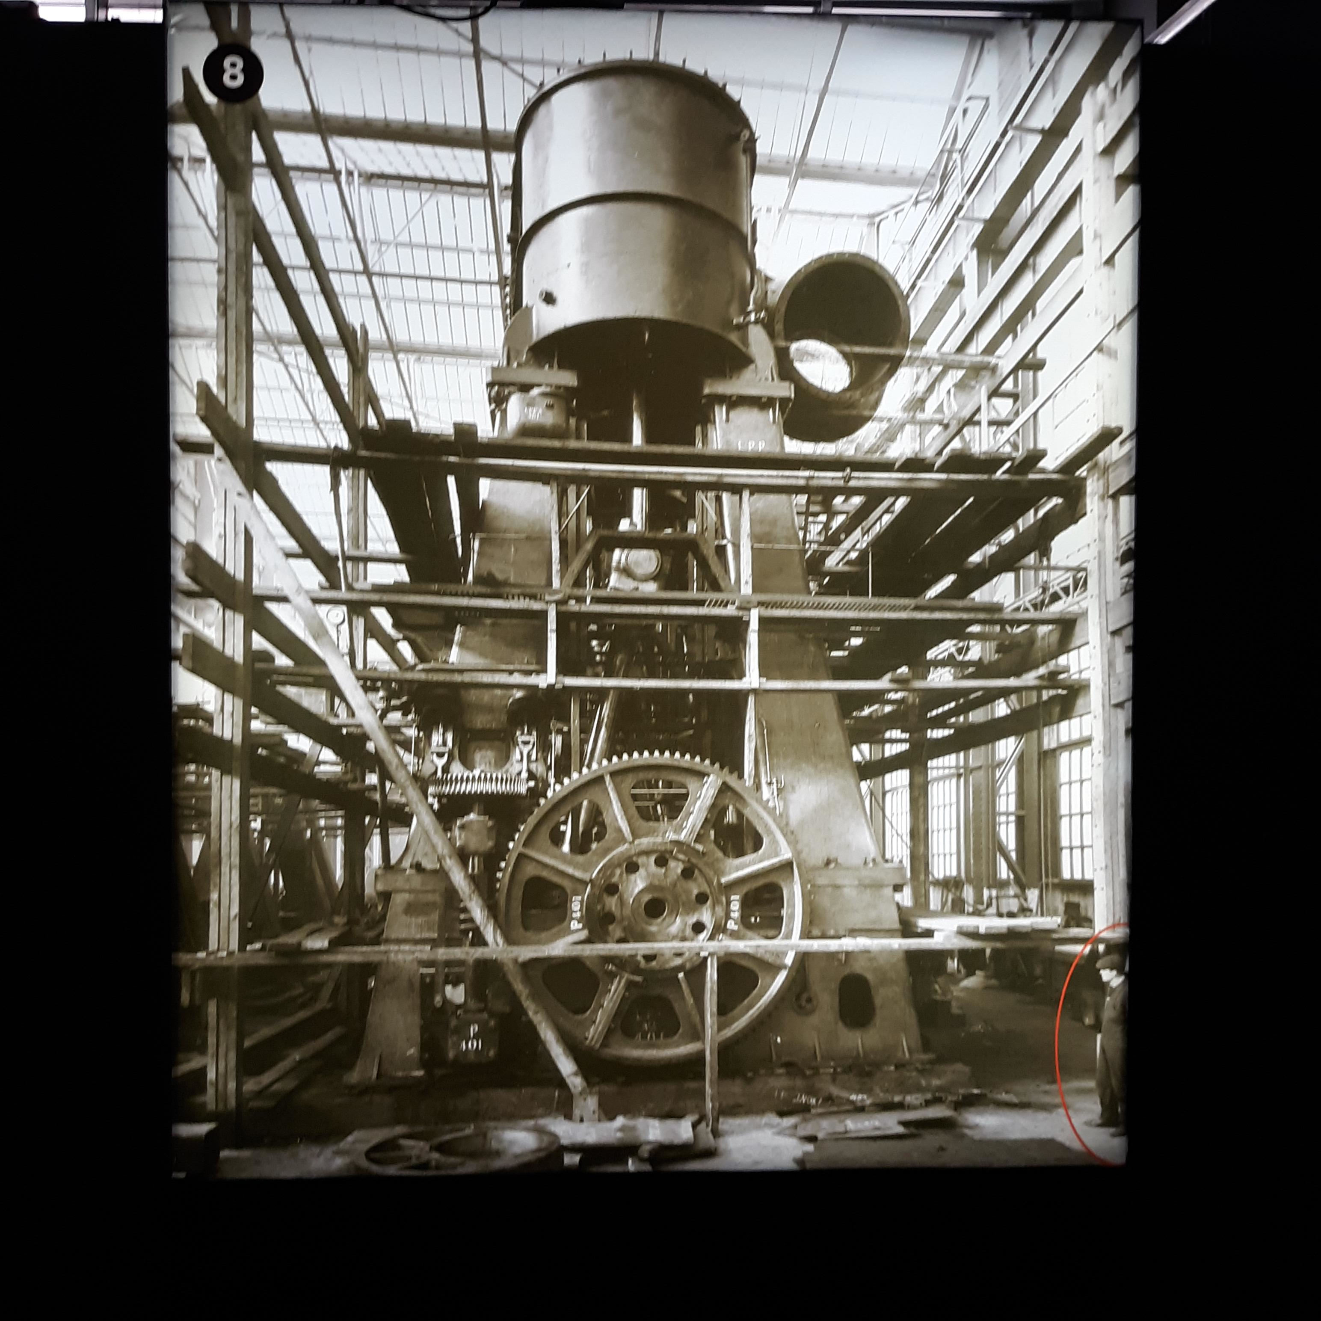
Notes:
For scale of size, this is what one of the boilers looked like.

Slide 18
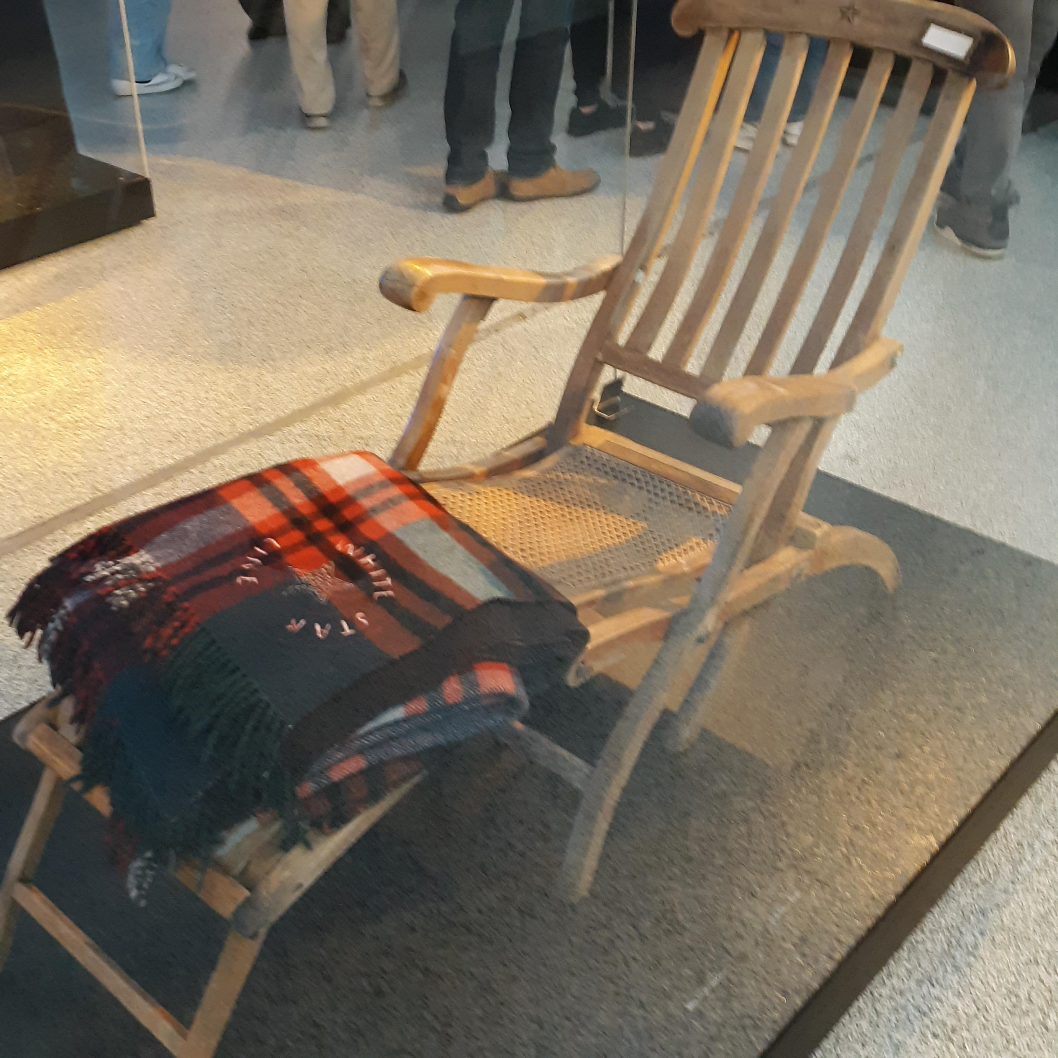
Notes:
Here we see a White Star line deck chair and blanket which would have been seen aboard.

Slide 19
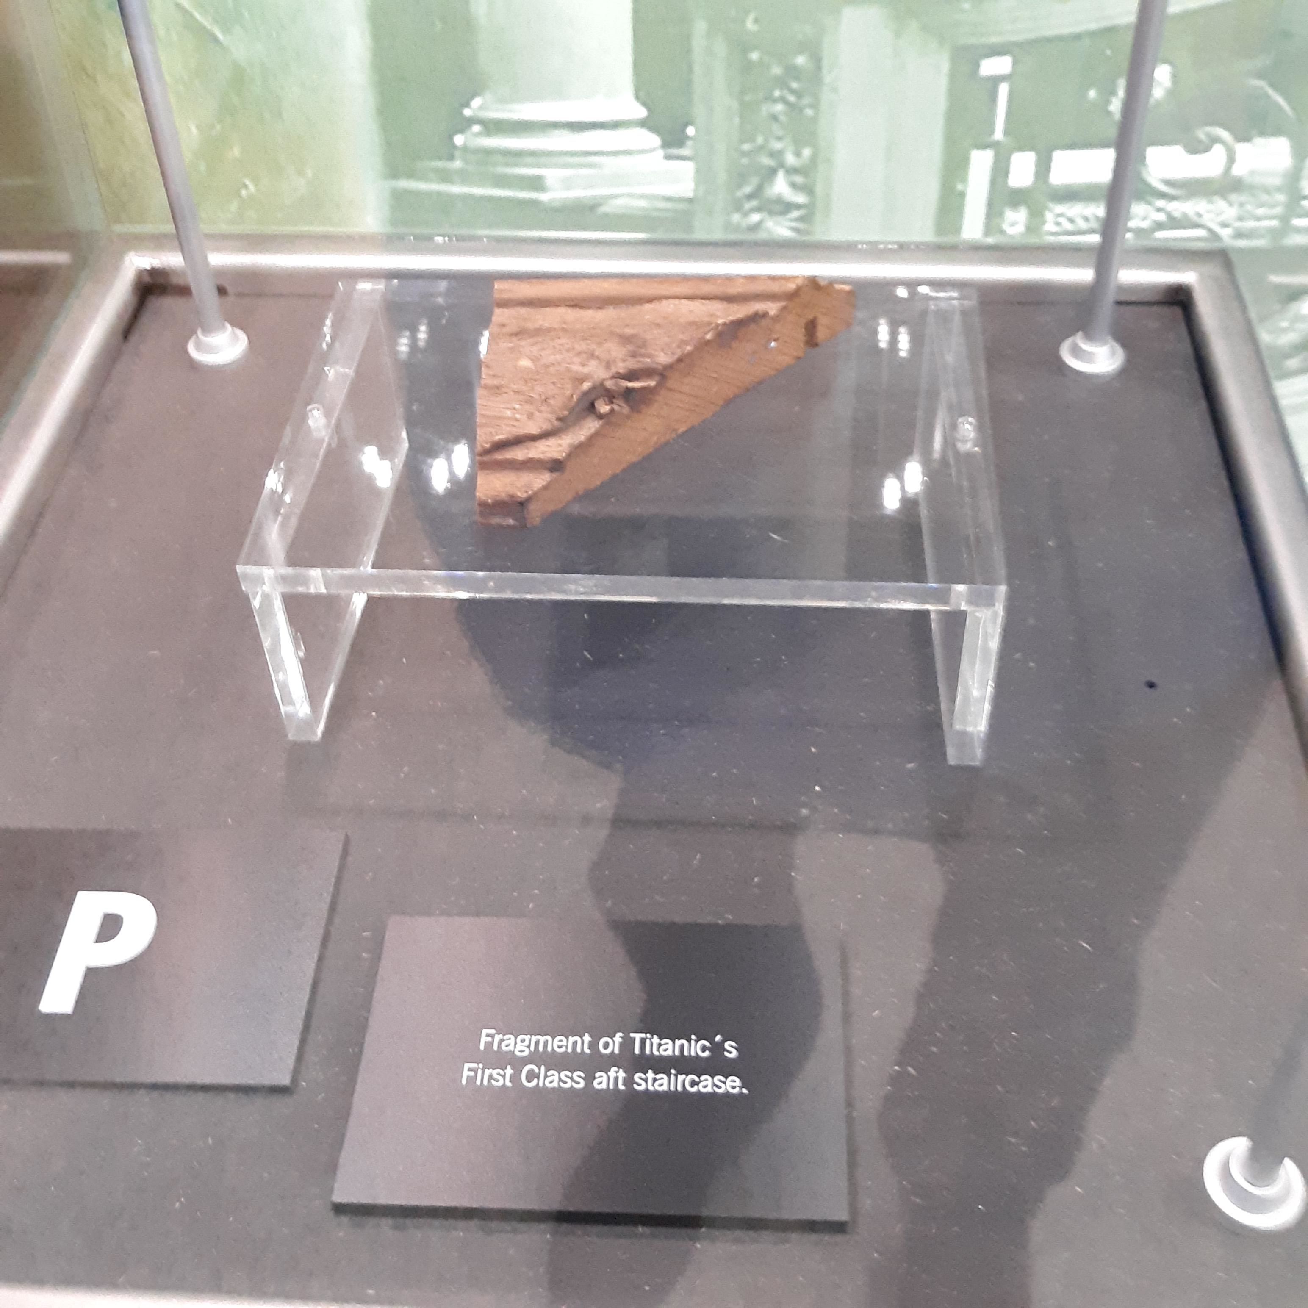
Notes:
Amazingly, here is a piece of the staircase.

Slide 20
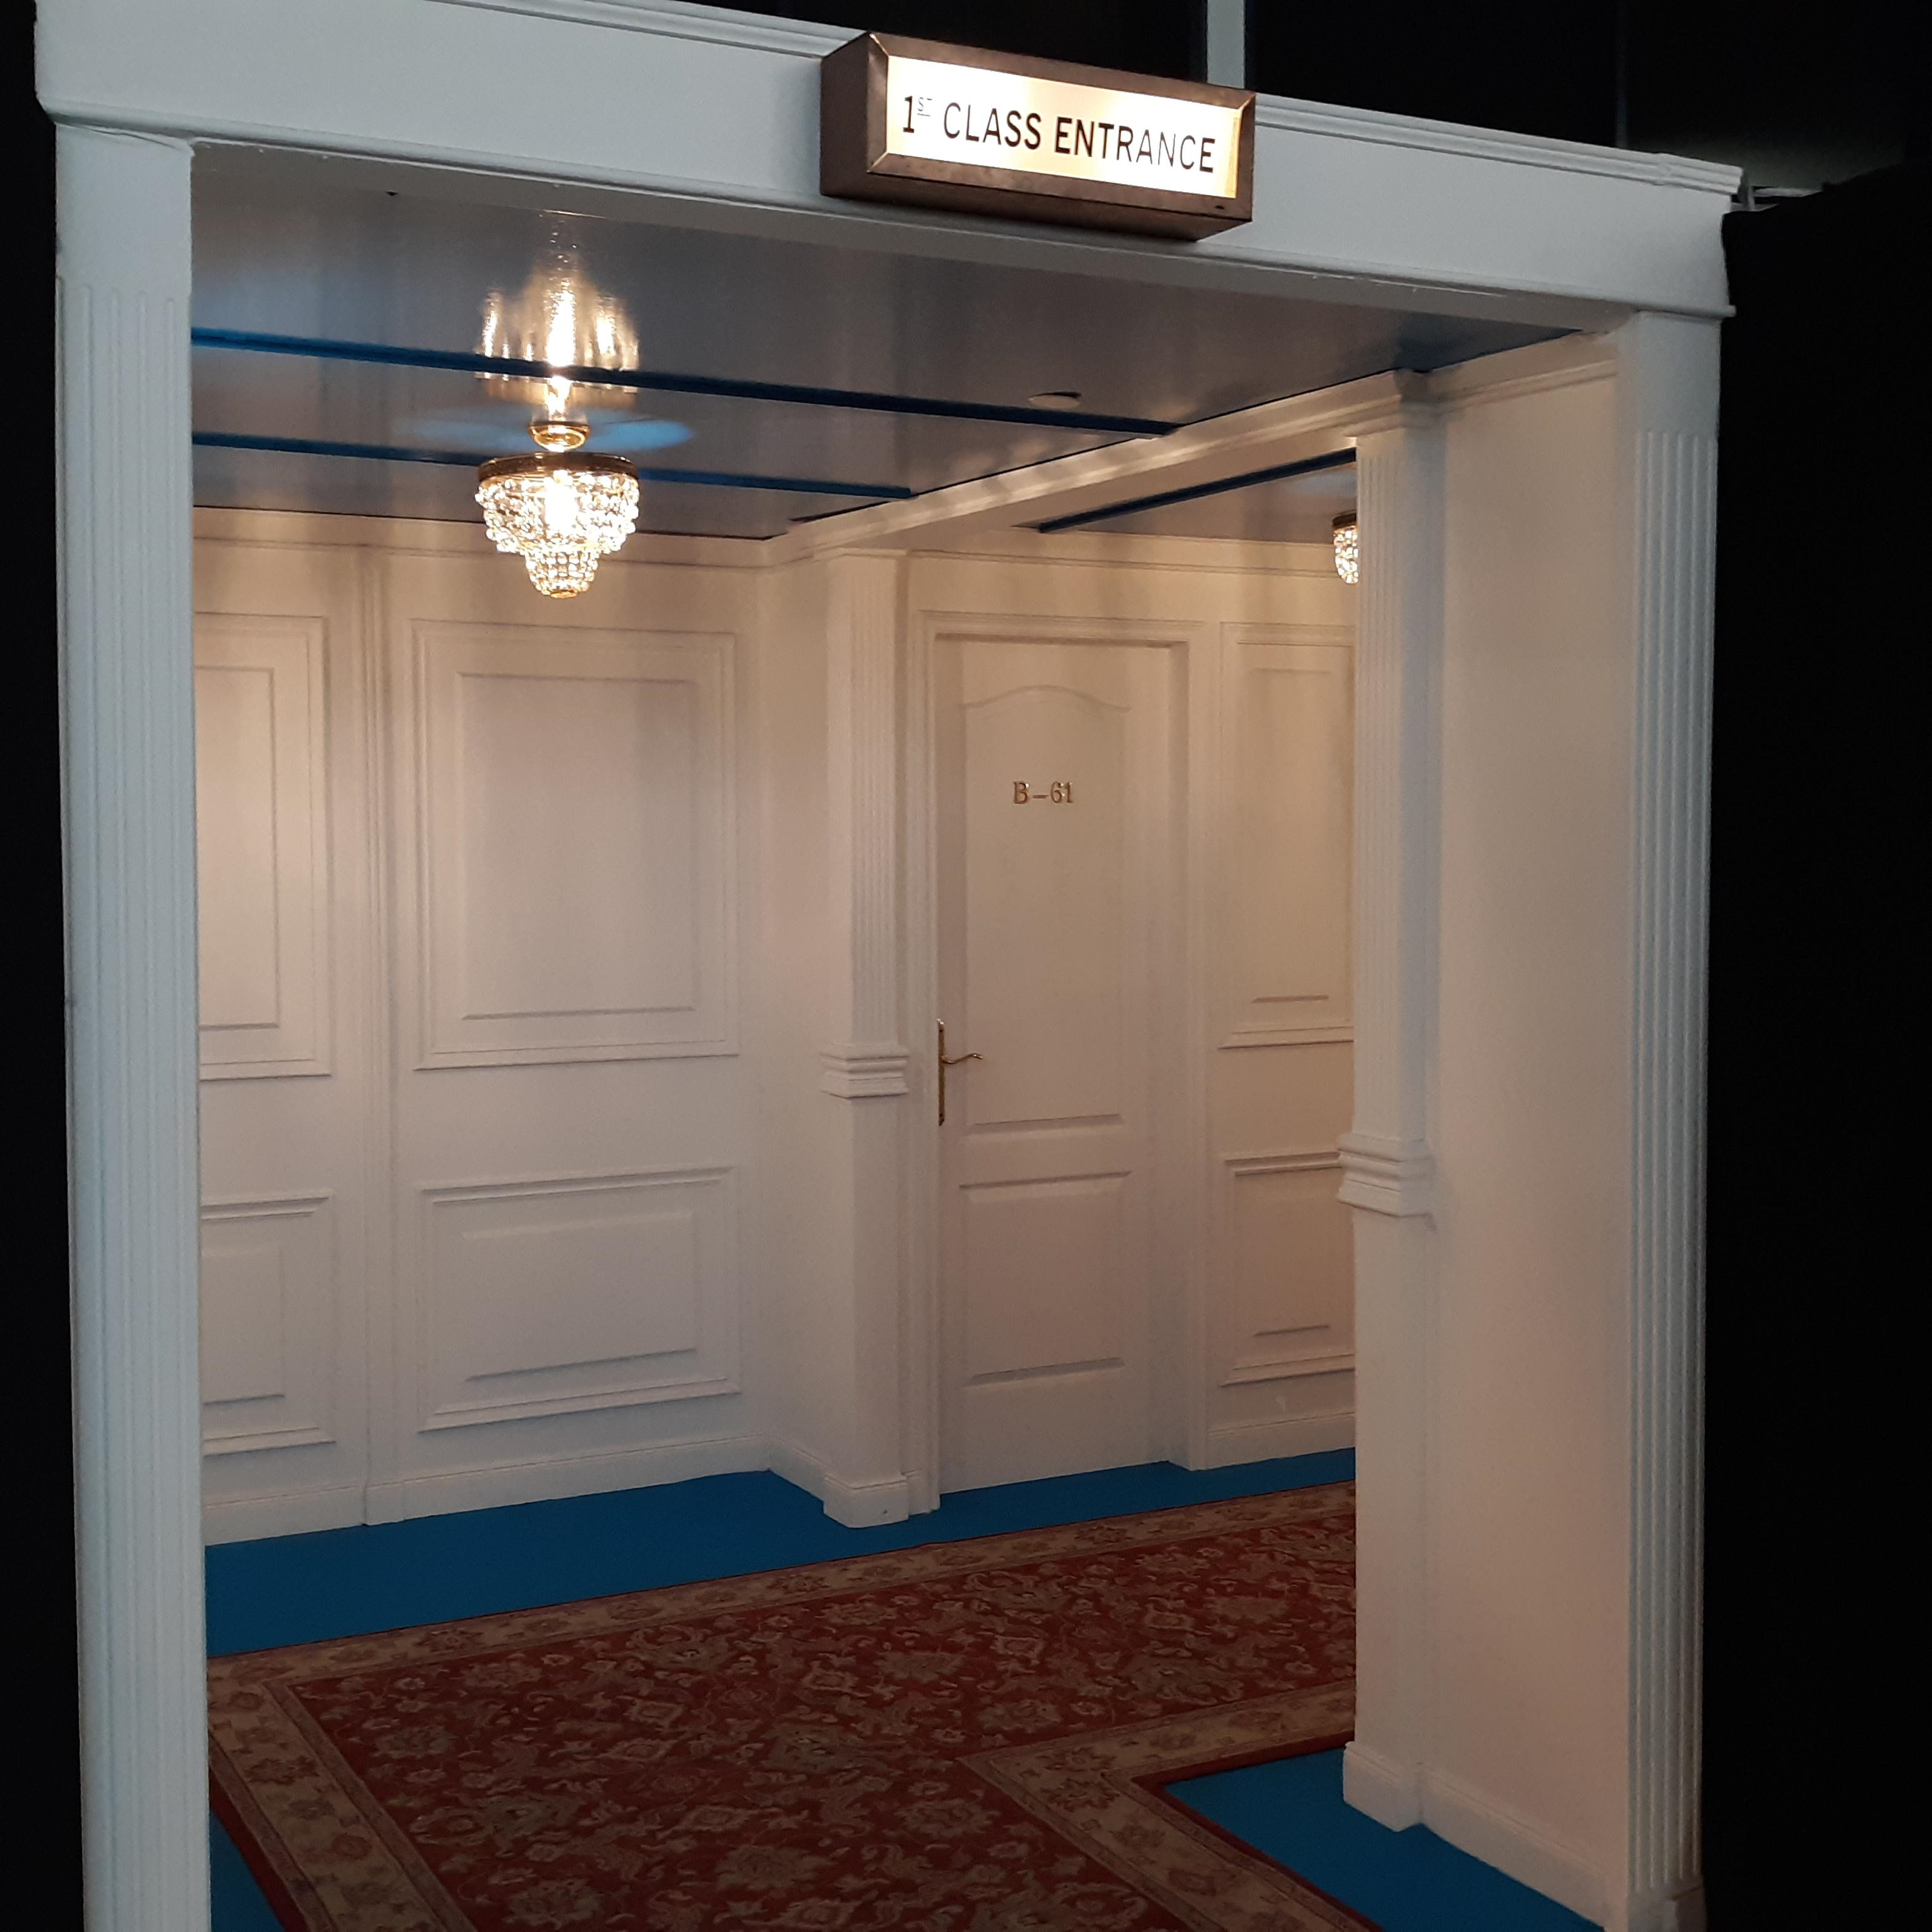
Notes:
The exhibit included walk throughs like this of hallways and various accommodations.

Slide 21
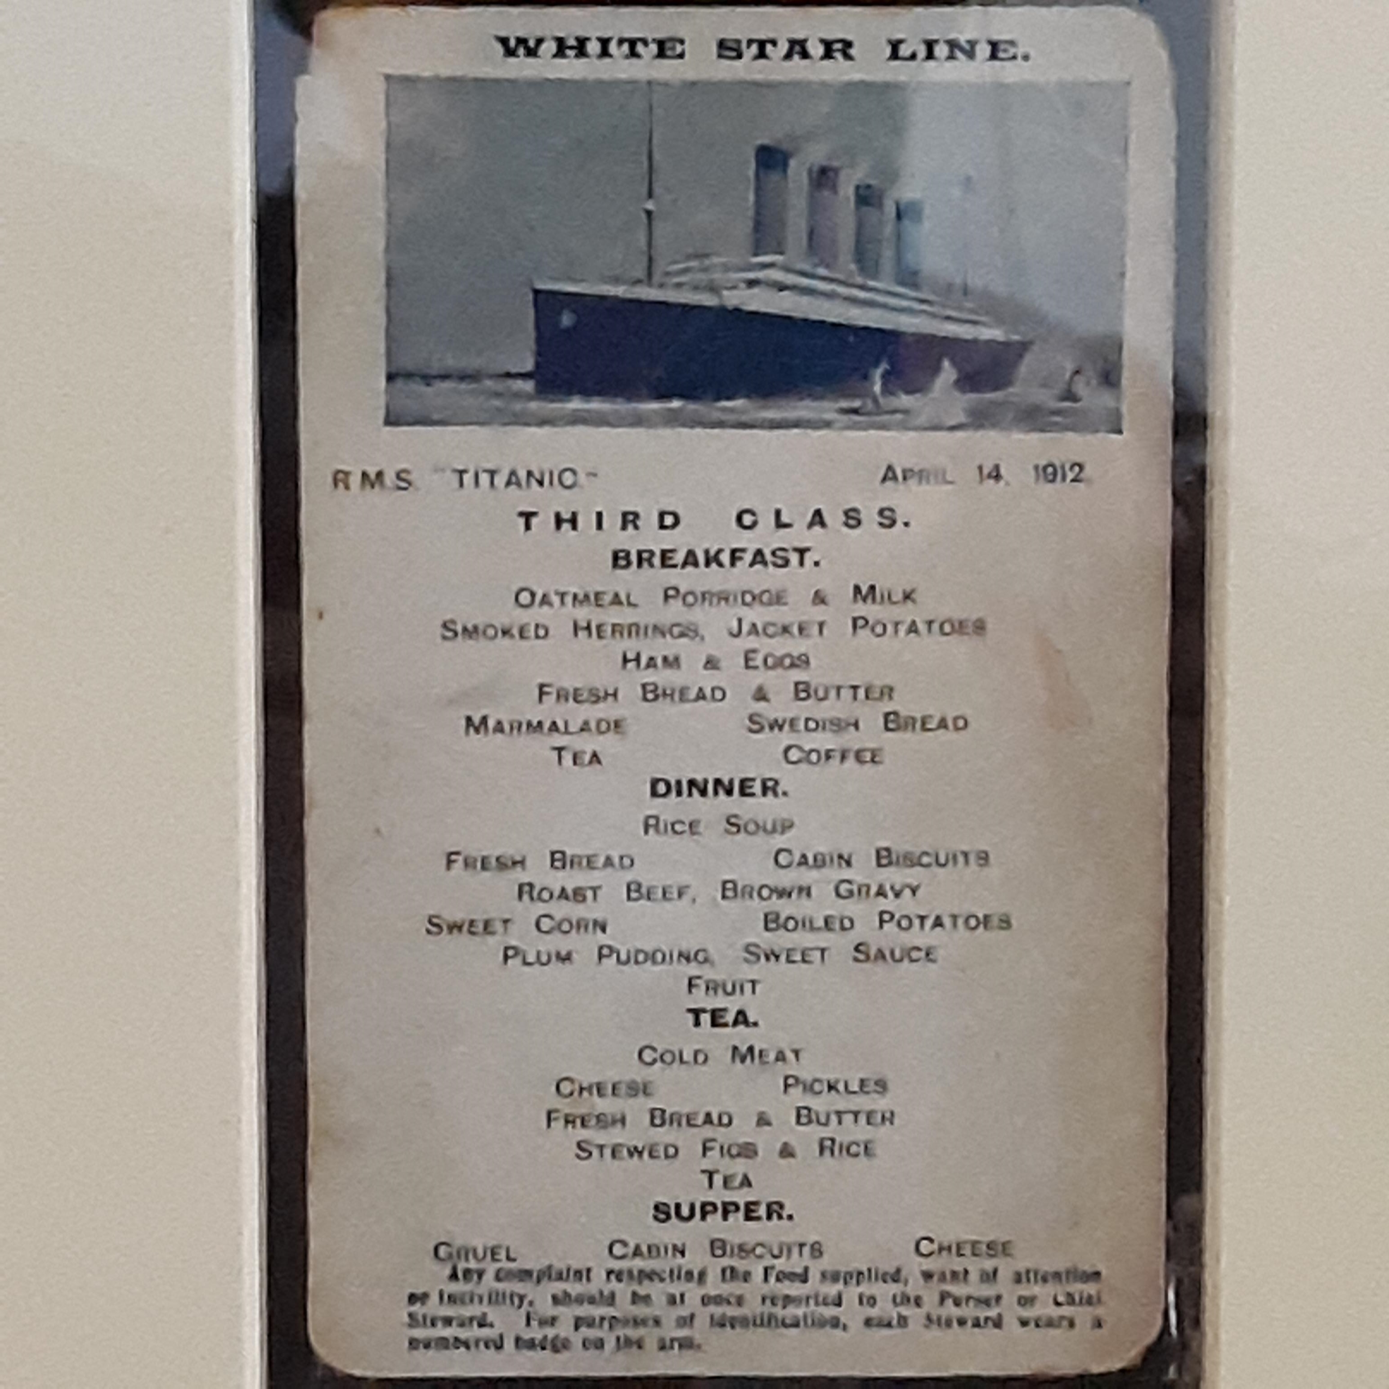
Notes:
The only known original of the Third Class menu for April 14th 1912, carried in the handbag of passenger Sara Roth, who survived in lifeboat C

Slide 22
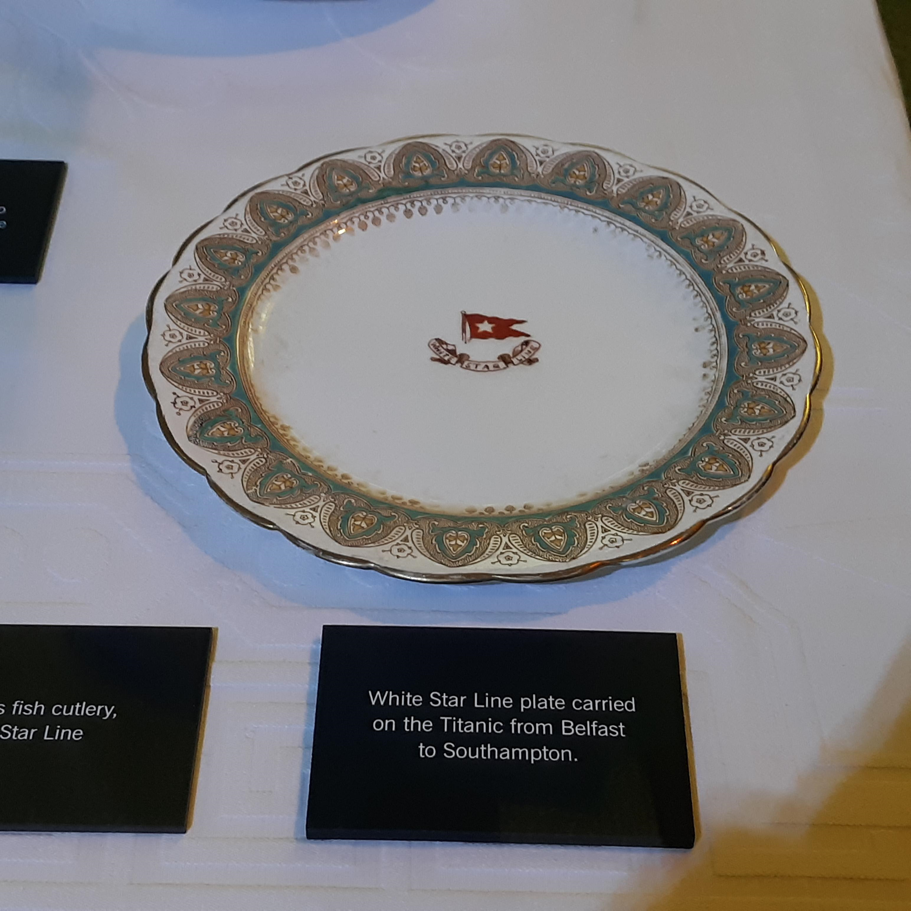
Notes:
Somebody must have knicked this off the ship before that fatal voyage.

Slide 23
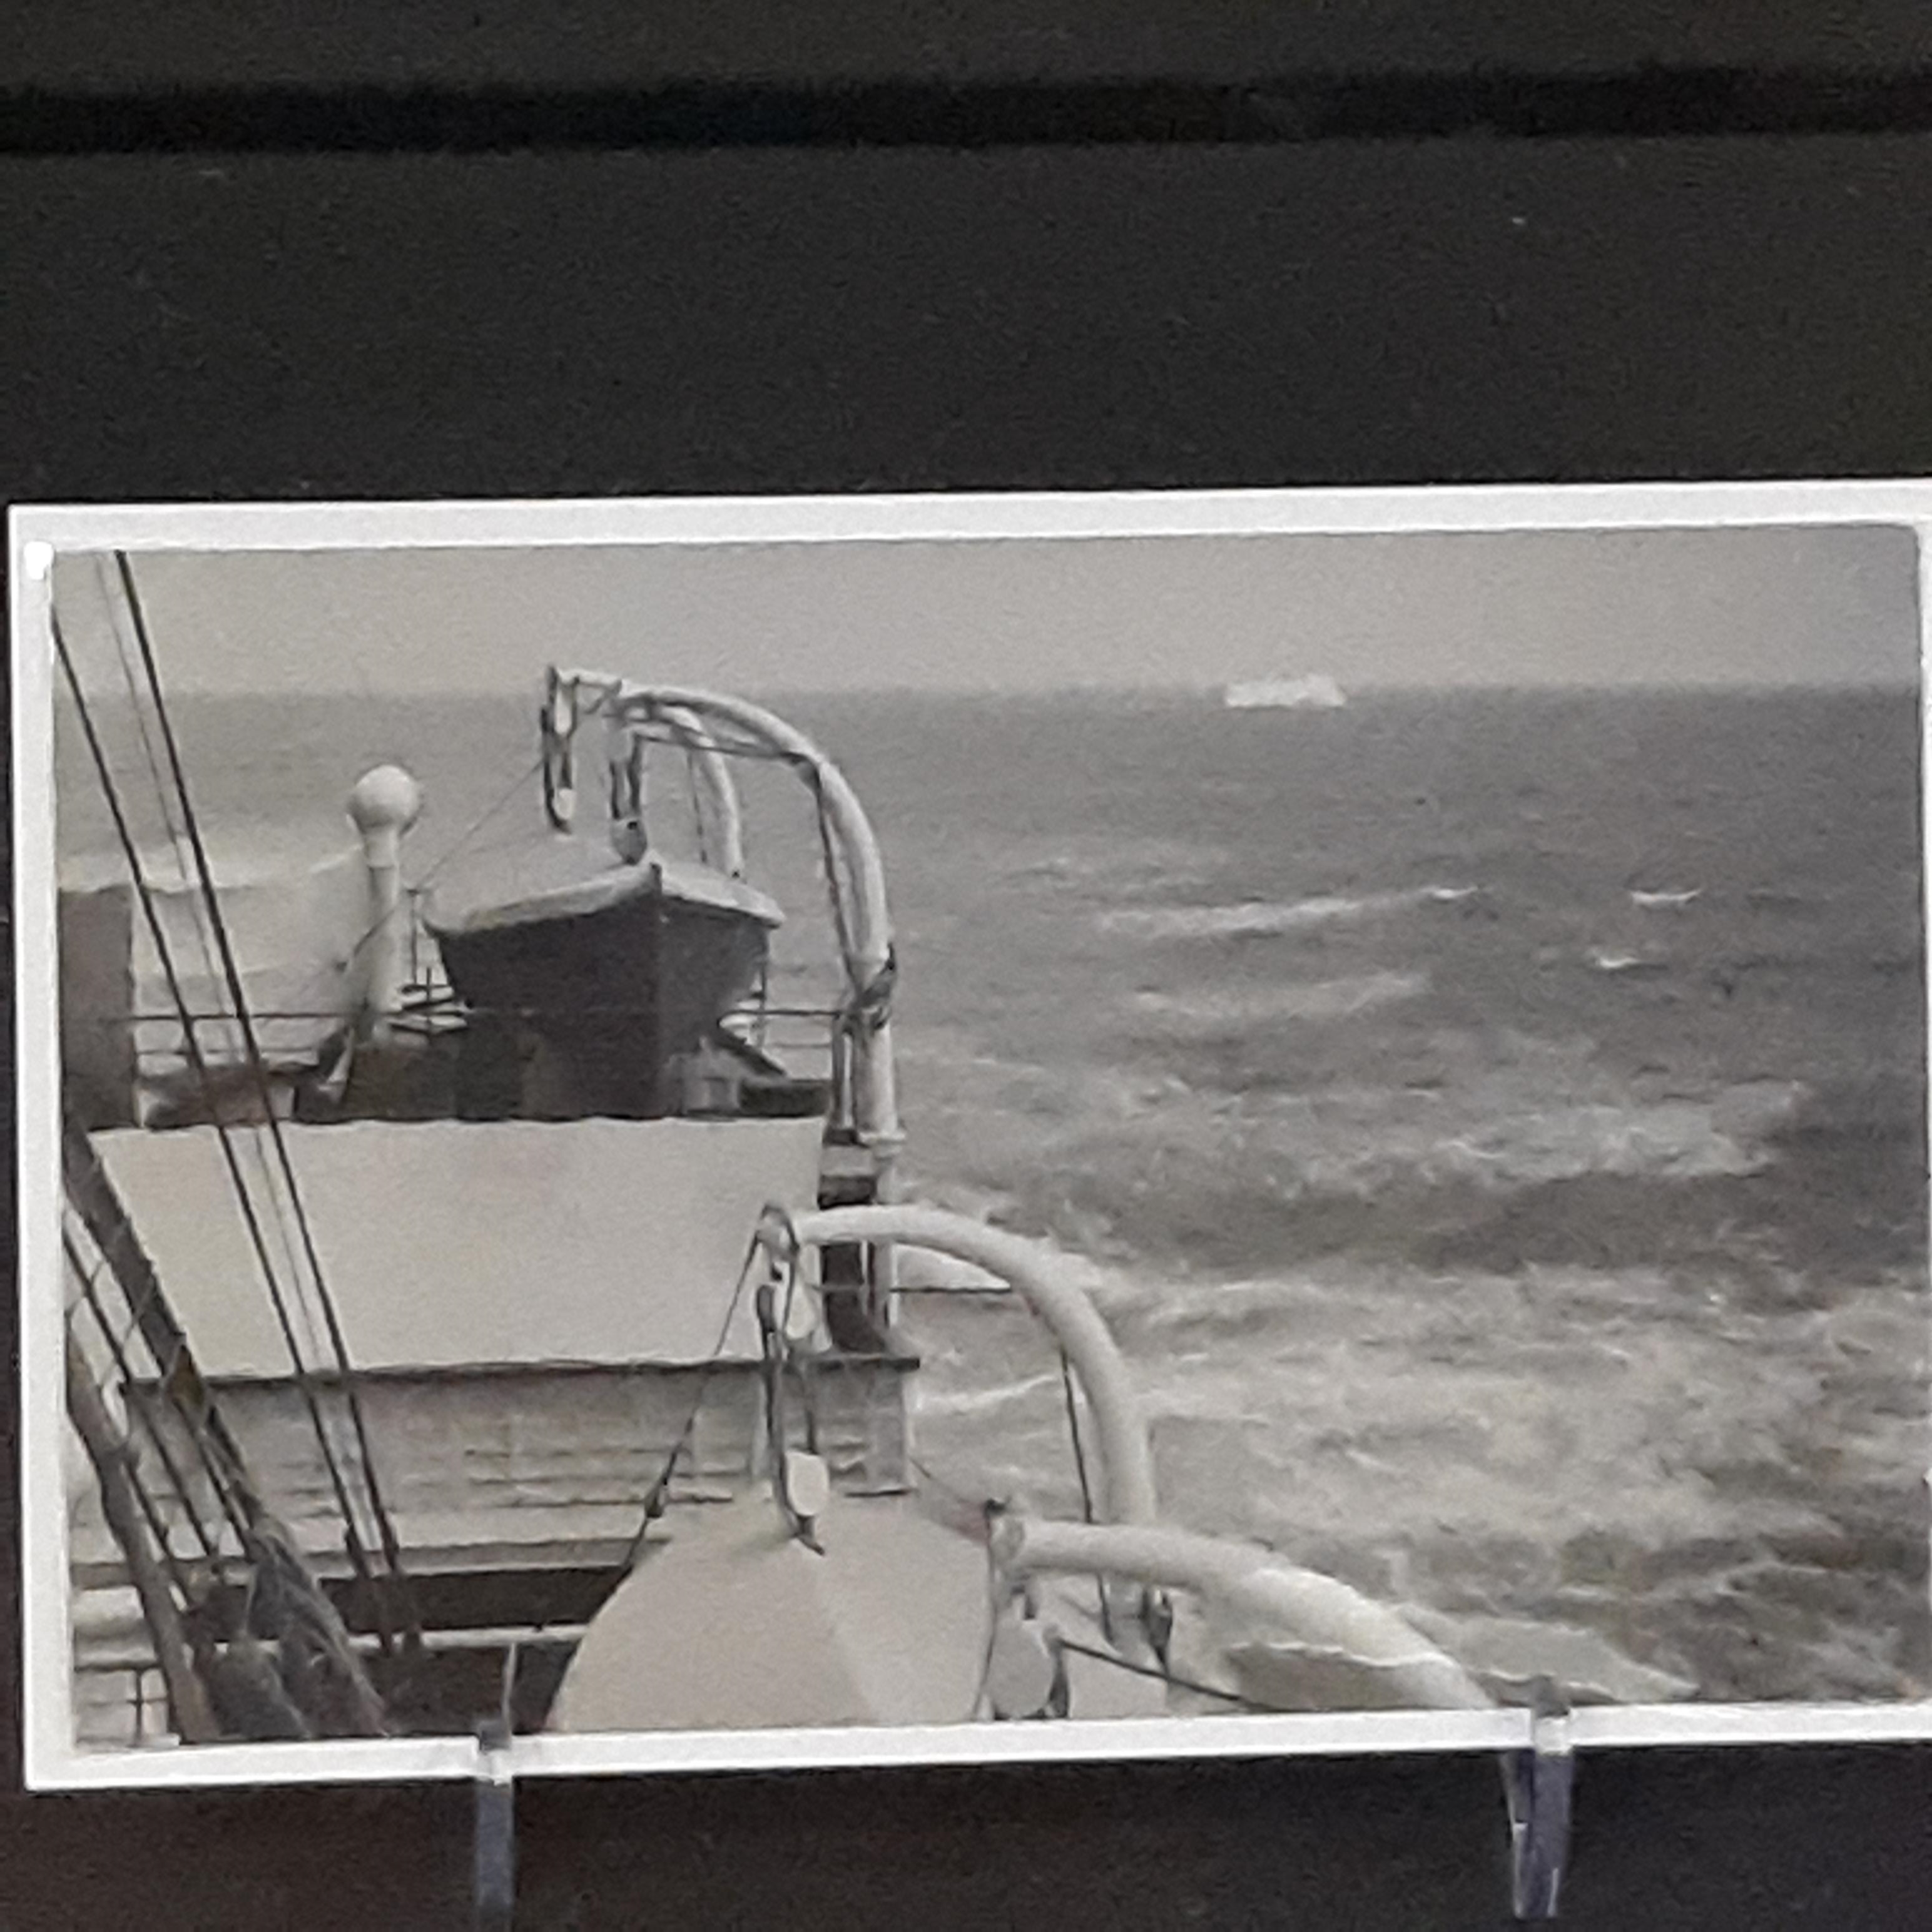
Notes:
Photo of an iceberg taken 36 hours before the Titanic disaster and in the vicinity of the sinking.
I could not believe this photo even existed!

Slide 24
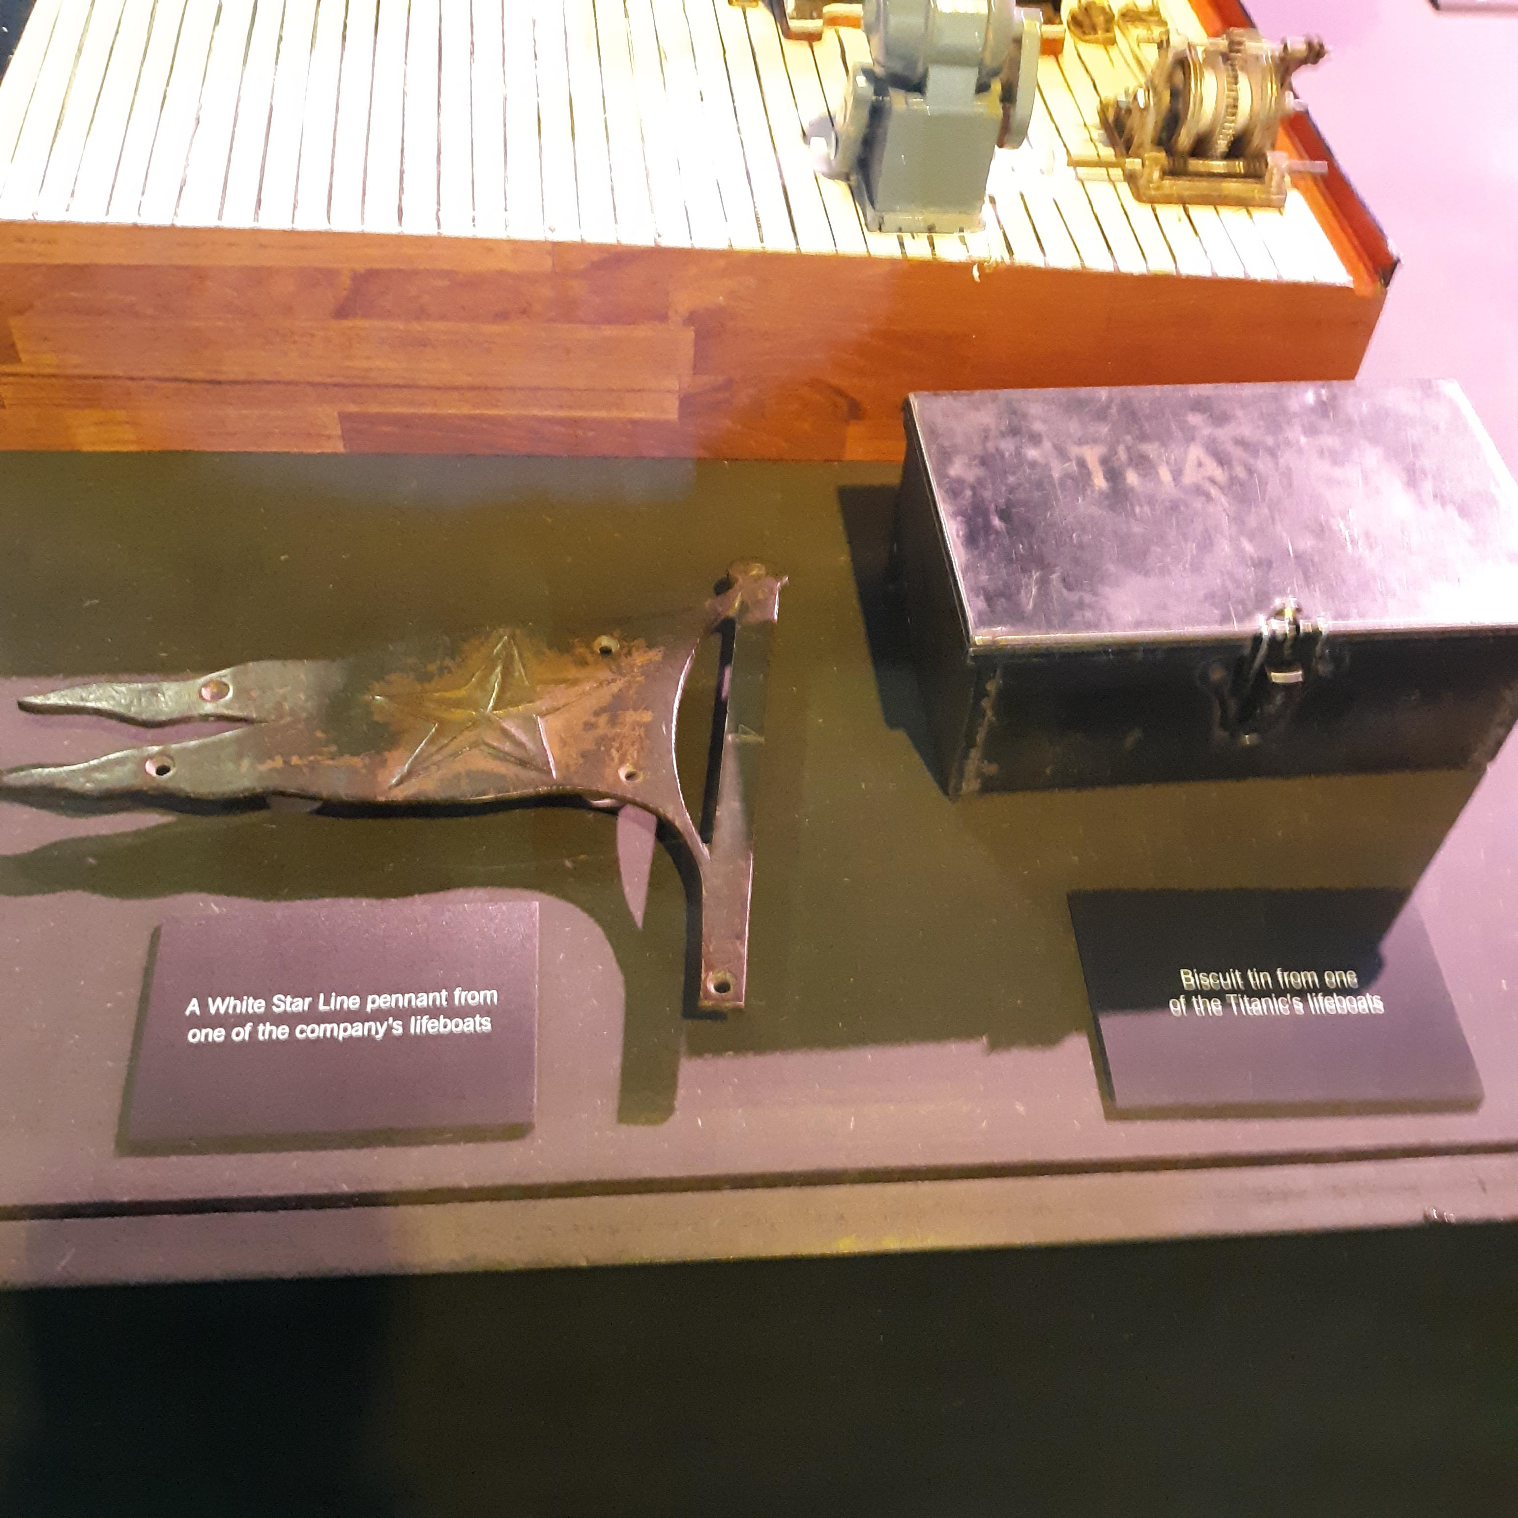
Notes:
The item on the right is a biscuit tin from one of the Titanic lifeboats.

Slide 25
Conclusion of the program and the year of programs
Notes:
Conclusion of the program and the year of programs:
This year we heard about:
Freemasons and Railroading
Groundhog’s Day
The Lost Jewel in Ireland
Masonry in Ireland and England
Bermuda Lodge St. George No. 200 G.R.S.
A Point Within A Circle
The Lost History of the Freemasons in Scotland
The Masonic Apron of Major General Lew Wallace, Author of Ben-Hur
The Rossend Arús Masonic Library in Barcelona
Freemasonry in Cuba
Masonic Connections to Titanic
It is my hope that throughout the course of the year you found these programs to be of interest and that you will endeavor to present one of your own someday in lodge!

Slide 26
Sources:
RMS Titanic: The Maryland Masonic Connection - Scottish Rite of Freemasonry, S.J., U.S.A.
Oscar Scott Woody (google.com)
Tale of the Titanic twins | Museum of Freemasonry (museumfreemasonry.org.uk)
The Midnight Freemasons: Freemasons on the Titanic
https://www.rmsforgirls.com/
https://en.wikipedia.org/wiki/The_Royal_Masonic_School_for_Girls
https://en.wikipedia.org/wiki/Bartholomew_Ruspini
Was Titanic inquiry scuppered by the Freemasons? (telegraph.co.uk)
Freemasons may have influenced Titanic inquiry, newly disclosed list of members' names reveals | The Independent | The Independent
Freemasons 'fixed inquiry into sinking of the Titanic to clear bosses' | Daily Mail Online
Titanic. The Exhibition in D.C. Area (titanicexhibition.com)
"A Masonic Apron at the Titanic Museum, Branson, Mo" – YouTube
Abbey 3341 | museum2017 (hertsmasonicbanners.uk)
Lane's Masonic Records 1717-1894 (dhi.ac.uk)
Sailing on the Balmoral in the Path of the Titanic - National Mall and Memorial Parks (U.S. National Park Service) - Ranger Journal (nps.gov)

