Slide 1
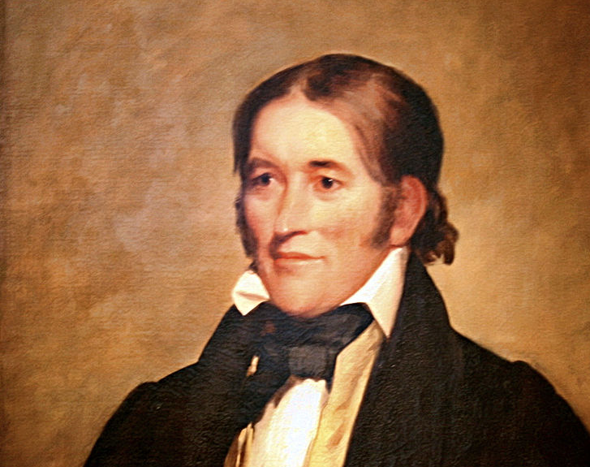
Born on the Wild Frontier
A program about David Crockett
Notes:
Portrait of David (Davy) Crockett.
[Image available on the Internet and included in accordance with Title 17 U.S.C. Section 107.]
When you hear the name Davy Crockett, for many of us older Americans, we instantly call to mind the familiar tune about him and may start singing about a man…”born on a mountaintop in Tennessee…”
Many of us might never have heard of him without the help of Walt Disney, a former DeMolay, who eventually produced both a tv series about him and the movie "Davy Crockett, King of the Wild Frontier.“

Slide 2
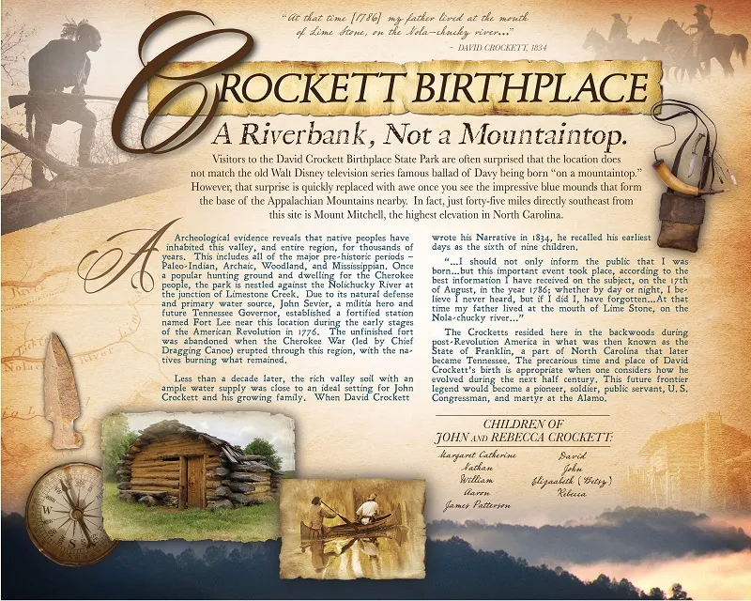
Notes:
Image source: Two New Murals to be Installed at David Crockett State Park – Limestone, TN – August 17, 2018 – Direct Descendants & Kin of David Crockett (goahead.org)
Contrary to the popular mythology, he was not born on a mountaintop, and technically he was not born in Tennessee. As we see in this image, per his own words he was born at the mouth of the Nolichuky River in the “State of Franklin, a part of North Carolina that later became Tennessee.”
As another author points out, he was also never documented called “Davy” in his lifetime as that would have been insulting ie “little Davy”…he was typically called Colonel David Crockett, Congressman David Crockett or simply David Crockett.

Slide 3
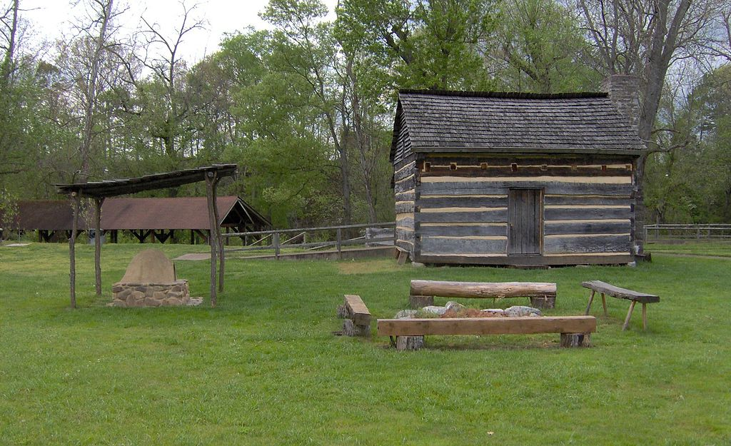
Notes:
Replica of Davy Crockett's birthplace in Greene County, Tennessee.
[Image available on the Internet and included in accordance with Title 17 U.S.C. Section 107.]
Birth and early life
Born in Greene County, in what is now Tennessee, on August 17, 1786
Not a student…

Slide 4
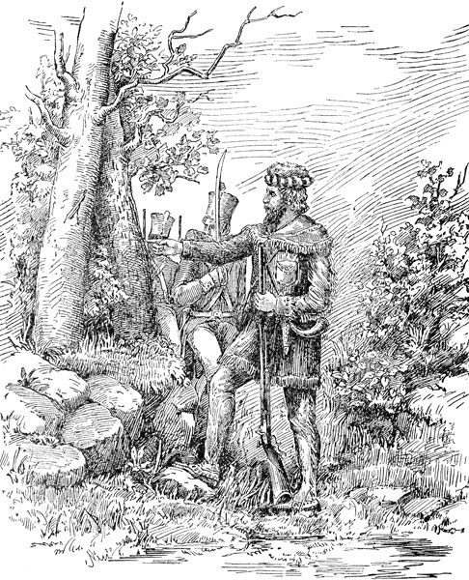
Notes:
[ref: OH-069.pdf (huntsvillehistorycollection.org)]
David Crockett was more of a farmer that the frontiersman that we picture him as today.
“Strangely, for a man who would later become one of the region’s most noted storytellers, there is no evidence to show that he was particularly well known, even to his neighbors, at this time. On the contrary, contemporary accounts suggest he was simply a typical farmer who occasionally had a tendency to perhaps gamble or drink a bit too much.”
Image source: David Crockett (ushistoryimages.com)

Slide 5
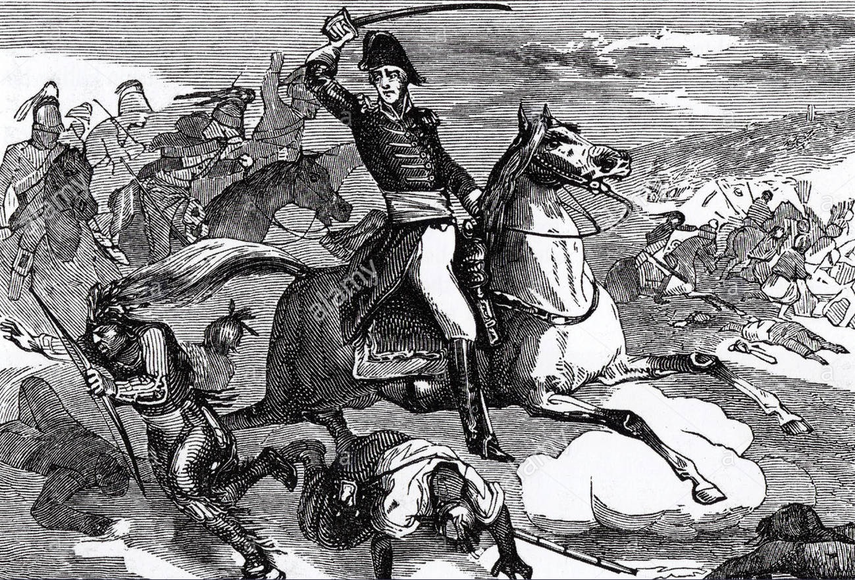
Notes:
At the age of 27, in September of 1813, he enlisted as a militia scout under Maj. Gibson in Winchester, Tennessee, to avenge a massacre of over 200 men, women and children by the Creek Indians at Fort Mims, Alabama.
On November 3, under Andrew Jackson, Crockett participated in the retributive attack on the Indian town of Tallushatchee, which marked the beginning of his military career.
[Image available on the Internet and included in accordance with Title 17 U.S.C. Section 107.]
He returned home when his ninety-day enlistment for the Creek Indian War expired on the day before Christmas
Reenlisted on September 28, 1814, as a third sergeant in Capt. John Cowan's company.
He arrived on November 7, the day after Jackson took Pensacola, and spent his time trying to ferret out the British-trained Indians from the Florida swamps.
Discharged in 1815 as a fourth sergeant
On May 21, 1815, Crockett was elected a lieutenant in the Thirty-second Militia regiment of Franklin County.
Marries a widow with two kids
Fall of 1815, explored Alabama and nearly dies of malaria

Slide 6
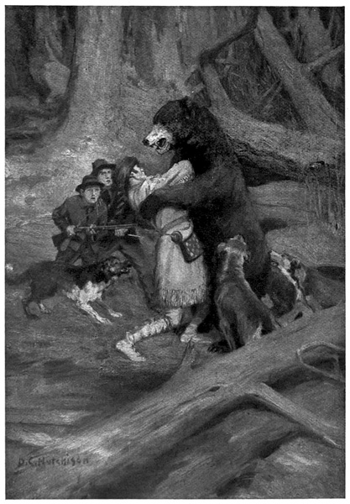
Notes:
Image source: David Crockett (ushistoryimages.com)
Crockett tried his hand at everything from farming to manufacturing wood barrels and gunpowder, but he found his greatest success as a professional hunter. He spent much of his life stalking black bears in the woods of Tennessee and selling their pelts, meat and oil for profit. He even claimed to have bagged 105 of the animals in a seven-month period during the winter of 1825-26. Crockett’s fondness for hunting dangerous game—and the tales he spun about it—later played a major part in making him a frontier hero. According to one oft-repeated yarn, he once killed a bear in pitch-black darkness by stabbing it in the heart with a butcher knife

Slide 7
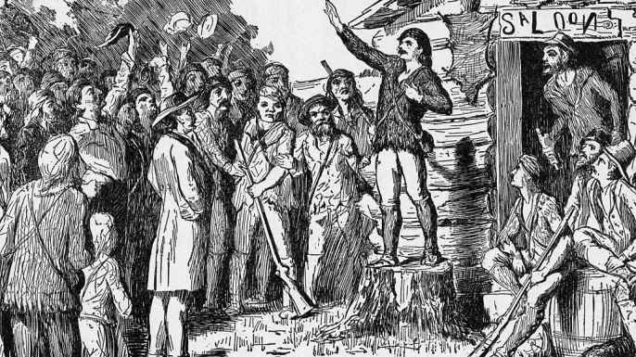
Notes:
[Etching of Davy Crockett campaigning for the U. S. House of Representatives in the Tennessee frontier. (Credit: Bettmann)]
[Image source: Lodge Sir George Cathcart No. 617 (masonic-website.org)]
As a Politician:
Became a justice of the peace on November 17, 1817, a post he resigned in 1819.
He became the town commissioner of Lawrenceburg before April 1, 1818
Was elected colonel of the Fifty-seventh Militia regiment in the county that same year.
Elected to Tennessee State Legislature 1821-1824
I will note here that President Andrew Jackson had the distinguished honor of serving as Grand Master of the Grand Lodge of Tennessee during the years of 1822 through 1823.
Congressman for West Tennessee 1827-1831 and 1833-1835
His fierce opposition to President Andrew Jackson’s Indian Removal Act contributed to his final election defeat in 1835

Slide 8
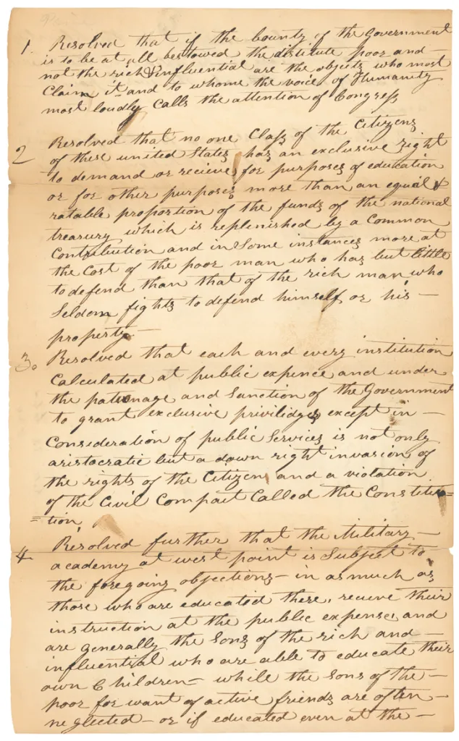
Notes:
Image: Page one of Congressman Davy Crockett’s resolution to abolish the military academy at West Point, February 25, 1830; Records of the U.S. House of Representatives. National Archives Identifier 2173241
Source: Strategically Important: West Point – Pieces of History (archives.gov)
Although he was hardly ever present while in office, and having never passed a bill, he was known for this:
“… on February 25, 1830 Crockett submitted a bill calling for the abolition of West Point on the grounds that it was only a school for the “sons of the noble and wealthy,” complicating a larger problem that “no man could get a commission in the Army unless he had been educated at West Point.”
The resolution said:
Resolved further that the military academy at West Point is subject to the foregoing objections—in as much as those who are educated there, receive their instruction at the public expense and are generally the sons of the rich and influential who are able to educate their own children while the sons of the poor for want of active friends are often neglected…
Crockett’s resolution was ultimately tabled.”

Slide 9
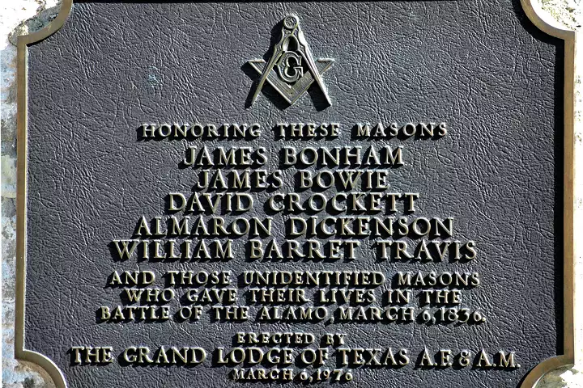
Notes:
Was he a Freemason?
It is alleged that while he was serving in Congress in Washington he became a mason, and when he left to explore Texas he gave his masonic apron to the “Weakly Lodge” in Tennessee, where it reportedly remained according to some sources. (https://historicallight.com/davy-crockett/)
Some sources indicate that an apron was made for him by Mrs. W. C. Massey, which was entrusted to the Sherriff of Weakley (County), in northwestern Tennessee.
The “Weakly Lodge” of which Crockett was said to be a member of burned during the Civil War which destroyed its records.
Allegedly the apron was inherited and preserved by the Sherriff’s nephew. (https://masonicship.com/famous-freemasons/mason/?i=763)
I have, to date, been unable to find proof of any such lodge called Weakly Lodge ever existing, although there are several lodges within Weakley County (ref: THE GRAND LODGE OF TENNESSEE (grandlodge-tn.org).
A review of some history of Masonry in Tennessee provided by George Washington Lodge No. 181 also seems to confirm this. (ref: ABOUT G.W. LODGE #181 | gw181 (gwlodge181.wixsite.com))

Slide 10
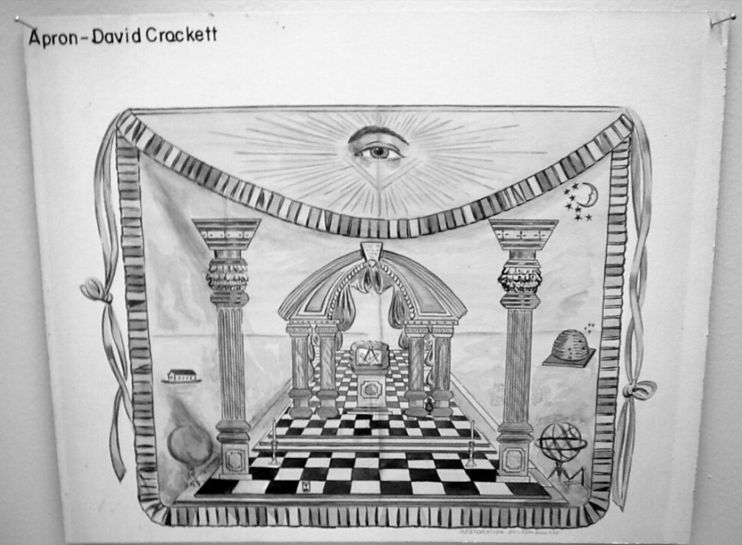
Notes:
If you visit the Grand Lodge of Texas you can find this image of what his apron would have looked like.
I have so far been able to find a photograph of any object claimed to be his actual apron.
Image source: A visit to the Masonic Grand Lodge of Texas, AF&AM | Flickr
I did contact the Grand Lodge of Texas for some materials I had previously gathered as part of my research as they had been lost due to a transition to a new web host.
The Grand Lodge of Texas obliged me with a copy of the previously published article about David Crockett’s travels through the Red River Valley as well as a supplemental article about a specific property he stayed at.
Unfortunately, none of these materials discussed him as being a Freemason.

Slide 11
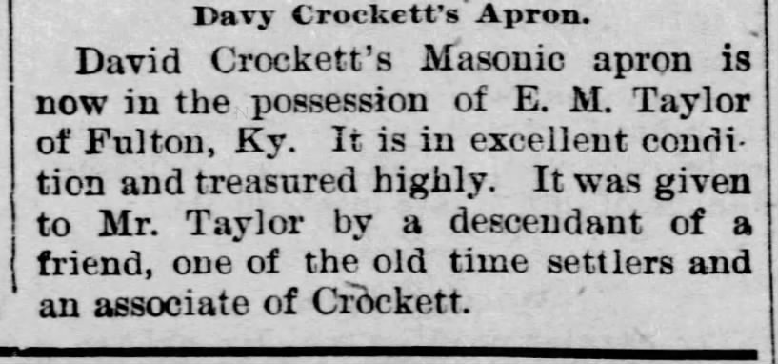
Notes:
Other evidence indicates this is what happened to his apron.
Article clipped from The Beatrice Daily Express - Newspapers.com
The Beatrice Daily Express
Beatrice, Nebraska • Thu, Nov 12, 1896 Page 3
I have found no evidence of his actual apron. I have also written to a group of his descendants. Does his own memoirs make a mention? Surely such an achievement would have been noted therein.

Slide 12
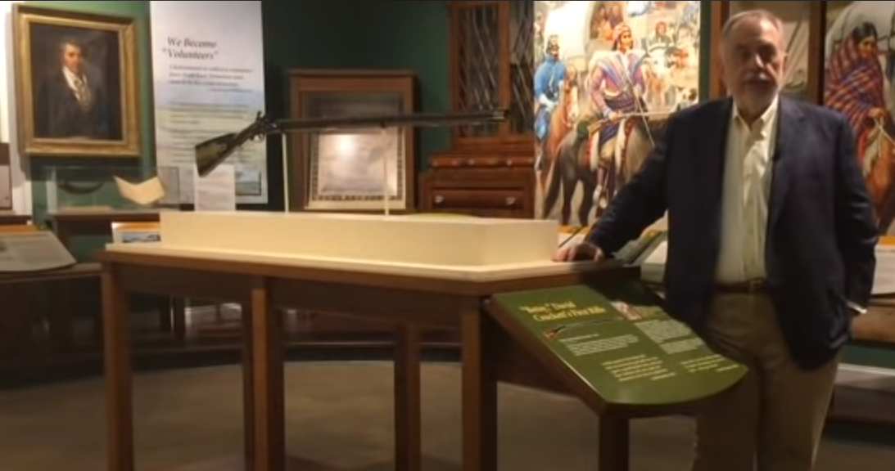
Notes:
Joe Swann, caretaker of Crockett's rifle, shares the story behind this iconic piece of American history.
One of Crockett's rifles that he actually used is on view at the Museum of East Tennessee History in downtown Knoxville, Tennessee.
Link to video: David Crockett's Rifle: An Interview with Joe Swann - YouTube

Slide 13
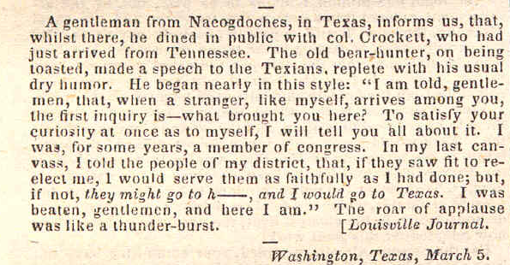
Notes:
Here is the "You may all go to Hell and I will go to Texas" story as told by Davy Crockett himself in Nacogdoches, Texas in 1836 as reported on page 99 of the April 9, 1836, Niles' Weekly Register.
Niles Weekly Register April 9, 1836 Page 99 (tripod.com)

Slide 14
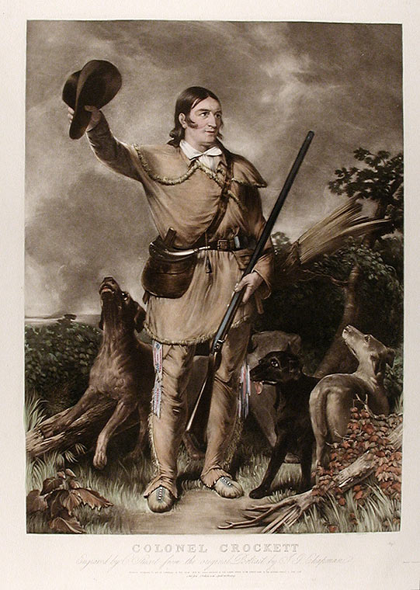
Notes:
Portrait of Davy Crockett from 1839, when he was new to Texas.
[Image courtesy of Donald Heald. Image available on the Internet and included in accordance with Title 17 U.S.C. Section 107.]
Note: This is an image which David carefully collaborated with the artist to create, as he detested his image as a Congressman. Which brand do you think makes more money?
That of a Congressman, or that of the frontier explorer, giving a wave of his hat like a friendly neighbor?
“That glimpse comes courtesy of portraitist John Gadsby Chapman, who was fascinated enough by his subject to write nine pages of reminiscences. Chapman first painted “a study of his head alone,” but Crockett didn’t care for the result. It was a picture, he said, “like all the other painters make of me, a sort of cross between a clean-shirted Member of Congress and a Methodist Preacher.” Why not go for something new? “If you could catch me on a bear-hunt … with hunting tools and gear, and a team of dogs, you might make a picture better worth looking at.”
Chapman said he’d try, and Crockett really got into it.
He scoured Washington for props: leggings, moccasins, a hatchet, a butcher knife, a battered rifle and “a well worn linsey-woolsey hunting shirt.” He insisted on authentic mongrels, not purebreds, as models for his hunting dogs, informing Chapman that there were “plenty of first-rate fellows to be found about the country carts any market day.” With the painting well under way, he suggested a change in his overly static pose, demonstrating what he was after by raising his broad-brimmed hat above his head and giving “a shout that raised the whole neighborhood.”
Talk about a man conscious of how his public saw him!”
The dogs were rounded up from the streets of Washington D.C.

Slide 15
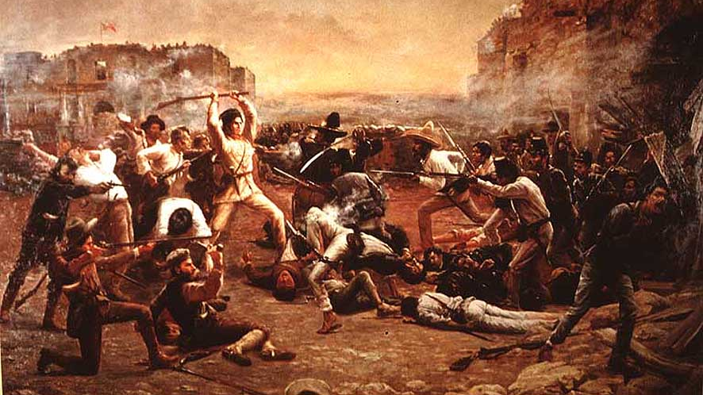
Notes:
Painting, Fall of the Alamo (circa 1903) by Robert J. Onderdonk, which hangs in the Texas Governor's Mansion in Austin.
[Image available on the Internet and included in accordance with Title 17 U.S.C. Section 107.]
Which gun did he use?
[source: David Crockett and Betsy - True West Magazine]
“After the battle at the Alamo, what happened to all of the weapons belonging to the Texians, the rifles, pistols, etc? Did Davy Crockett actually have “Old Betsy” with him?
Three important rifles are attributed to David (he preferred to be called David) Crockett.
The first was a .48-caliber flintlock, owned by Joe Swann of Knoxville, Tennessee, and on exhibit at the East Tennessee History Center in Knoxville. [see previous slide]
To honor his service in the Tennessee State Assembly, Crockett’s Lawrence County constituents presented him with a .40-caliber flintlock crafted by James Graham circa 1822. Crockett affectionately named this rifle “Old Betsy,” either after his wife or sister. He gave it to his son, John Wesley, when he headed for Texas in 1835. Today, it resides in the Alamo Museum collection in San Antonio.
The Whig Society of Philadelphia presented him with the third rifle, “Pretty Betsy.” It is believed to be a percussion cap rifle. The owner, a Houston attorney who descends from the Crockett family, won’t let anybody see it nor does he answer questions regarding the weapon.
None of these rifles played a role in the 1836 Alamo battle. Crockett earned acclaim after dying while defending the fort during a 13-day siege by the Mexican Army.
There is no evidence available regarding which rifle Crockett was carrying at the Alamo battle. “Old Betsy,” and “Pretty Betsy” remained in Tennessee when Davy headed for Texas. He sold two rifles to the Texas Army but the one he used in the fight remains a mystery. My hunch is it went back to Mexico in the hands of some anonymous soldier.”
In 1975, an alternate account of David Crockett’s last stand was discovered in the diary of a Mexican officer named Jose Enrique de la Peña. According this version, Crockett and a handful of others survived the battle and were captured and were subsequently executed on the orders of Santa Anna. The subject remains controversial, though many feel that this is the most reliable account of Crockett’s death.
Joe, a slave, and the only adult male Texan to survive the battle, reported seeing Crockett lying dead with slain Mexicans around him and stated that only one man surrendered, and he was promptly shot.
Some say he lived on. There was even one tale that depicted him as surviving as a slave in a Mexican salt mine.

Slide 16
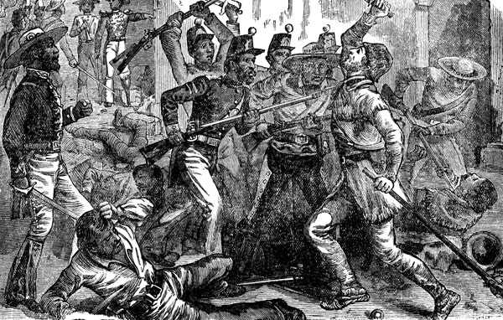
Notes:
Image source: David Crockett (ushistoryimages.com)
“A common myth about Crockett's death in American culture is one of heroic last stand, a story supported by some historical evidence. For example, a former African-American slave named Ben, who served as a cook for one of the Santa Anna officials, said Crockett's body was found in a barracks surrounded by "more than 16 Mexican corpses," some of whom were killed. One claimed Crockett's knife was buried. one of them. However, there is historical evidence to refute this theory, and stories of Crockett's surrender and execution date back only a few weeks after the battle. The opposite myth gained historical momentum when it was discovered by Jesús Sánchez Garza in 1955. A memoir of Mexican officer José Enrique de la Peña who took part in the Battle of the Alamo, self-published as La Rebelión de Texas – Manuscrito Inédito de 1836 por un Official de Santa Anna. Texas A&M University Press published an English translation of "With Santa Anna in Texas: A Personal Narrative of the Revolution" in 1975. The English-language publication caused a scandal in the United States because it claimed that Crockett did not die in battle. Carmen Perry, the translator of the English-language publication and former librarian of Texas Republican Girls, was harassed by Crockett supporters with anonymous letters and threatening phone calls. Crockett supporters viewed the mere suggestion that Crockett did not die in battle as blasphemy. Some people are skeptical. Validity of the text. Author and former firefighter William Groenman III claimed that the journal consisted of several types of paper from several different paper manufacturers, all truncated to size. Long-time John Wayne aficionado Joseph Musso also said that based on the timing of the diary's release and the fact that there was a growing historical interest in the subject around the same time as Walt Disney's miniseries, Des.・I questioned the legitimacy of La Peña's diary. Davy Crockett was released in 1955. Some questions were resolved when: Finally, in 2001, archivist David Gracie published a detailed analysis of the manuscript containing the research findings. He noted, among other things, that the paper and ink were of the type used by the Mexican military in the 1830s, and that the handwriting was written or signed by de la Peña and other documents in the Mexican military archives. found to match the handwriting of For those who question de la Peña's ability to identify any of the Alamo pro-Alamos by name, historians believe that de la Peña may have witnessed or been informed of the execution of Alamo survivors. I believe that it is high quality. And while some claim that neither he nor his associates knew who those men were, others conclude that "a vast body of evidence" supports the surrender-execution hypothesis. . Further to the controversy, comparable evidence is available for tales of "heroic last stand" by several survivors who claim Crockett fought to the death and first-hand witnesses to the battle.”

Slide 17
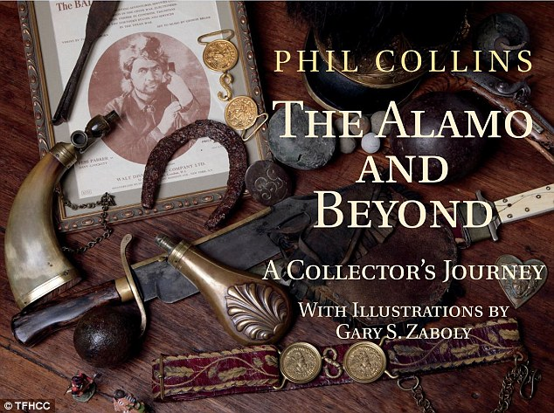
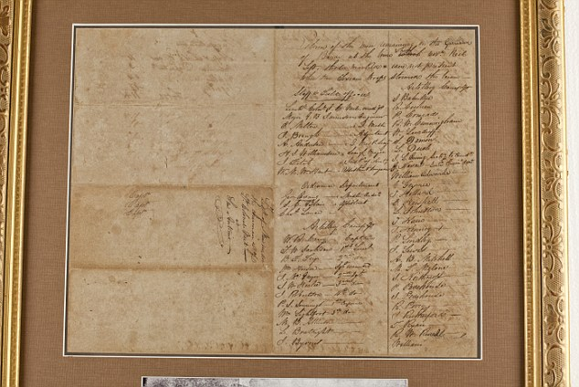
Notes:
Images: book cover and the last surviving roll from the Alamo.
Article: 'Remember the Alamo': Phil Collins donates vast collection of battle artifacts he has amassed over the years to Texas fort so epic standoff is never forgotten | Daily Mail Online
Collins donated 200-plus pieces related to the 1836 battle to museum
It includes 4 rifles belonging to Davy Crockett and Jim Bowie's knife
In 2012, Collins wrote The Alamo and Beyond: A Collector's Journey
Collins says: 'Some people buy Ferraris, others buy houses, I bought old bits of metal and old bits of paper’
He kept the collection in his basement in a house in Switzerland but decided everyone should have access to these things. Newer acquisitions he keeps for about a month before shipping them to the museum

Slide 18
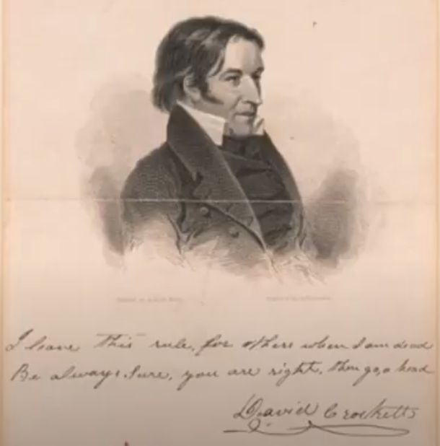
Notes:
This is the complete version of one of his famous quotes or taglines he would use to sign things with.
He had posters like this produced which he would sign to raise money.
He became known for the phrase “go ahead”.

Slide 19
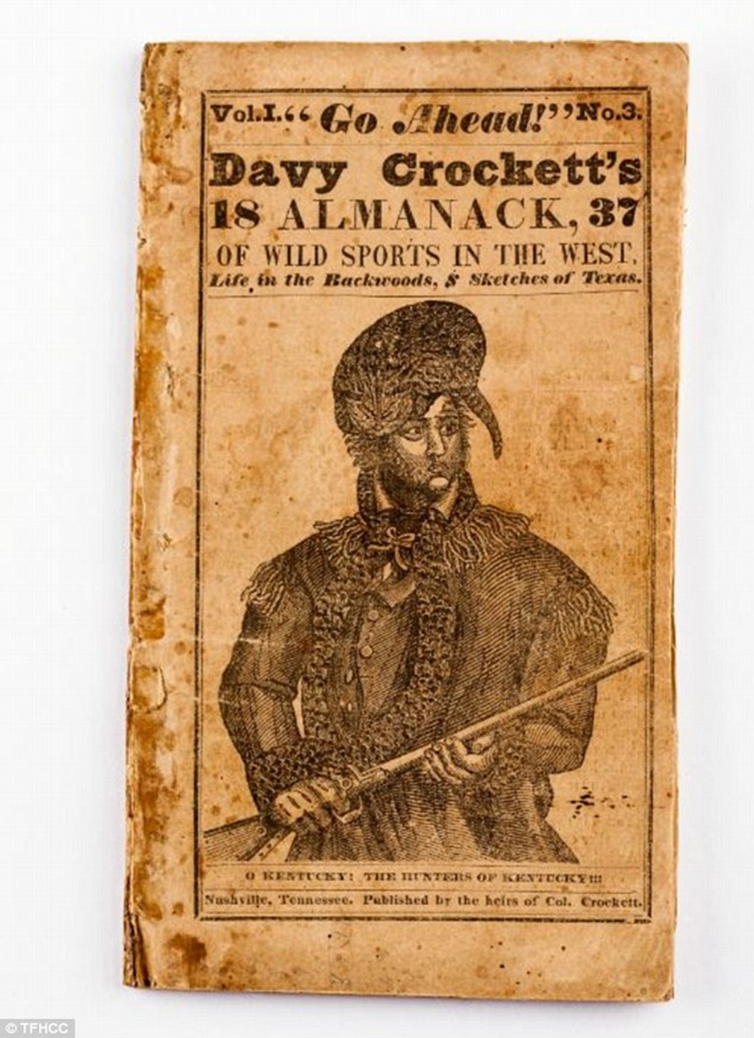
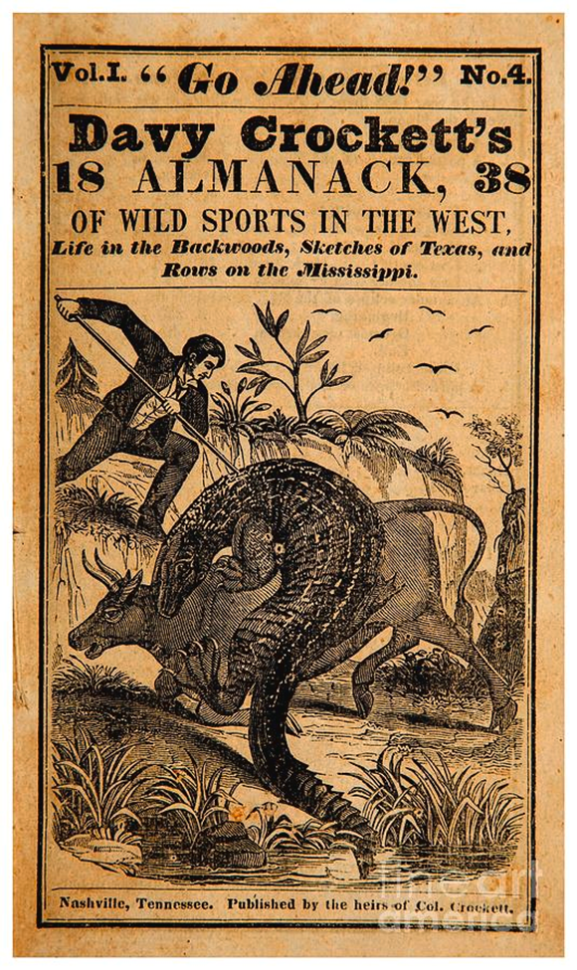
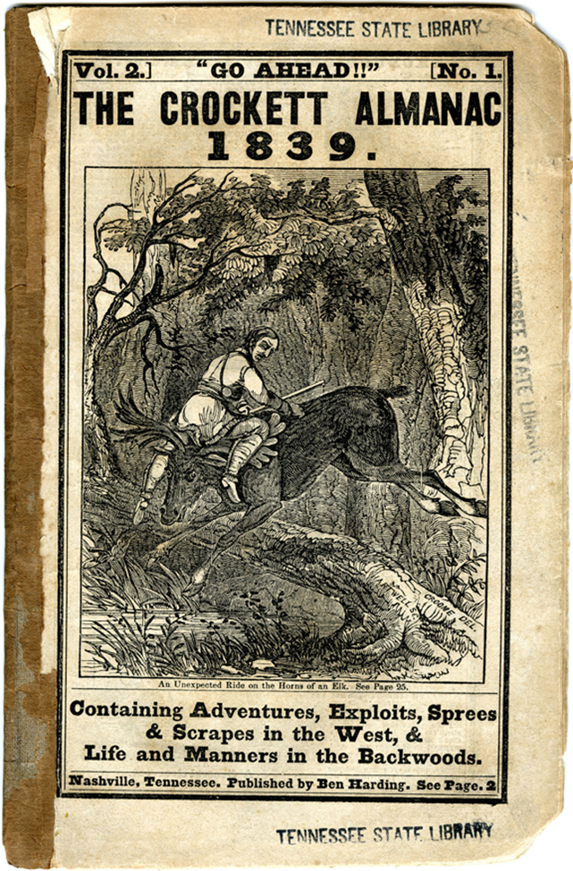
Notes:
As we see here, the shortened phrase “Go Ahead!” quicky made its way into publication.
By the very next year after the fall of the Alamo in 1836, his heirs were publishing fantastic tales.
Also note here the use of the name Davy.
The image of the coonskin cap seems to have come from an international play called “The Lion of the West” which featured a character called “Nimrod Wildfire”

Slide 20
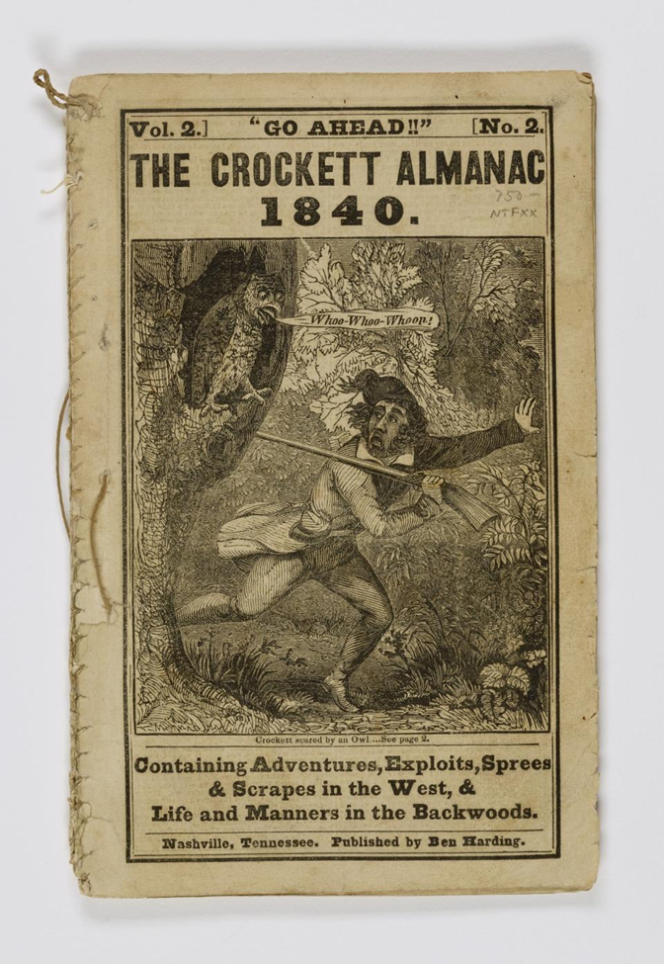
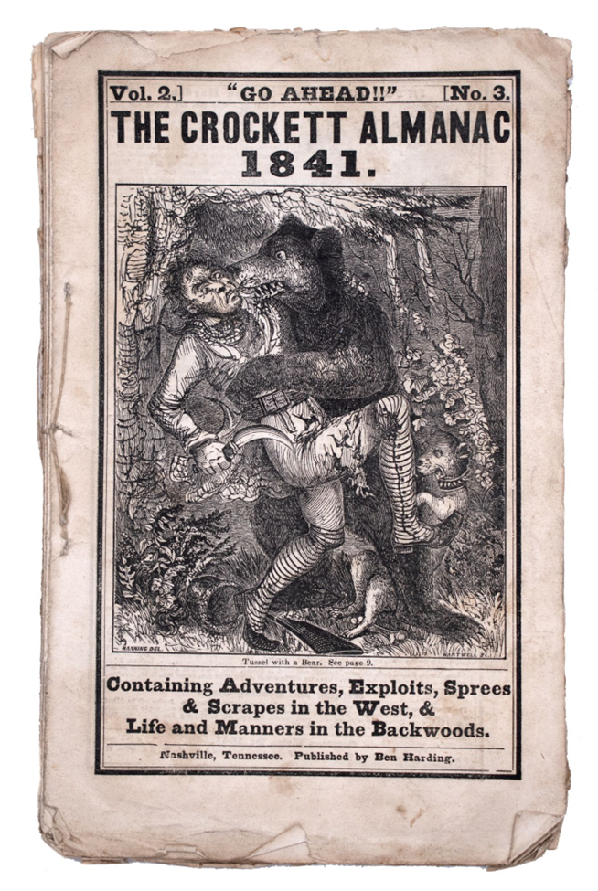
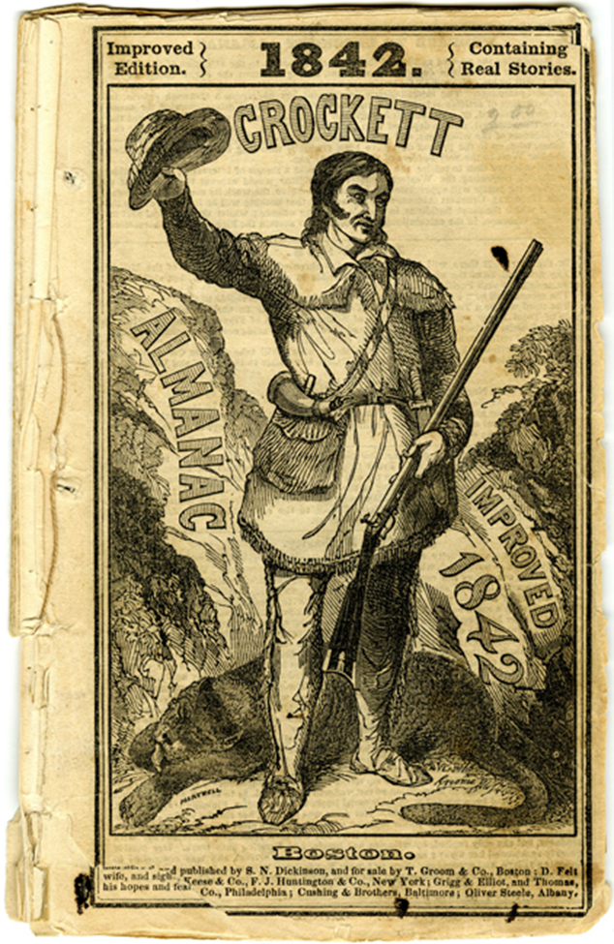
Notes:
The 1842 edition is improved because it now contains “real stories”.

Slide 21
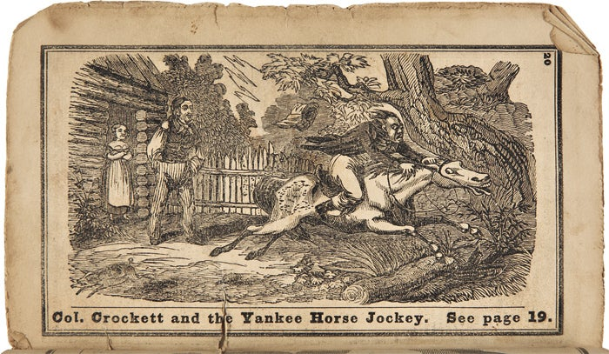
Notes:
Surely you have all heard the story of Colonel Crockett and the Yankee Horse Jockey?

Slide 22
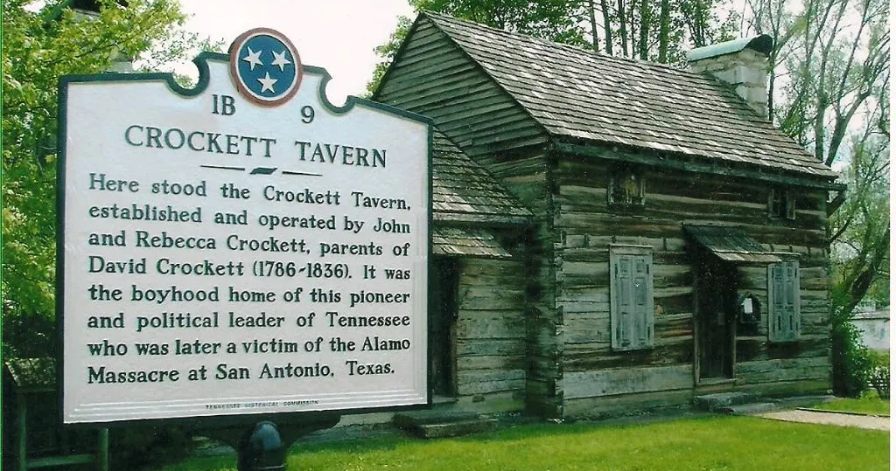
Notes:
BUILT ON THE SITE OF THE BOYHOOD HOME OF DAVID CROCKETT, you can visit the Crockett tavern museum. Which is A RECONSTRUCTION OF THE 1790'S JOHN CROCKETT TAVERN
Crockett Tavern Museum
[Image source: Crockett Tavern Museum]

Slide 23
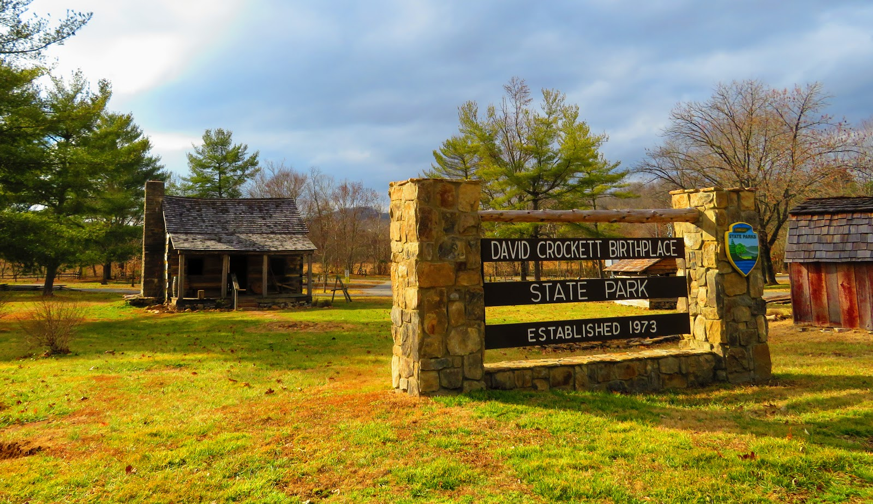
Notes:
DAVID CROCKETT BIRTHPLACE STATE PARK – LIMESTONE, TN
1245 Davy Crockett Park Road
Limestone, TN 37681
Hours: 8:00 a.m. – 4:30 p.m
(423) 257-2167
[image source: 20180124040637_IMG_6658.JPG (1600×924) (bp.blogspot.com)]

Slide 24
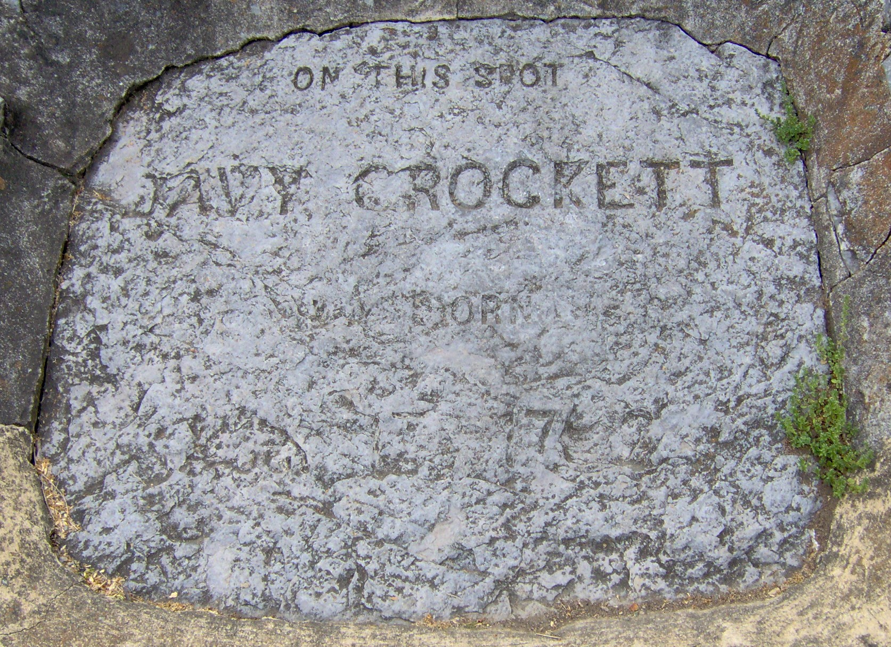
Notes:
The park includes this badly worn monument to his birth.

Slide 25
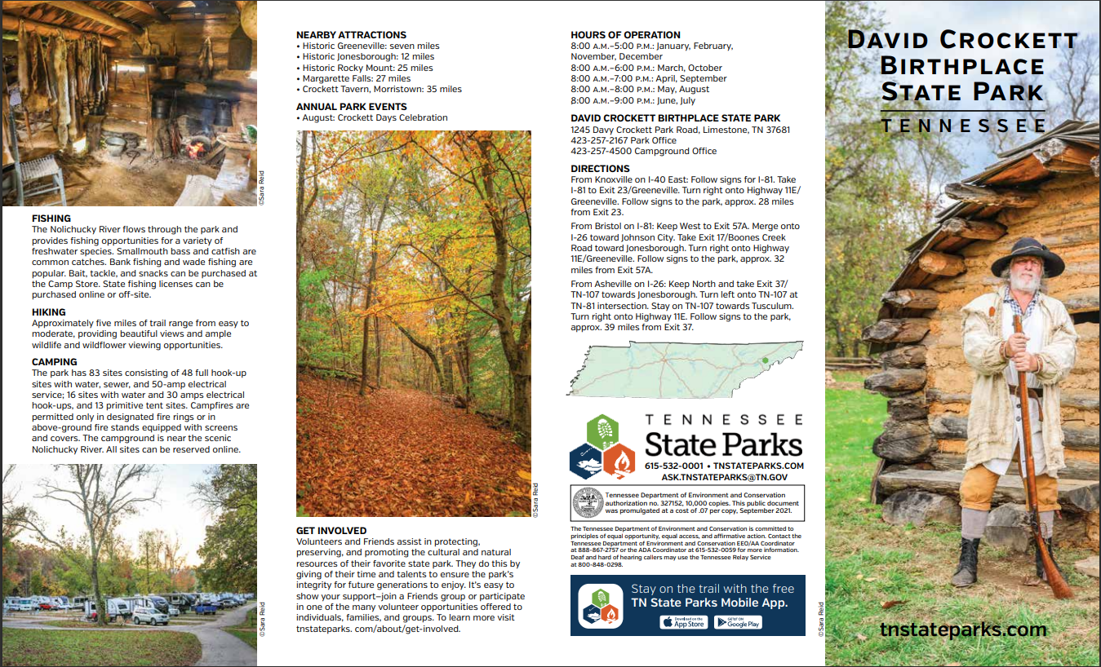
Notes:
The park seems like a great place for a family trip, especially in August when they feature the annual Crockett Days Celebration

Slide 26
Sources:
https://www.tshaonline.org/handbook/entries/crockett-david
http://www.midnightfreemasons.org/2014/12/brother-davy-crockett-rest-of-story.html
https://en.wikipedia.org/wiki/Davy_Crockett
https://m.facebook.com/GroesbeckLodge.354/photos/a.699014446815883/900439120006747/?type=3
https://www.universalfreemasonry.org/en/famous-freemasons/davy-crockett
Davy Crockett – Freemason, frontiersman, folk hero, congressman and Alamo defender – Freemasonry Matters
https://oneminutemason.blogspot.com/2021/02/did-davy-crockett-survive-alamo.html ( https://youtu.be/K5iecHAN63g : 141 Masonic Minute Davy Crockett )
https://martinparmer.tripod.com/id11.html
https://www.youtube.com/watch?v=gkKLpYuc8dE ( The Legend of Davy Crockett - The Incredible Journey )
https://www.youtube.com/watch?v=ujNVLsRA6xk ( The Legend of Davy Crockett Explained in 12 Minutes )
https://www.youtube.com/watch?v=Zi2ZjoufqC4 ( America Unearthed: Lost Secrets of the Alamo Revealed (S3, E1) | Full Episode | History )
https://www.youtube.com/watch?v=3GOxrFPOFY8 ( America's Treasures - Davy Crockett )
https://www.youtube.com/watch?v=BV8n8F31xIk ( Davy Crockett: From wildman to congressman )
https://www.youtube.com/watch?v=2HwAcmRdwho ( David Crockett's Rifle: An Interview with Joe Swann )
https://www.youtube.com/watch?v=LRFaGi2lqrY ( "Not Yours to Give" Davy Crockett's Speech before the House )
https://www.youtube.com/watch?v=56SJx1nHOkg ( How Davy Crockett REALLY Died )
The Real David Crockett: An Evening Lecture with Scott Williams - YouTube
Direct Descendants & Kin of David Crockett – "Be Always Sure You Are Right – Then Go Ahead.“
Crockett Tavern Museum

Slide 27
Strategically Important: West Point – Pieces of History (archives.gov)
OH-069.pdf (huntsvillehistorycollection.org)
Davy Crockett: Most Up-to-Date Encyclopedia, News & Reviews (academic-accelerator.com)
David Crockett and Betsy - True West Magazine
David Crockett, celebrity pioneer, went from wrestling bears to wrestling with his image - The Washington Post

